Slide 1

NIHF Education Programs
Mathematics
K-6 examples of NIHF Educational
Programs math alignments

Slide 2
How NIHF Aligns to the Standards for Practice
National Inventors Hall of Fame (NIHF) Education Programs help youth cultivate:
An inventive mindset
Skills needed to approach mathematical problems and work toward solutions effectively
Confidence in tackling problems
Resilience to overcome challenges and obstacles
This is accomplished through...
Engagement with real-world STEM challenges
The opportunity to practice tackling problems through the lens of curiosity
Applying persistence to move through challenges
Navigate challenges using deductive and constructive reasoning

Slide 3
How NIHF Aligns to the Standards for Practice
According to research completed by https://seisummit.org/, Camp Invention can impact math test scores.⁽¹⁾ Through the use of real-world STEM and invention challenges, participants:
Use practical math skills and tools to strategically solve challenges
Use precision when cutting materials to fit on or in a prototype
Explore scale when creating models and two-dimensional plans
Utilize manipulatives and mathematical instruments to reinforce math concepts through hands-on exploration
Look for patterns, count objects, estimate measurement, and complete simple calculations as they develop solutions to invention challenges
Participants are exposed to mathematical tools and instruments such as:
Tape measures
Rulers
Play money
Protractors
By laying the foundation of the skills and mindset needed to solve invention challenges, and exposing participants to physical tools as they prototype, NIHF provides opportunities for participants to confidently engage with and embrace mathematics.⁽²⁾
1. Summit Education Initiative, National Inventors Hall of Fame Camp Invention, a Program Component of Akron Public Schools Innovation 365(I365): Wraparound Summer 2022 (January 2023)
2. R. Moore, The Impact of Invention Education Participation on Students’ Confidence and Anxiety in STEM. The Center for Education Integrating Science, Mathematics and Computing, Georgia Institute of Technology (April 2024)

Slide 4
Counting and Cardinality

Slide 5

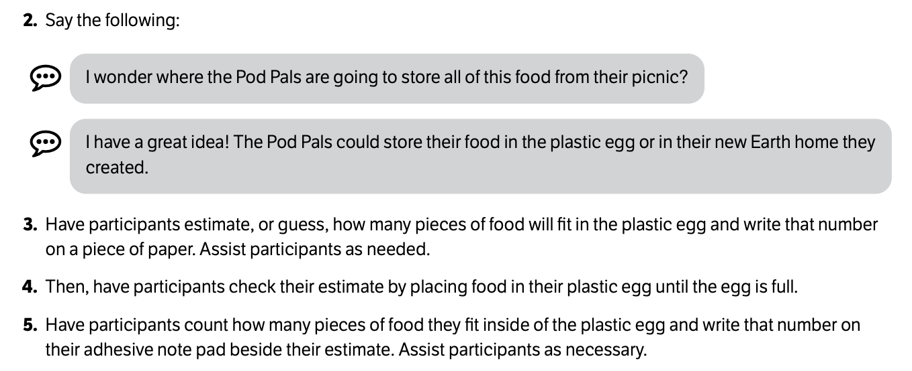
Counting and Cardinality
To practice counting and cardinality, participants estimate how many pieces of "food" will fit inside of plastic egg, then check their estimate by counting how many pieces fit into the egg.
Excerpt from curriculum:
In Pod Pals™, participants meet friendly pretend creatures who love to cruise the galaxy and discover new things about science, the Pod Pals! Throughout the module, children build amazing inventions and explore science alongside of the Pod Pals.

Slide 6

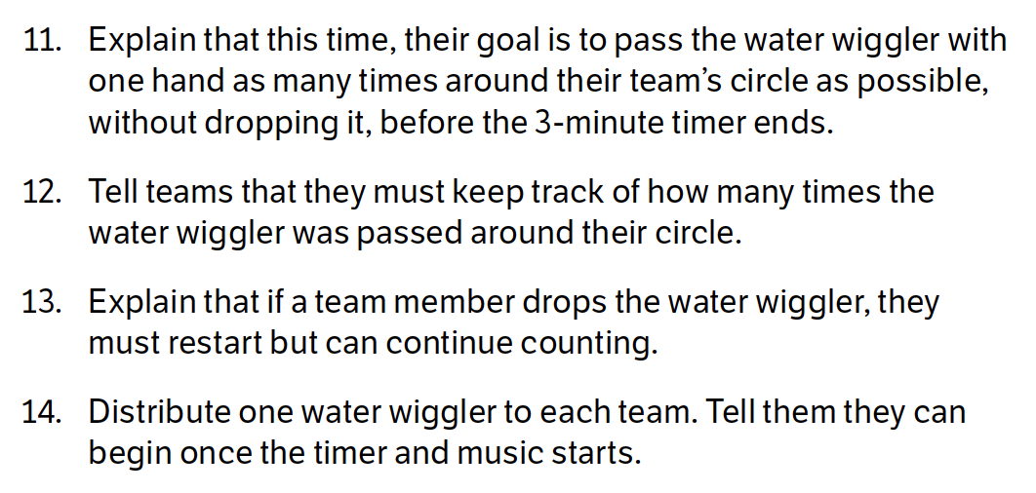
Counting and Cardinality
Participants count how many times a water wiggler is passed around a circle in a three-minute period. If the water wiggler is dropped, the participants must restart the count.
Excerpt from curriculum:
In Ooze and Aahs™, children explore ooey gooey chemistry concepts as they investigate some of nature’s tiniest organisms in the Backyard Laboratory!

Slide 7

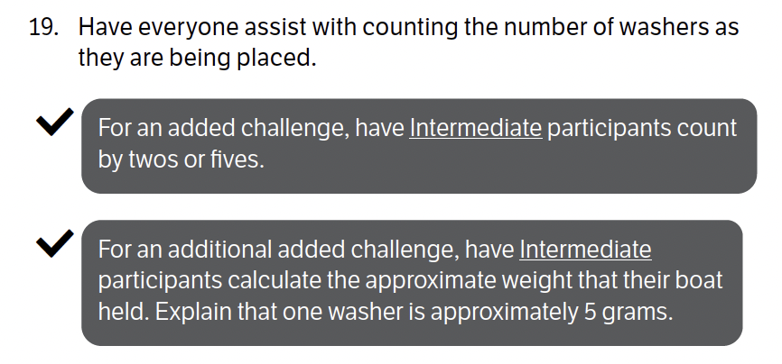
Counting and Cardinality
Participants count the washers as they are placed in an aluminum foil boat. Intermediate participants are encouraged to count by twos or fives.
Excerpt from curriculum:
In Make Waves™, children catch their first big break as they ride the waves of invention and entrepreneurship!

Slide 8

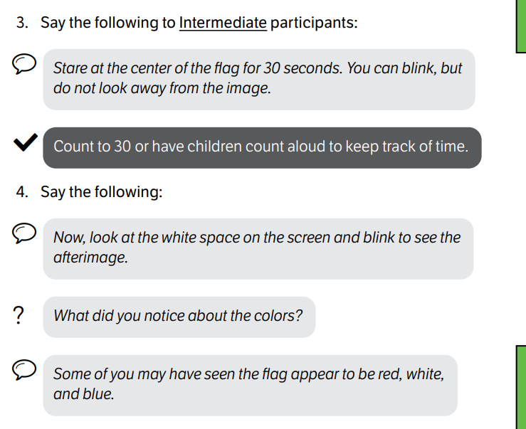
Counting and Cardinality
Participants examine various optical illusions. For this activity, they look at an image of the American flag for 30 seconds, counting aloud together to keep track of the time.
Excerpt from curriculum:
In Illusion Workshop™, children discover the mesmerizing world of illusions, where things are not always as they appear! Through hands-on activities and experiments, they go behind the scenes of the tech tricks used in theme parks, animated films, and theater.

Slide 9

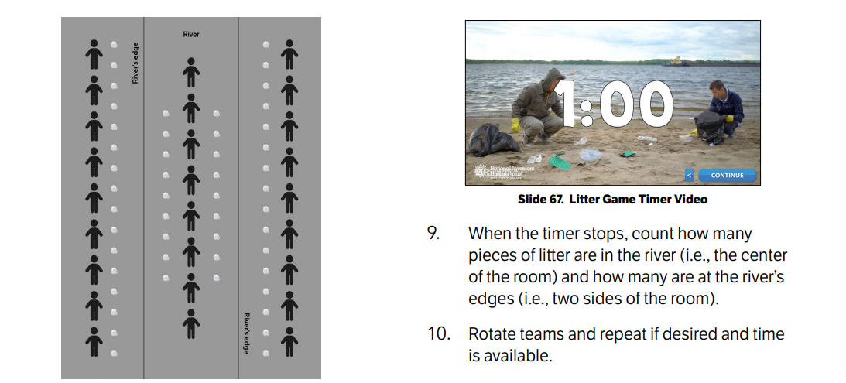
Counting and Cardinality
Participants play a river steward game in which they work in teams to remove litter from the river. At the end of the game, they count how many pieces of litter remain in the river.
Excerpt from curriculum:
In Operation: HydroDrop™, Children head out on an epic global operation to explore and solve water challenges around this big blue planet!

Slide 10
Operations and Algebraic Thinking

Slide 11
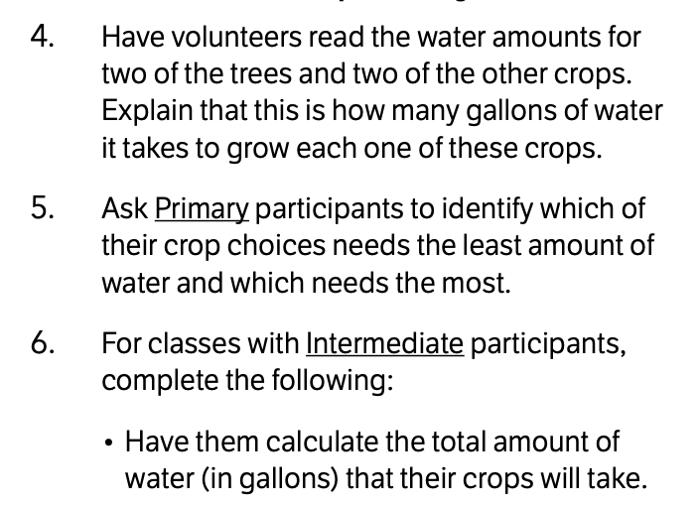
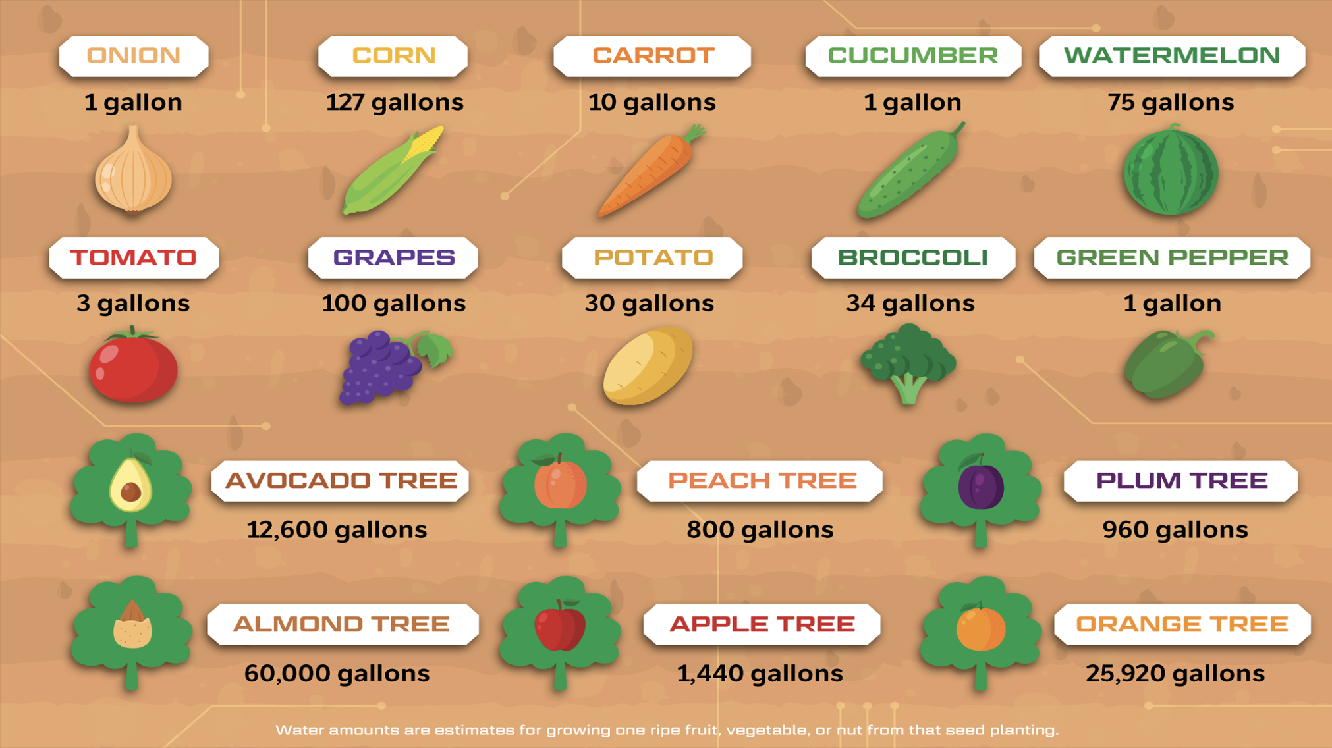
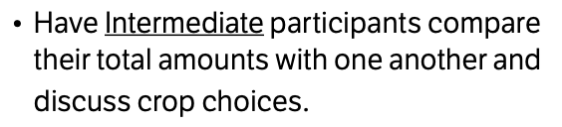
Operations and Algebraic Thinking
Participants calculate the water usage of various crops and make comparisons.
Excerpts from curriculum:
In Operation: HydroDrop™, Children head out on an epic global operation to explore and solve water challenges around this big blue planet!

Slide 12
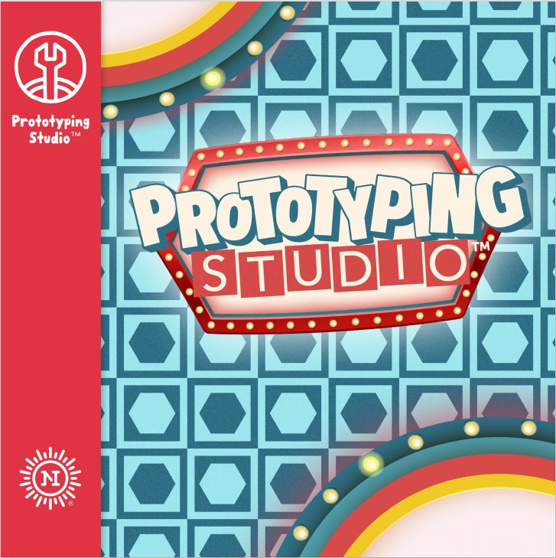
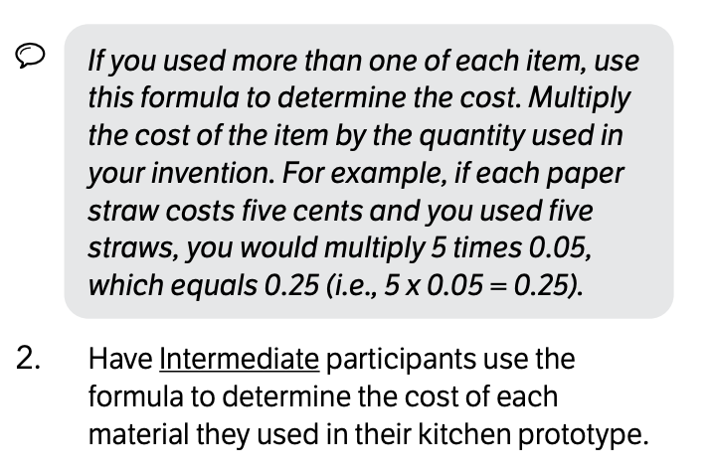
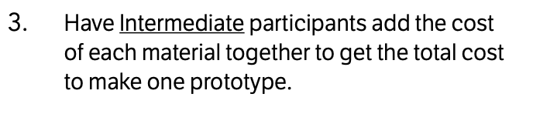
Operations and Algebraic Thinking
Participants calculate the total cost of the materials used to make their prototype.
Excerpts from curriculum:
Children are contestants on Prototyping Studio™—a game show hosted by NIHFty Bot™, where they embark on an invention journey to uncover the ultimate place to invent.

Slide 13

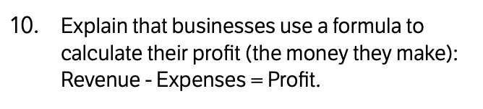
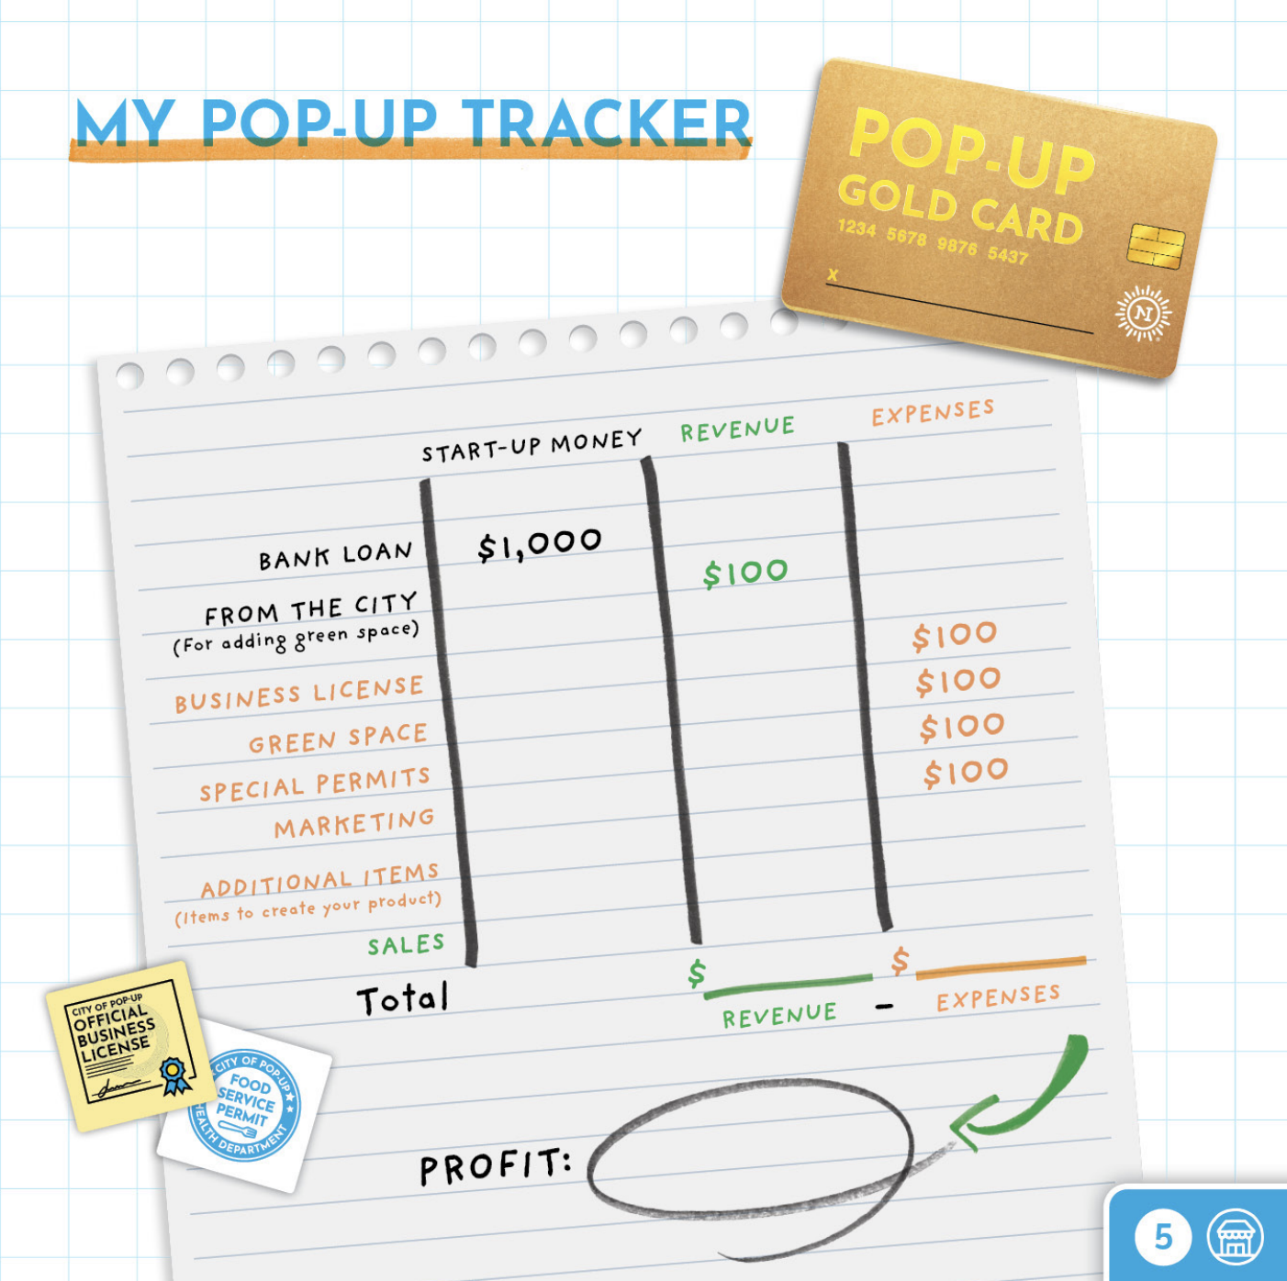
Operations and Algebraic Thinking
Participants calculate their total profit by subtracting their business expenses from their revenue.
Excerpt from curriculum:
In Pop-Up Venture™, children design their own Pop-Up business! Participants make strong financial decisions, overcome unexpected challenges, and explore opportunities that pop up along the way while building entrepreneurship skills.

Slide 14
Number and Operations

Slide 15

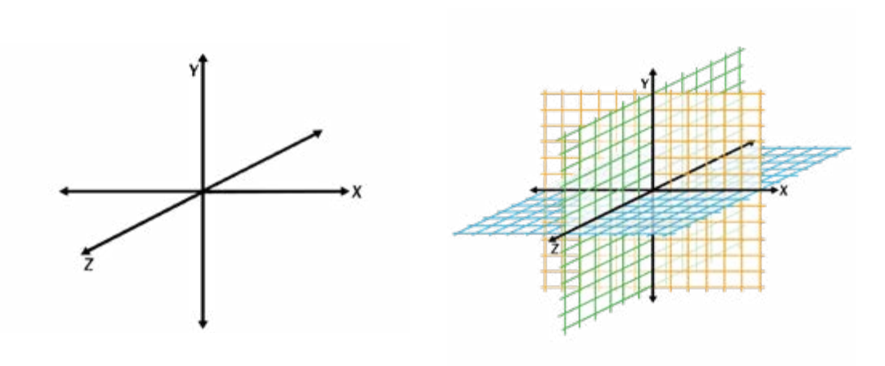
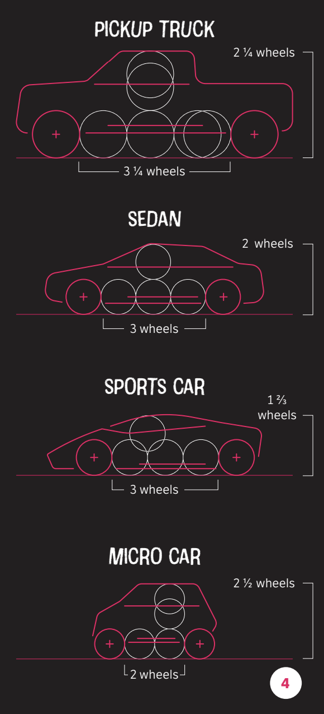
Number and Operations
Participants experiment with positive and negative numbers by analyzing a graph
and creating designs on a clay piece that go above and below the surface.
Participants look at fractions as they experiment with scale and proportion to design their vehicle.
In Automotive Design 101™, participants explore the principles of art and automotive design. They investigate the emotion of a sketch and sculpt with clay as they become immersed in car design.

Slide 16

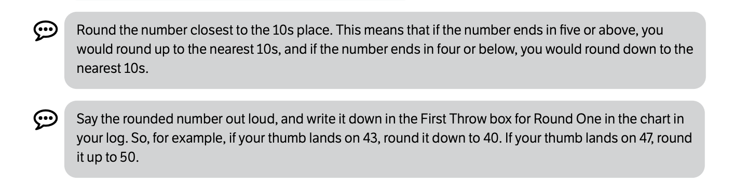
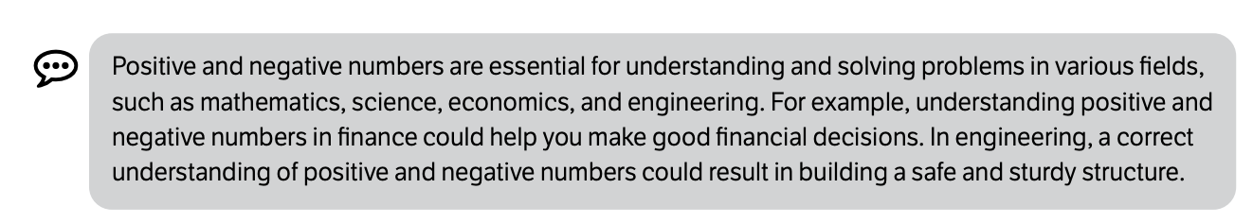
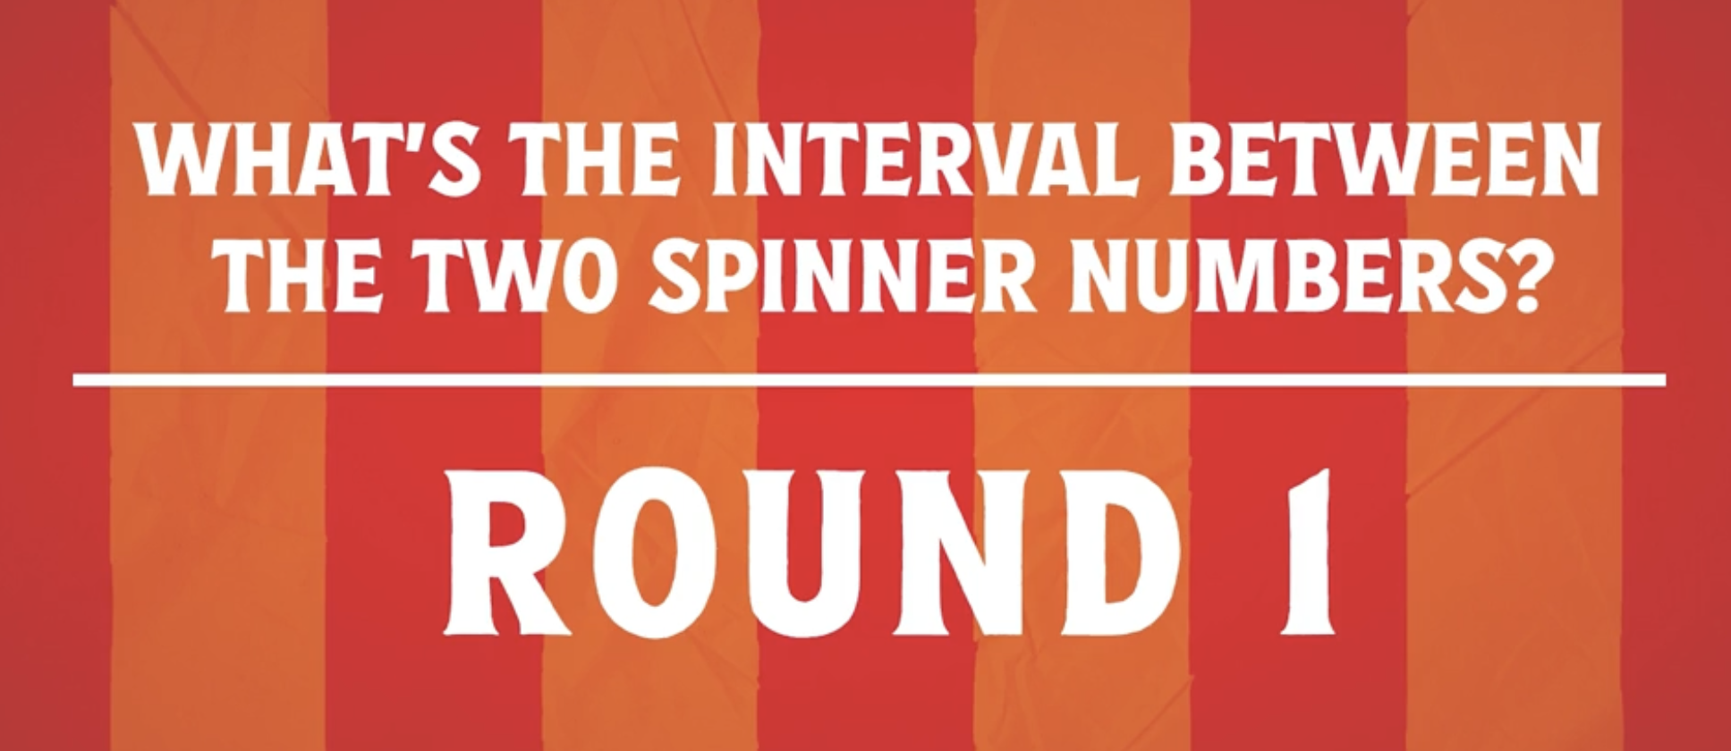
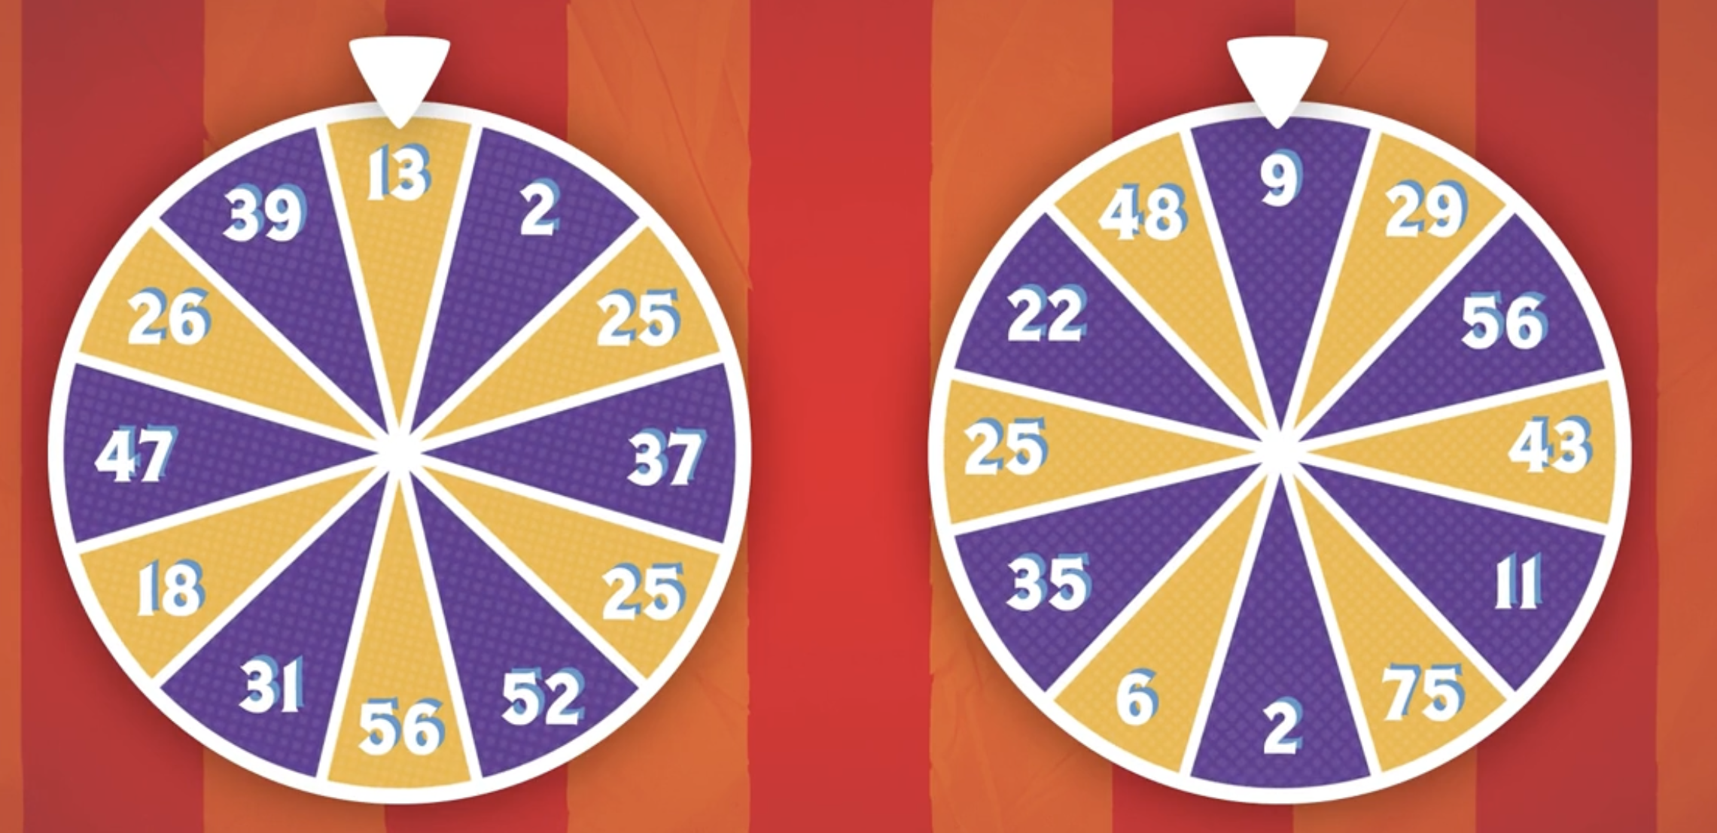
Number and Operations
Participants explore number and operations as they analyze positive and negative numbers, practice rounding, and determine intervals while playing math-themed games.
Excerpts from curriculum:
In Fair Games™, children are introduced to the concepts of measurement, number operations, geometry, and algebraic thinking through carnival games.

Slide 17
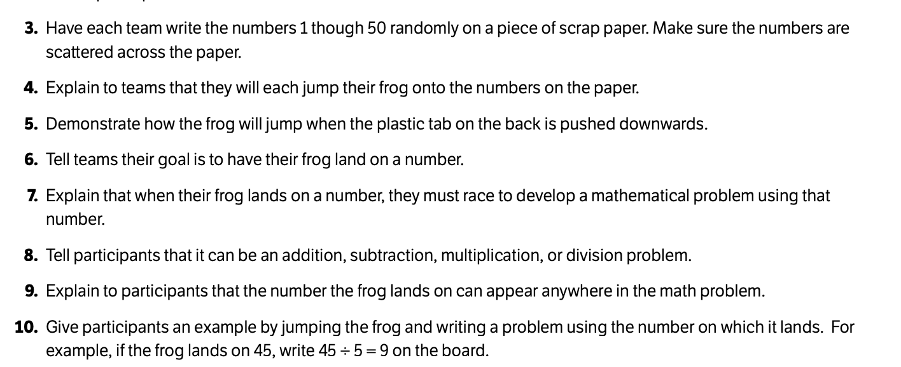
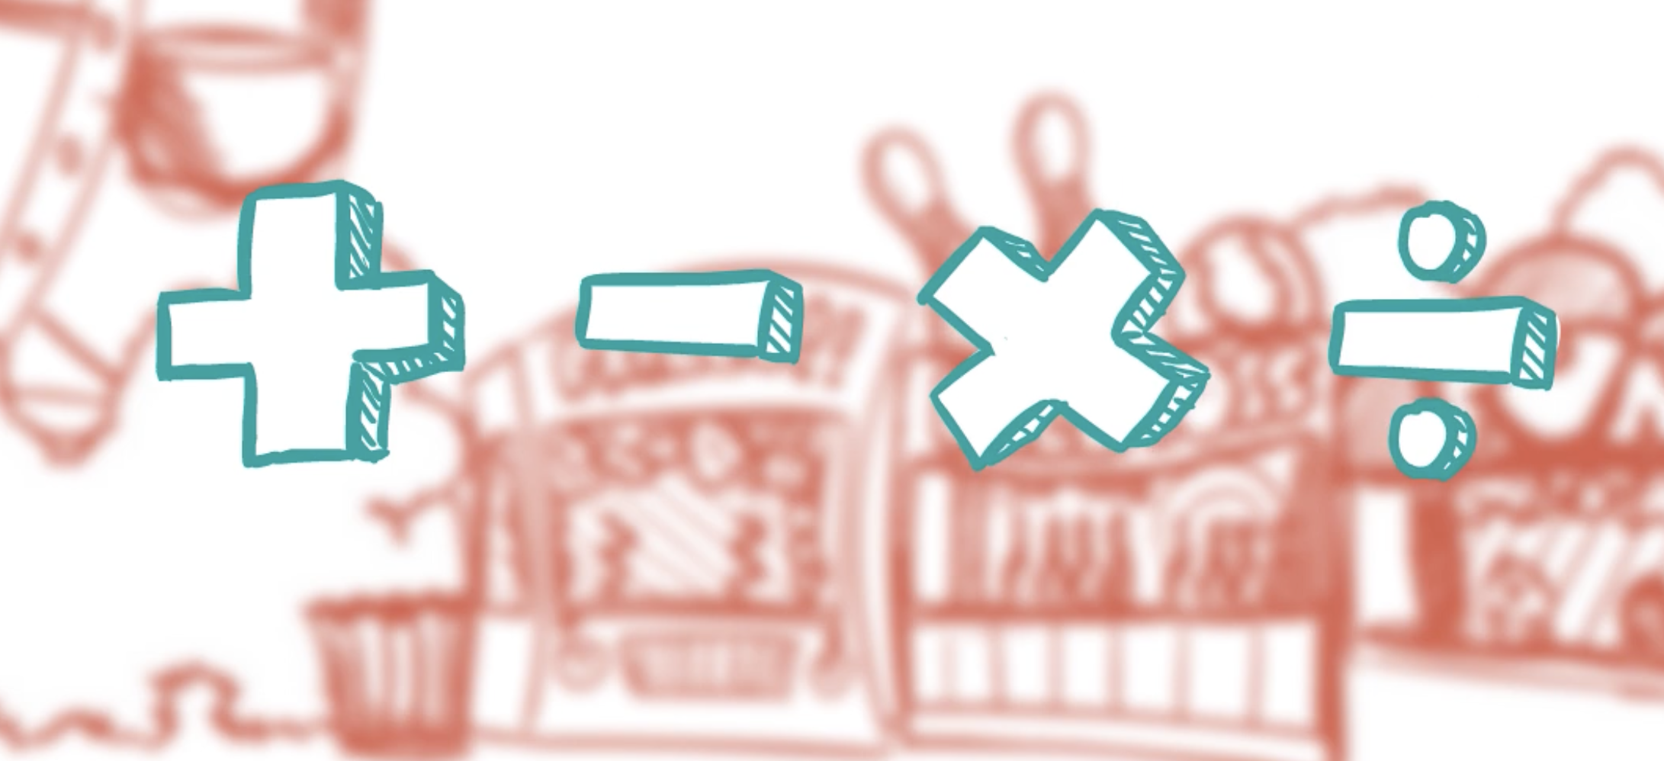
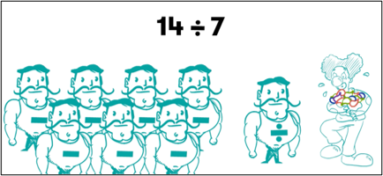
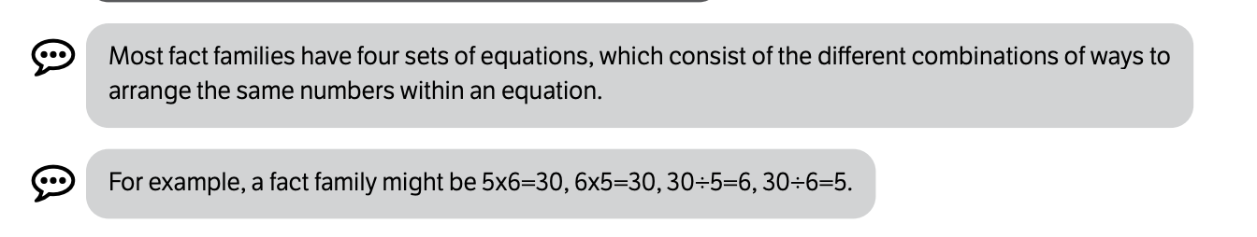
Number and Operations
Participants also complete basic operations and discover fact families in Fair Games™.
Excerpts from curriculum:

Slide 18
Measurement and Data

Slide 19

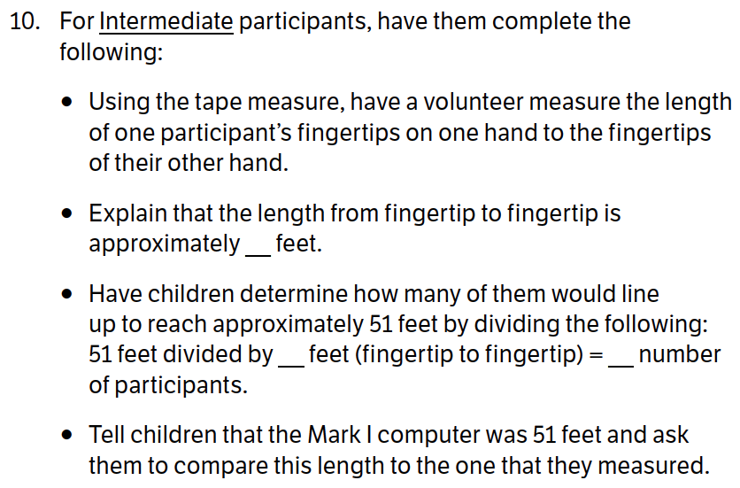
Measurement and Data
Participants measure their wingspan and stand in a line to see how long the Mark 1 computer (one of the earliest computers) was.
Excerpt from curriculum:
In The Infringers™, children use the superpowers of the I Can Invent® Mindset
to team up with the Innovation Force®— the National Inventors Hall of Fame Inductees—to identify and solve challenges in their community and around the world!

Slide 20

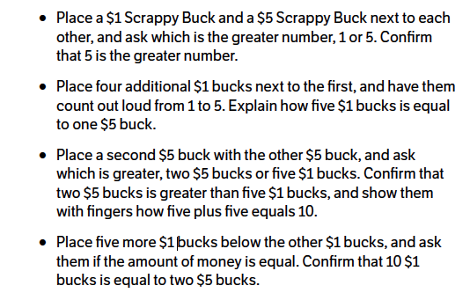
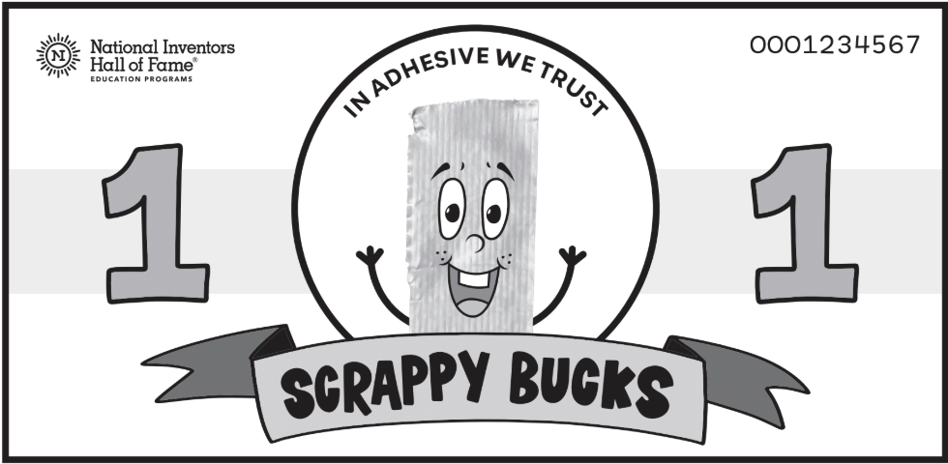
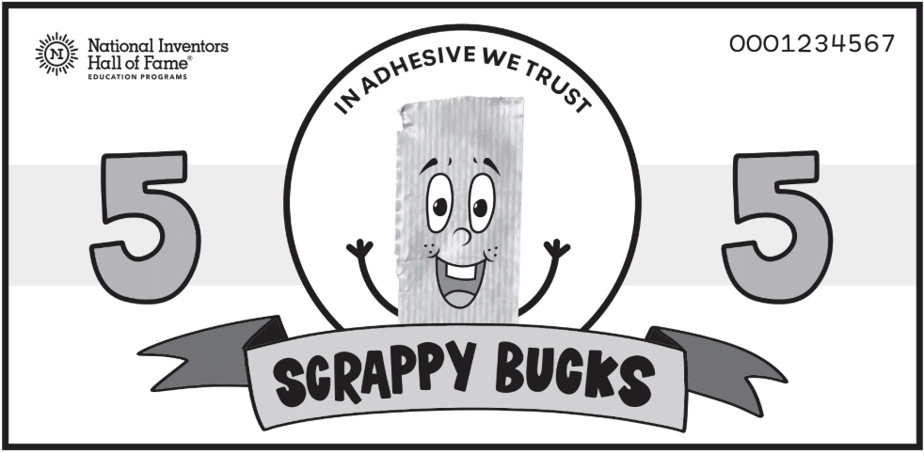
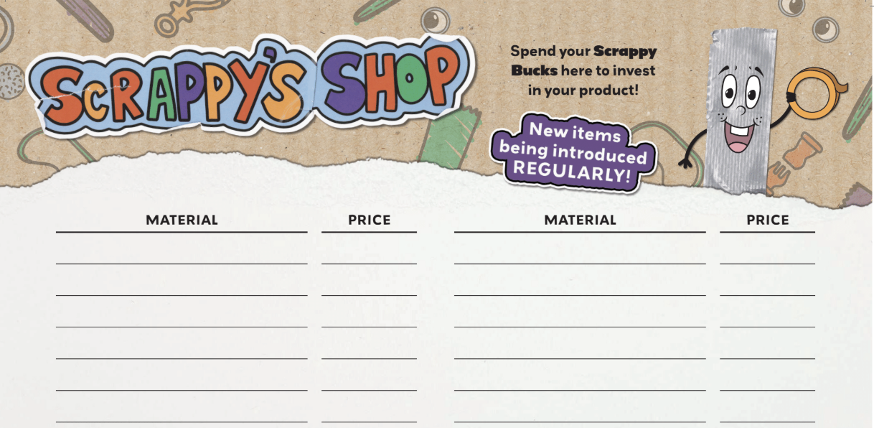
Measurement and Data
Participants practice counting money as they earn Scrappy Bucks and visit Scrappy's Shop.
Excerpt from curriculum:
In Stuck!™, children get down to business and design an exclusive new product to showcase at the Designs and Inventions by Youth (DIY) Expo.

Slide 21

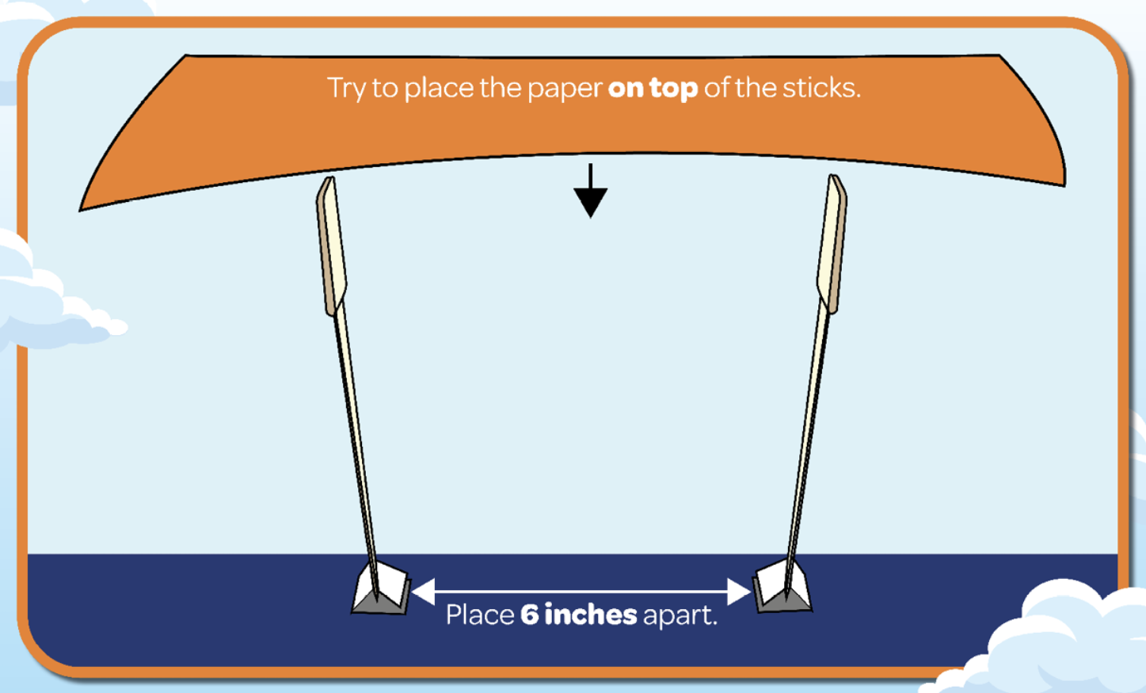
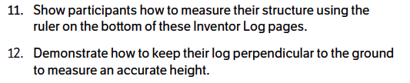
Measurement and Data
Participants practice measuring their designs using the ruler located at the bottom of the Inventor Log.
Children reach for New Heights™ as
they discover what it takes to design
and engineer buildings that touch the
sky!

Slide 22
Geometry

Slide 23

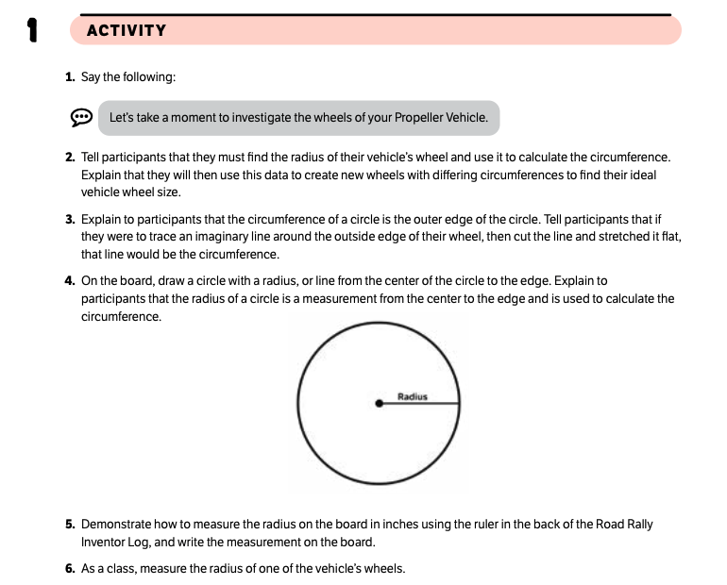
Geometry
Children explore geometry as they calculate the radius and circumference of their vehicle's wheels.
Excerpt from curriculum:
In Road Rally™, participants explore energy and fuel and apply nature-based discoveries to design their own unique vehicle that morphs!

Slide 24
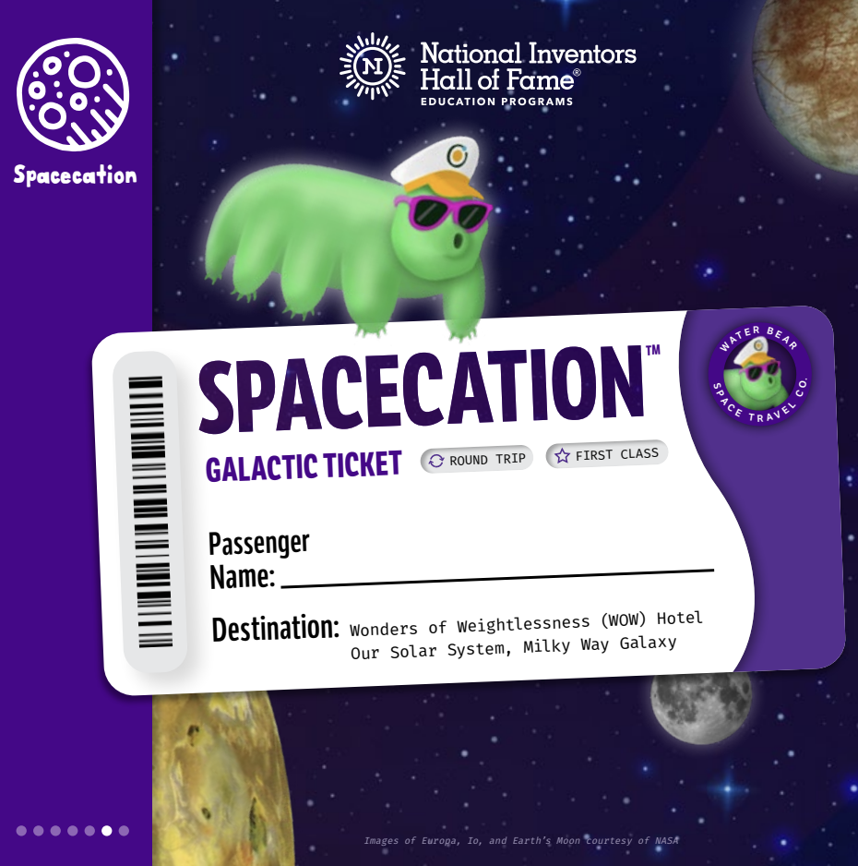
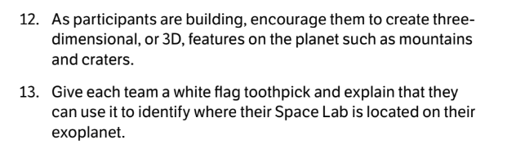

Geometry
Children explore geometry as they create 3D features for a planet and dock spacecrafts in a circular target.
Excerpt from curriculum:
Get ready for an out-of-this-world vacation to space in Spacecation™! Participants follow a fantastical itinerary filled with awesome astro-adventures that are rooted in real-world, cutting-edge space exploration science.

Slide 25
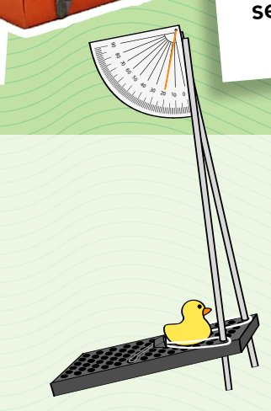
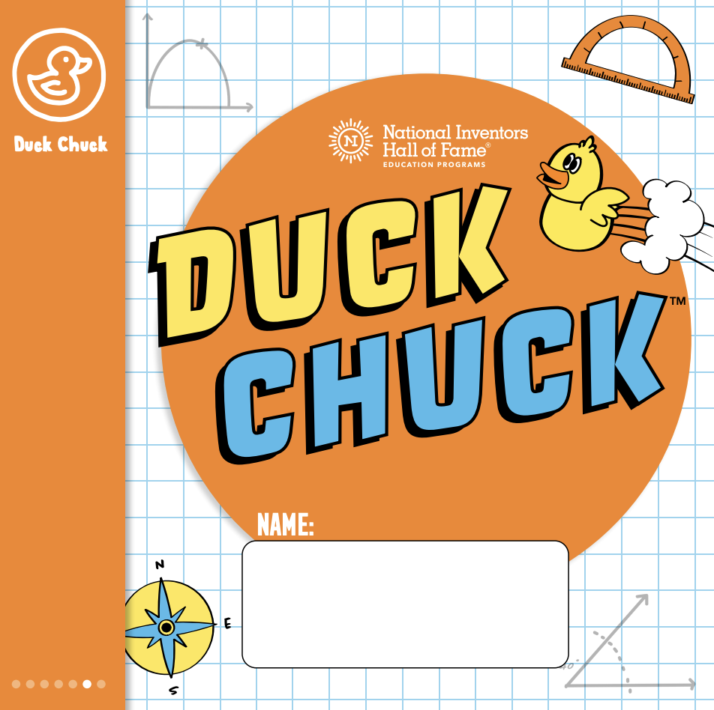
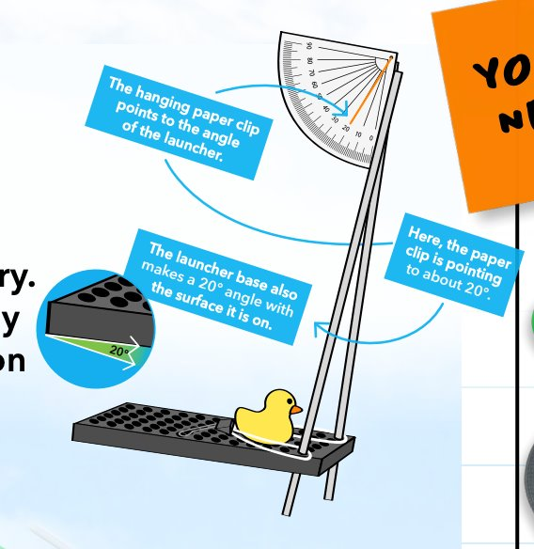
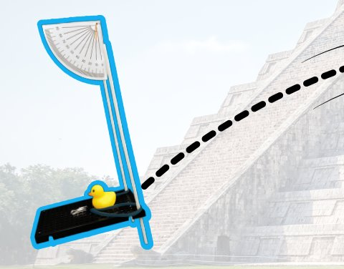
Geometry
Participants experiment with launching their duck at different angles.
In Duck Chuck™, children let physics fly as they launch rubber ducks to far-flung locations around the globe!

Slide 26
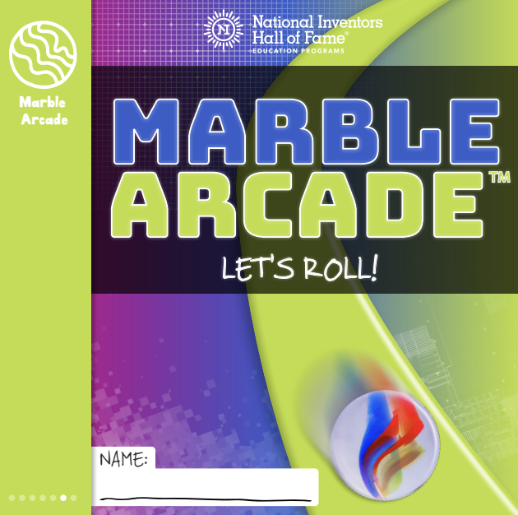
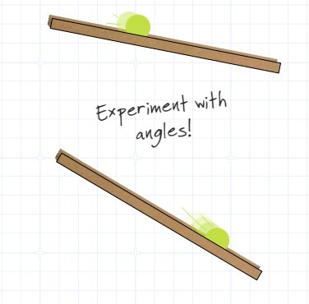
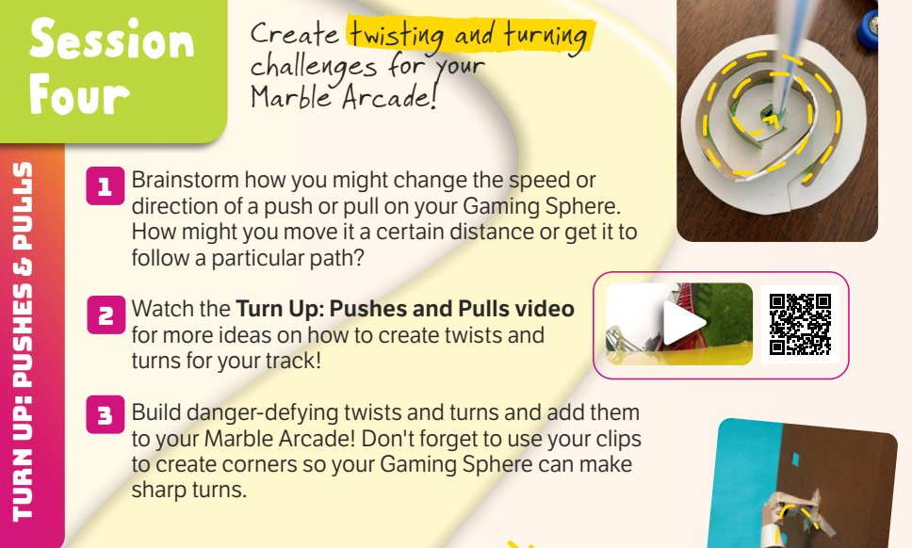
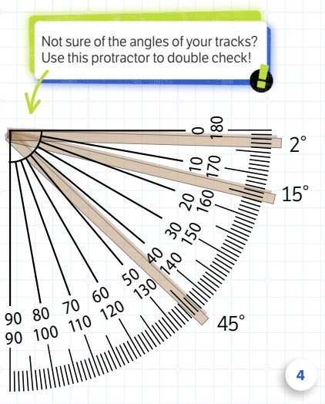
Geometry
Children experiment with the shape and angle of their marble arcade's tracks.
In Marble Arcade™, Gamers use physics
to build a Marble Arcade that keeps a Gaming Sphere in motion for 10 seconds. Gamers explore how mass and size affect movement and motion.

Slide 27
Statistics and Probability

Slide 28

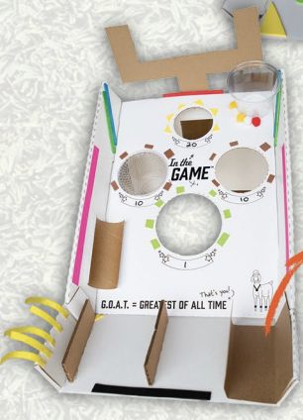
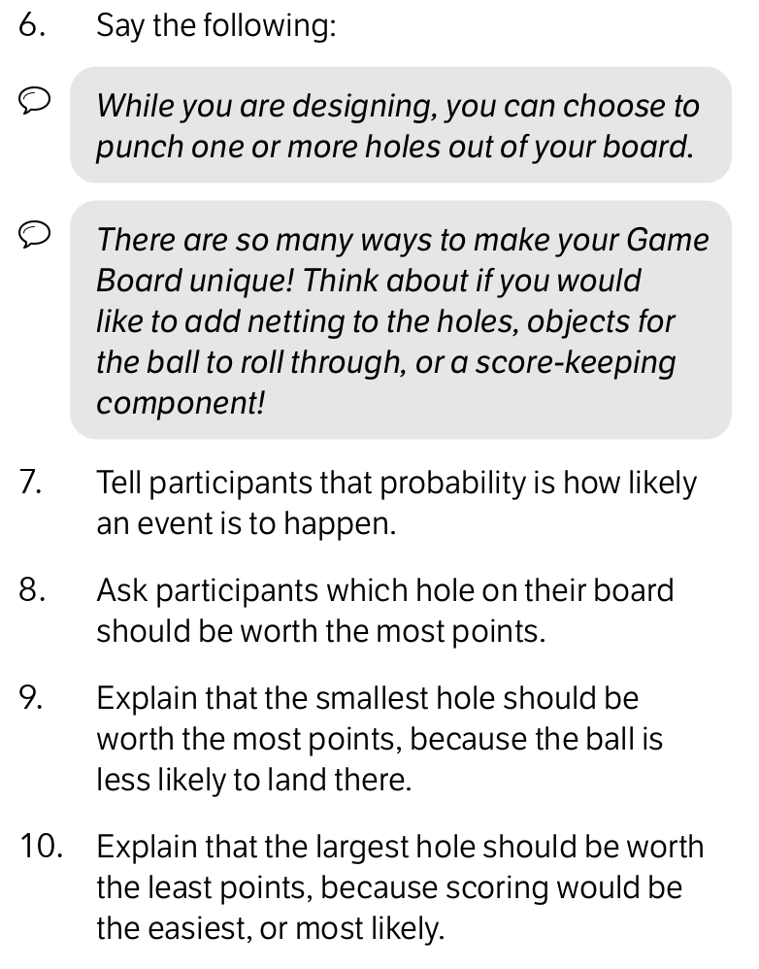
Statistics and Probability
Participants explore probability as they create a point system for their game board.
Excerpt from curriculum:
Children are invited to be In the Game™— where athletics, design, invention, and business come together for the win!

Slide 29

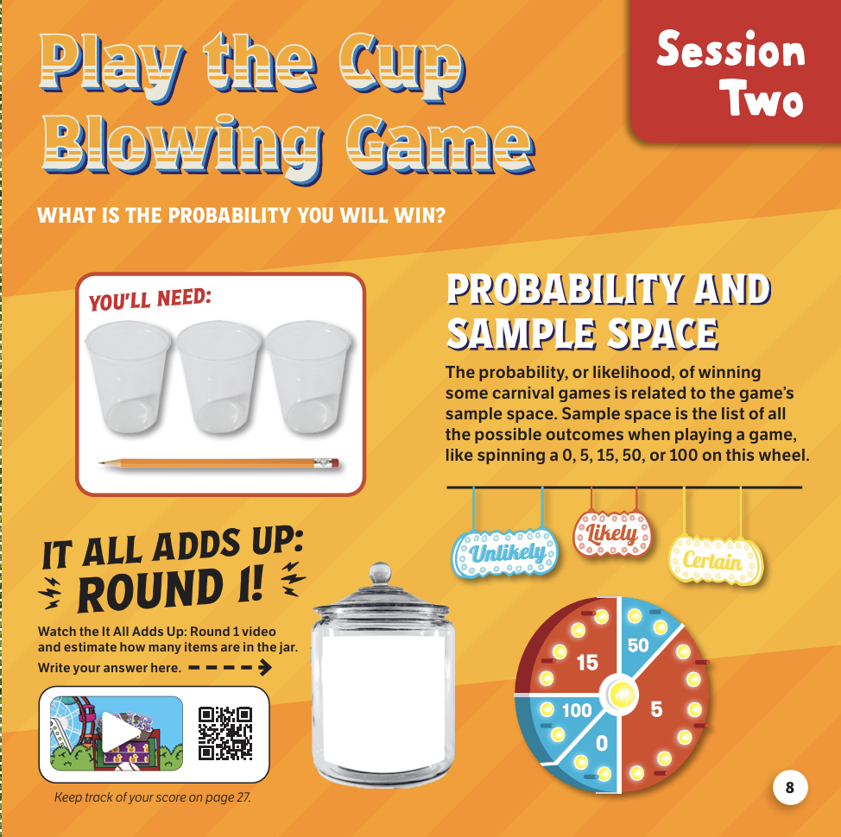
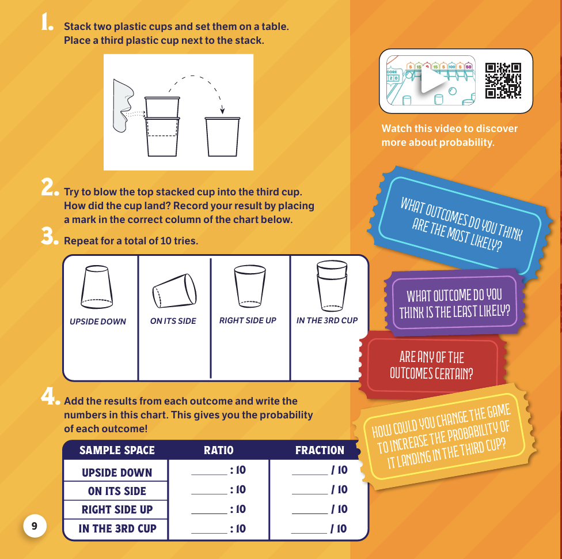
Statistics and Probability
Participants experiment with odds and sample space and calculate probability while playing carnival games.
In Fair Games™, children are introduced to the concepts of measurement, number operations, geometry, and algebraic thinking through carnival games.

Slide 30

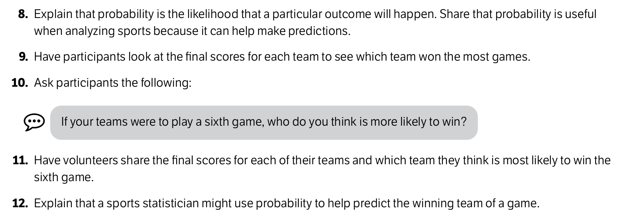
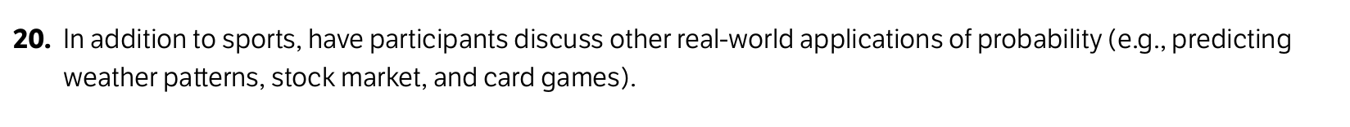
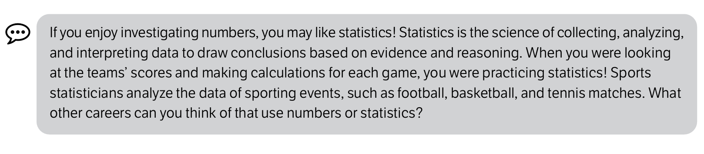
Statistics and Probability
Participants explore probability and statistics as they determine the likelihood of their team winning the next game.
Excerpts from curriculum:
In Champions™, children discover the unseen champions of the sports world and explore how innovators have changed the way people experience sports! Champions participants build their own functioning tabletop games and investigate National Inventors Hall of Fame Inductees who have revolutionized sports.

