Slide 1

NIHF Education Programs
English Language Arts
K-6 examples of NIHF Educational
Programs ELA alignments

Slide 2
ELA in STEM
STEM experiences support English Language Arts by:
Promoting active listening
Exposing learners to various texts and literacy types
Providing meaningful experiences and background knowledge for reading comprehension
Teaching background knowledge and vocabulary
Exploring how words and phrases come together to create meaning
Using inferences to draw conclusions
STEM adds excitement to literacy, allowing young readers to engage with content in a whole new way!

Slide 3
How NIHF Incorporates ELA
The National Inventors Hall of Fame (NIHF) Education Programs use multimodal learning to incorporate key English language arts concepts, such as:
Reading informational text
Following written instructions
Sharing and responding to ideas
Constructing written stories, instructions, and ideas
Using and applying new academic vocabulary
Throughout NIHF programs, participants are exposed to the I Can Invent® Mindset, which showcases key skills needed in ELA, such as persistence and confidence. According to research completed by https://seisummit.org/, Camp Invention can impact reading test scores.¹
Notes:
Footnotes:
(1)The i-Ready reading scores, both average (47) and median (43) percentile scores for students who participated in the program were higher than the district average for all students, including all summer program participants.(Summit Education Initiative, National Inventors Hall of Fame Camp Invention, a Program Component of Akron Public Schools Innovation 365 (I365): Wraparound Summer 2022 (January 2023).

Slide 4
Reading

Slide 5
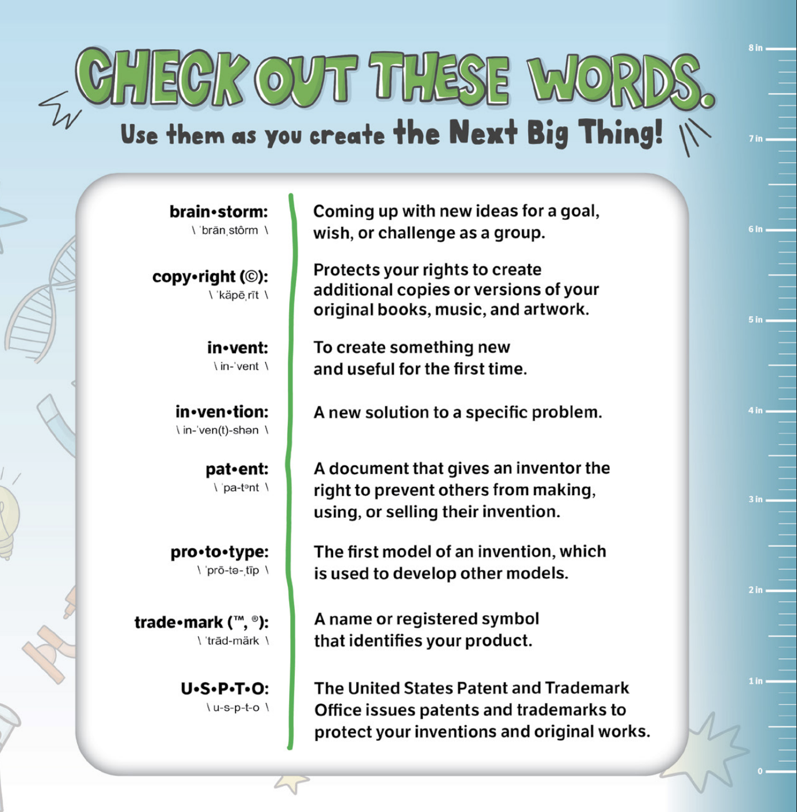
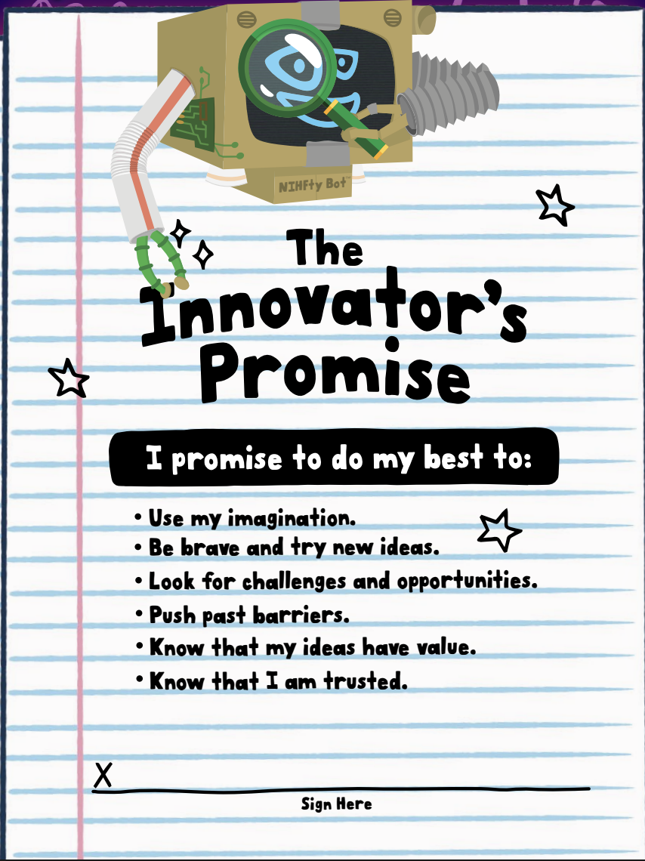
Reading
Each Inventor Log contains an Innovator's promise and a Glossary.
Participants read and sign the Innovator's Promise prior to the start of the program.
Participants can reference the Glossary for invention-inspired vocabulary.

Slide 6
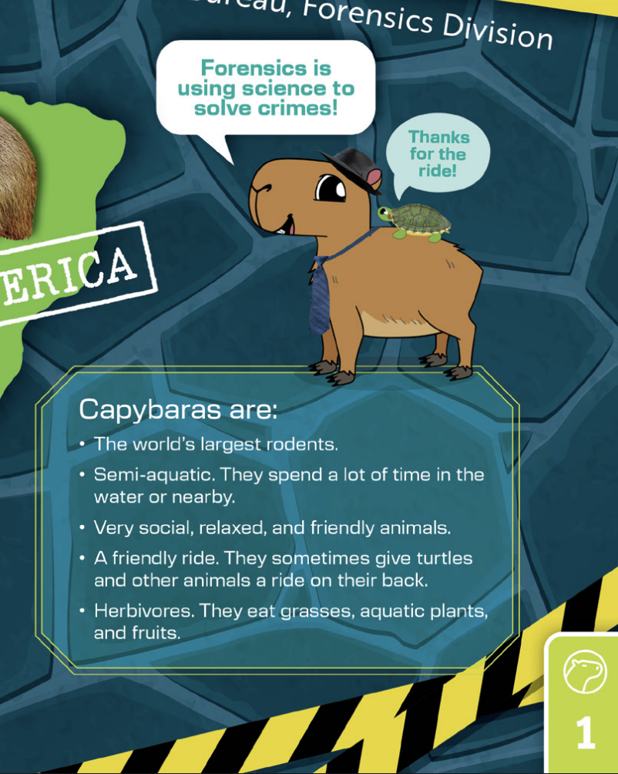
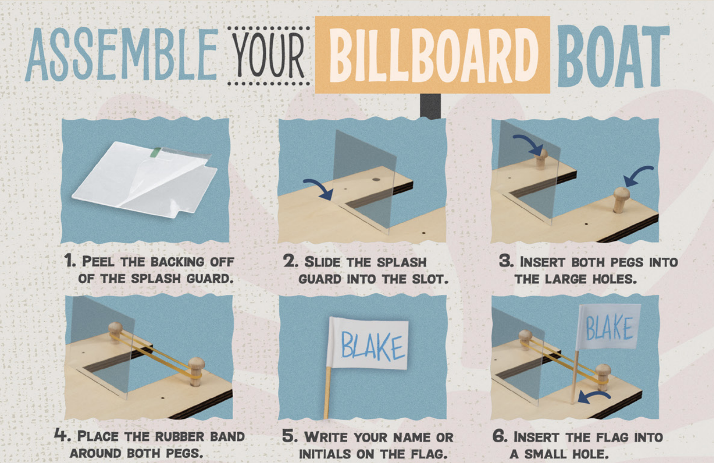
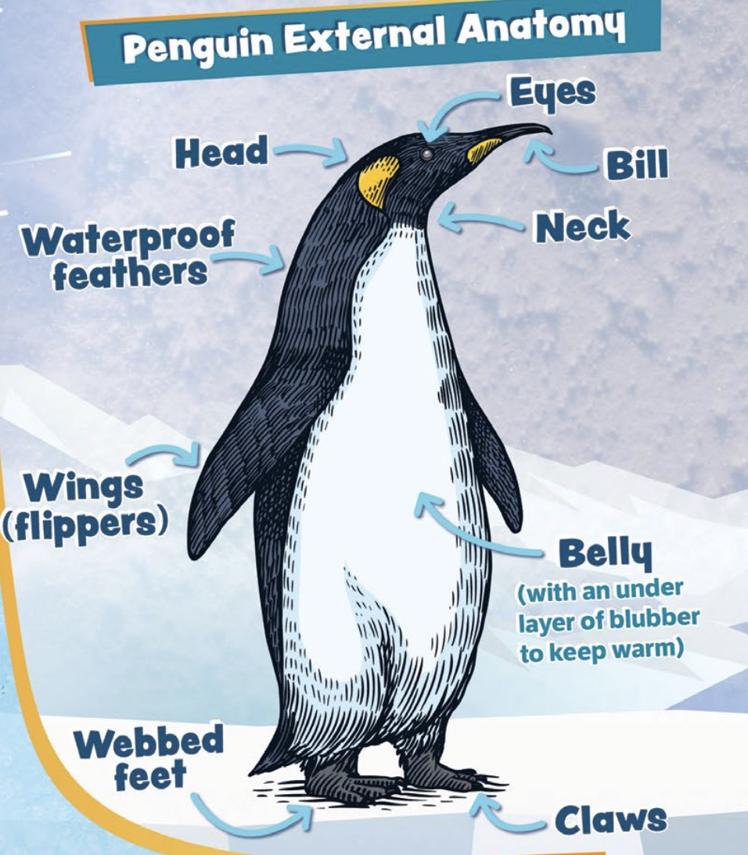
Reading
Other opportunities for reading in the Inventor Log include:
Step-by-step instructions to assemble items
STEM facts

Slide 7
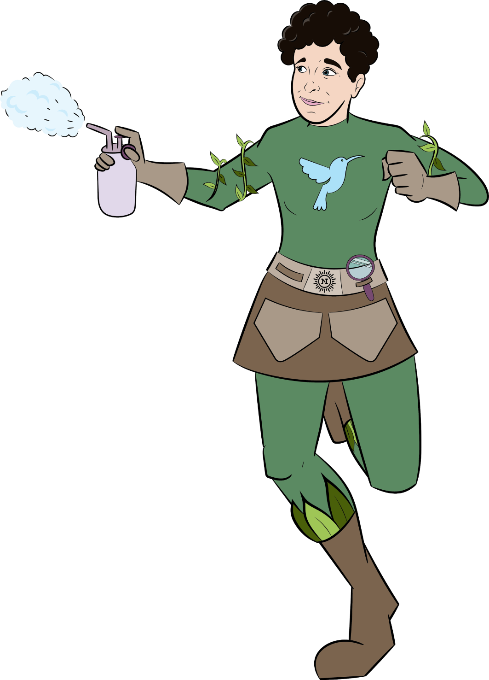




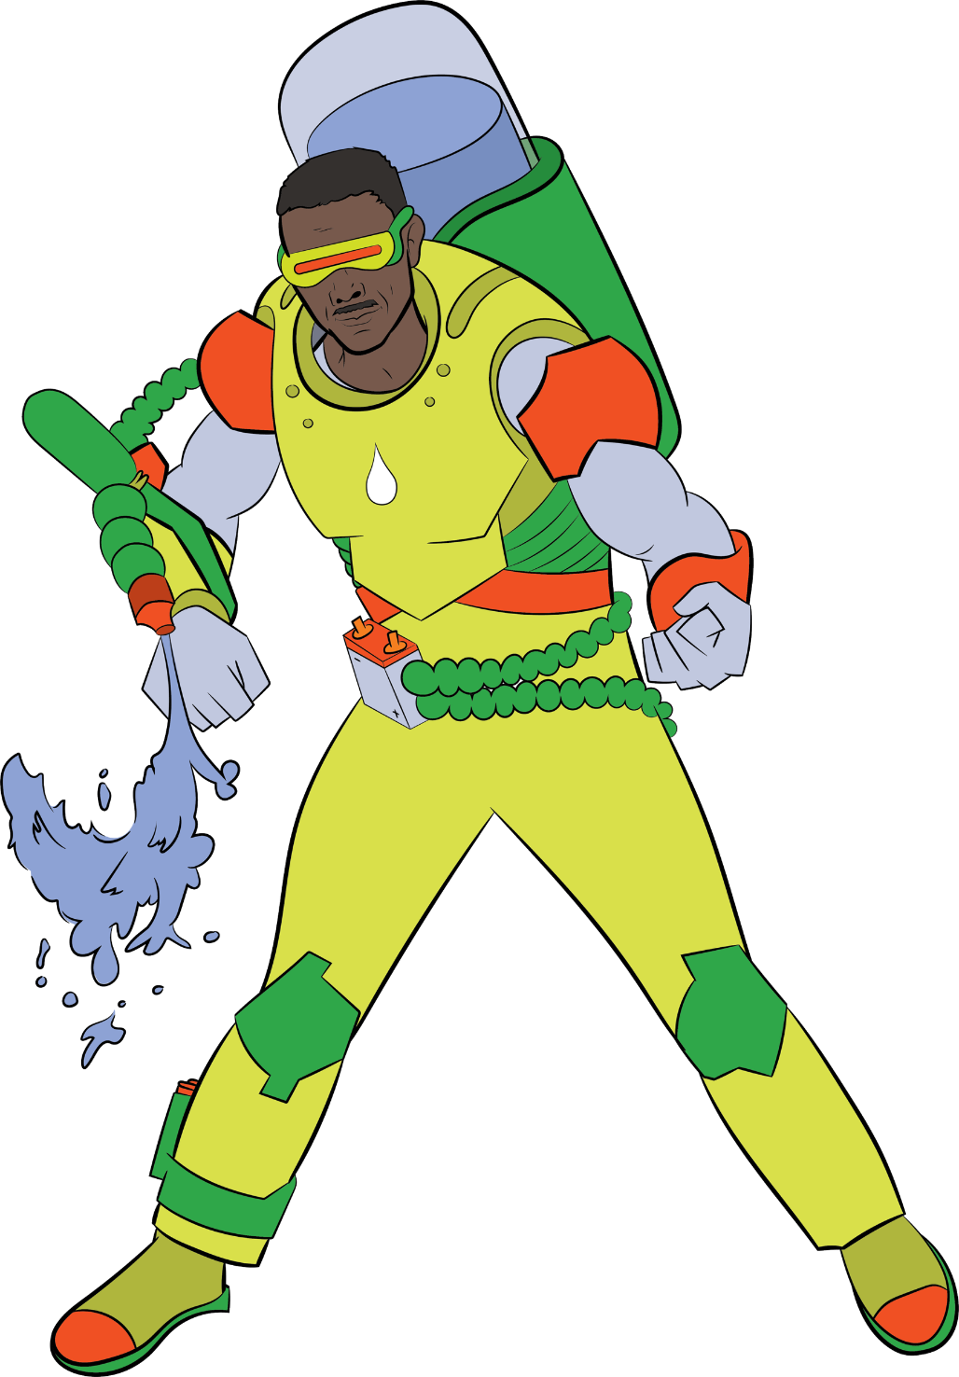
Reading
The Inventor Log also includes reading passages on the National Inventors Hall of Fame Inductees.

Slide 8

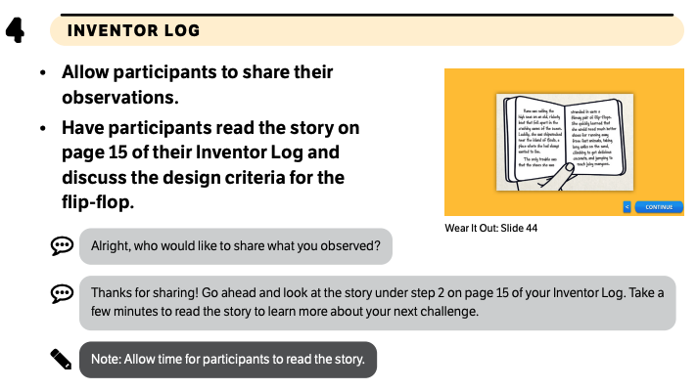
Reading
Participants read a story about a flimsy pair of flip flops in their Inventor Log and discuss how to improve the design.
Excerpt from curriculum:
In Wear It Out™, Innovators combine creative ideas and maker materials to invent clothing and accessories that are both fashionable and functional.

Slide 9

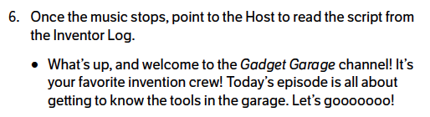
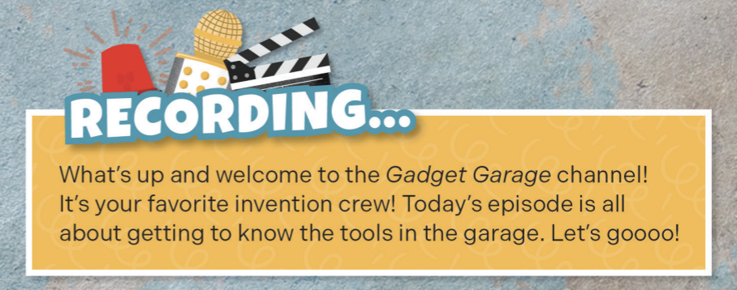
Reading
In each Session, participants are asked to read a script for their new episode on the Gadget Garage channel.
Excerpt from curriculum:
Excerpt from Inventor Log:
3… 2… 1... Get ready to discover, deconstruct, and design on the set of Gadget Garage™, where participants work in crews to solve viewer challenges through innovation!

Slide 10
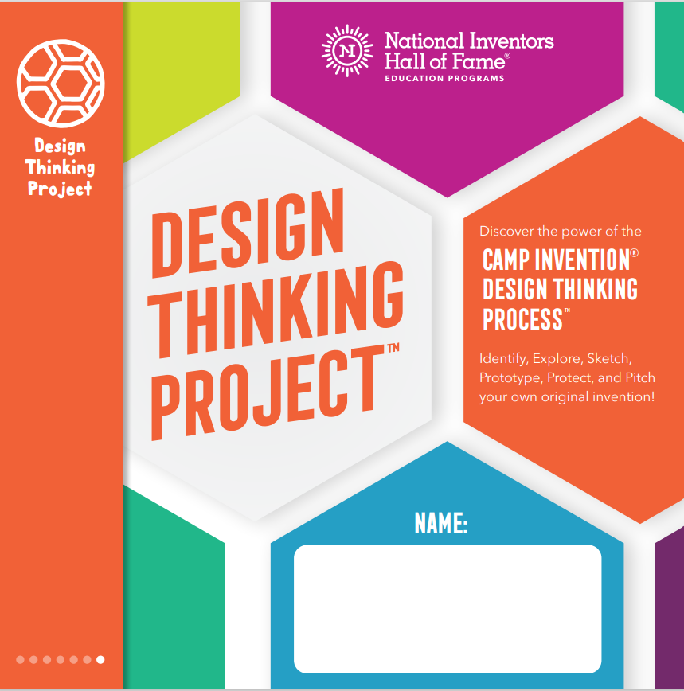
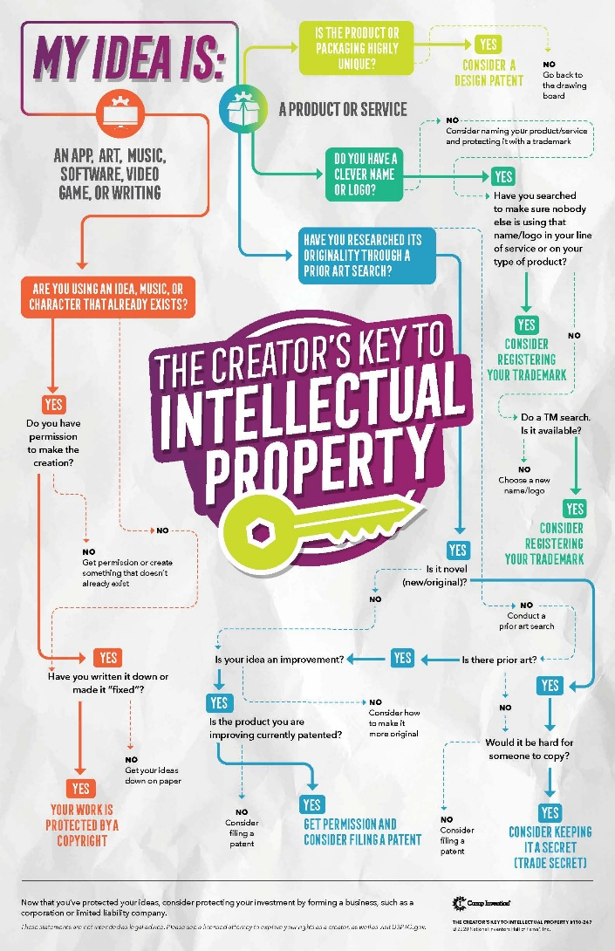
Reading
Participants use a dichotomous key as a tool to search and locate information efficiently and determine how to protect their ideas.
In Design Thinking Project™, participants discover the power
of the Camp Invention Design Thinking Process™, identify, explore, sketch, prototype, protect, and pitch, as they invent the Next Big Thing!

Slide 11
Writing

Slide 12
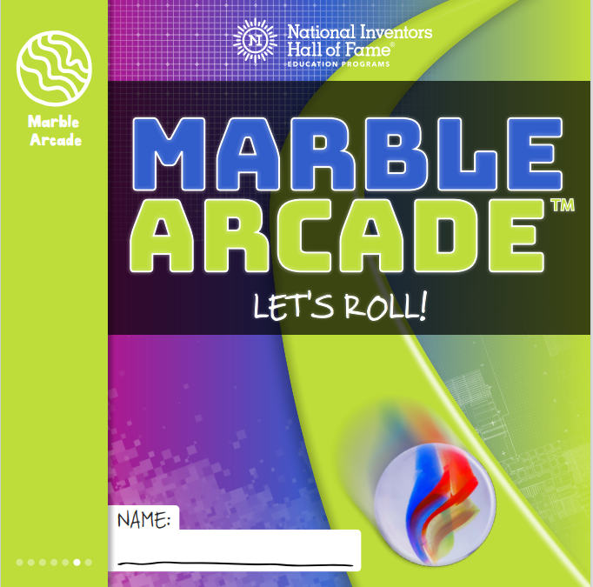
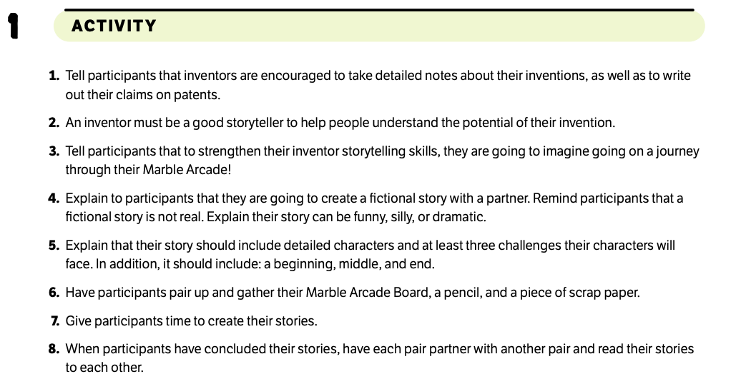
Writing
Participants write a fictional story about traveling through their Marble Arcade. The story must include three challenges, along with a beginning, middle, and end.
Excerpt from curriculum:
In Marble Arcade™, Gamers use physics to build a Marble Arcade that keeps a Gaming Sphere in motion for 10 seconds.

Slide 13
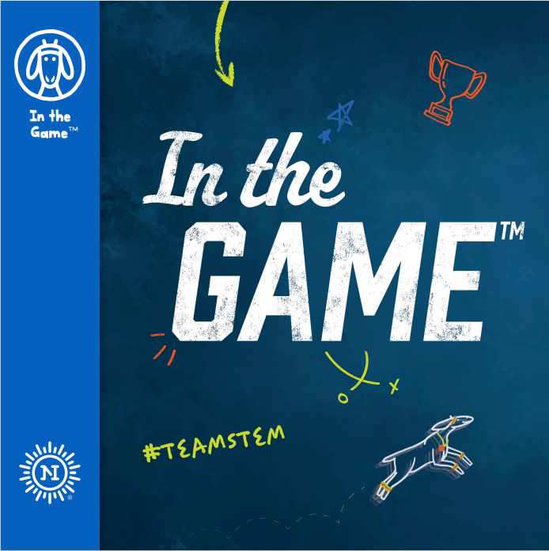

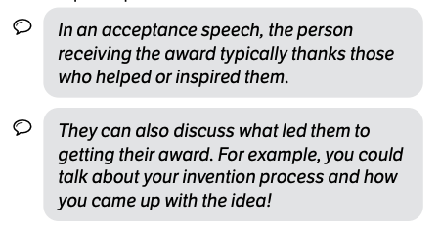
Writing
Participants write an acceptance speech for their induction into The Game of Fame. They reflect on their invention journey and write their invention journey in chronological order.
Excerpt from curriculum:
Children are invited to be In the Game™— where athletics, design, invention, and business come together for the win!

Slide 14
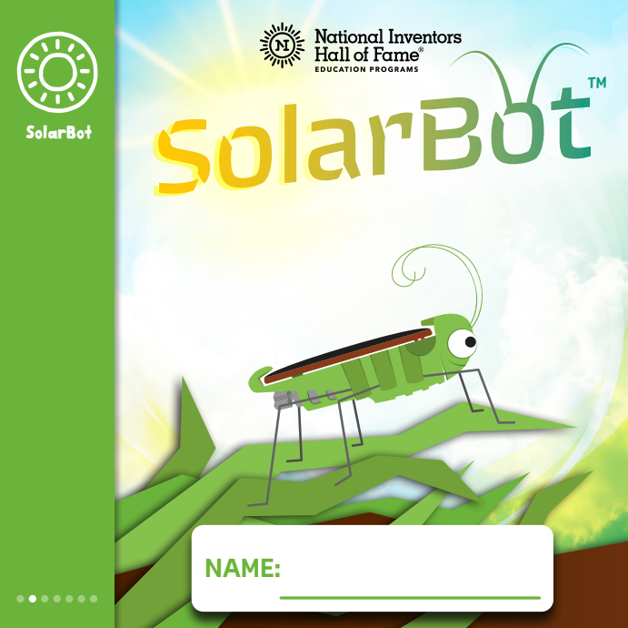
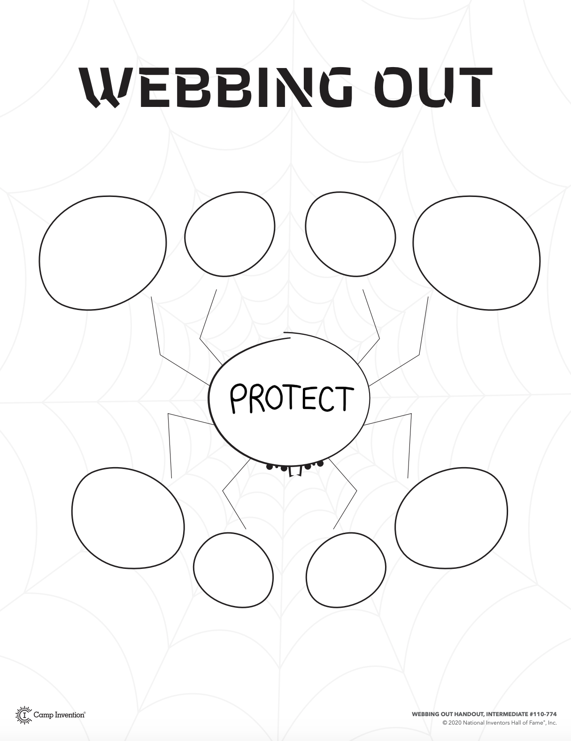
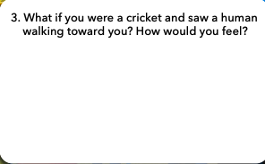
Writing
Participants write a web of ideas to organize and develop their thoughts.
Participants write answers to prompts that help them brainstorm solutions as they build.
Inspired by live crickets, SolarBot™ blends the life of insects with robots and the power of solar energy. Children build and adopt their very own solar-powered cricket. They experience a cricket’s point of view as they design habitats, cricket-inspired inventions, and protective gear to outsmart predators

Slide 15
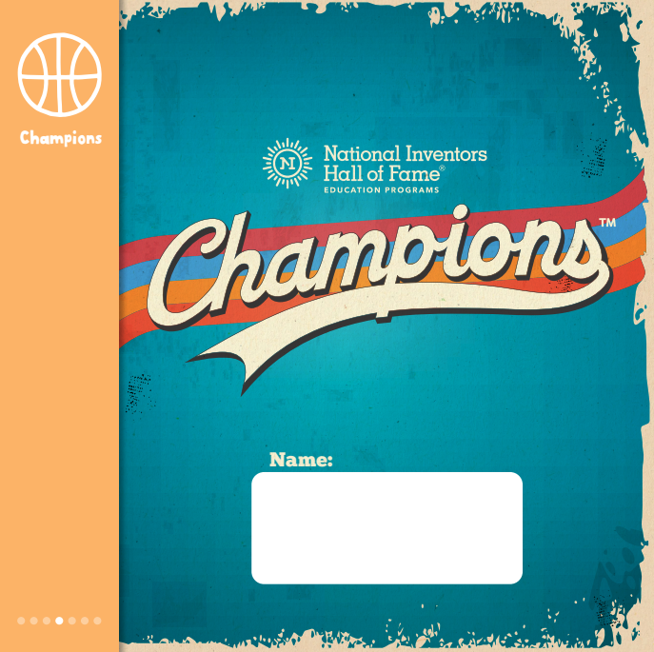
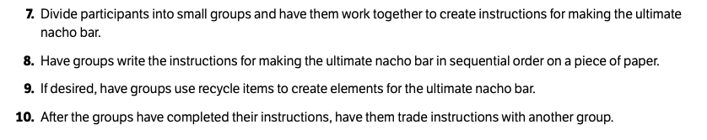
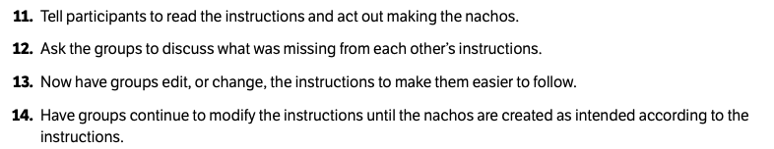
Writing
Participants write a sequence of instructions for making the ultimate nacho bar, then trade their instructions with other groups to test if they are clear.
Excerpts from curriculum:
In Champions™, children discover the unseen champions of the sports world and explore how innovators have changed the way people experience sports!

Slide 16

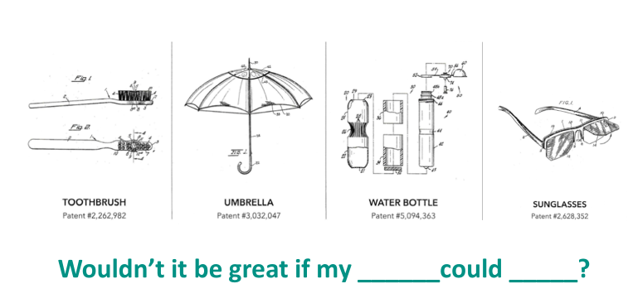
Writing
Participants engage in written brainstorming activities to organize their ideas and plan their inventions.
In Open Mic™, participants get ready to voice their ideas as they look inside a wireless microphone to discover the parts and pieces that will inspire their invention pitch!

Slide 17
Speaking and Listening

Slide 18
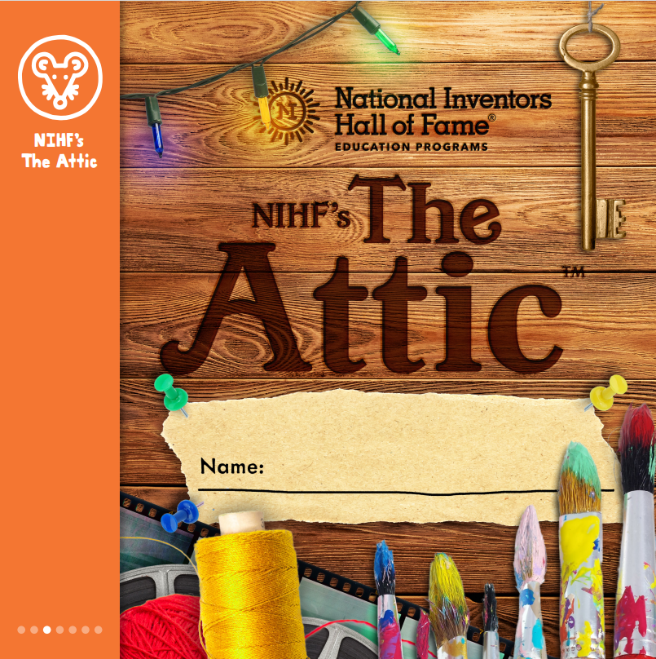
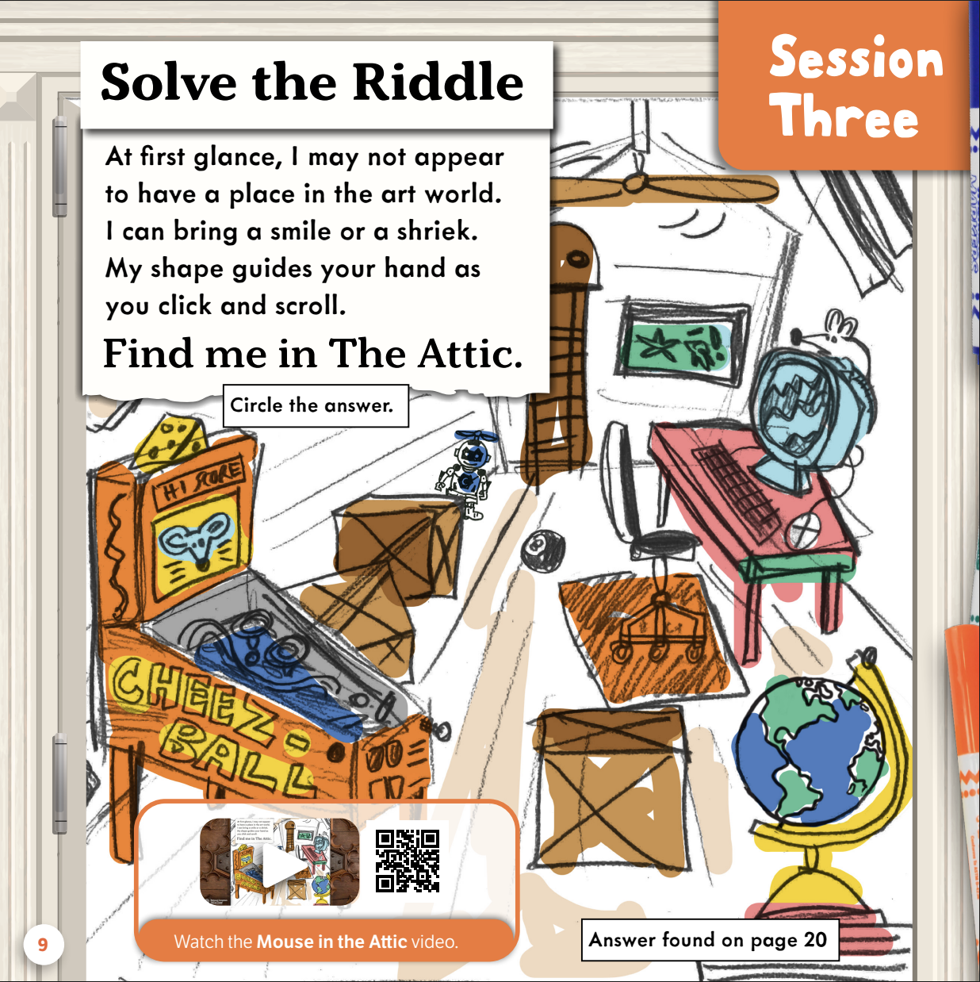
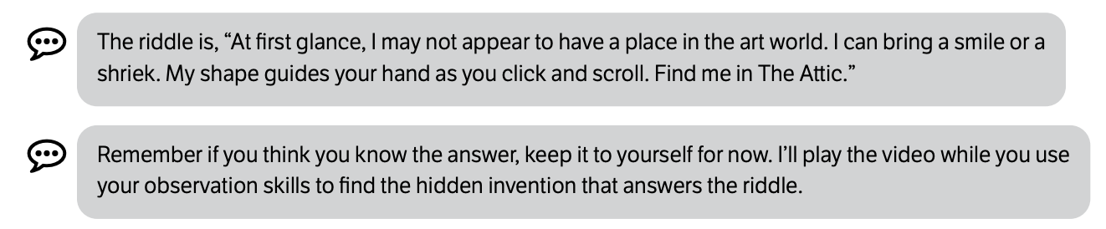
Speaking and Listening
Participants listen to the riddles as they are read aloud and then search in the corresponding images to solve them.
Excerpt from curriculum:
In NIHF’s The Attic™, children solve riddles to find inventions that have shaped and changed the way people create. From xanthan gum, a key ingredient used in watercolor paint,
to a sewing machine, participants never know what they will find in The Attic.

Slide 19
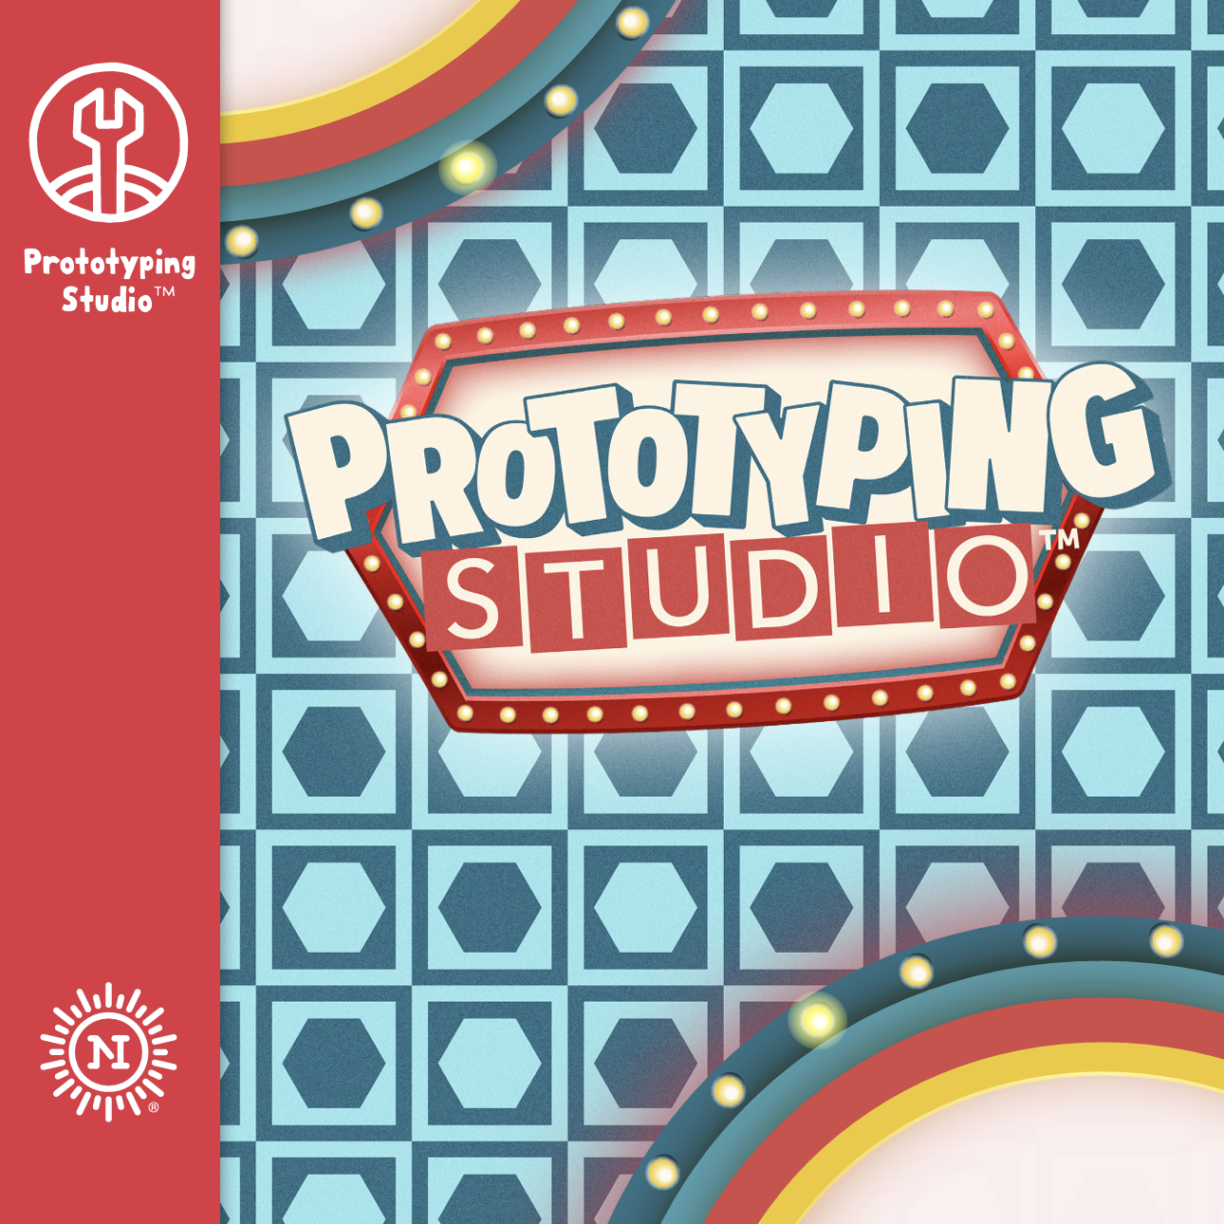
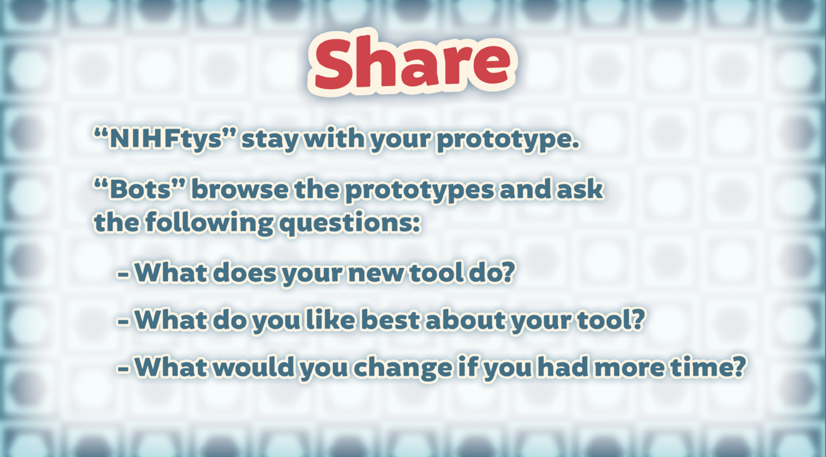
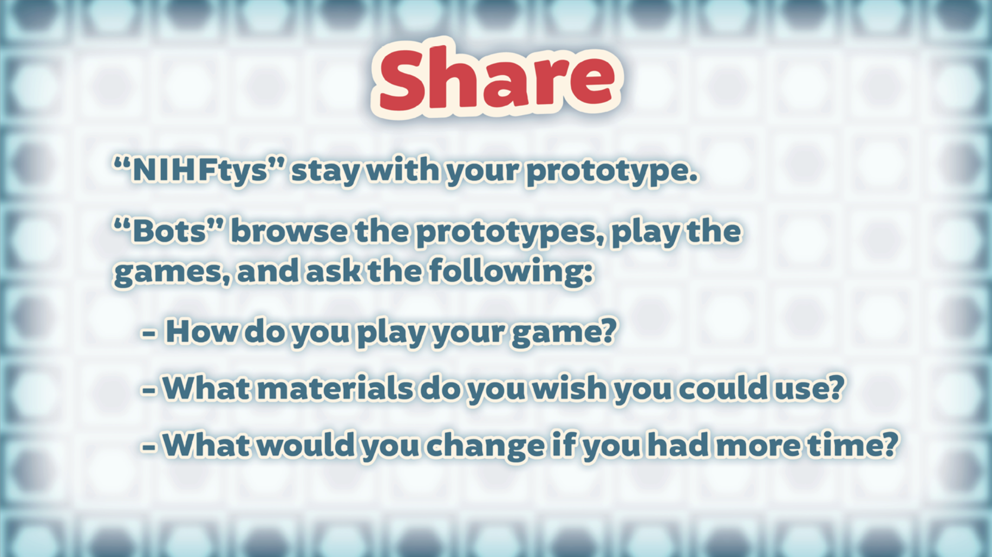
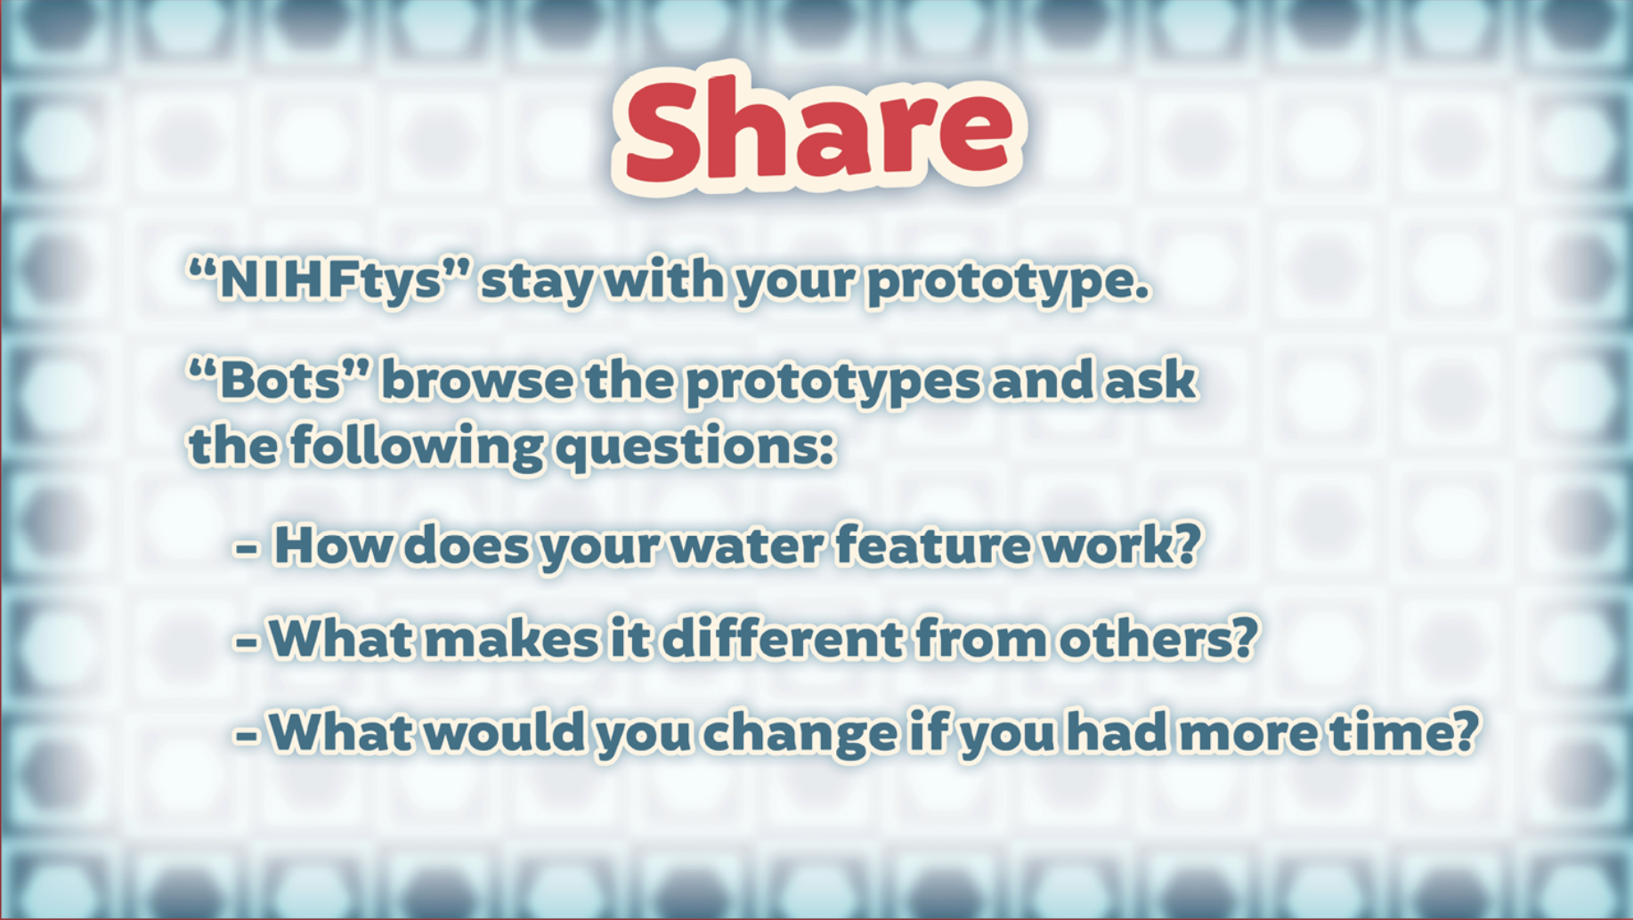
Speaking and Listening
Participants take turns asking and answering questions about their prototypes.
Children are contestants on Prototyping Studio™—a game show hosted by NIHFty Bot™, where they embark on an invention journey to uncover the ultimate place to invent.

Slide 20
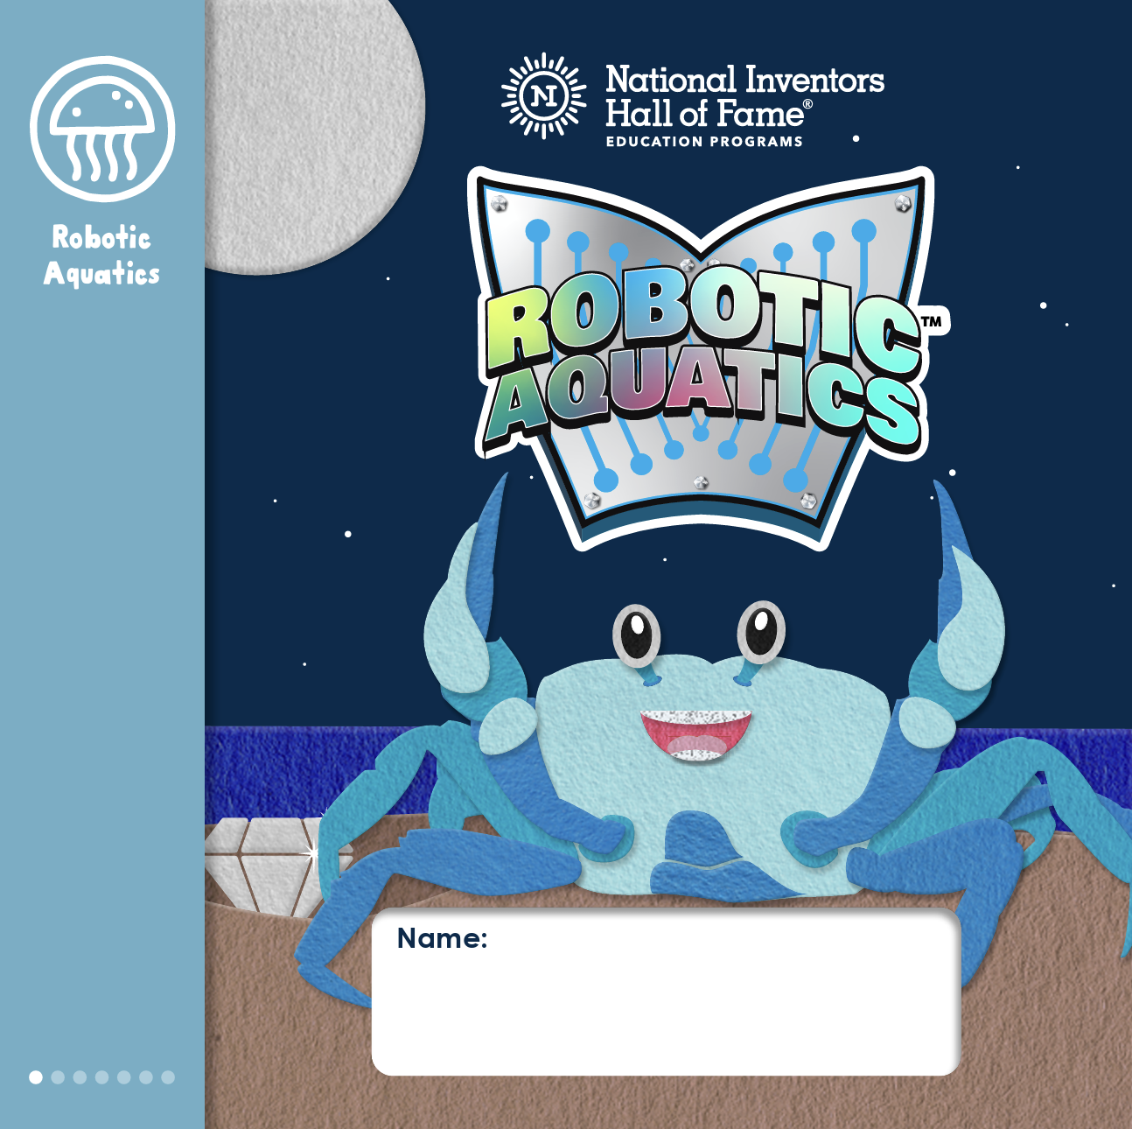
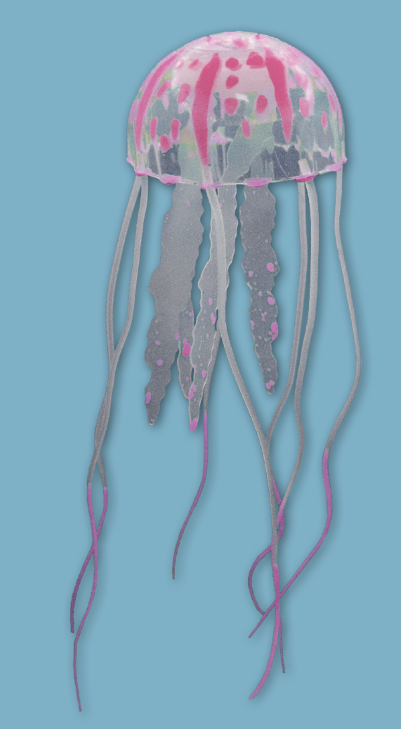
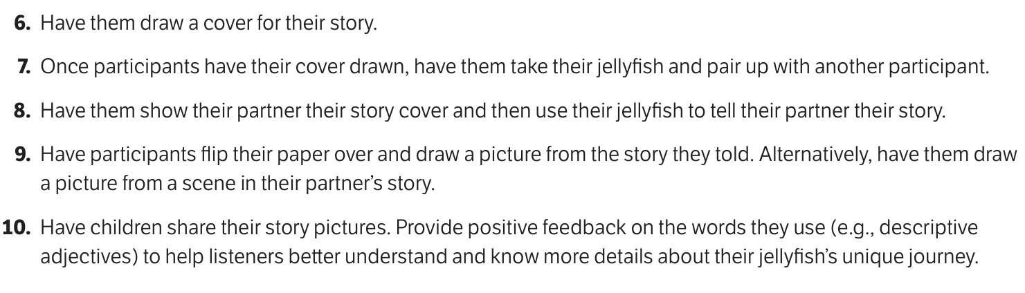
Speaking and Listening
Participants take turns telling a fictional story about their jellyfish, and draw a picture based on the story they heard
from their partner.
Excerpt from curriculum:
In Robotic Aquatics™, children explore aquatic innovations. They create a home for their fluorescent jellyfish and bring a splash of color to their aquatic animal’s habitat.

Slide 21

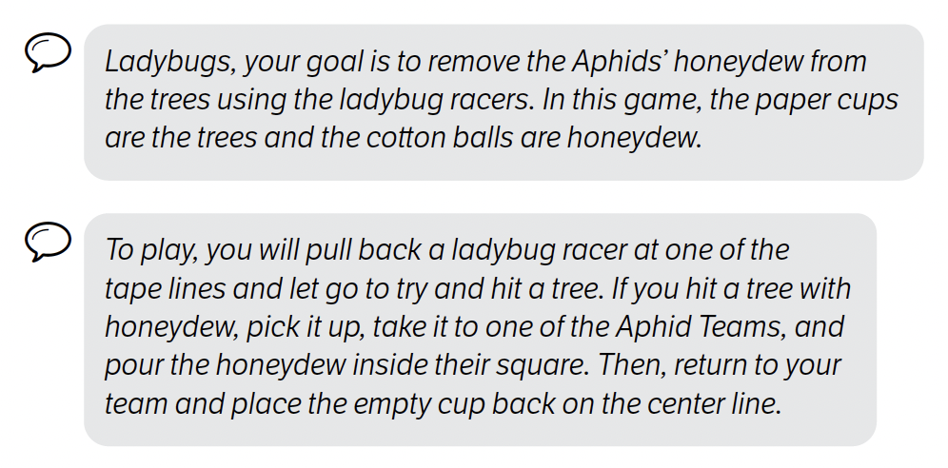
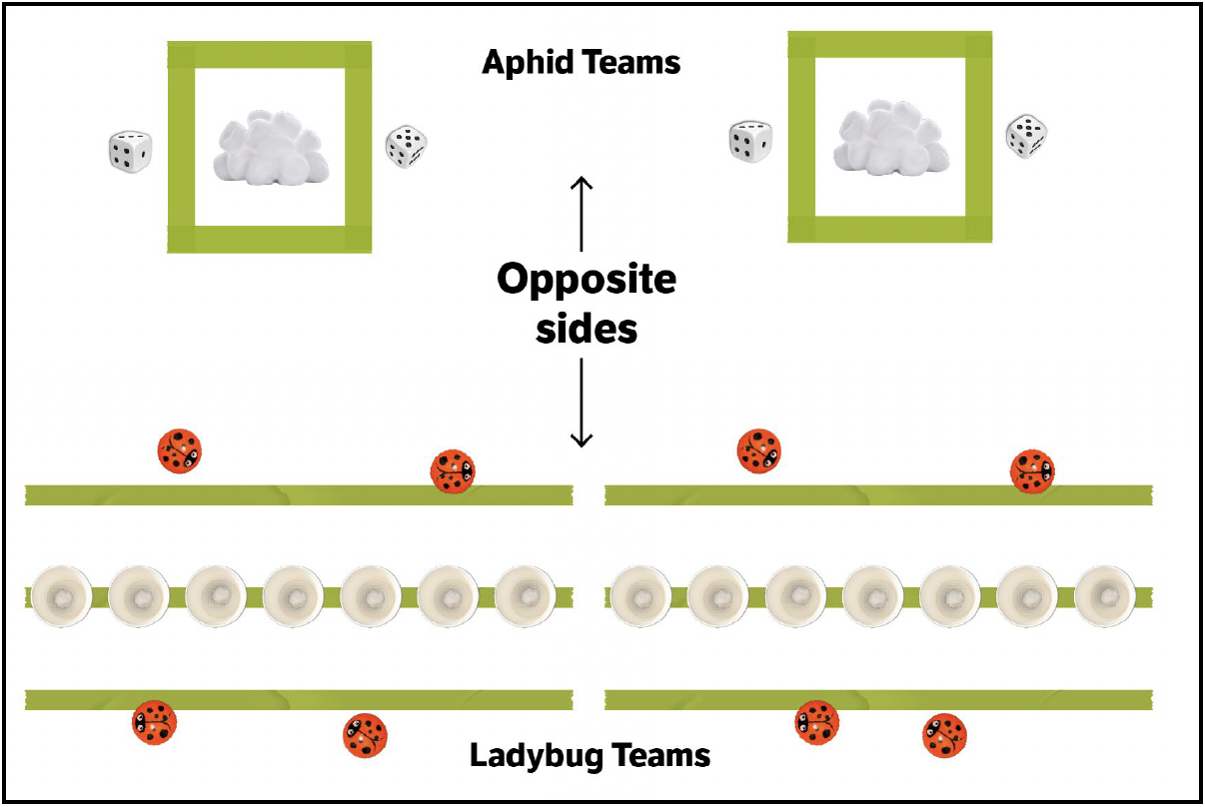
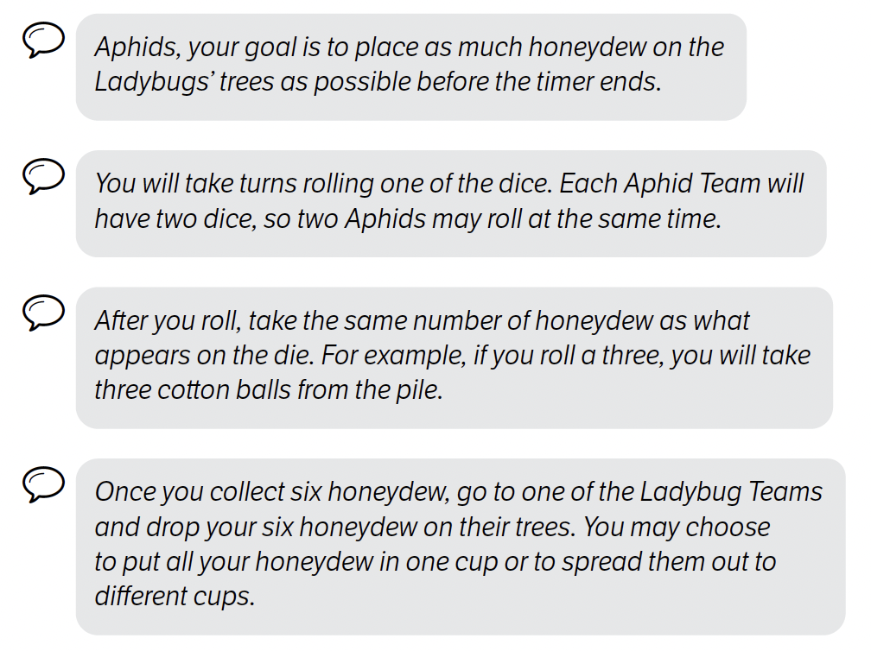
Speaking and Listening
Participants listen to multi-step instructions on how to play a Ladybug and Aphid game.
Excerpts from curriculum:
In Ooze and Aahs™, children explore ooey gooey chemistry concepts as they investigate some of nature’s tiniest organisms in the Backyard Laboratory!

Slide 22



Speaking and Listening
Participants use their microphone to deliver a 30-second pitch of their invention to the class.
In Open Mic™, participants get ready to voice their ideas as they look inside a wireless microphone to discover the parts and pieces that will inspire their invention pitch!

Slide 23
Language

Slide 24

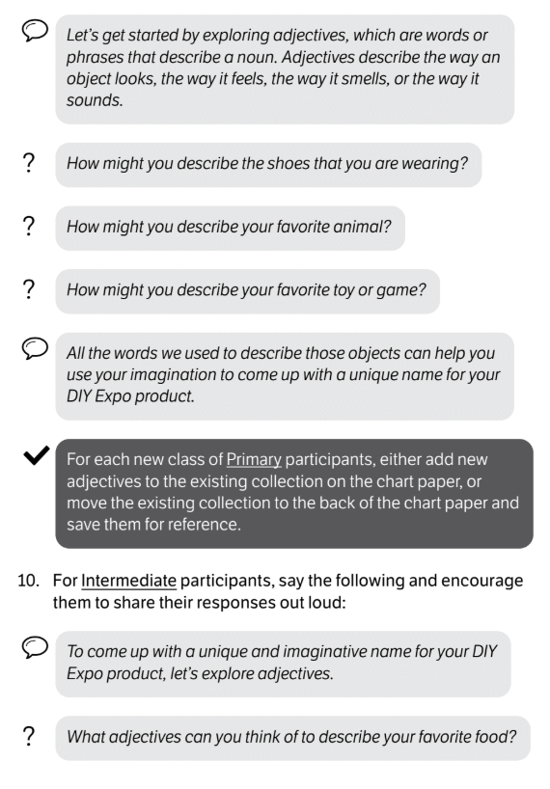
Language
Participants brainstorm and use adjectives to name their DIY Expo product.
Excerpt from curriculum:
In Stuck!™, children get down to business and design an exclusive new product to showcase at the Designs and Inventions by Youth (DIY) Expo.

Slide 25

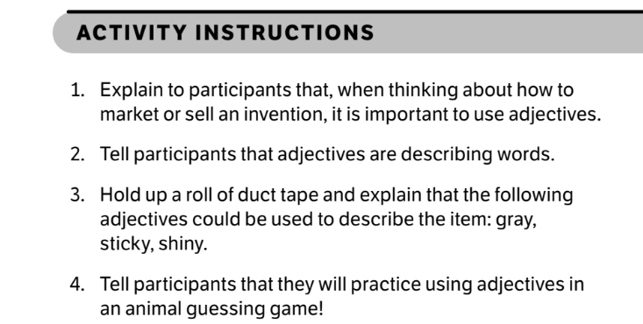
Language
Participants brainstorm adjectives and use them to play a game.
Excerpt from curriculum:
In Make Waves™, children catch their first big break as they ride the waves of invention and entrepreneurship!

Slide 26



Language
Participants recognize, explain, and brainstorm idioms.
The Stick To It™ module is a whale of a good time! Participants get to the heart of what it means to be an inventor: thinking through challenges, overcoming failure, testing and retesting, and reinspiring themselves.

Slide 27
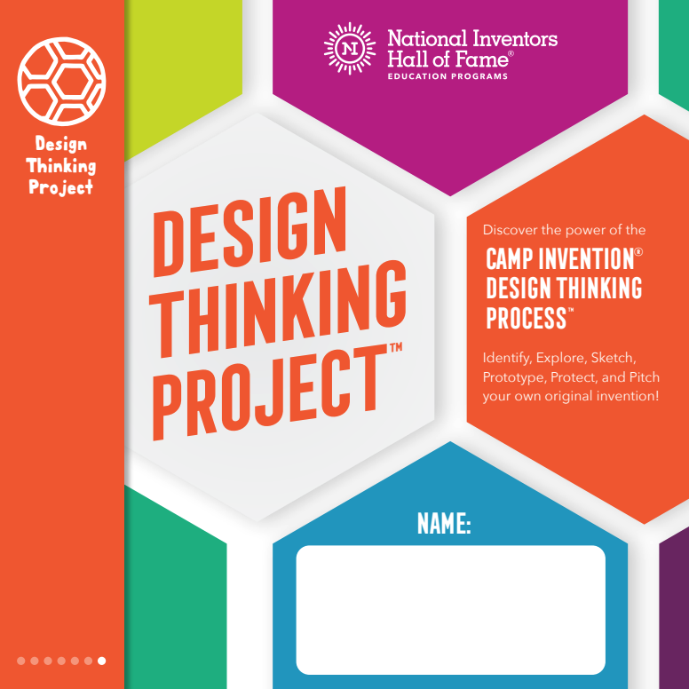
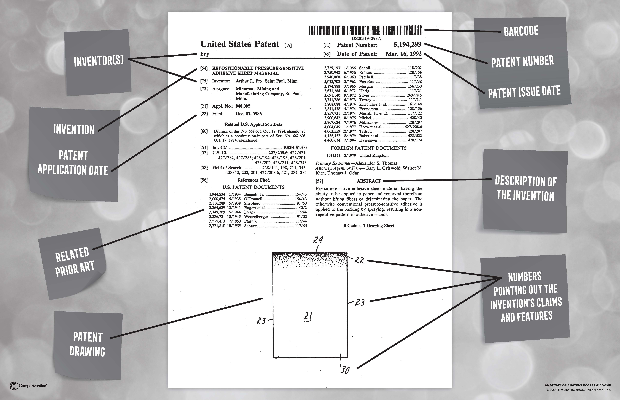
Language
Participants determine the meaning of words used in patent creation and then choose words to represent their prototype.
In Design Thinking Project™, participants discover the power of the Camp Invention Design Thinking Process™, identify, explore, sketch, prototype, protect, and pitch, as they invent the Next Big Thing!

Slide 28


Language
Participants ask suspects who, what, where, when, why, and how questions to collect evidence and draw conclusions.
In Fur-ensics™, children arrive at the Camp Invention Biopark, where they are recruited to sharpen their detective skills. They investigate a series of mischievous crimes committed by one of the animal residents! With the help of Captain E. Bara, children explore the “who” and “how” behind the animal antics within the park.

Slide 29
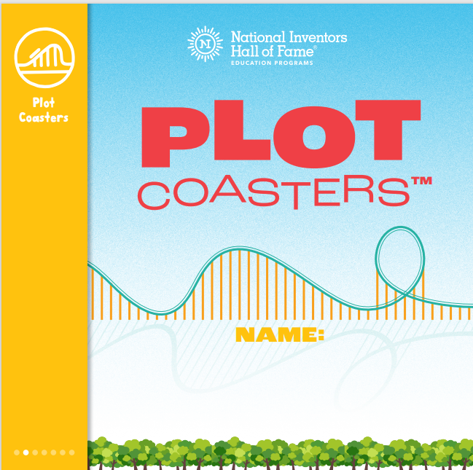
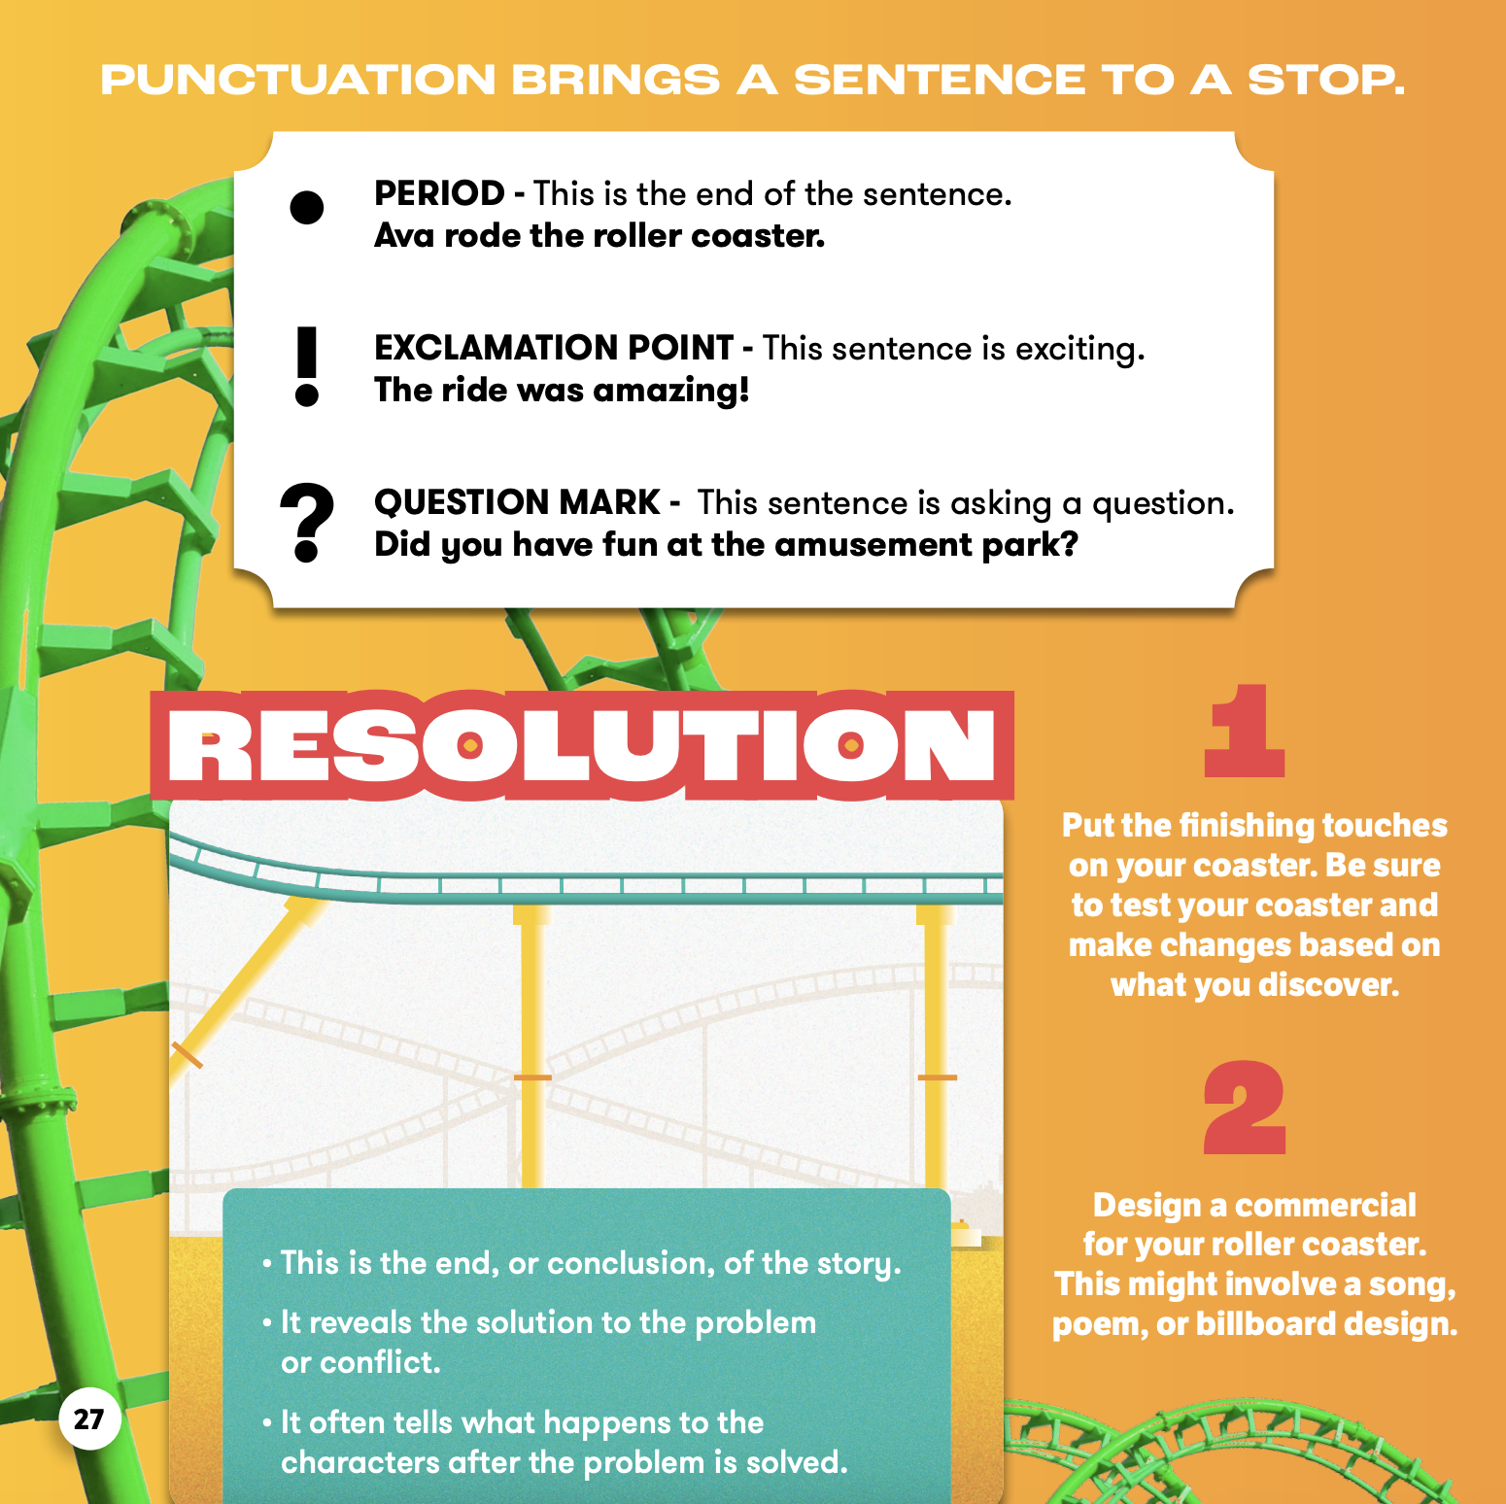
Language
Participants use correct punctuation to end sentences in their roller coaster stories.
Children fasten their seat belts and design an epic roller coaster during their Plot Coasters™ adventure! They work as design interns for the world’s newest amusement park—Imagination Point! Their challenge is to build an exciting roller coaster that will attract visitors and to write a best-selling story that can be sold in the gift shop.

