Slide 1

National Inventors Hall of Fame Invention Education Programs
Examples of the Integration of
Workforce Development

Slide 2
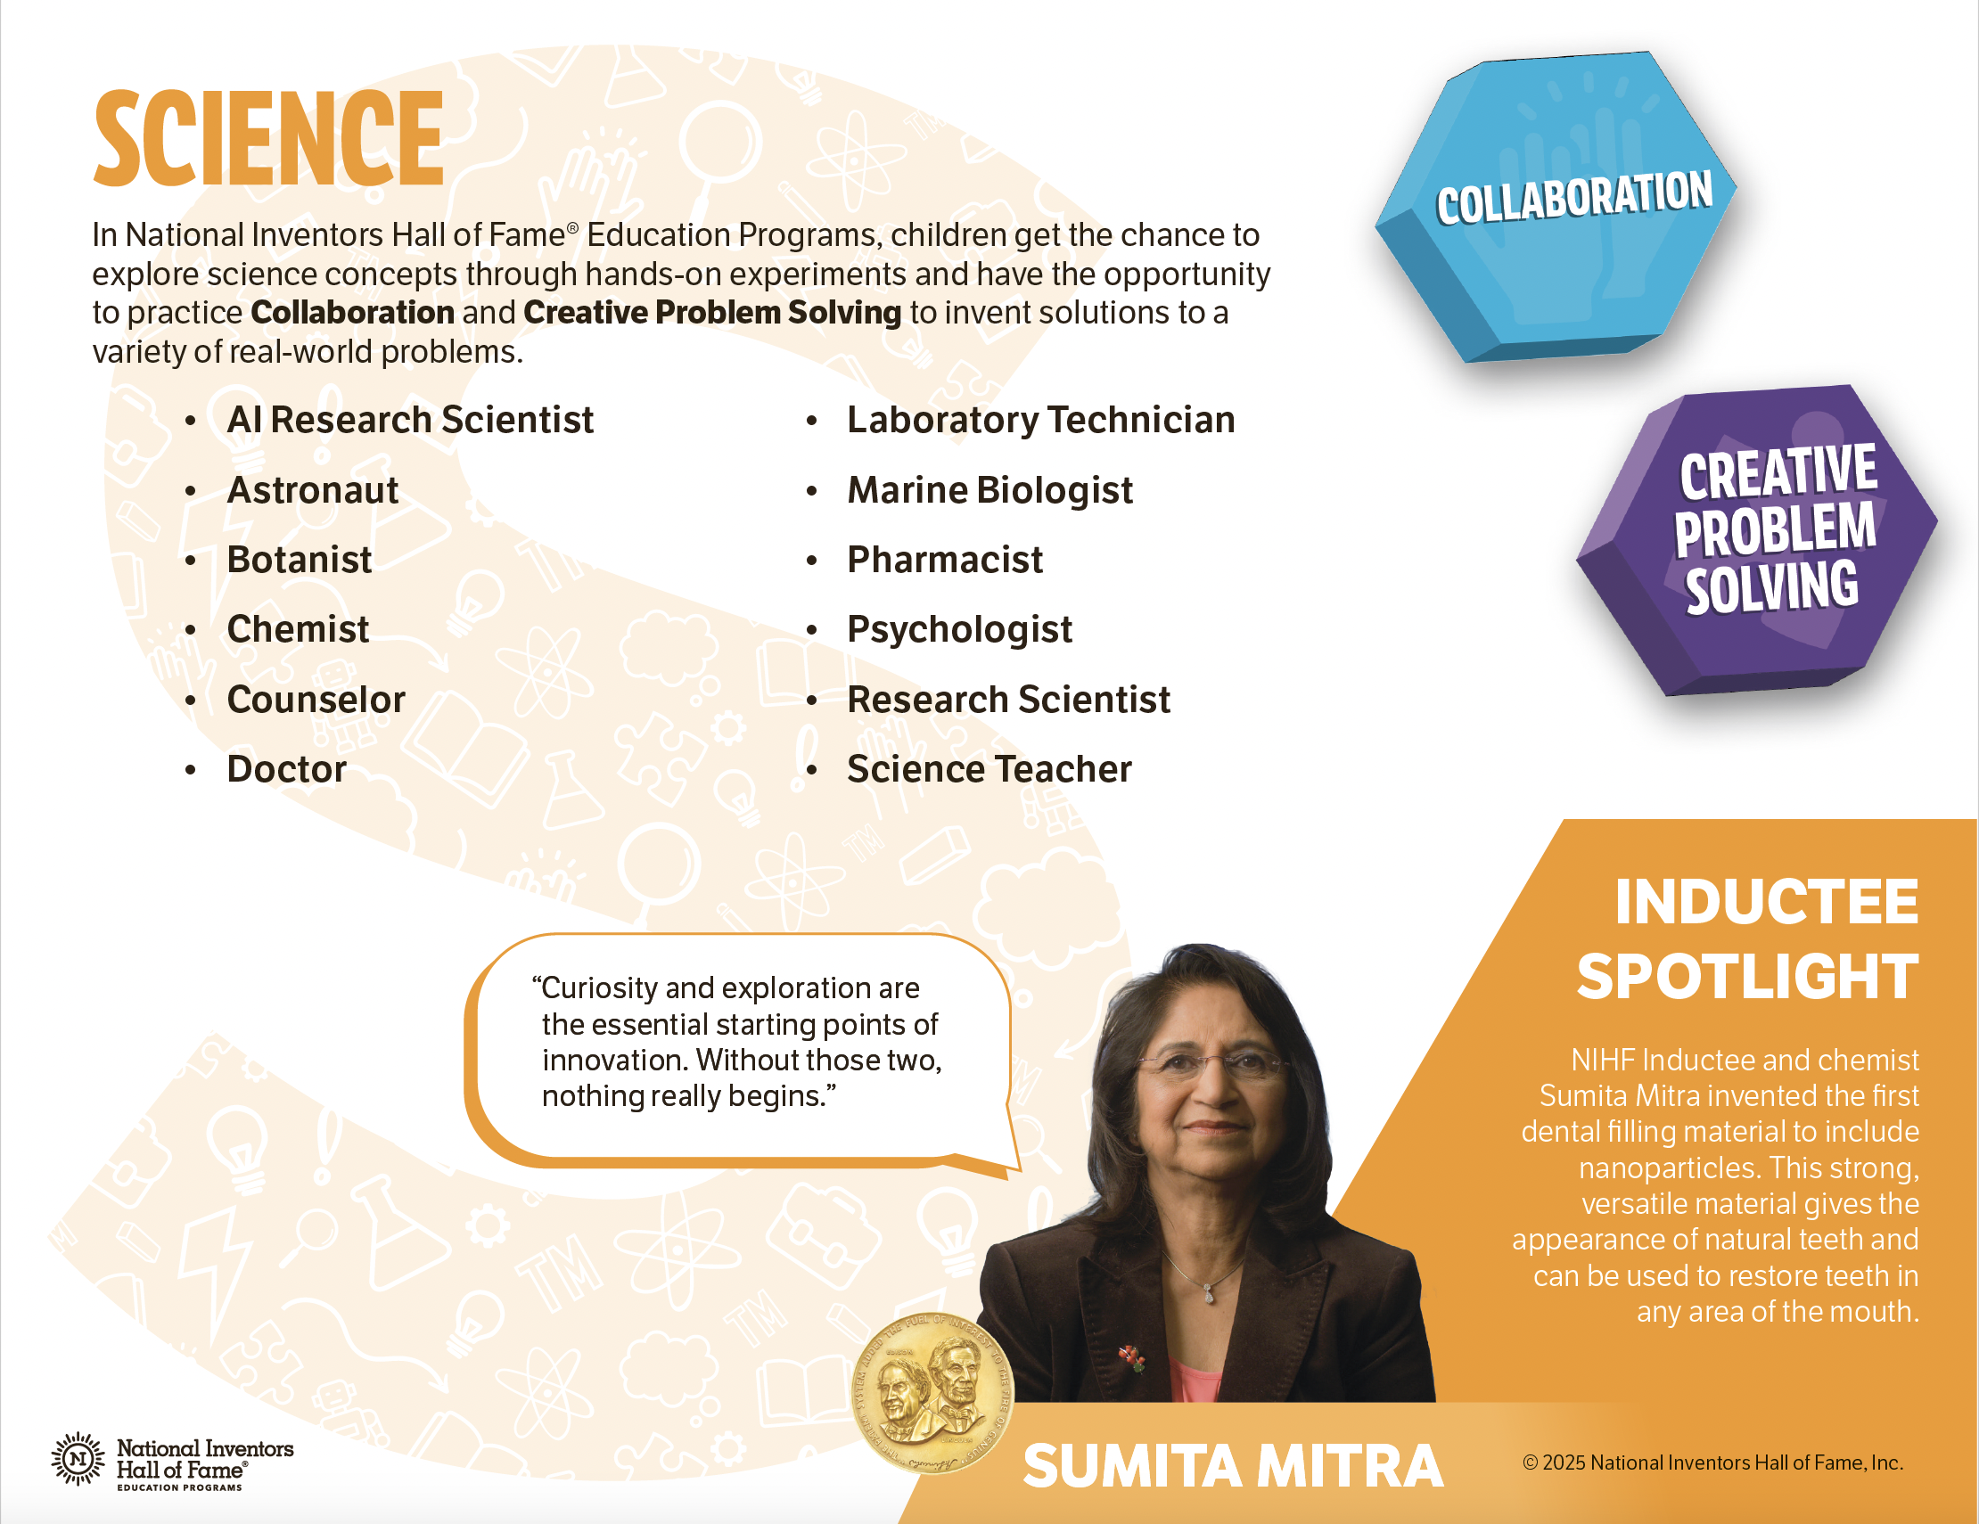
Career connections found in curricula and through our Inductees

Slide 3
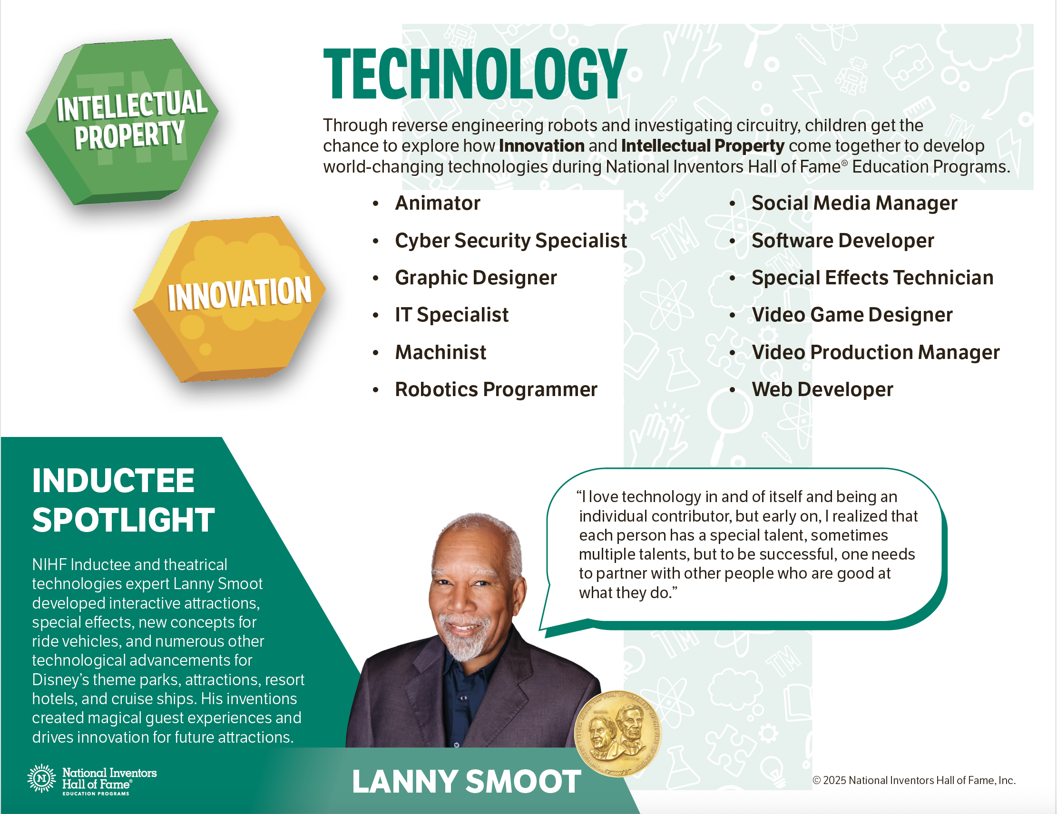

Slide 4
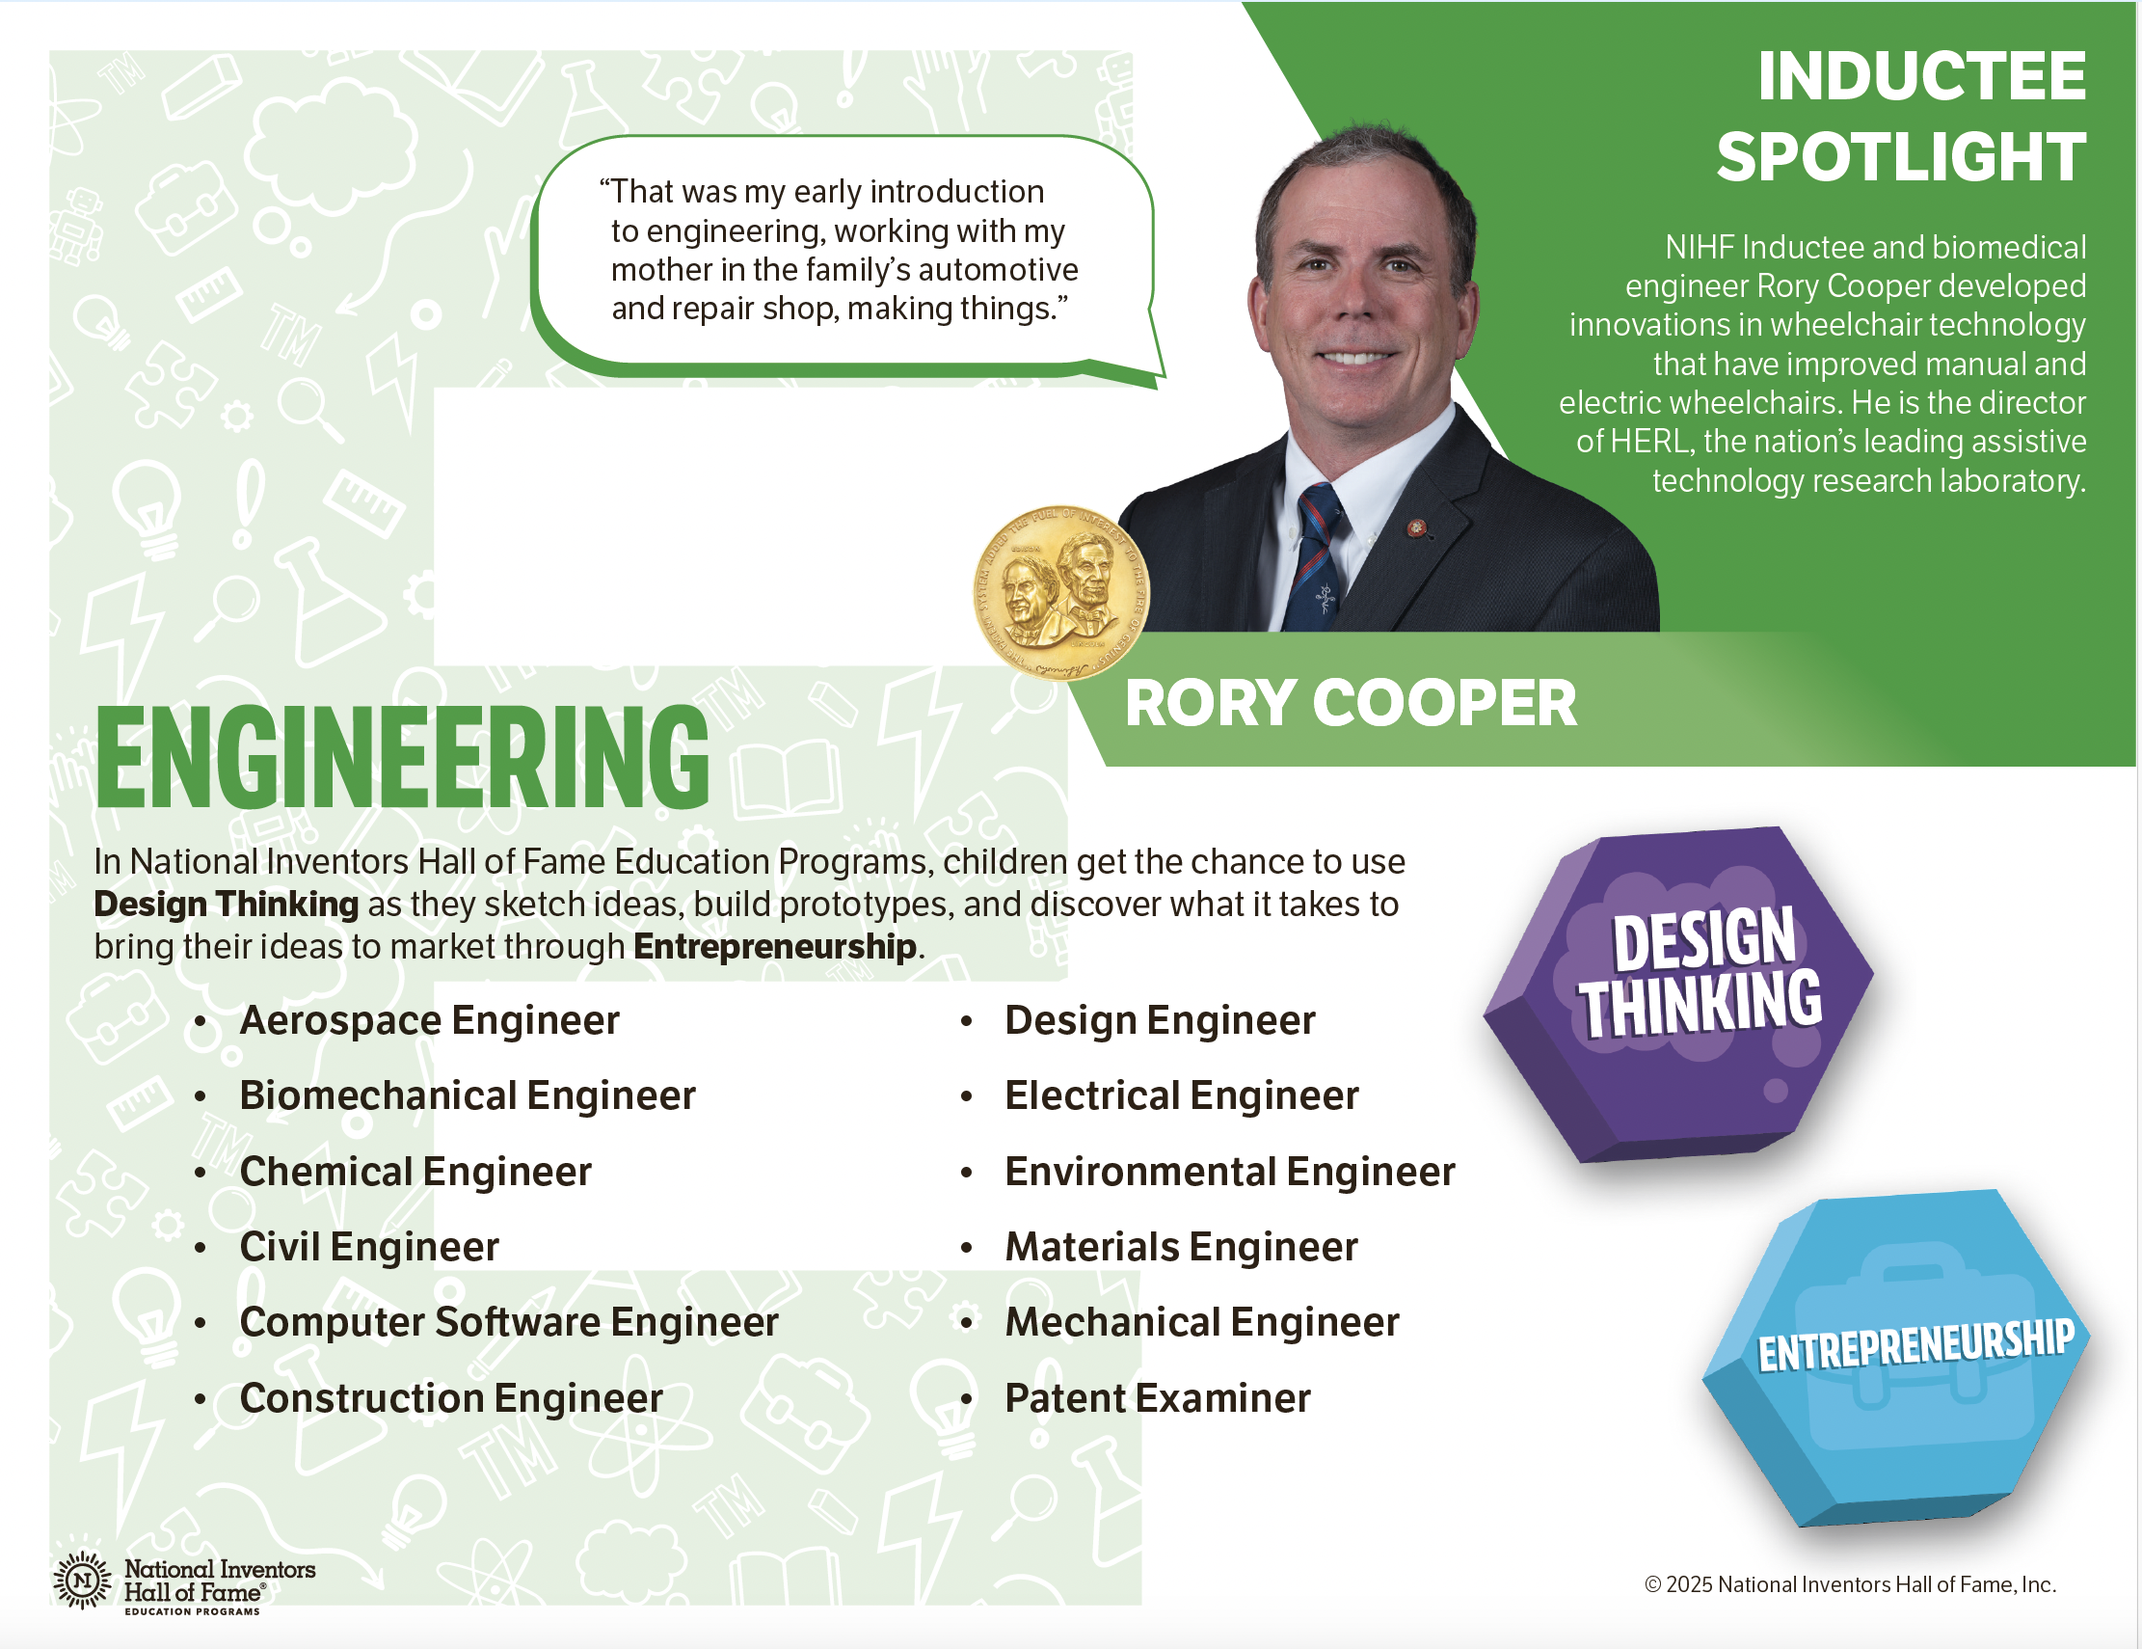

Slide 5
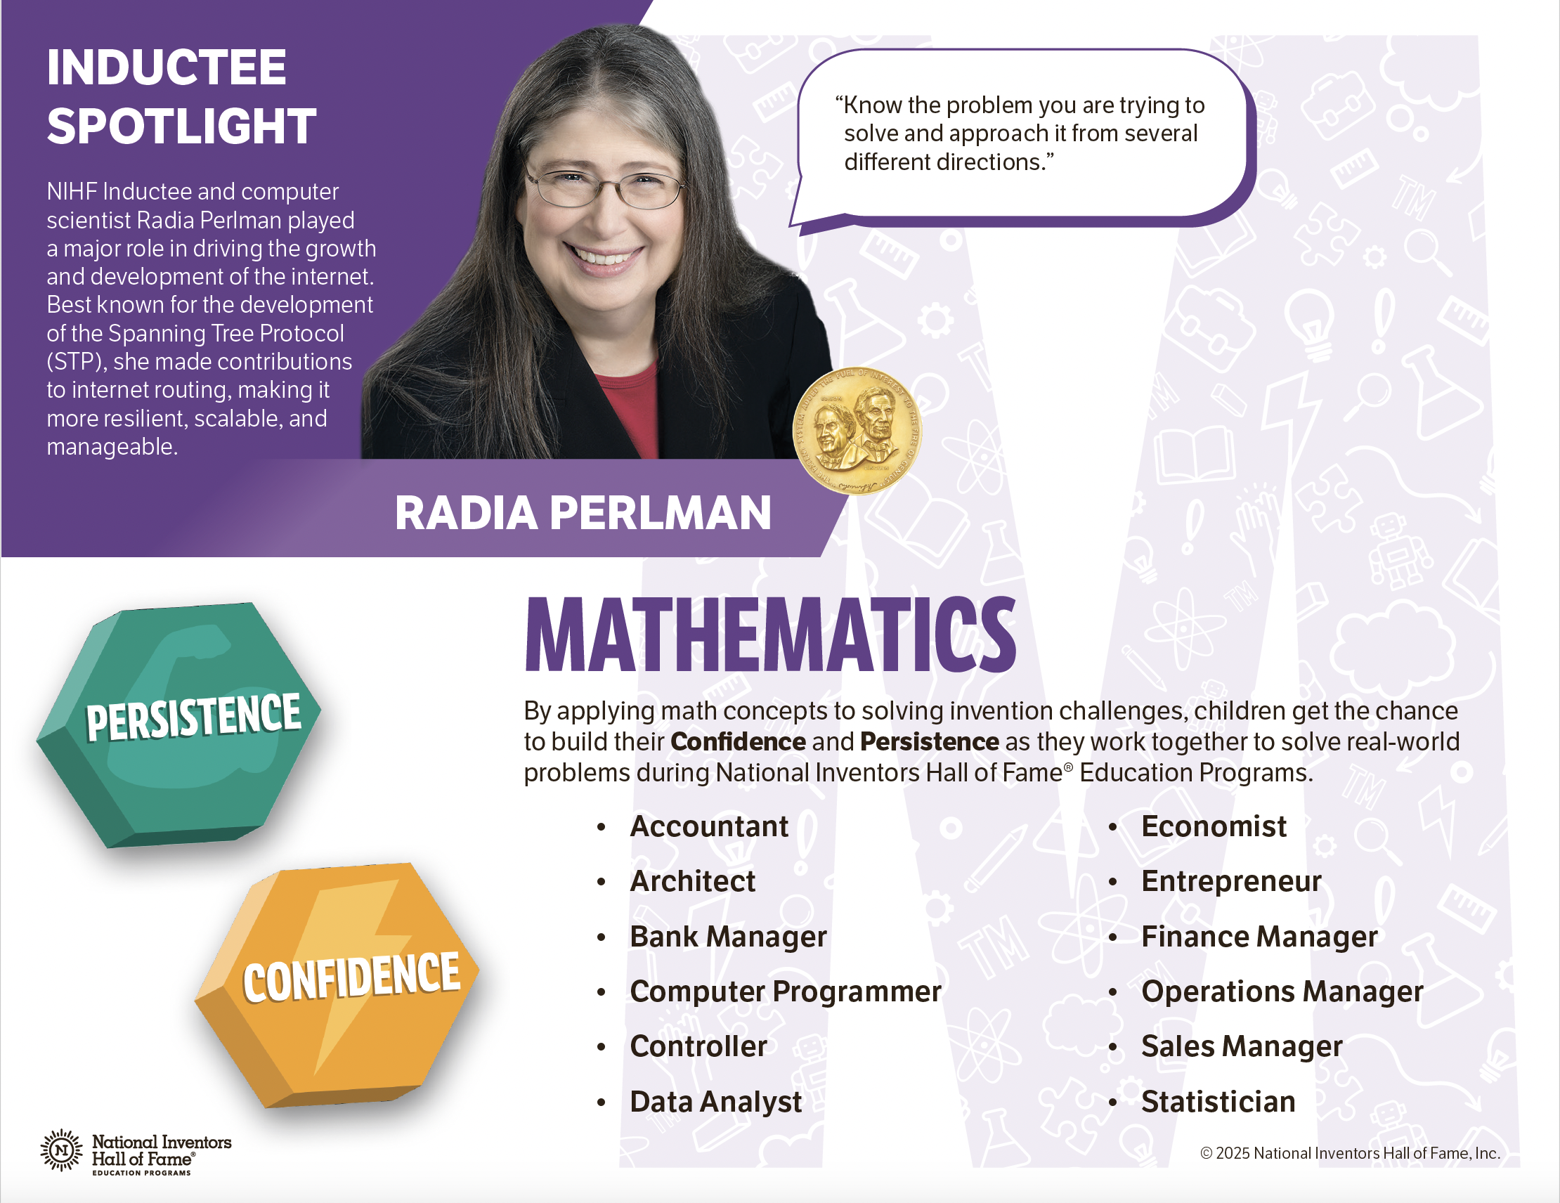

Slide 6
Workforce Development – RAND Survey Measures
The following are being added to the RAND student surveys to help us measure our impact on workforce development skills and STEM career interest.
WFD Skill: Problem Solving | I can think of different ways to solve a problem.
WFD Skill: Problem Solving | I think about what might happen before making a decision.
WFD Skill: Problem Solving | When I have a problem, I work to figure out a solution.
WFD Skill: Collaboration | I can appreciate opinions that are different from my own.
WFD Skill: Collaboration | I can help a group be successful.
WFD Skill: Collaboration | I can be a team player in a small group.
STEM Career Interest | I would like to have a job that uses STEM.
STEM Career Interest | I want to learn about careers that use STEM.

Slide 7
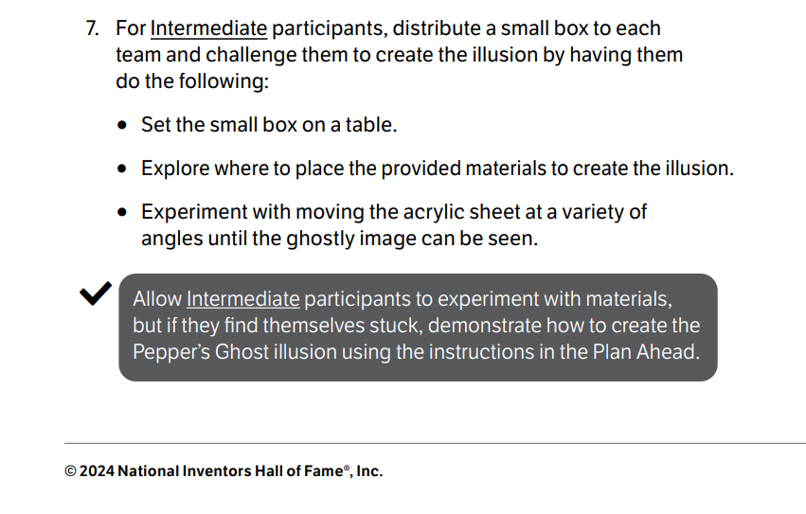

Durable Skills in NIHF Education Programs
Critical Thinking
Troubleshooting
Problem Solving
Illusion Workshop™
Let's Glow™
https://americasucceeds.org/what-we-do

Slide 8
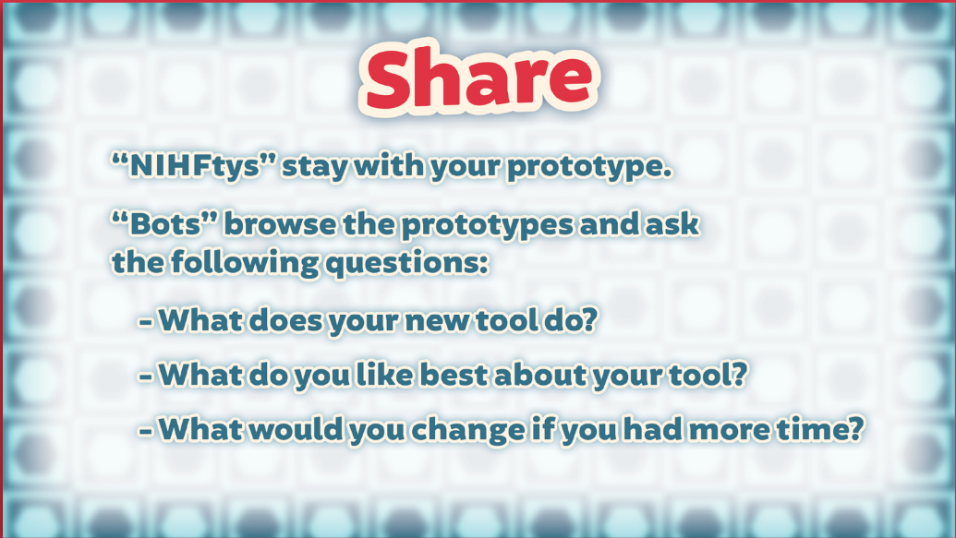

Durable Skills in NIHF Education Programs
Communication
Public Speaking
Verbal Communication Skills
Prototyping Studio™
Open Mic™

Slide 9

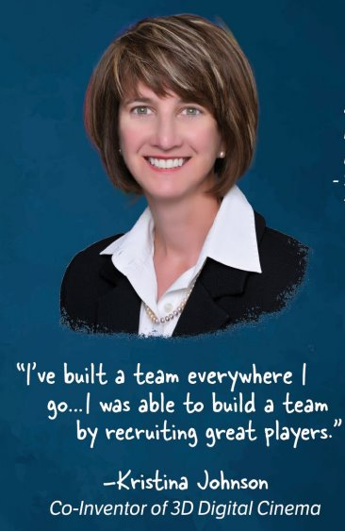
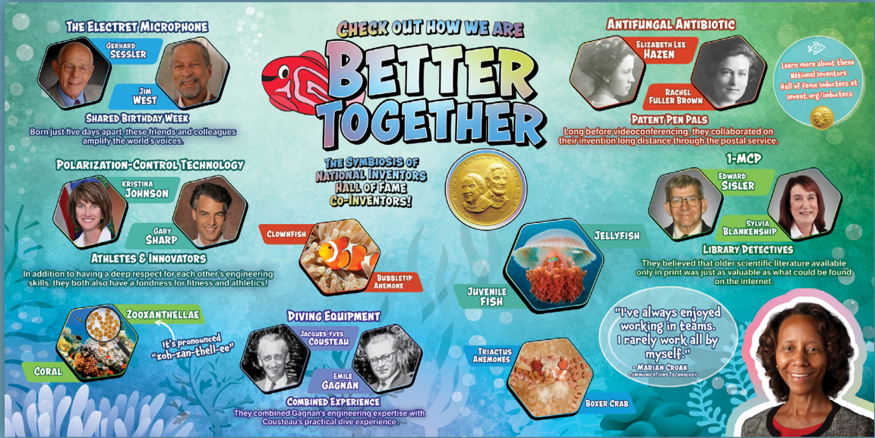
Durable Skills in NIHF Education Programs
Gadget Garage™
In The Game™
Collaboration
Teamwork
Team Building
Robotic Aquatics™

Slide 10
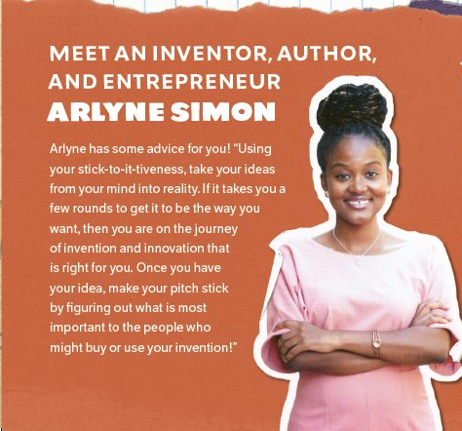

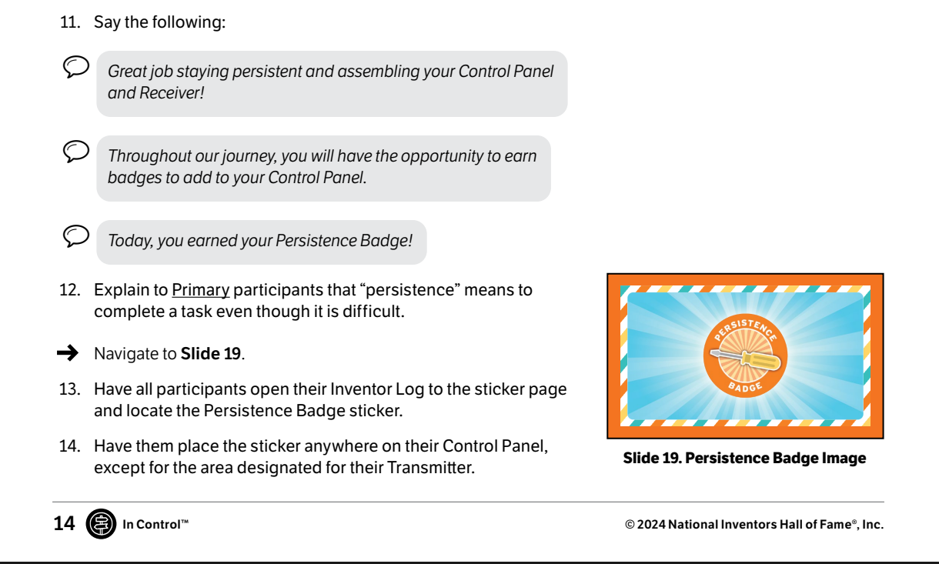
Durable Skills in NIHF Education Programs
Fortitude
Persistence
Resilience
Stuck!™
In Control™

Slide 11
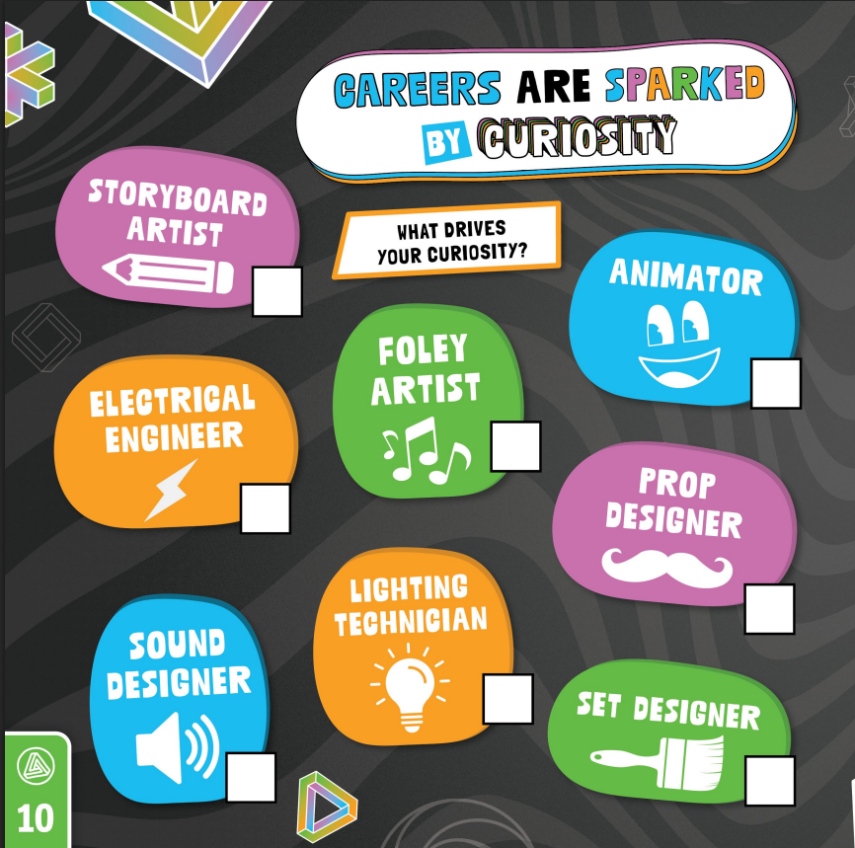

Durable Skills in NIHF Education Programs
Growth mindset
Curiosity
Entrepreneurship
Illusion Workshop™
Make Waves™

Slide 12

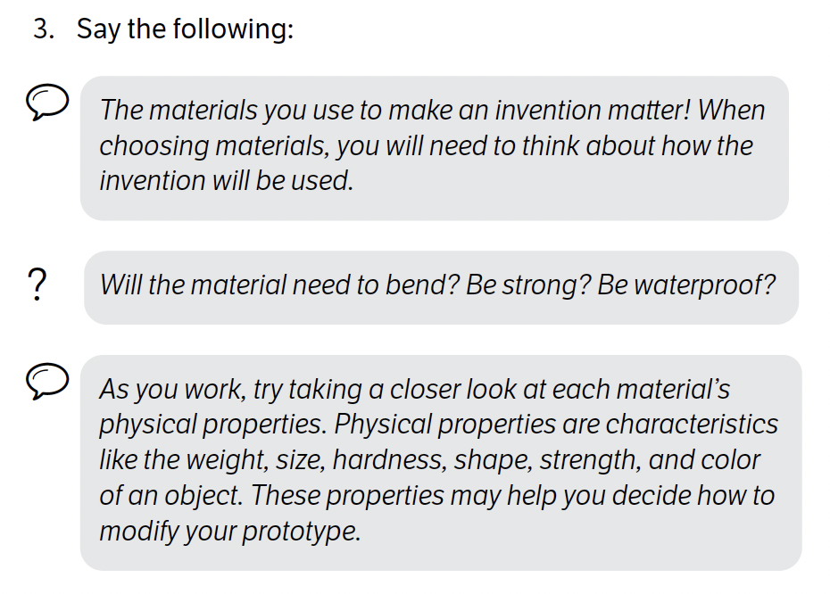


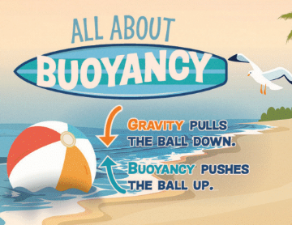
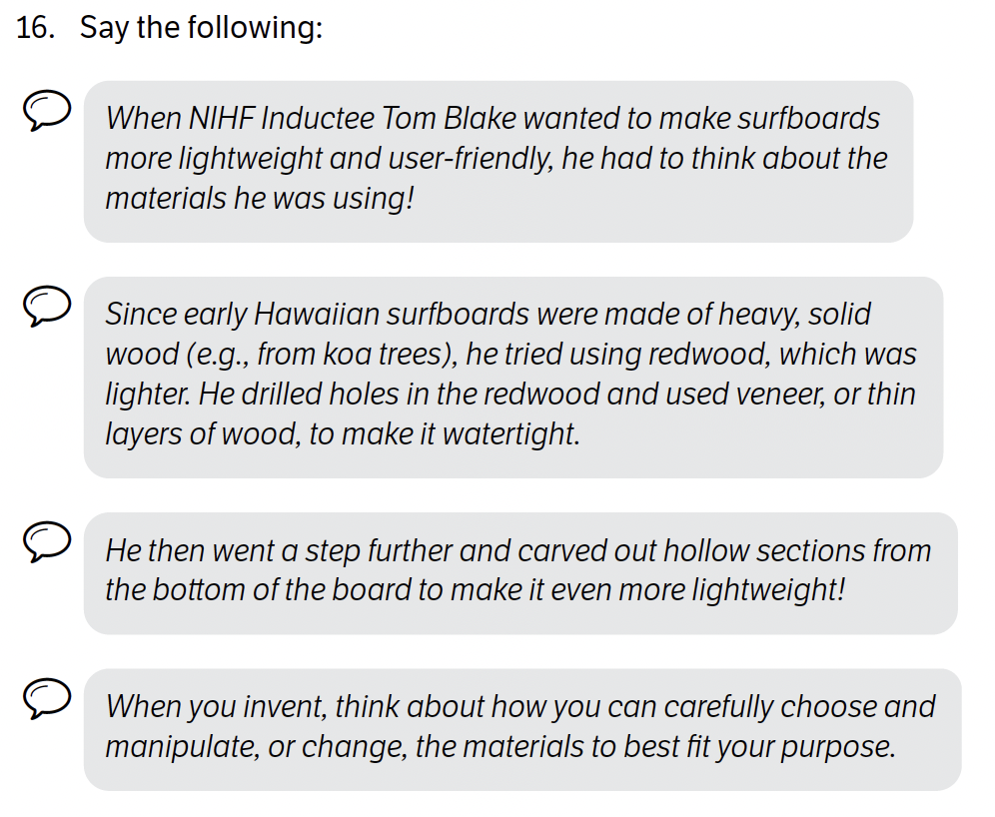
Materials Science

Slide 13
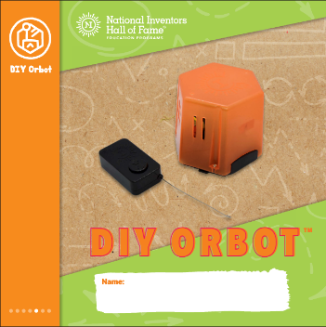

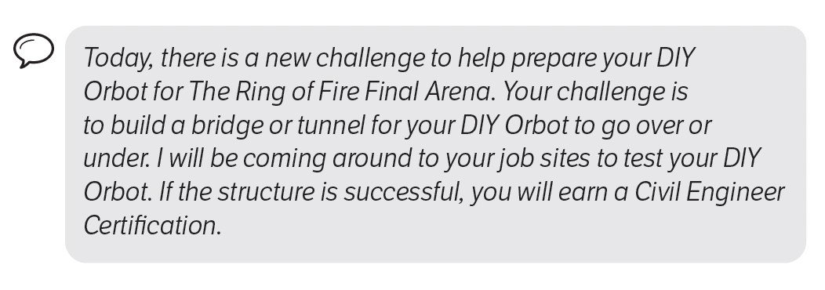

Engineering

Slide 14
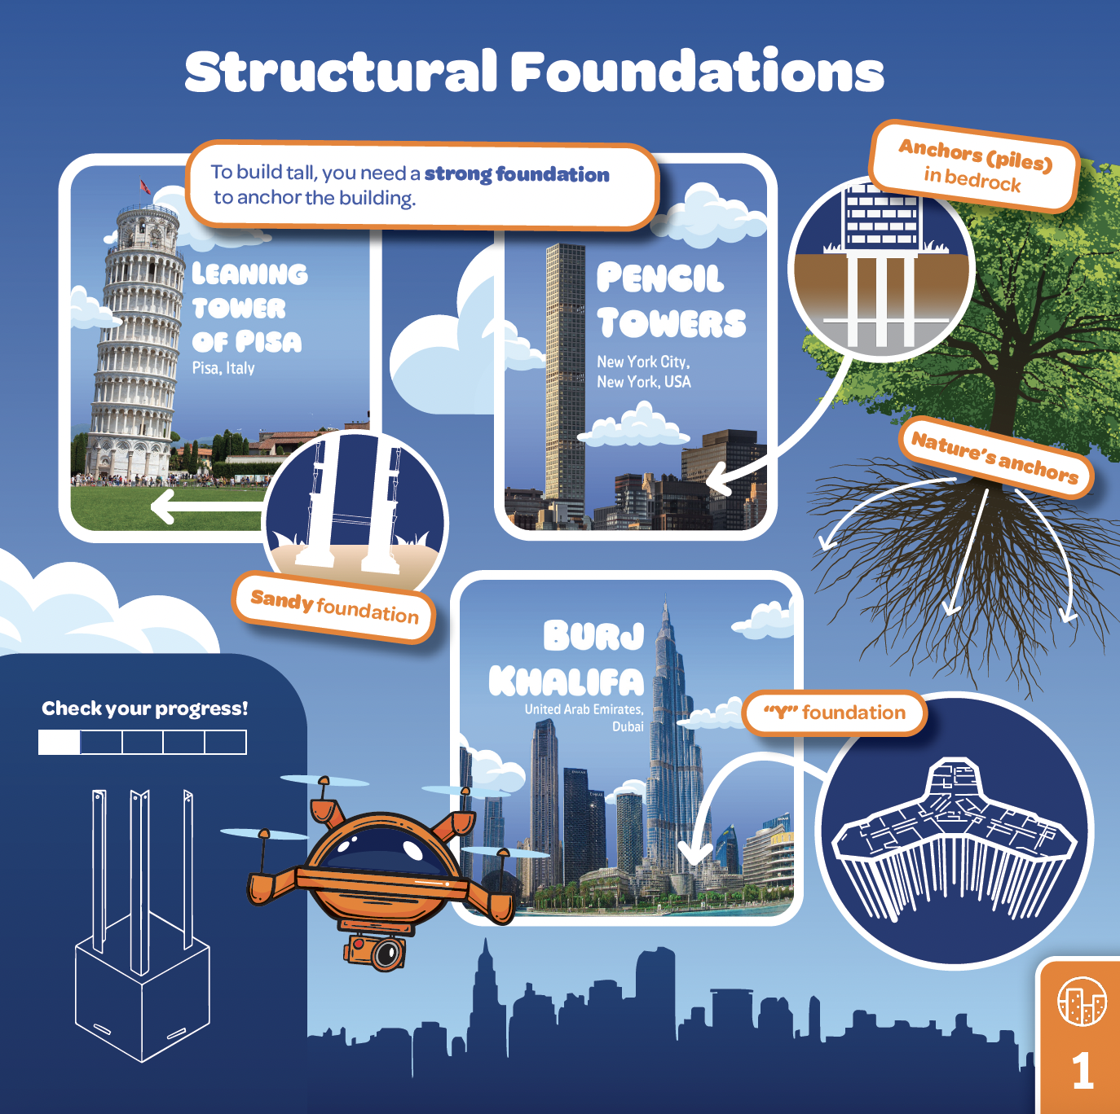
Engineering
New Heights™
Children reach for new heights as they discover what it takes to design and engineer buildings that touch the sky! Inspired by innovative architecture and materials technologies, participants construct, test, and modify a sustainably built superstructure. Children lay the foundation and look below the surface, being guided by nature and load-bearing systems. After investigating buildings around the world, participants refine and strengthen their superstructure. As they near the top, children assemble a construction elevator and lift materials to finish the interior and exterior design. With their newly built confidence, participants present their unique architectural superstructure during a Real Estate Tour where they give the ultimate elevator pitch, showcasing their building’s structural soundness, clever and eco-friendly design solutions, and smart features.

Slide 15
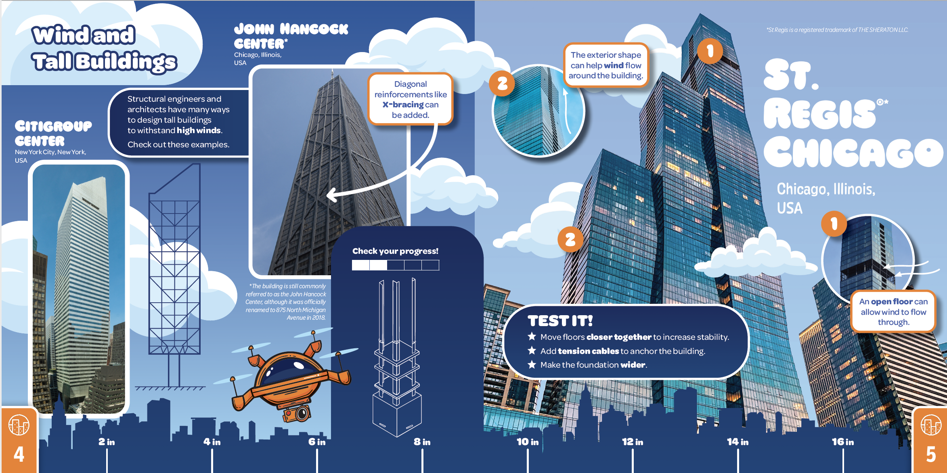
Engineering
New Heights™

Slide 16
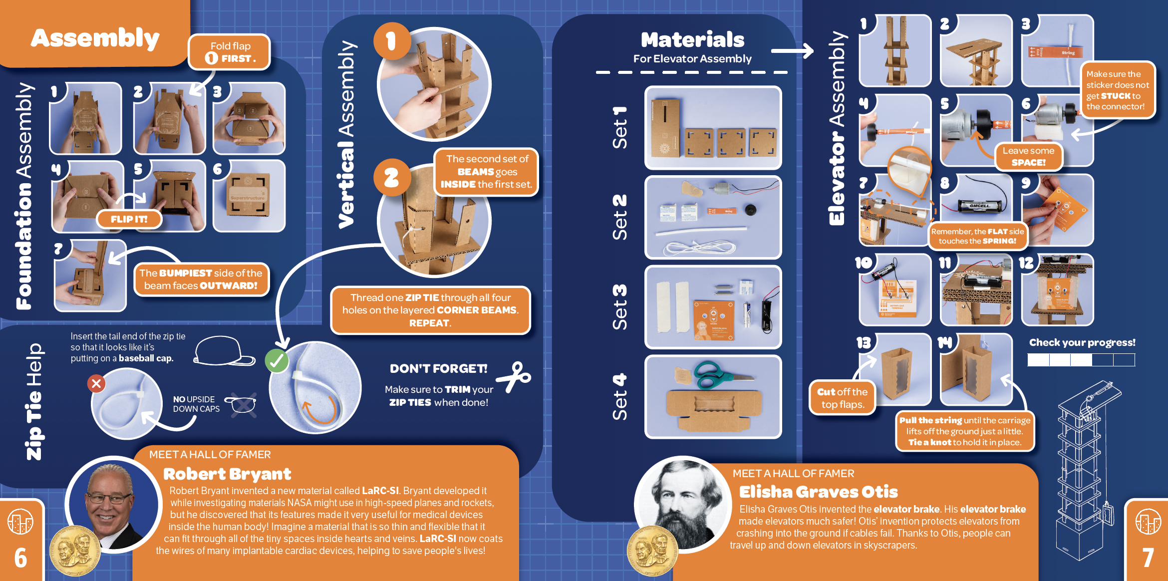
Engineering
New Heights™

Slide 17
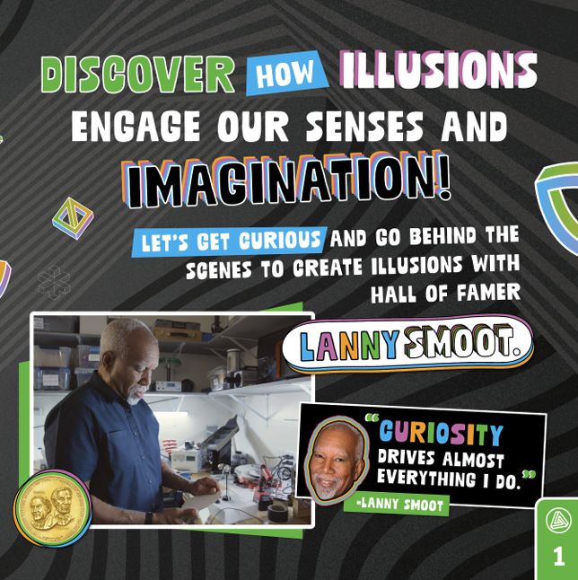
Engineering
Illusion Workshop™
Children discover the mesmerizing world of illusions, where things are not always as they appear! Through hands-on activities and experiments, they go behind the scenes of the tech tricks used in theme parks, animated films and theater. Guided by illusion expert and National Inventors Hall of Fame Inductee Lanny Smoot, children explore the science behind special effects —from reflection to refraction to visual perception — and meet additional inventors whose technology immerses the senses and imagination. Using design and electrical engineering skills, participants build an animation device called a Spin-o-scope™ to bring drawings to life. Children hone their storytelling skills by creating their own movable prop and dabble in Foley techniques to generate sound effects. By the end of the experience, participants become illusion experts and discover a variety of careers connected to the next wave of crafting innovative entertainment experiences.

Slide 18
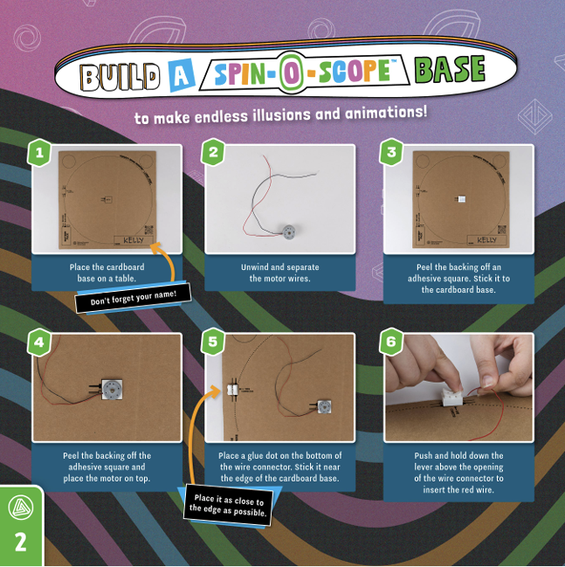
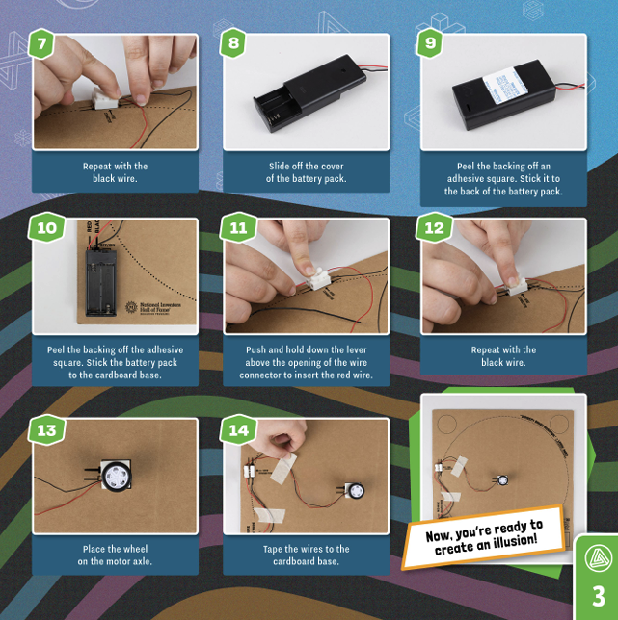
Engineering
Illusion Workshop™

Slide 19
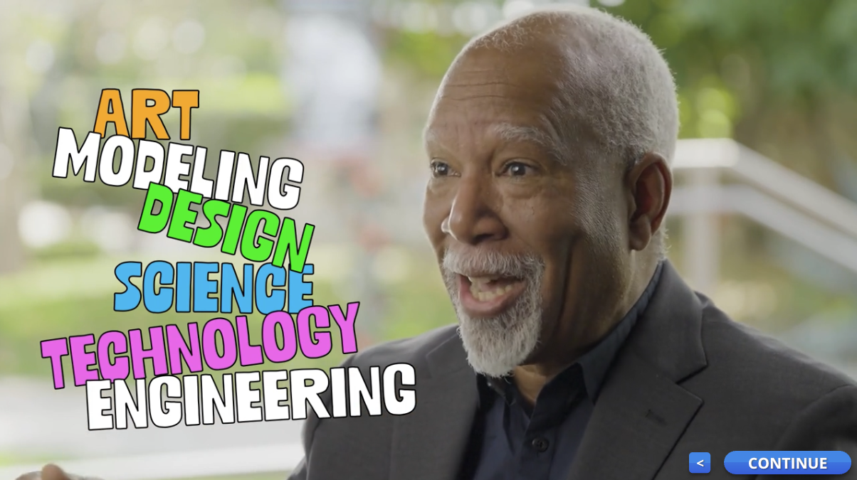
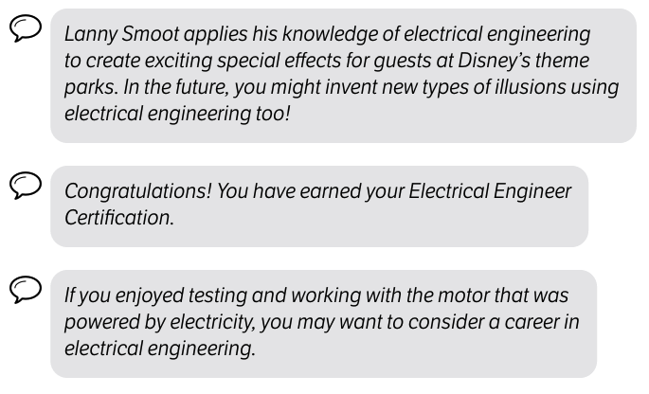
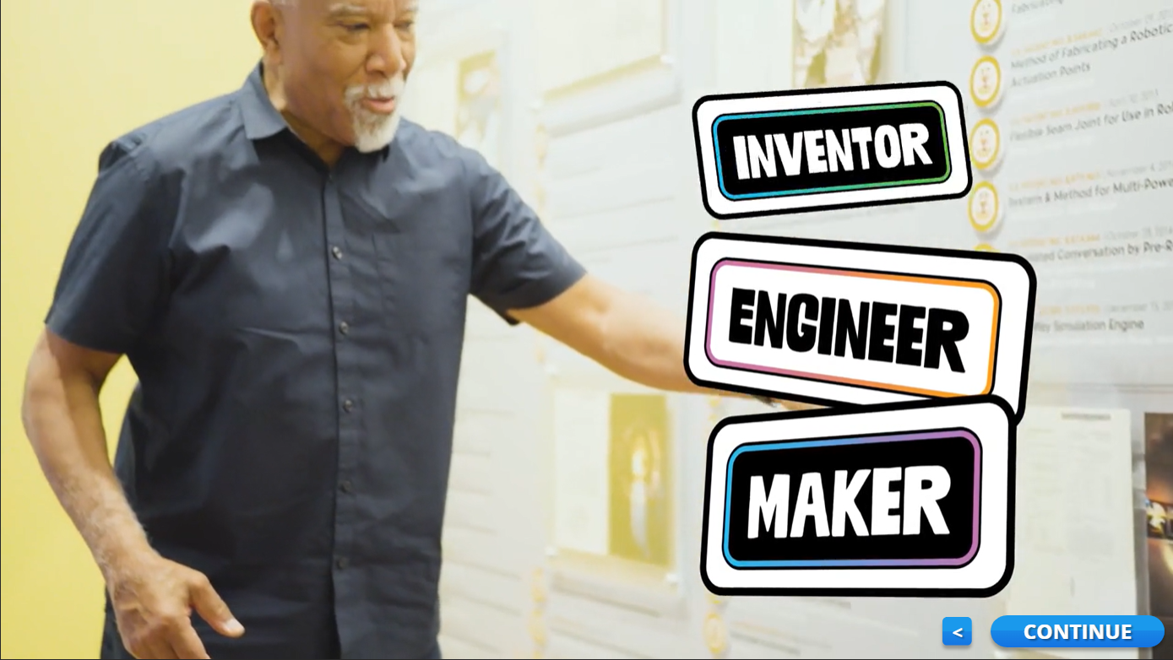

Engineering
Illusion Workshop™
"When I was young, my dad exposed me to electricity, and a little bit of electronics, and I began to look to see what career allows you to do electronics all the time. And I finally understood that it was an electrical engineer that can do that.”
—Lanny Smoot, National Inventors Hall of Fame Inductee, featured in Illusion Workshop™

Slide 20

Biotechnology
Lets Glow™ Bioluminescence Video

Slide 21

Biotechnology
Lets Glow™ How Gary Got His Glow Video

Slide 22


Biotechnology
Lets Glow™

Slide 23
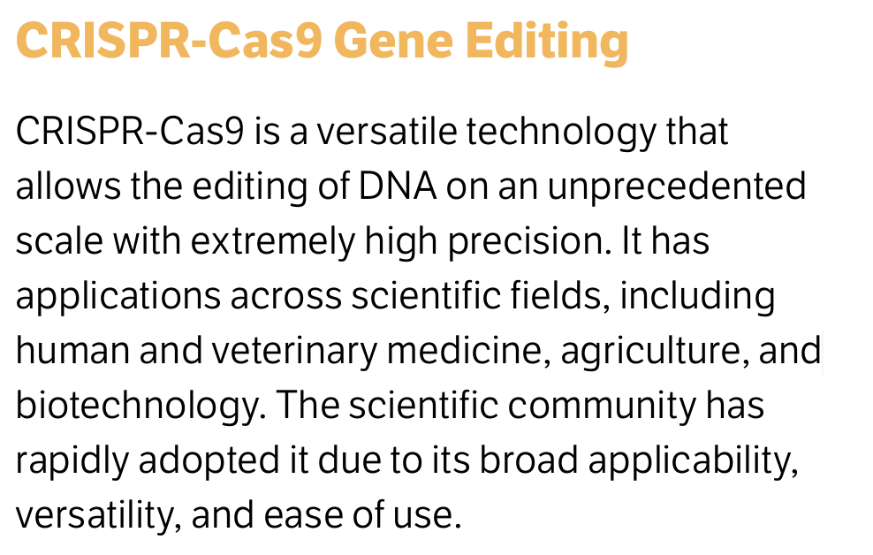
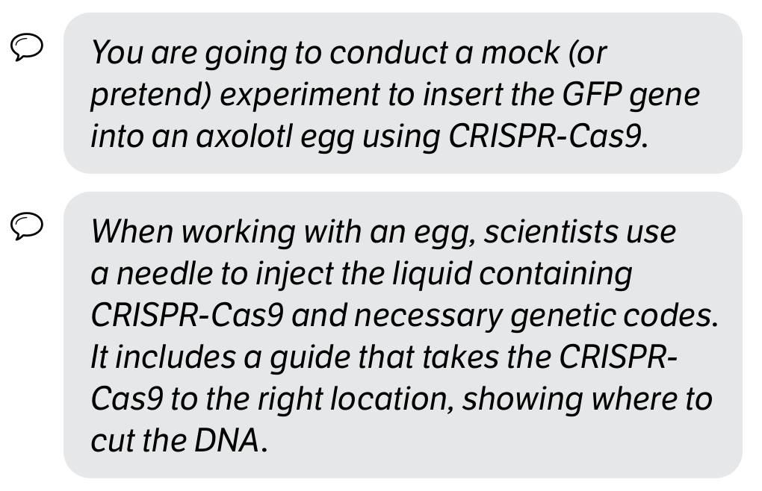
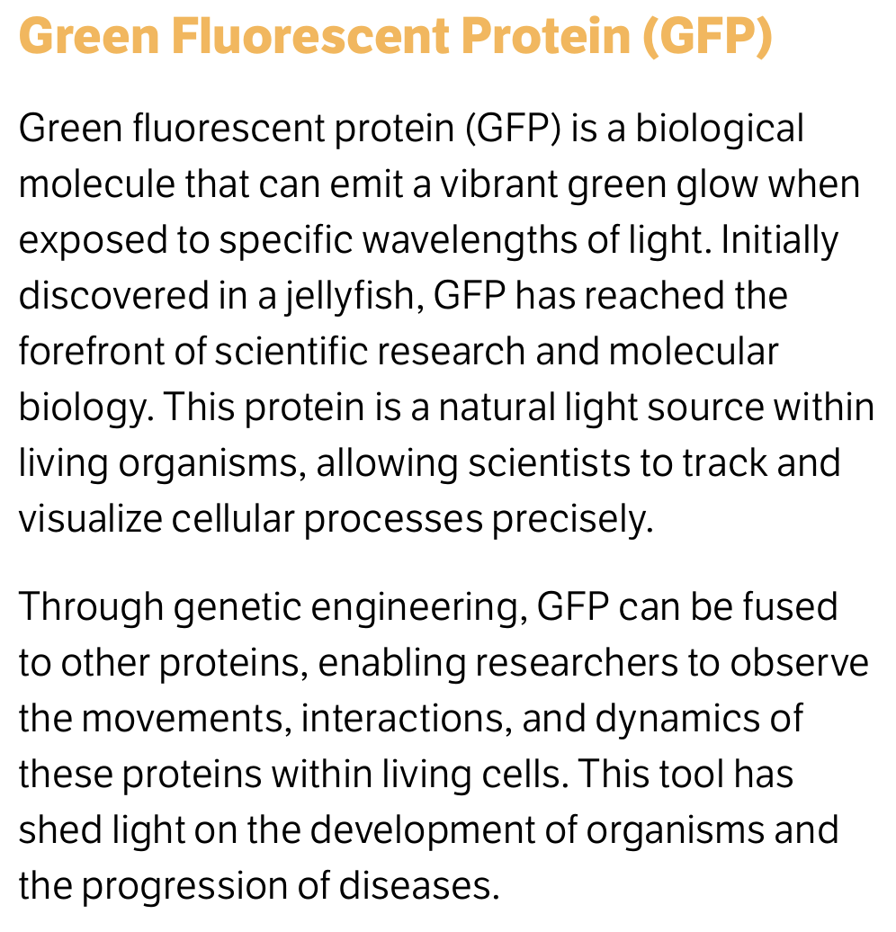

Biotechnology
Lets Glow™

Slide 24
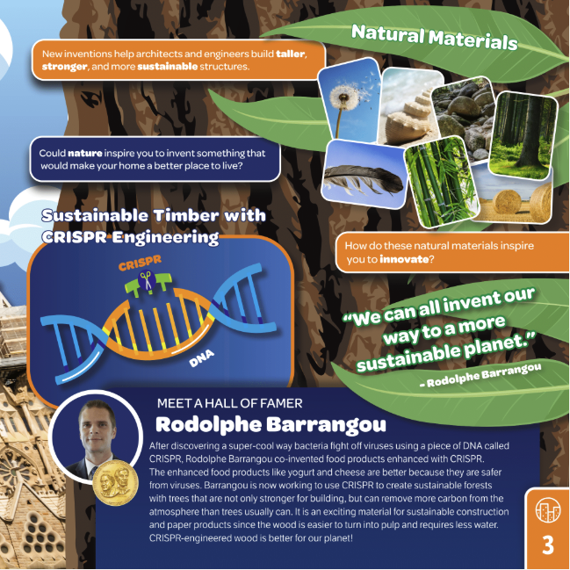
Biotechnology
"National Inventors Hall of Fame Inductee Rodolphe Barrangou has been working to apply new technologies to make forests even more sustainable, and wood even more beneficial for building construction and removing carbon from the environment."
—Video Voiceover from New Heights™
"The biggest genome on planet Earth is trees. There's some trees that have genomes that are 10 times bigger than our own genome. So that's my next challenge ... I want to try to use my CRISPR knowledge and expertise to build a more sustainable forest."
—Rodolphe Barrangou, National Inventors Hall of Fame Inductee, featured in New Heights™

Slide 25

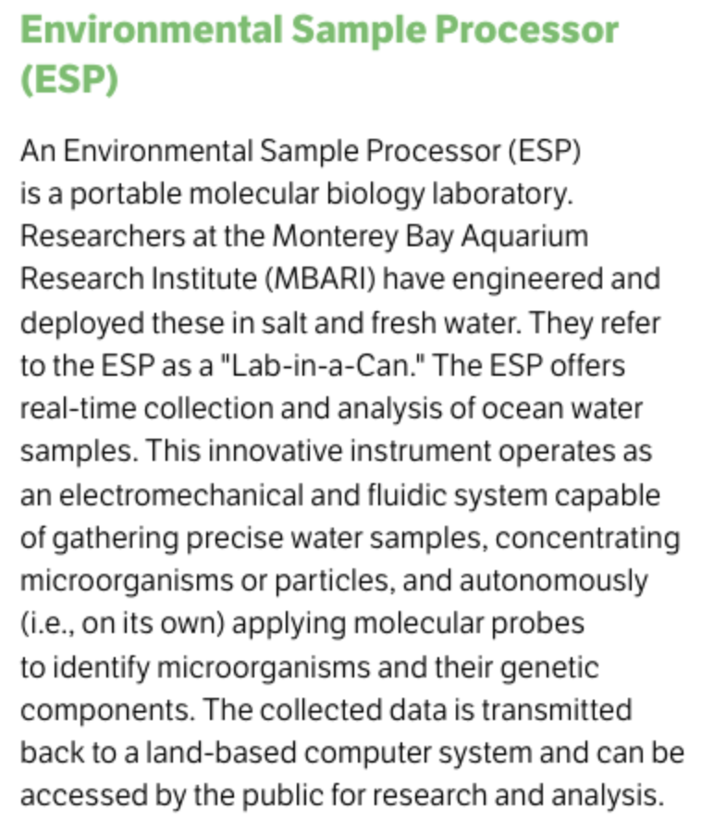
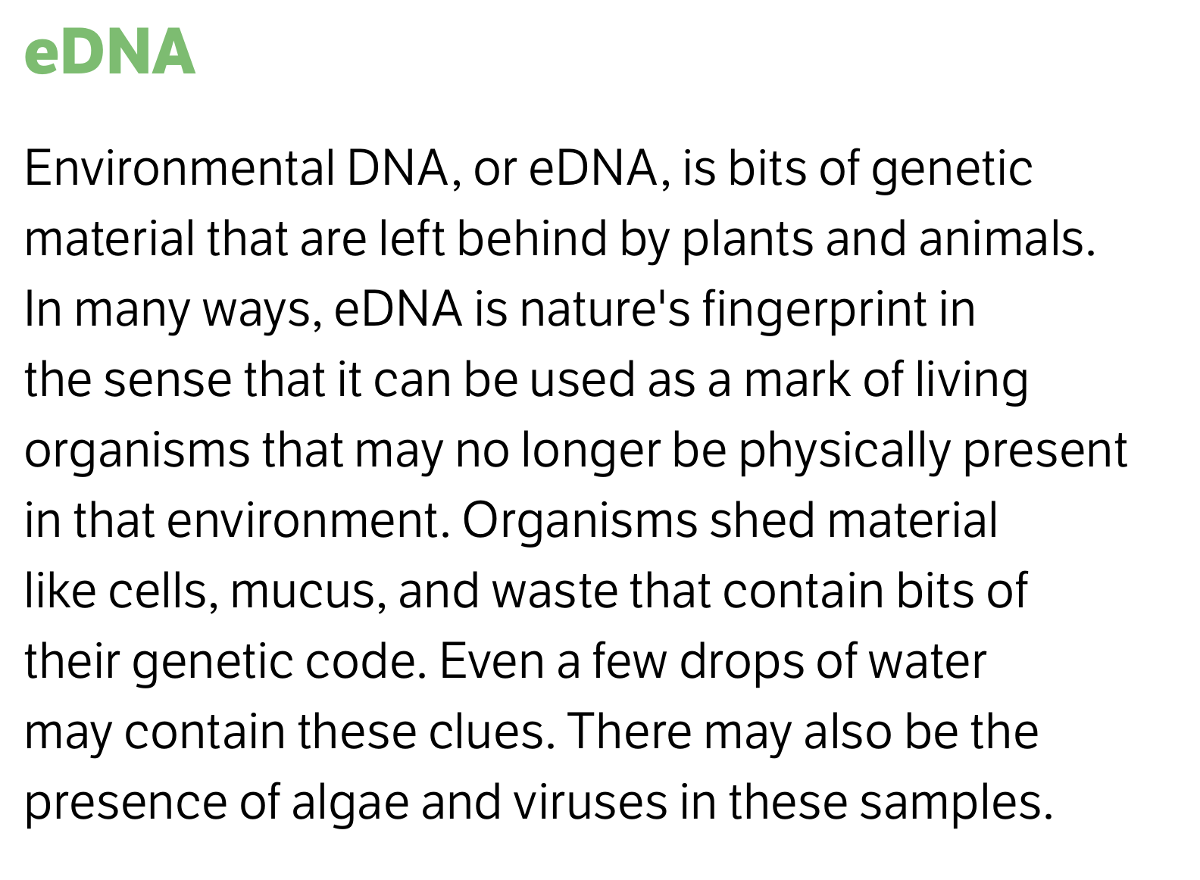
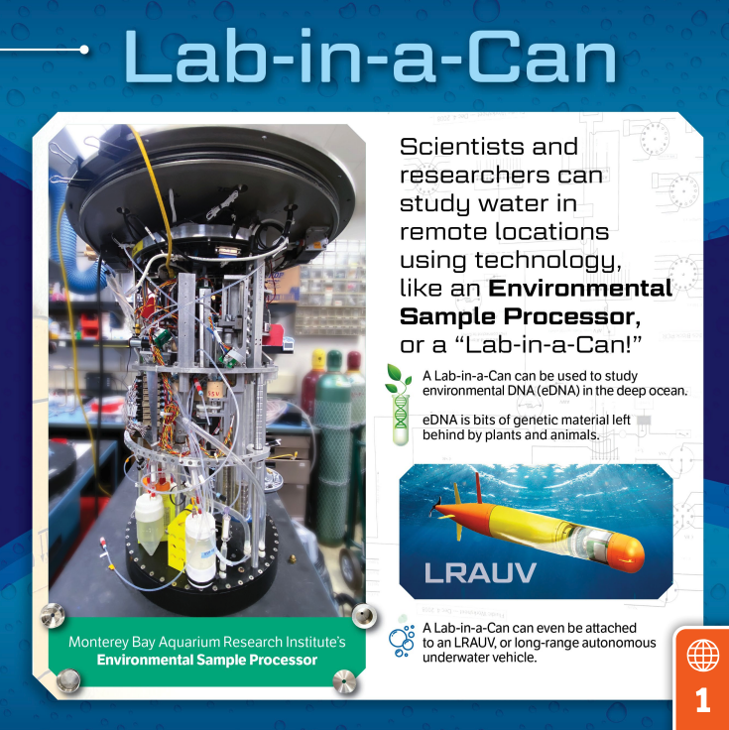
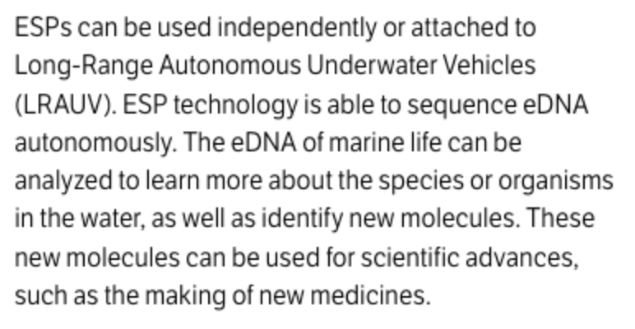
Biotechnology

Slide 26

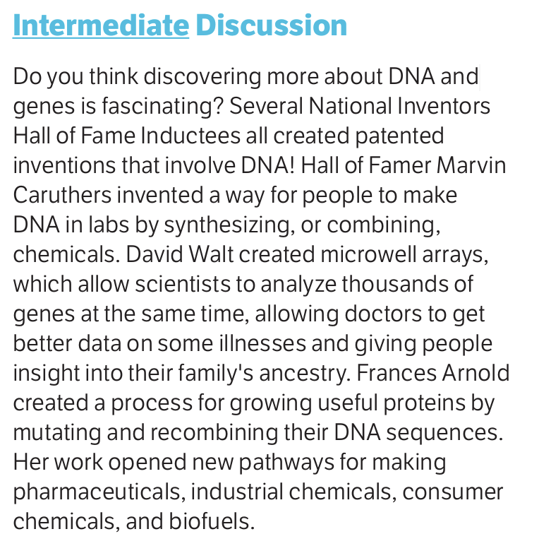

Biotechnology

Slide 27
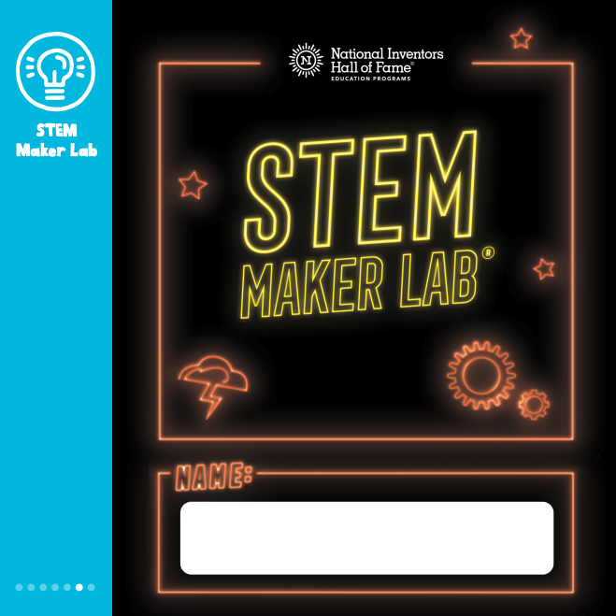
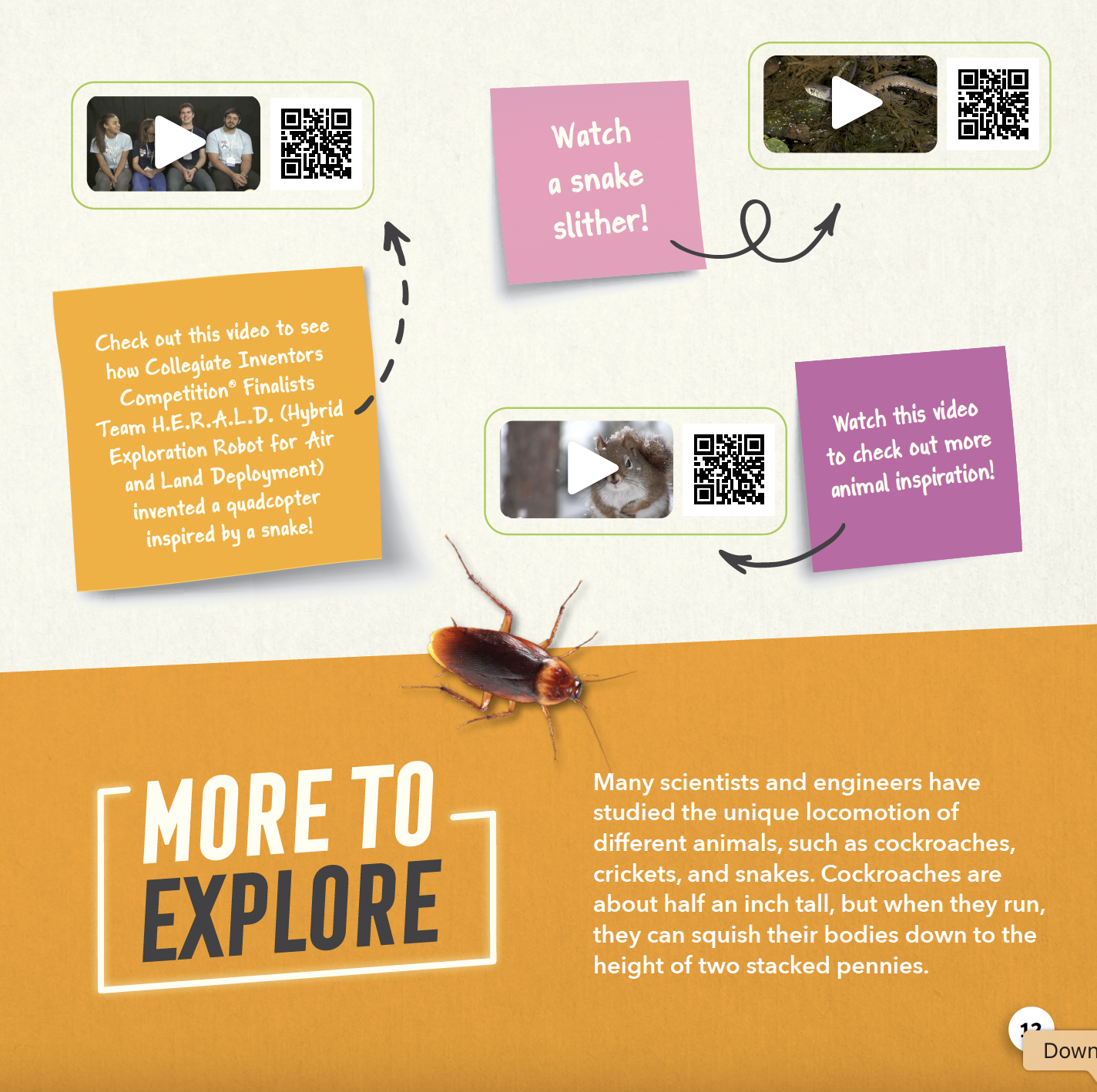

Biotechnology

Slide 28
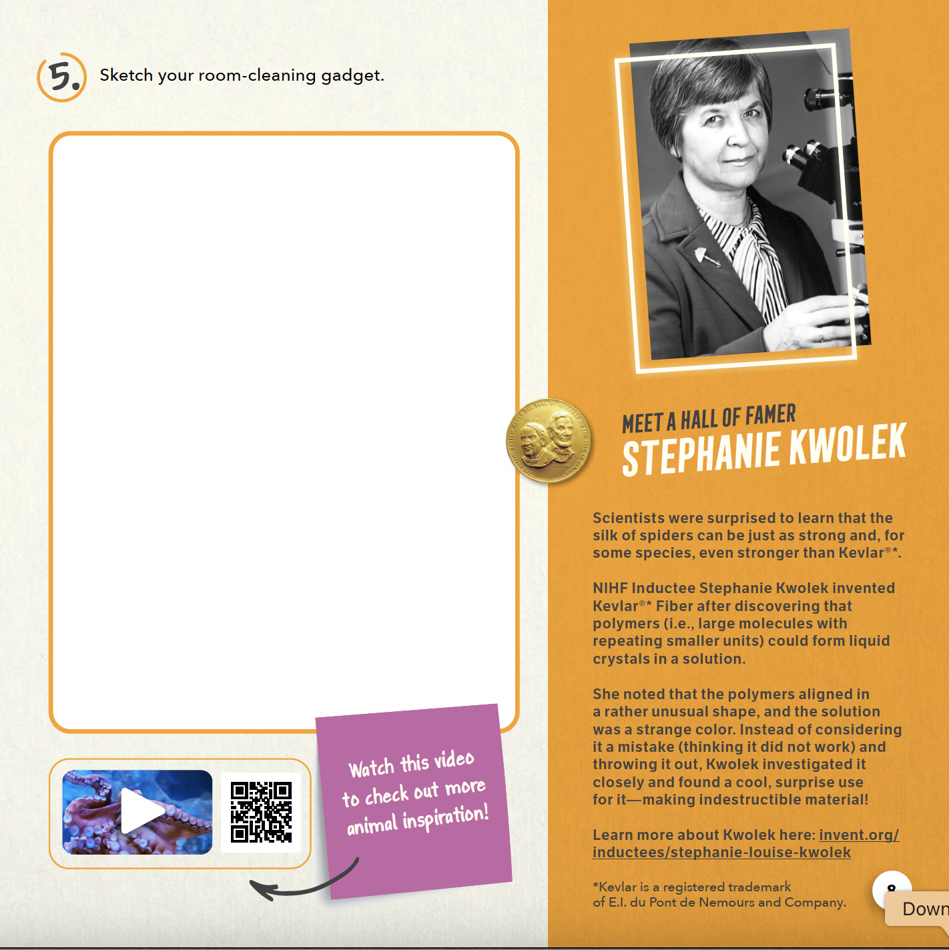

Biotechnology

Slide 29

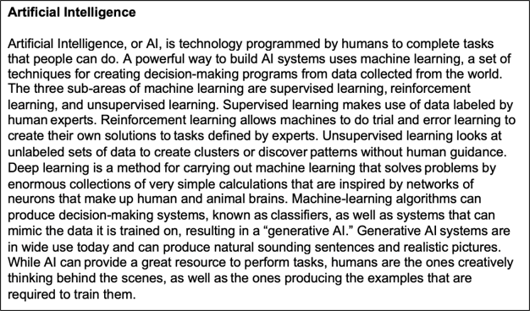
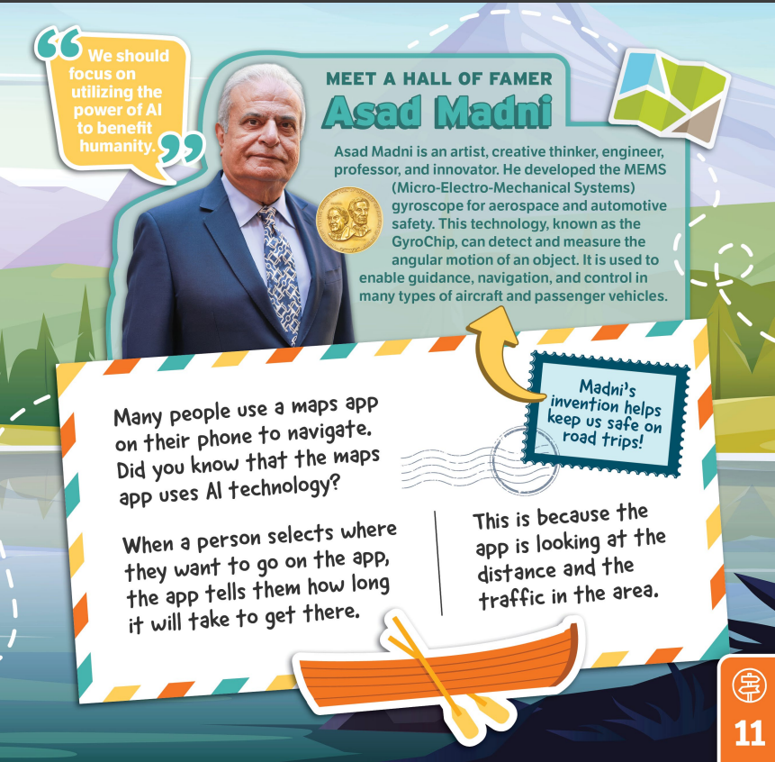
Artificial Intelligence

Slide 30
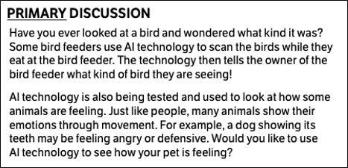
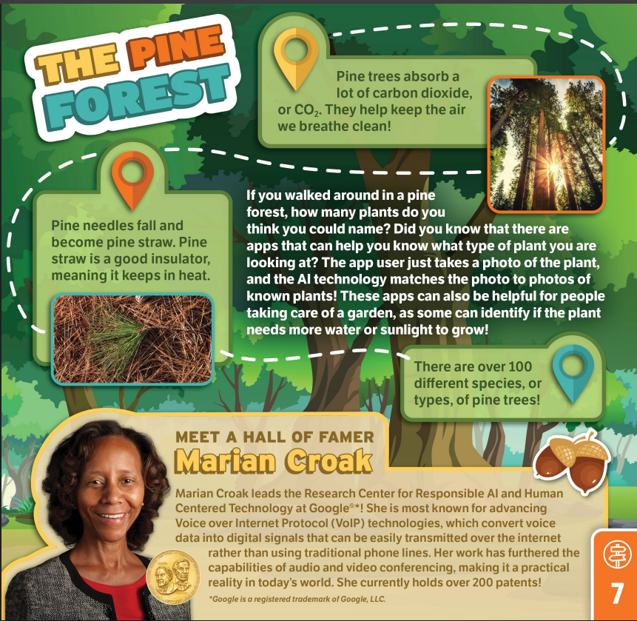
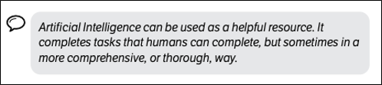
Artificial Intelligence

Slide 31
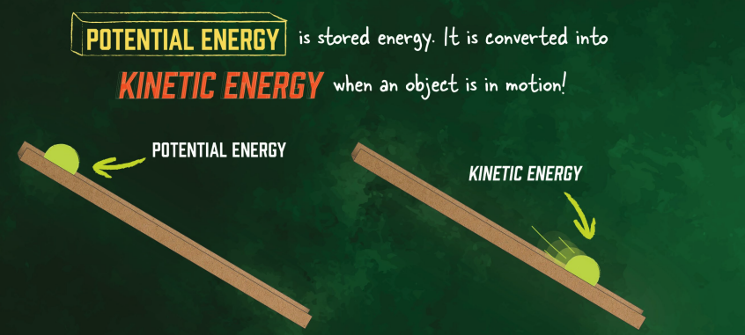
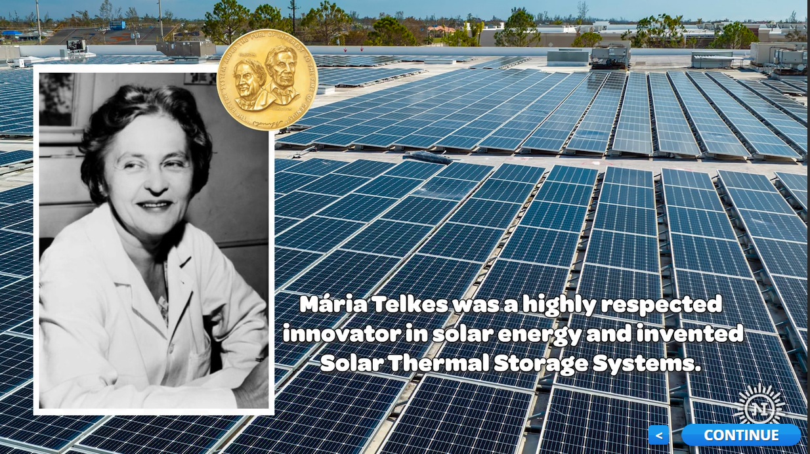
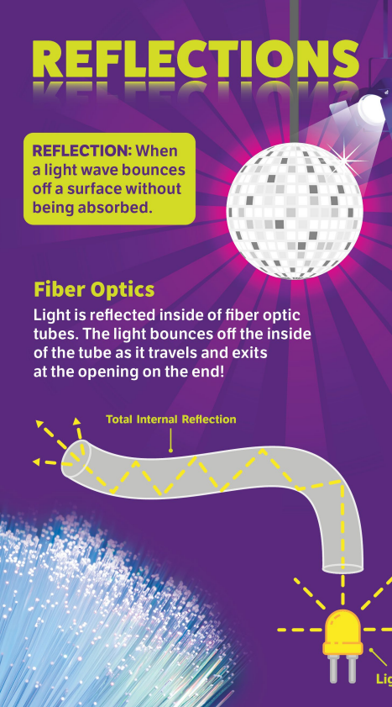
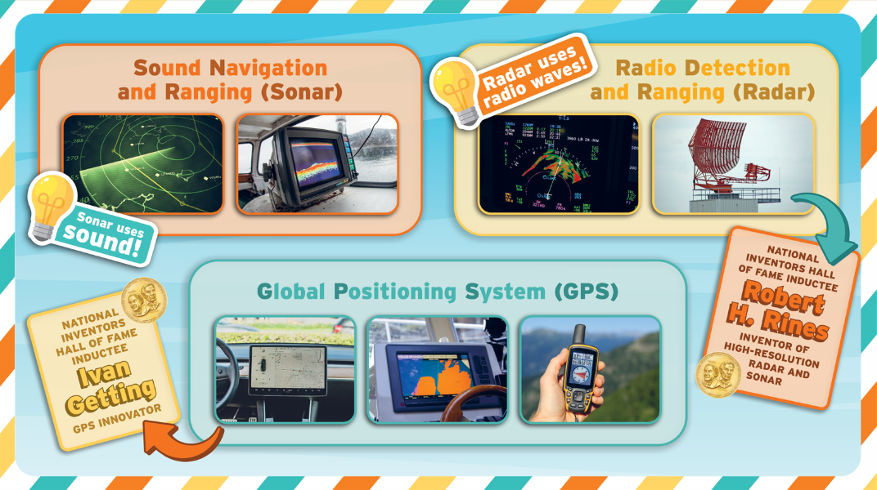

Energy
In the Game™
New Heights™
Let's Glow™
In Control™
Road Rally™

Slide 32

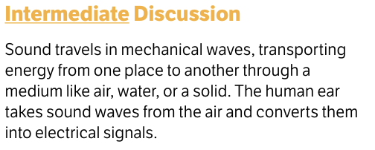

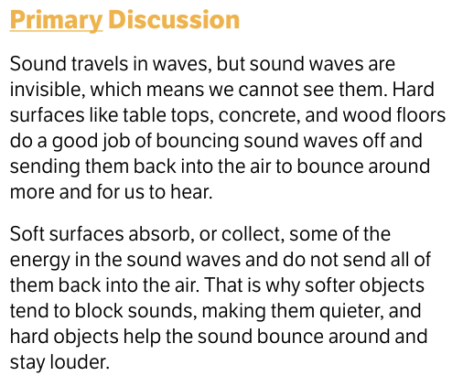
Energy

Slide 33
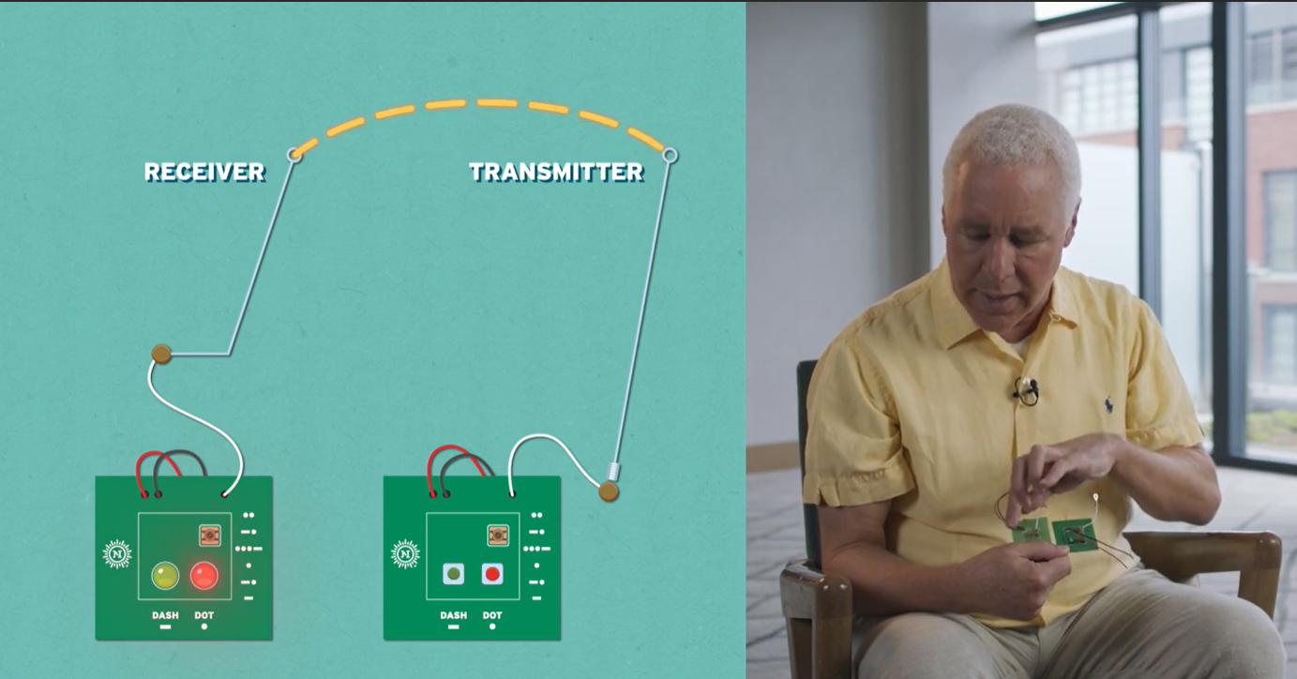
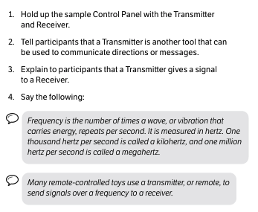
Energy
"We power up the transmitter and the receiver with a battery. And when we press one of these buttons, a signal pulses through the antenna, through the air, to this antenna which receives the signal. And its amplified, and it causes the lights to go on and off..."
— Robert Bryant, National Inventors Hall of Fame Inductee, featured in In Control™

Slide 34


Energy

Slide 35



Energy

Slide 36






Cybersecurity

Slide 37




Cybersecurity

Slide 38


Cybersecurity

Slide 39





Making Data-Driven Decisions

Slide 40







Making Data-Driven Decisions

Slide 41



Making Data-Driven Decisions

