Slide 1

National Inventors Hall of Fame Invention Education Programs
Examples of the Integration of
Economic Literacy, Entrepreneurship,
and Go-to-Market Principles

Slide 2
NIHF Education Programs
NIHF education programs develop skills central to fostering children’s entrepreneurship and Intellectual Property Literacy® to build a skilled, competitive workforce.
The following slides highlight how these education programs:
Teach children how to bring their novel, non-obvious, and useful ideas to market
Are designed from the latest research on creativity, innovation, and entrepreneurship
Help teachers embrace cutting-edge technology, including AI
Help children understand that Intellectual Property is the currency of innovation
Build financial literacy skills by exploring the concepts of revenue, expenses, and profit
Are not just inspired by Inductees, but directly shaped by them (e.g., Inductees giving direct invention challenges to program participants)
Develop pitching skills and hook investor interest
Integrate commercialization tips and techniques from the lens of highly successful Inductees
Promote career and workforce development through exposure to a variety of careers

Slide 3
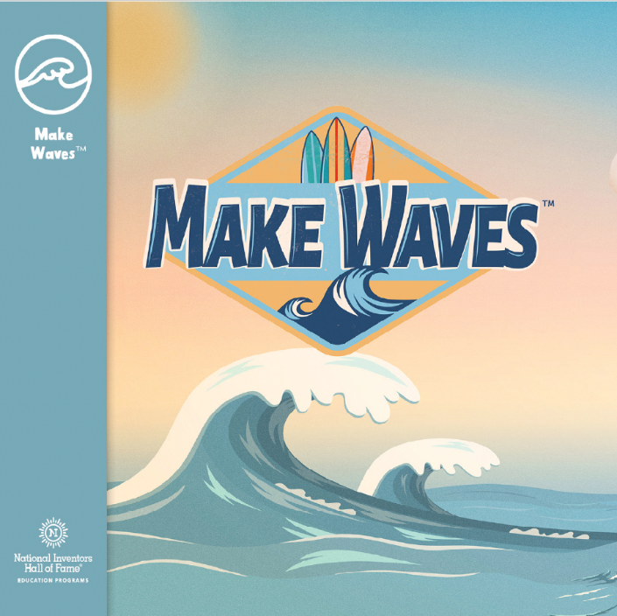
Curriculum: Make Waves™
In Make Waves, children catch their first big break as they ride the waves of invention and entrepreneurship! Inspired by National Inventors Hall of Fame Inductee Tom Blake — who helped make surfing more popular through his surfboard innovations — they paddle their way through salty challenges and generate ideas for a unique, innovative product. Like surfers moving from the safety of the shore to the rush of a breaking set of waves, participants take calculated risks as they use their prototype to hook investors and commercialize their product. After a dynamic dive into conducting customer research, children build a billboard boat that glides through the water and helps them “make waves” in the market!

Slide 4
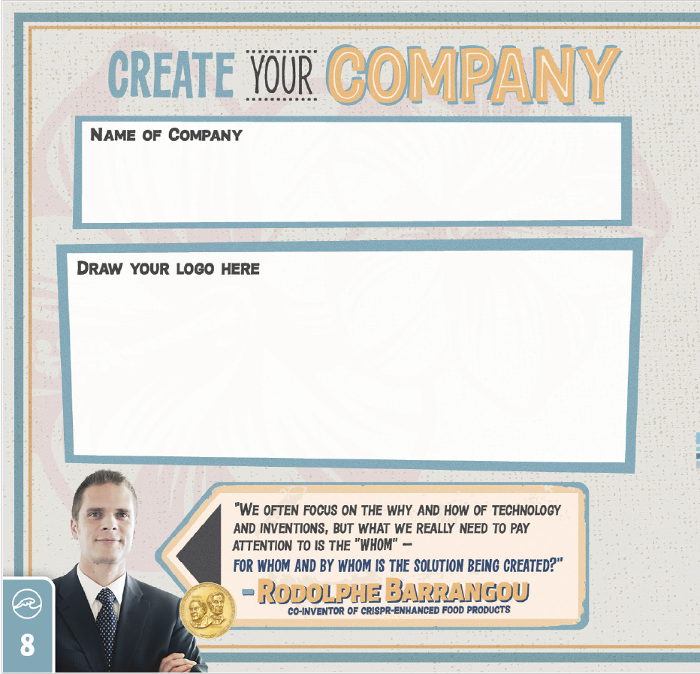

Slide 5
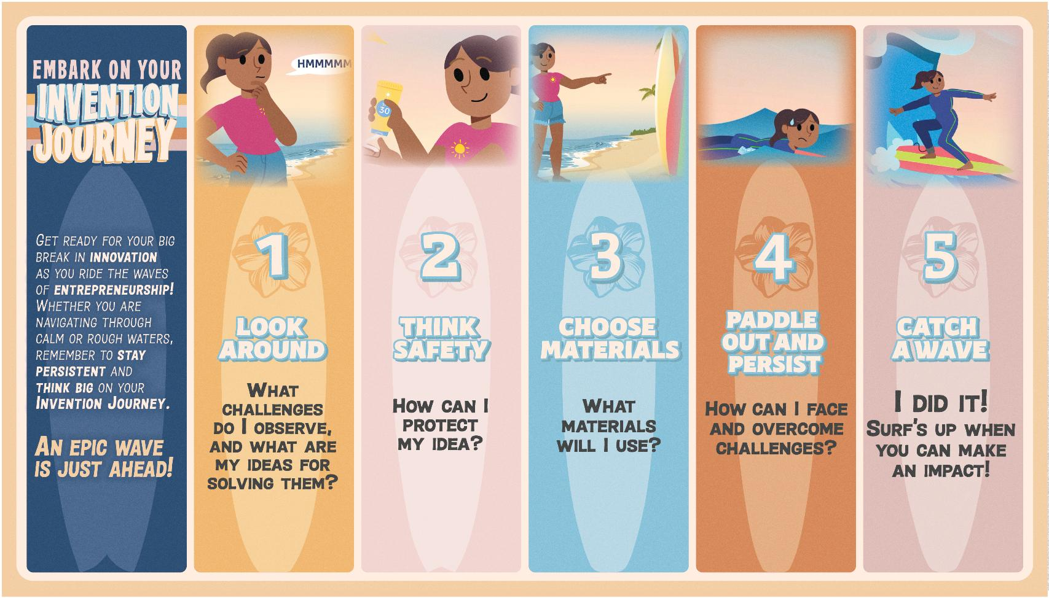

Slide 6
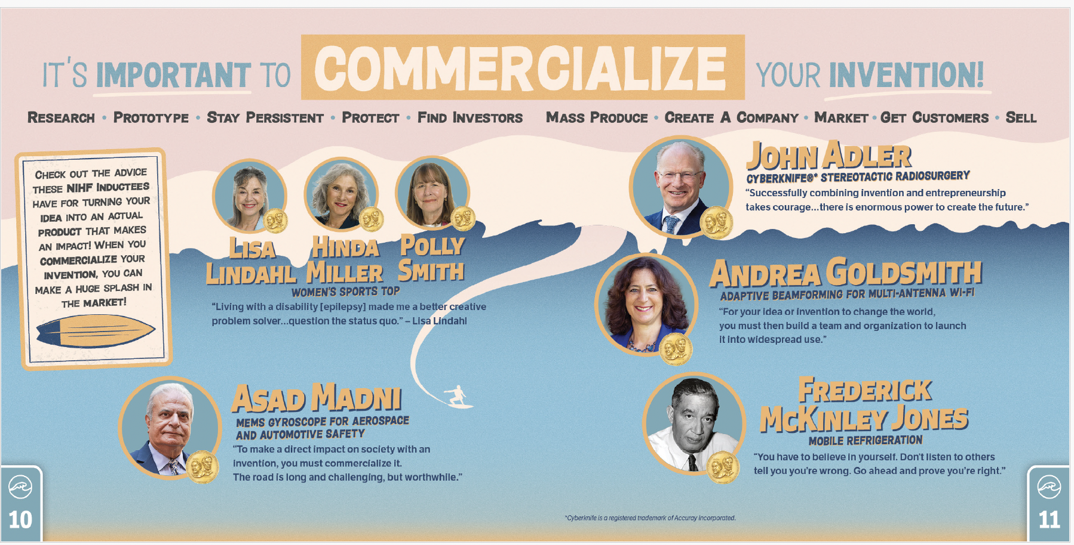

Slide 7

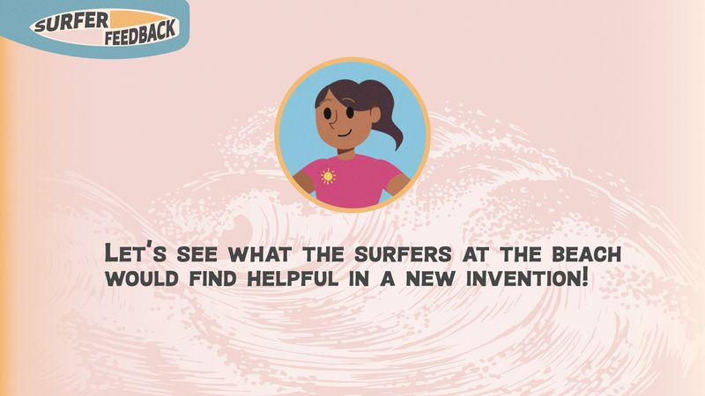
Pitching to investors
Making changes based on investor requests
Conducting market research
Gaining feedback from target audience
Adjusting prototypes based on feedback

Slide 8
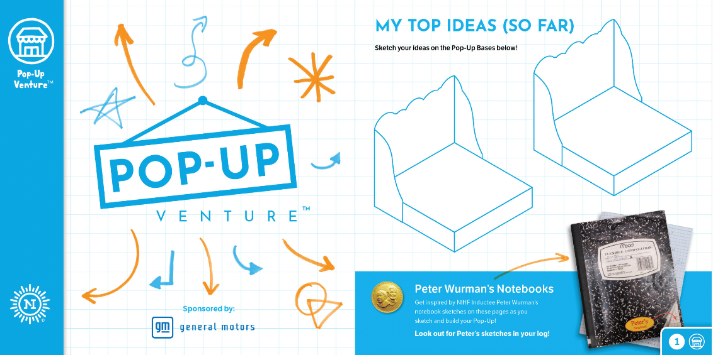
Curriculum: Pop-Up Venture™
In Pop-Up Venture, children design their own Pop-Up business! Participants make strong financial decisions, overcome unexpected challenges, and explore opportunities that pop up along the way while building entrepreneurship skills! Children compose business plans, design their Pop-Up layout, consider options for product distribution, and create marketing strategies. They build a unique, temporary Pop-Up for customers to shop and have a truly one-of-a-kind experience!

Slide 9
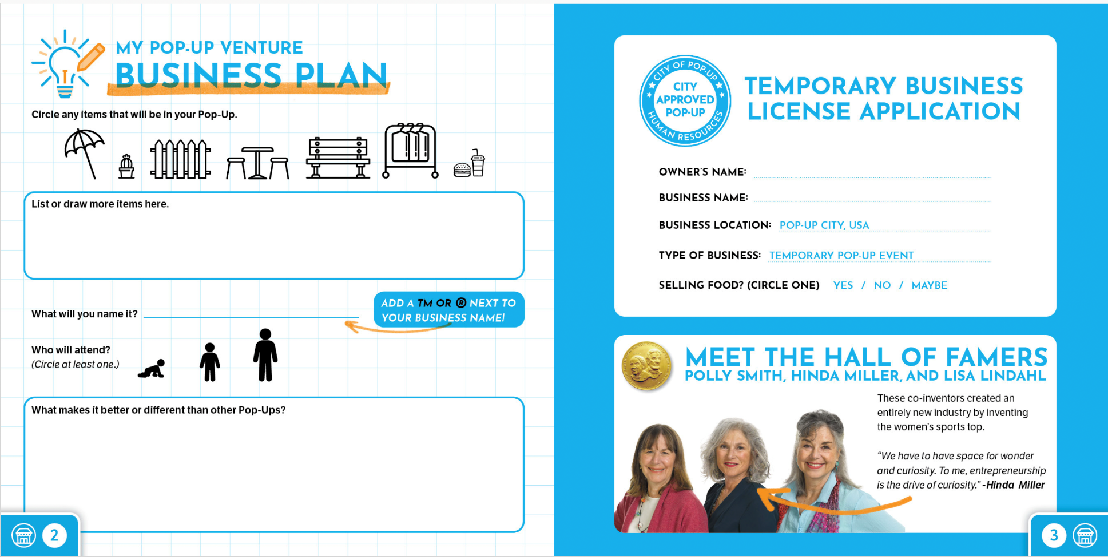

Slide 10
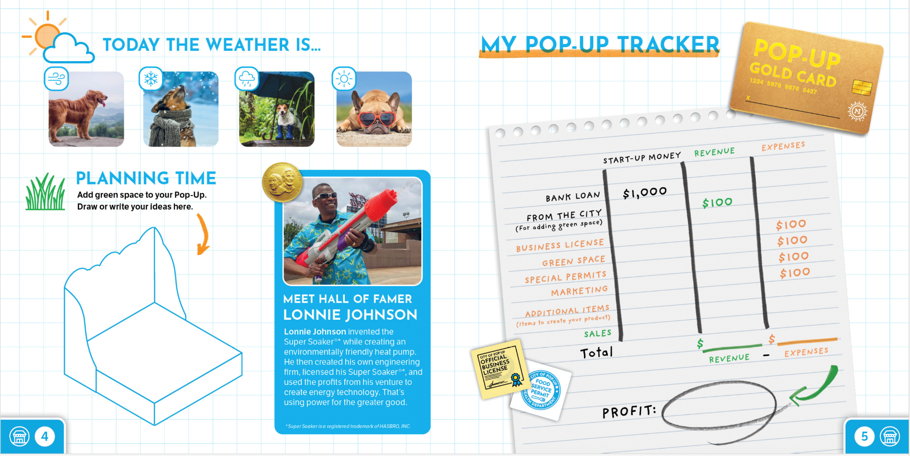

Slide 11
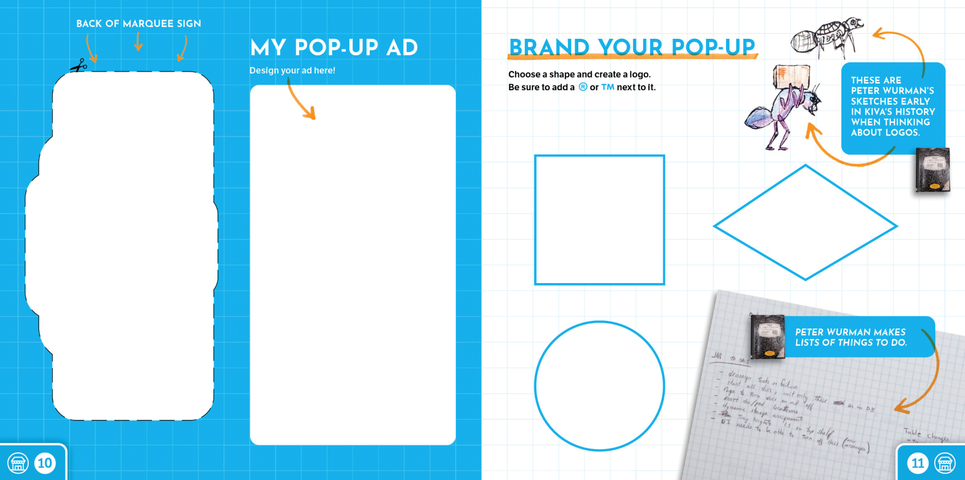

Slide 12
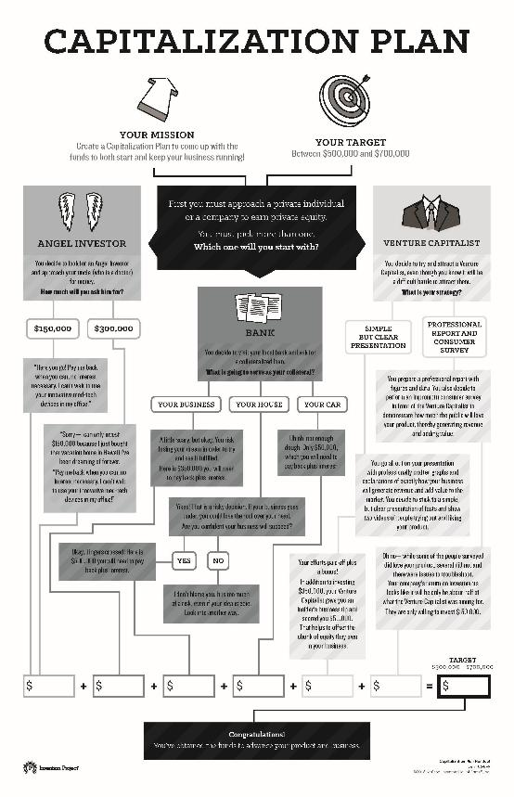
Curriculum: Start-up Med Tech
In Start-up Med Tech, innovators are challenged to create a successful start-up medical technology company that specializes in wearable innovative equipment. They create a Capitalization Plan to generate cash flow for their start-up and then build a prototype of their technology. After hearing from National Inventors Hall of Fame Inductee Al Langer about the value of listening to others' critiques, innovators give each other feedback on their tech prototypes. They then use this feedback to reconstruct the prototype and sell stock in their company to the doubters.

Slide 13
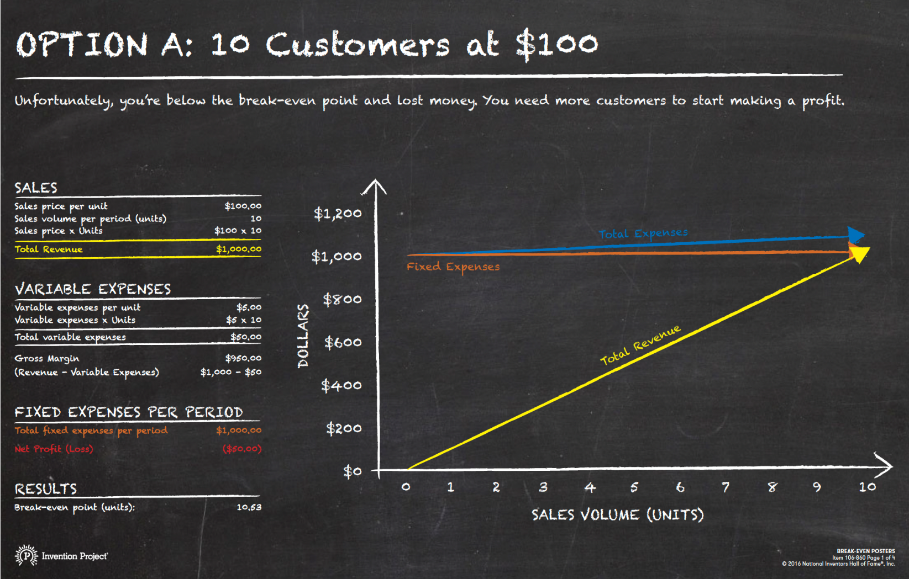

Slide 14

Curriculum: Stuck! ™
In Stuck!, children get down to business and design an exclusive new product to showcase at the Designs and Inventions by Youth (DIY) Expo. They kick off their entrepreneurial endeavor with a prototyping challenge to test the power of triangles and then discover three phases of product development. Along the way, children find out about making good business decisions from National Inventors Hall of Fame Inductees and Collegiate Inventors Competition® Finalists and Winners, many of whom are also entrepreneurs. Throughout this experience, participants get the opportunity to take risks, earn rewards in the form of Scrappy Bucks, and visit the Sticky Situation Station for inspiration if they get stuck. Finally, they showcase their unique product at the DIY Expo to impress investors and discover how a little stick-to-it-tiveness can lead to greatness!

Slide 15
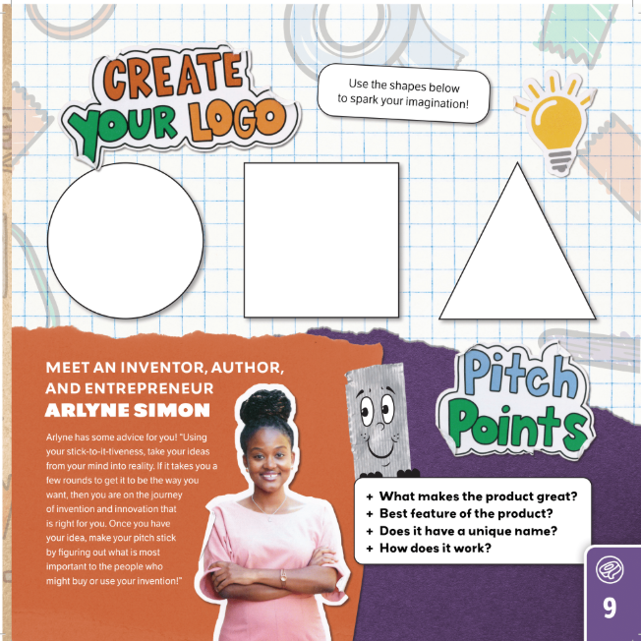

Slide 16
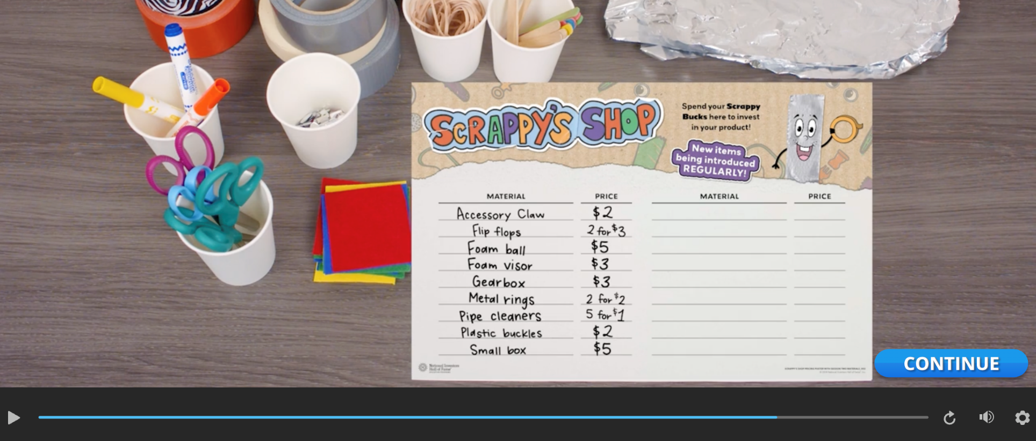

Slide 17
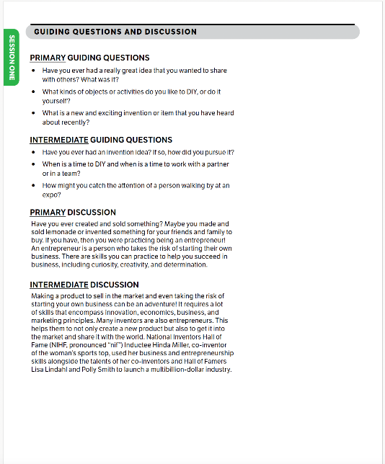
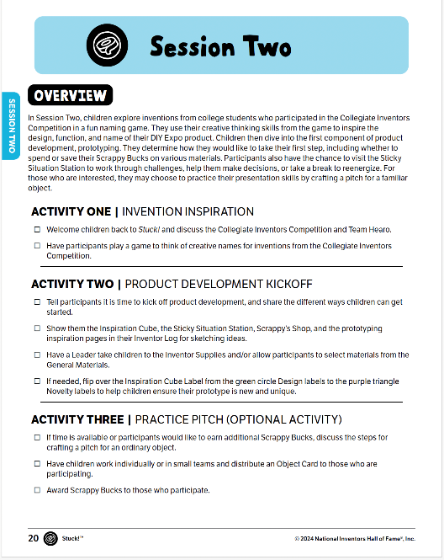
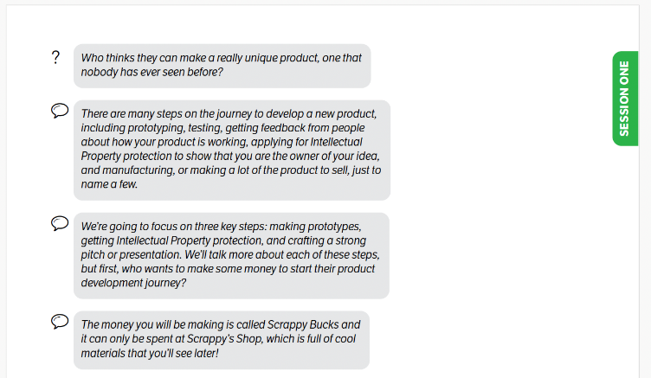
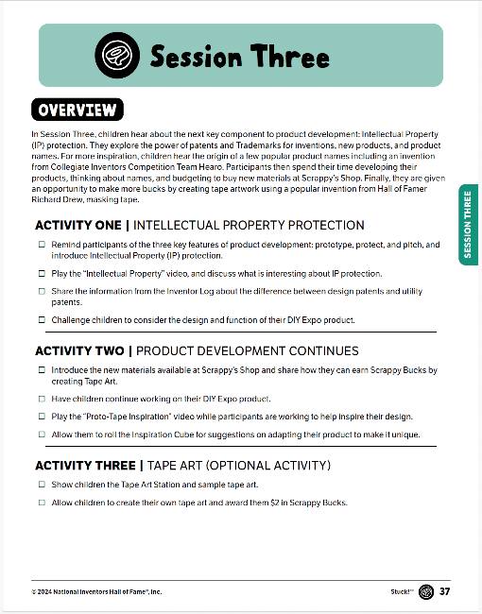
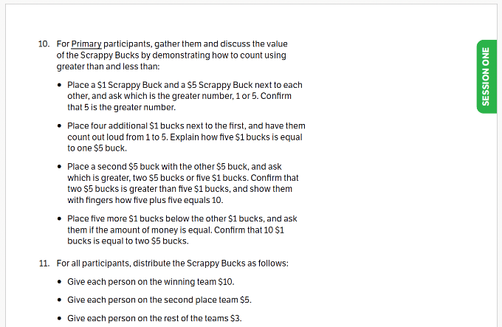

Slide 18
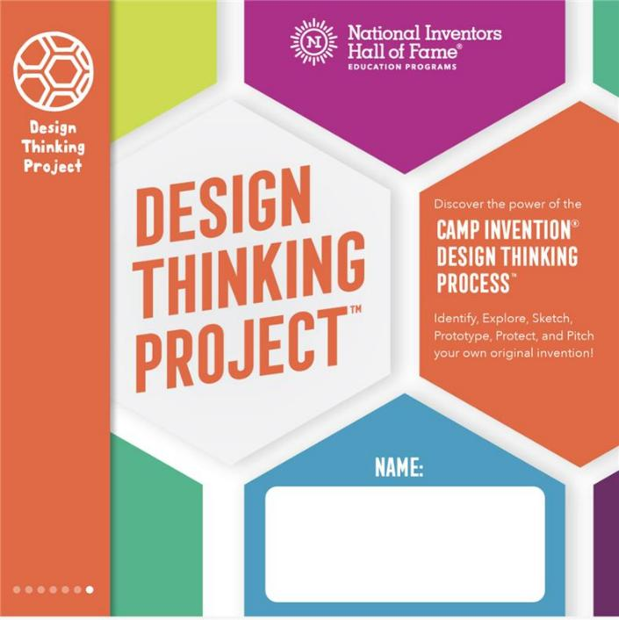
Curriculum: Design Thinking Project™
In Design Thinking Project, participants discover the power of the Camp Invention Design Thinking Process™, identify, explore, sketch, prototype, protect, and pitch, as they invent the Next Big Thing! Inspired by National Inventors Hall of Fame Inductees and Collegiate Inventors Competition finalists, participants build the Design Thinking skills of empathy, ingenuity, and persistence. At the end of the program, participants make their final pitches and take home a Design Thinking Portfolio of their work, along with an innovative mindset to make their unique mark on the world!

Slide 20
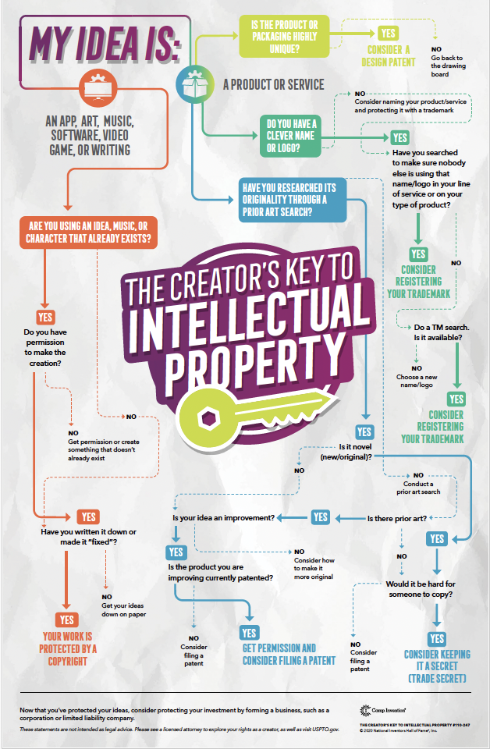

Slide 21
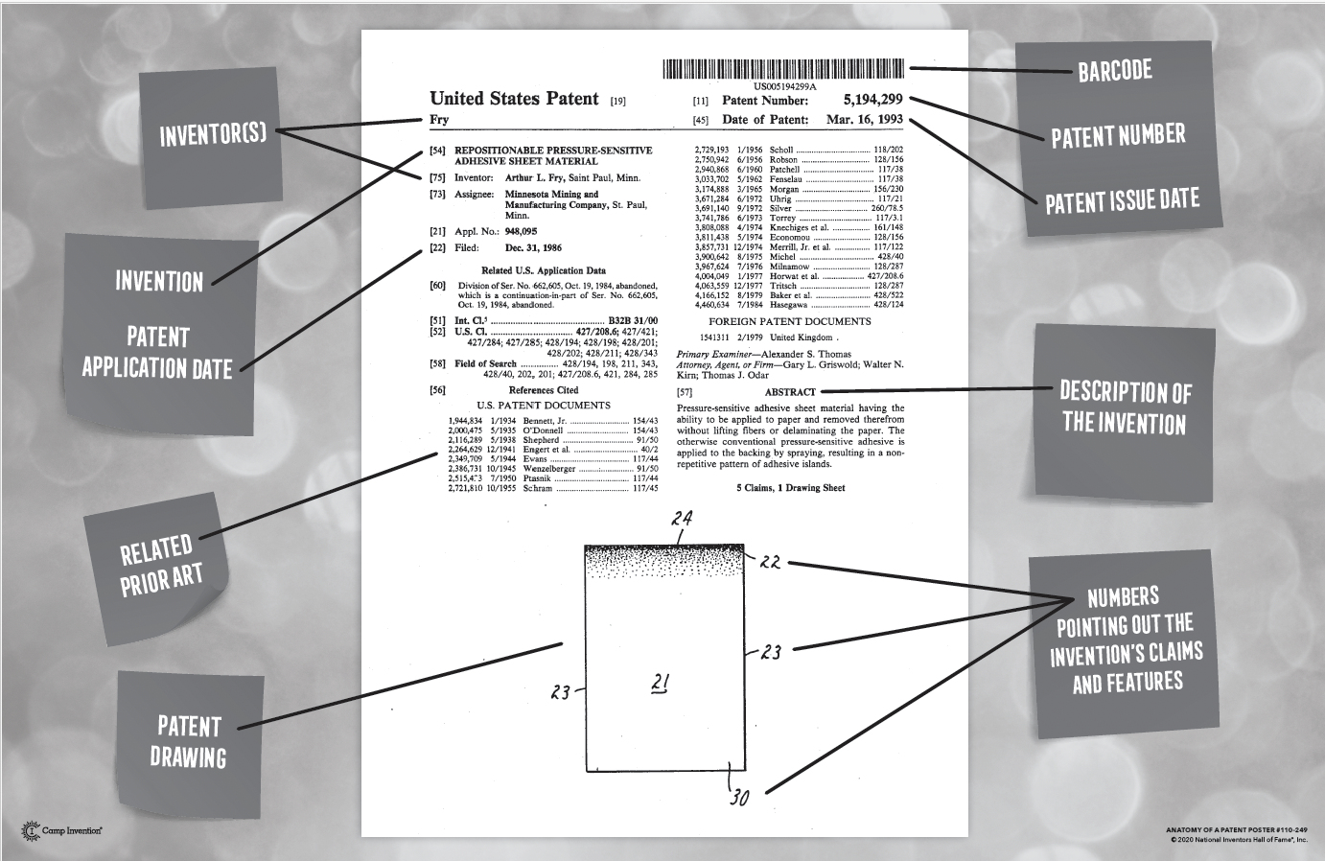

Slide 22
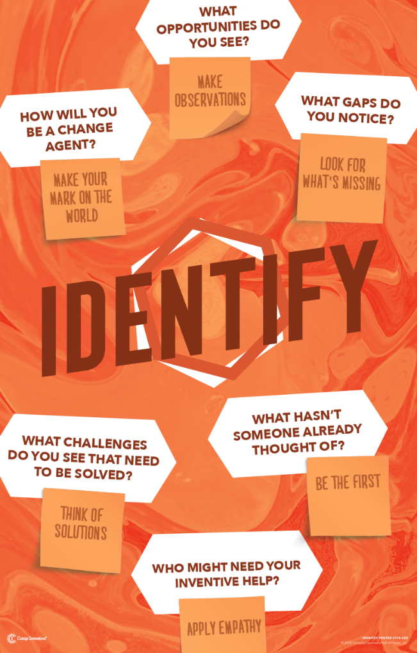


Slide 23

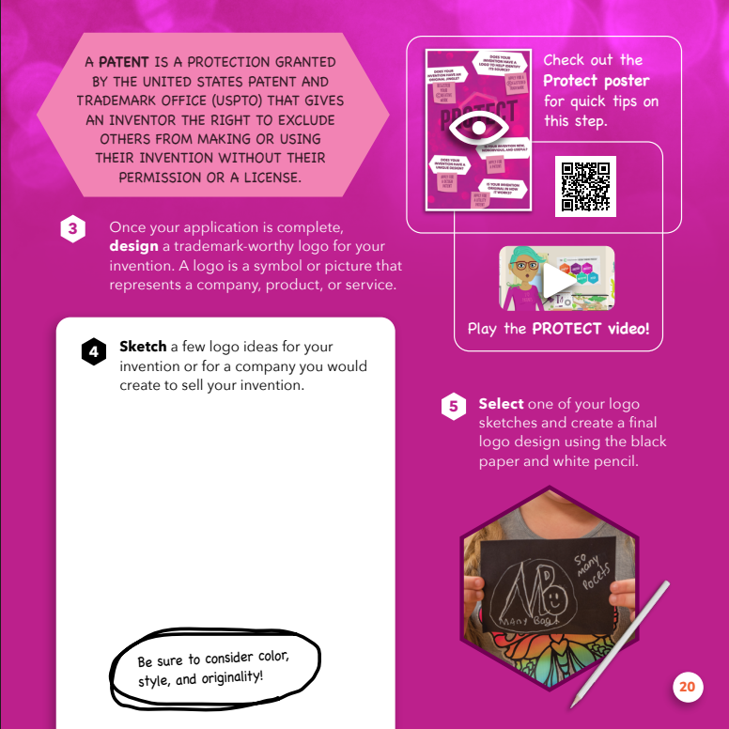

Slide 24
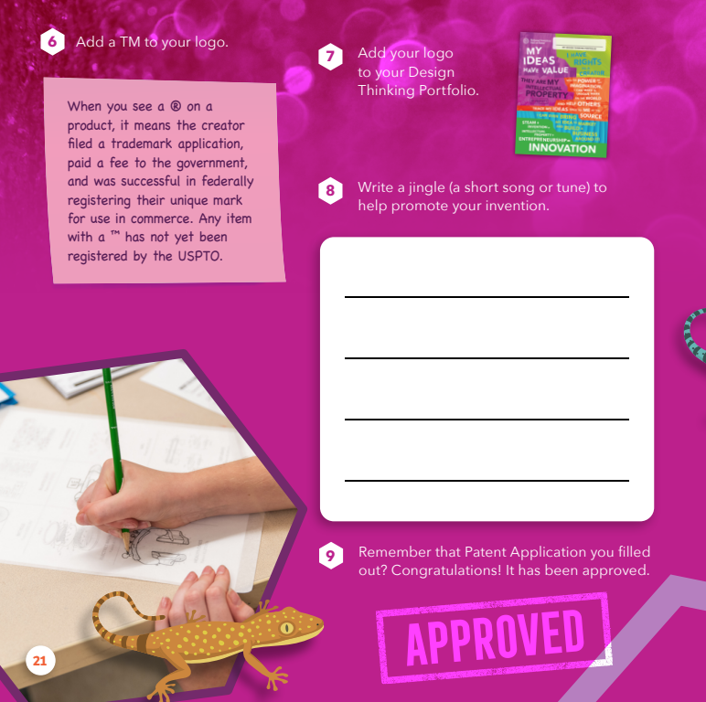

Slide 25
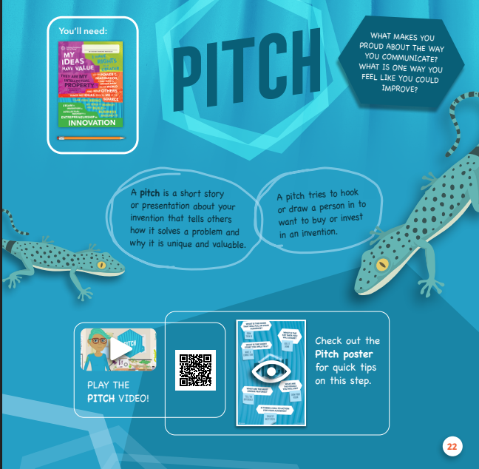
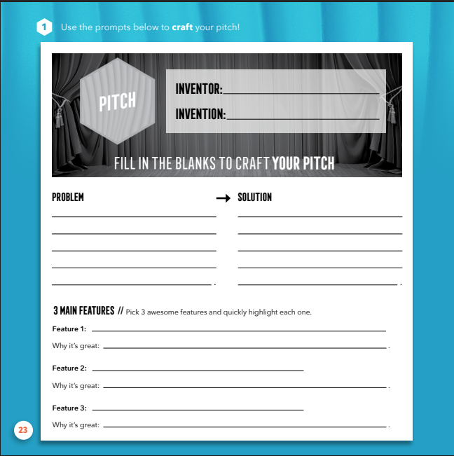

Slide 26
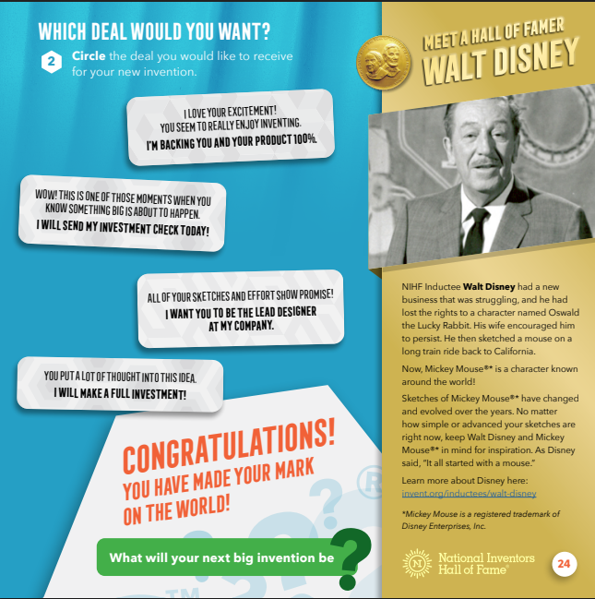

Slide 27
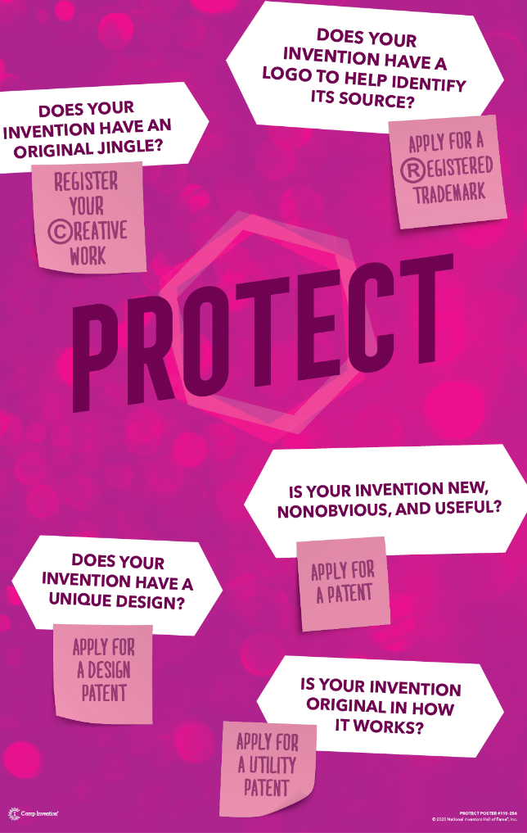
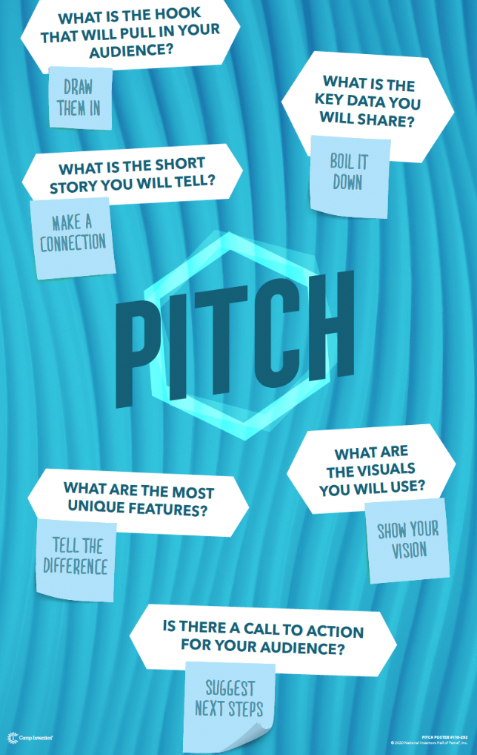

Slide 28
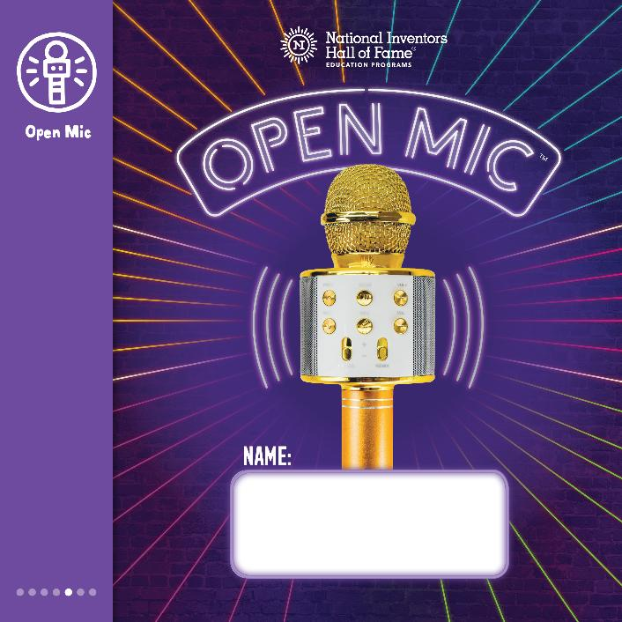
Curriculum: Open Mic™
In Open Mic, participants get ready to voice their ideas as they look inside a wireless microphone to discover the parts and pieces that will inspire their invention pitch! They amplify their ideas by using the Camp Invention Design Thinking Process™ to identify, explore, sketch, prototype, protect, and pitch a one-of-a-kind invention, and land a deal. Inspired by unique DIY prototyping tips combined with insights from Our Nation’s Greatest Innovators™, participants step up to the mic to share their original ideas with the world!

Slide 29

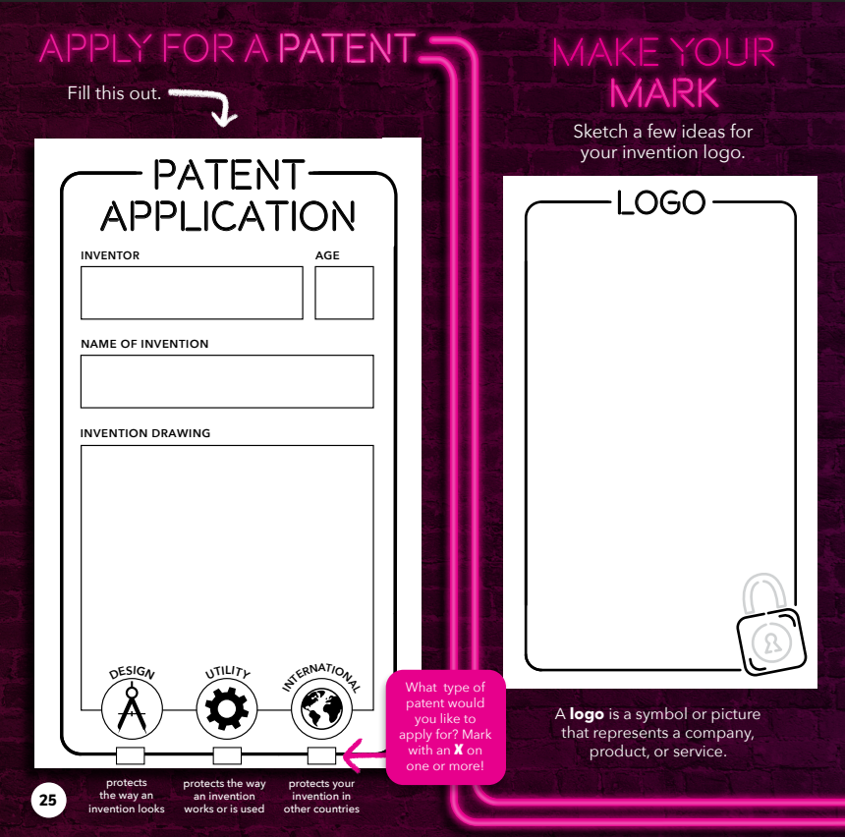

Slide 30
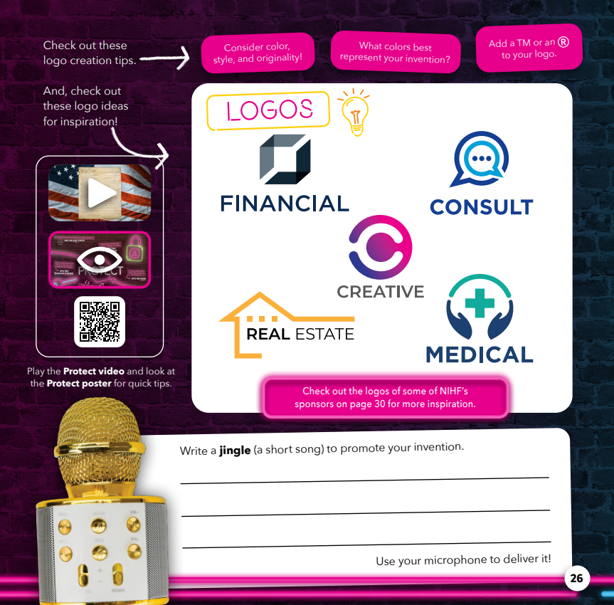

Slide 31
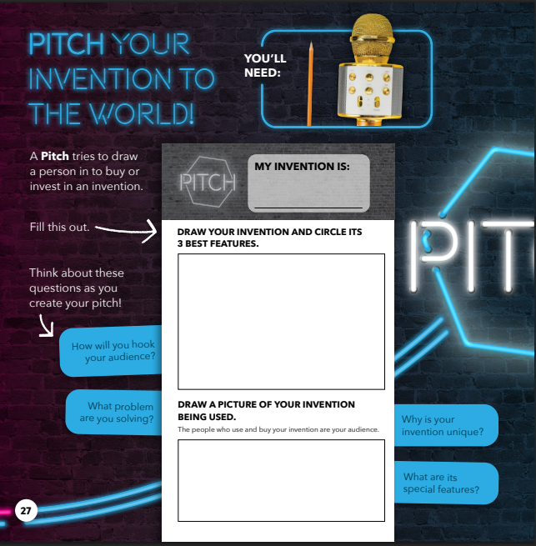
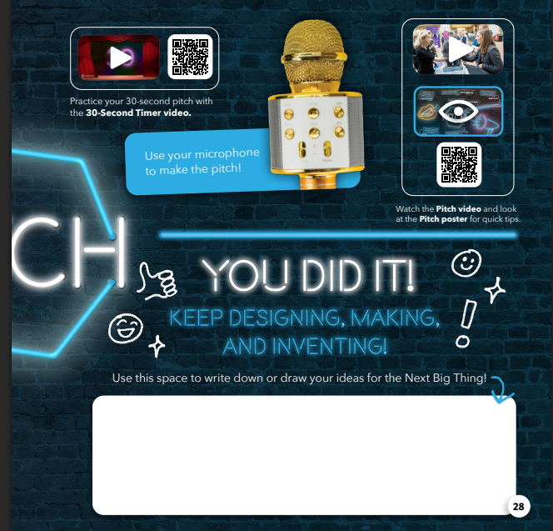

Slide 32
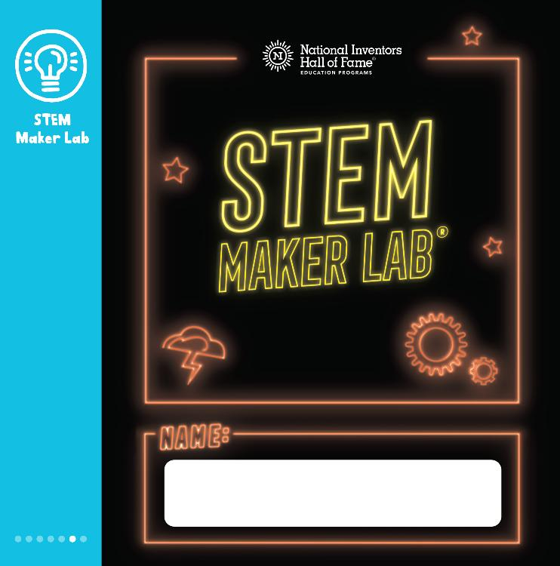
Curriculum: STEM Maker Lab®
In STEM Maker Lab, participants can take risks, build their tolerance for ambiguity, and ultimately explore who they are as a maker, an inventor, and an entrepreneur. They discover that having a curious mindset that embraces experimentation and creative problem solving is as important as tools and equipment. STEM Maker Lab provides participants with an interactive, hands-on exploration of design engineering, biomimicry, marketing, entrepreneurship, and Intellectual Property concepts inspired by many of the inventions from National Inventors Hall of Fame Inductees.

Slide 33



Slide 34
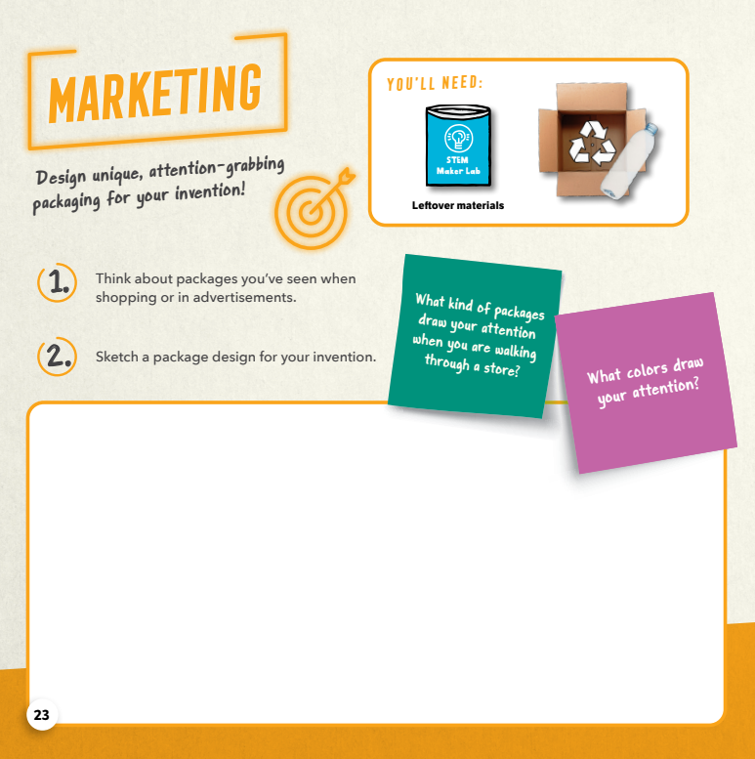
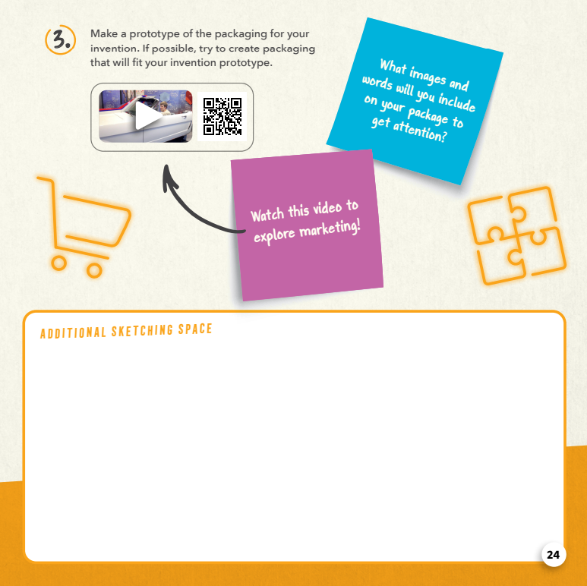

Slide 35
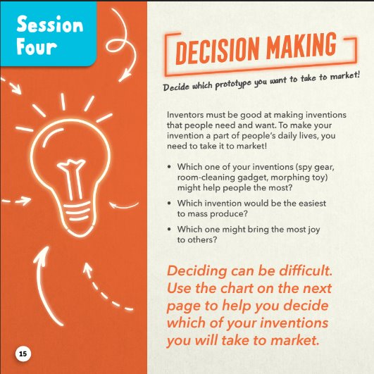
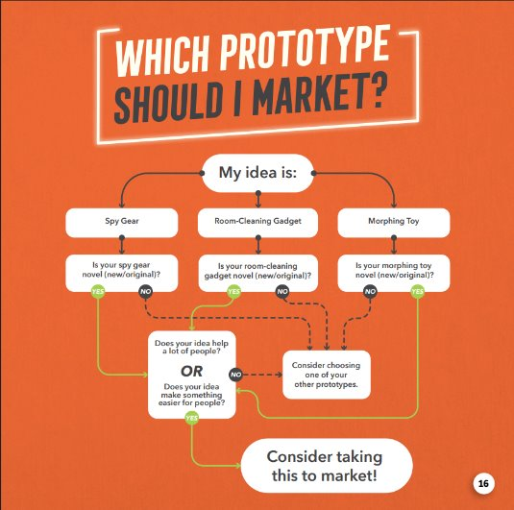

Slide 36
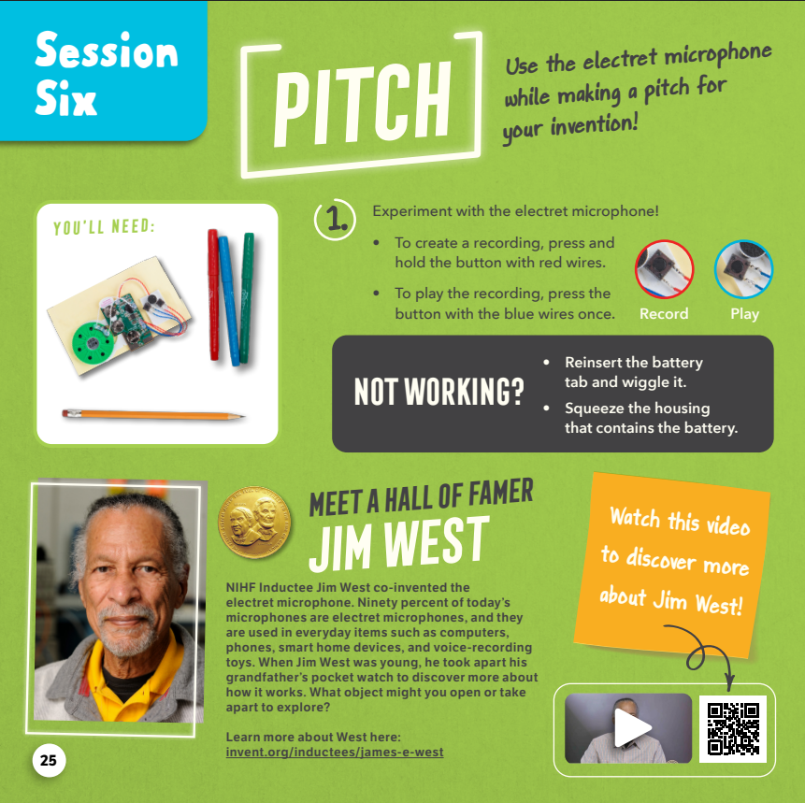
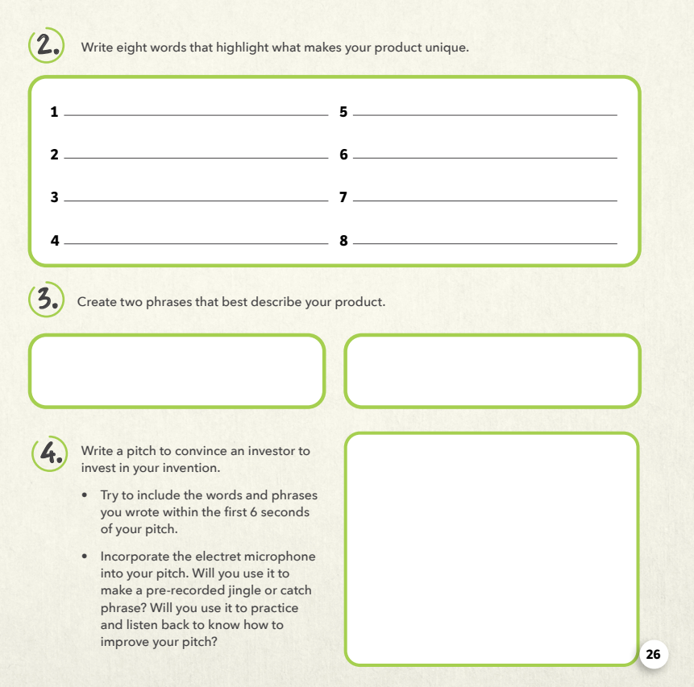

Slide 37
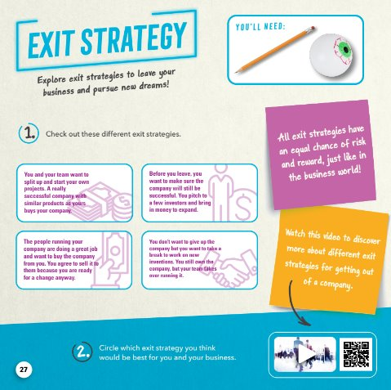
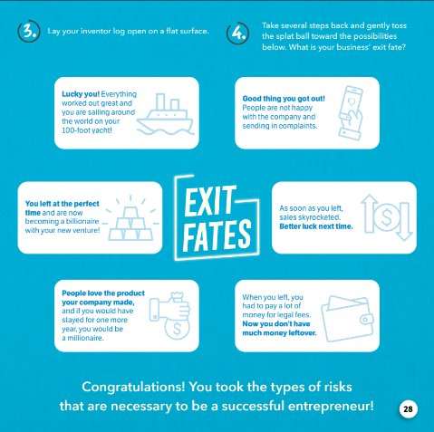

Slide 38

Curriculum: Wear It Out
In Wear It Out, innovators combine creative ideas and maker materials to invent clothing and accessories that are both fashionable and functional. They employ divergent and convergent thinking and creative problem solving to engineer clothing of the future that responds to extreme weather scenarios. Core skills include hands-on prototyping and testing, completing a business plan, creating a trademark-worthy logo and filing a Camp Invention patent application for their wearable technology. The curriculum also explores career connections most needed to prepare students for future careers, including Branding & Identity Strategist​, Ecosystem Analyst​, Materials Engineer​, Patent Examiner​, Graphic Designer​, Advertising Illustrator​, and Trademark Paralegal.

Slide 39


Slide 40
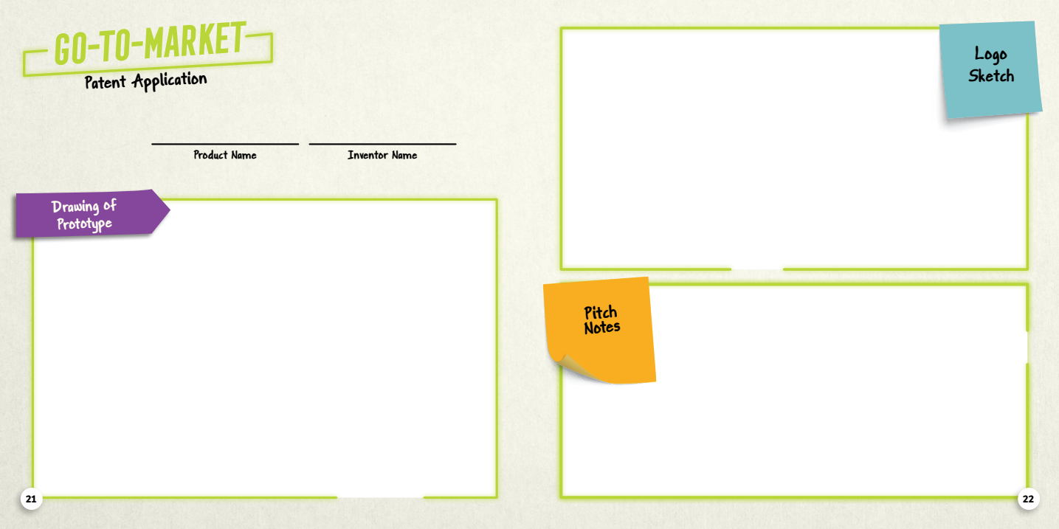

Slide 41
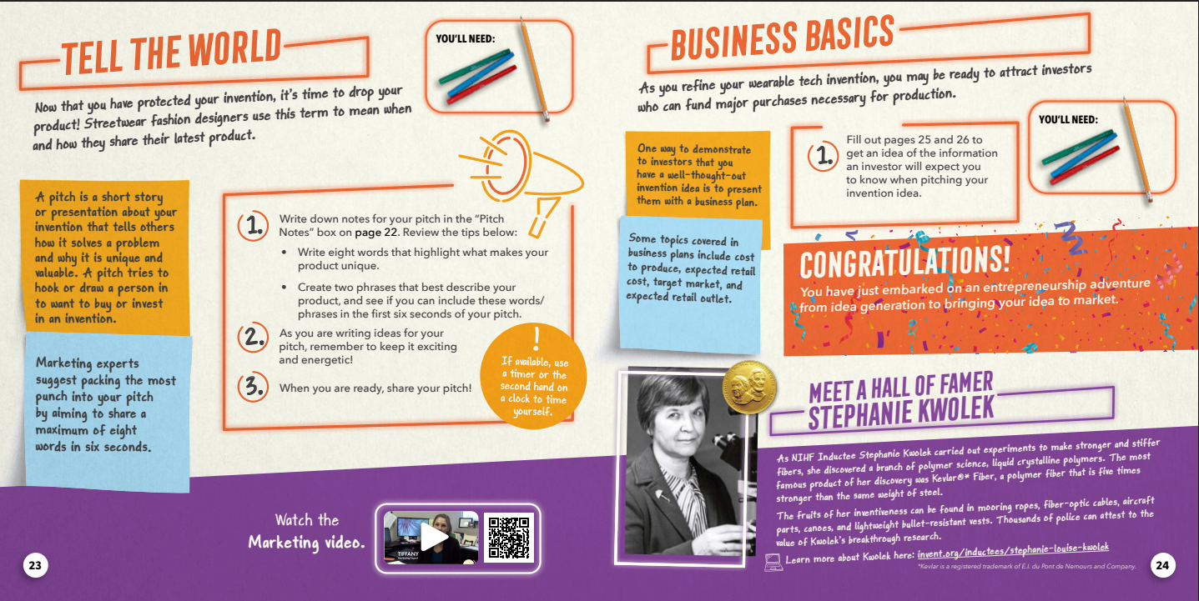

Slide 42
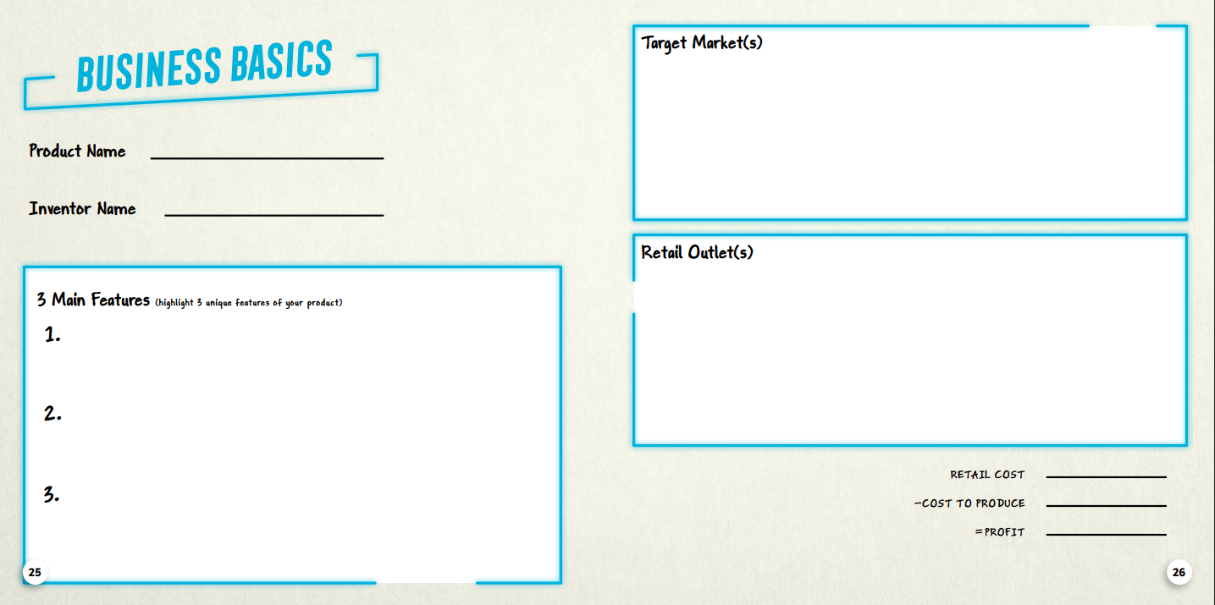

Slide 43
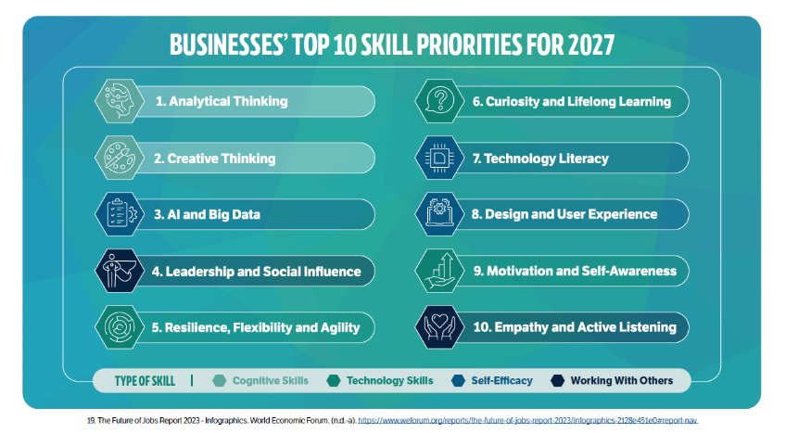

Slide 44
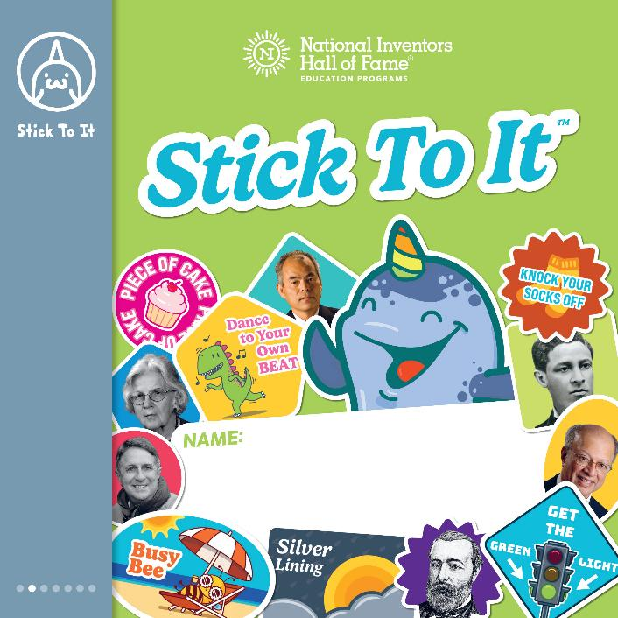
Curriculum: Stick To It™
In Stick To It, participants get to the heart of what it means to be an inventor: thinking through challenges, overcoming failure, persistence, testing and retesting, and reinspiring themselves. Each session is a new challenge with engaging, hands-on activities that give children a chance to think like a design engineer, a mechanical engineer, and a physicist. They are inspired by the inventions and careers of National Inventors Hall of Fame Inductees. With the Gnarly Narwhal sharing his awesome words of wisdom, children think big, dig in, and stick to it!

Slide 45
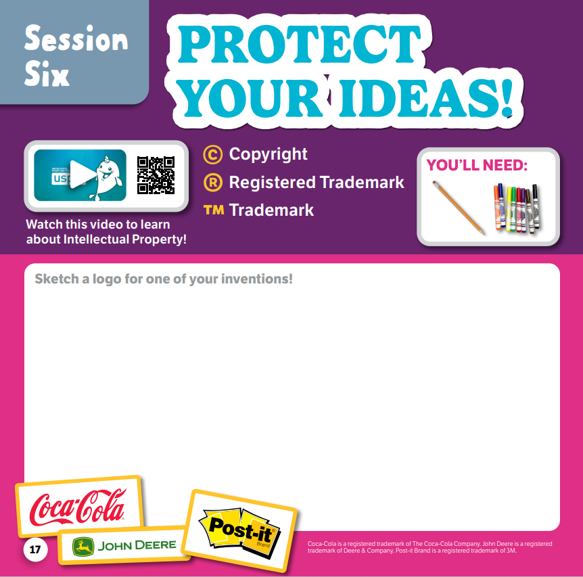
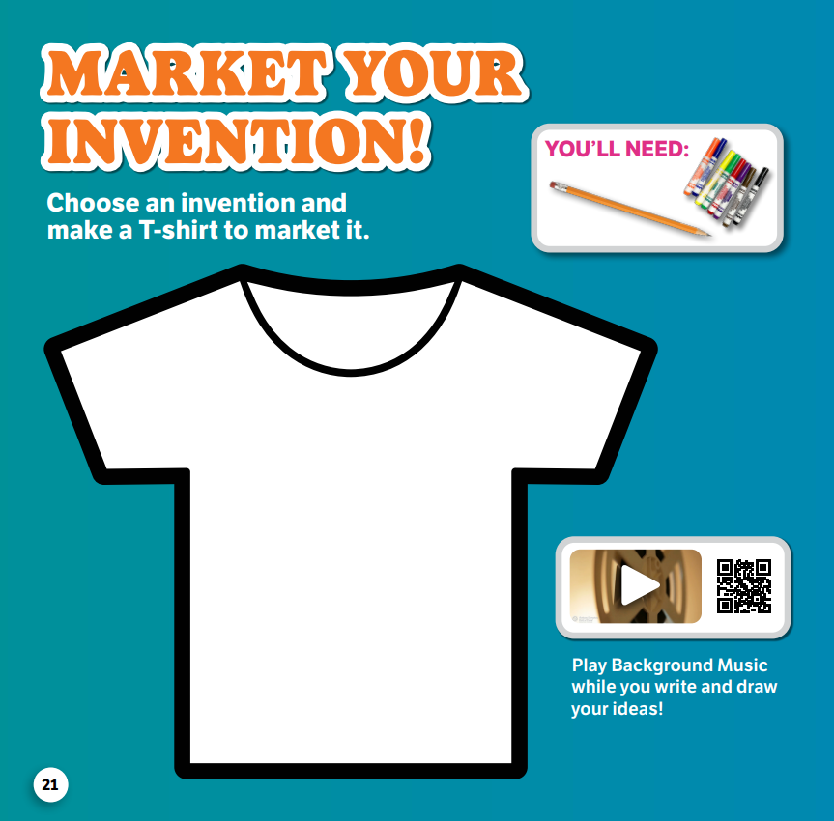

Slide 46

Curriculum: NIHF’s Automotive Design 101™
In NIHF’s Automotive Design 101, participants explore the principles of art and automotive design as they navigate a G2M strategy. They investigate the emotion of a sketch and sculpt with clay as they become immersed in car design. They are inspired by nature and are given real-world challenges to help them create futuristic car prototypes. They pitch their ideas before putting the finishing touches on their vehicles for the grand reveal.

Slide 47


Slide 48

Prototyping Studio™
Children are contestants on Prototyping Studio — a game show hosted by NIHFty Bot™, where they embark on an invention journey to uncover the ultimate place to invent. Is it in a basement, a kitchen, a garage, or a laboratory? Equipped with a DIY toolbox, contestants generate new ideas and bring them into reality as they discover the invention spaces of Our Nation’s Greatest Innovators™. After they complete a series of rapid prototyping challenges, they refine their invention ideas and protect their Intellectual Property. Contestants win the game by discovering that the ultimate space to invent is wherever they choose!

Slide 49


Slide 50



Slide 51



Slide 52

Curriculum: Robotic Aquatics™
Children are recruited to be trainees of Robotic Aquatics Academy, where they take a deep dive into aquatic innovation! After designing a device to retrieve their very own fluorescent jellyfish, trainees discover the cutting-edge science of soft robots and ocean research. They then receive a tank for their jellyfish and select a tropical reef or open ocean scene to bring a splash of color to their aquatic habitat. Participants further personalize their tank by creating and patenting innovative aquatic plants and adding special features — including symbiotic Best Friends Forever and rainbow tank lights! Finally, Trainees' workspace transforms into an inspirational Think Tank where they design the next great Aqua Innovation to lure in their target market — hook, line, and sinker!

Slide 53


Slide 54



Slide 55

Curriculum: Marble Arcade™
In Marble Arcade, Gamers zig-zag through physics, engineering, and gaming as they build a Marble Arcade that shows how math, motion, and mass can turn science into a marble-ous experience. Gamers use scientific principles, like potential and kinetic energy, and experiment with speed while rolling different Gaming Spheres. Exciting challenges shift the digital world into hands-on engineering design (identify the problem, explore solutions, sketch out ideas, design prototypes, protect with patents and trademarks, and pitch to investors) as they use a six-step engineering design process to team up to create a collaborative mega Marble Arcade!

Slide 56



Slide 57


