Slide 1

National Inventors Hall of Fame Invention Education Programs
Examples of the Integration of
Artificial Intelligence in Curricula

Slide 2
AI in NIHF Education Programs
As Artificial Intelligence continues to power industry and shape daily life, the National Inventors Hall of Fame® (NIHF) draws upon the groundbreaking achievements of its Inductees to highlight the real-world impact of AI for learners. From transformative technologies like the Kiva mobile robotic fulfillment system to human‑verification innovation such as reCAPTCHA, NIHF Inductees are pioneering paradigm‑shifting applications of AI that help define the technological frontier. Their stories bring to life how AI has evolved and continues to accelerate innovation.
Through extensive conversations with Our Nation’s Greatest Innovators™, NIHF has gathered powerful insights into the use of AI. By translating these insights into educator‑ready content, NIHF ensures instructors feel confident and grounded in core AI principles — supporting these educators in cultivating curiosity, creativity, and informed problem solving in the next generation of innovators.

Slide 3


AI in the Future of NIHF Curricula
NIHF is committed to embedding meaningful AI connections in all future Camp Invention® program series, as well as other experiences being researched and developed.
By featuring Inductees who are actively advancing areas like robotics and responsible AI, we equip both children and educators to navigate an increasingly fast‑paced technological landscape. This intentional integration ensures they not only understand AI as a tool but also recognize the human ingenuity behind it — preparing them to become tomorrow’s creators, leaders, and ethical stewards of emerging technology.

Slide 4
AI + Critical Technology Areas (CTAs)
NIHF Education Programs naturally cultivate the mindset and skills needed to contribute to today’s Critical Technology Areas by immersing learners in hands‑on innovation, problem solving, and real‑world STEM applications.
From exploring how Artificial Intelligence enhances efficiency, to how Biomanufacturing supports sustainable, biology‑driven solutions, participants strengthen skills, such as resilience and adaptability, through activities that mirror the invention process.
NIHF curricula also spark curiosity about emerging frontiers, challenging learners to think about materials science innovation and engineering basics.
Together, these experiences build foundational skills — creativity, critical thinking, collaboration, and technical fluency — that prepare young innovators to navigate and shape the nation’s most important technology domains.

Slide 5
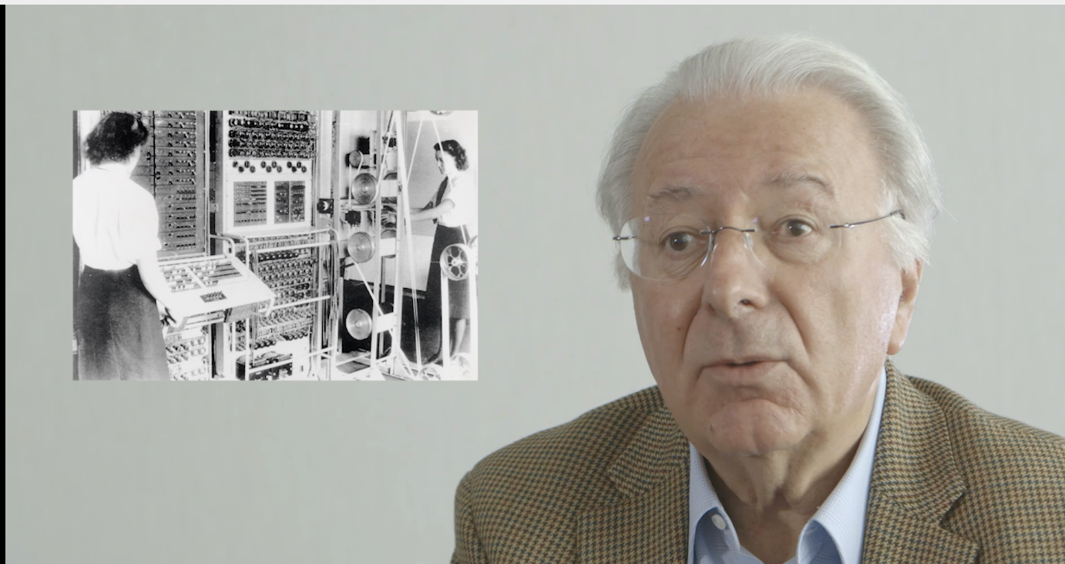
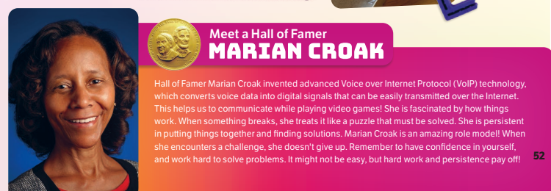
AI-Based Innovations from Inductees
NIHF Education Programs promote Artificial Intelligence literacy by featuring the powerful stories of NIHF Inductees with AI connections.
Hall of Famer Federico Faggin, inventor of the microprocessor, created the chip architecture that made modern smart and embedded systems possible. His groundbreaking work laid the foundation for the Internet of Things and the AI‑enabled technologies that power today’s intelligent devices.
Hall of Famer Marian Croak’s pioneering VoIP technology revolutionized digital communication by allowing voice and data to travel seamlessly over the internet. This breakthrough created essential infrastructure for today’s AI‑powered communication tools, from real‑time translation to intelligent call routing.

Slide 6

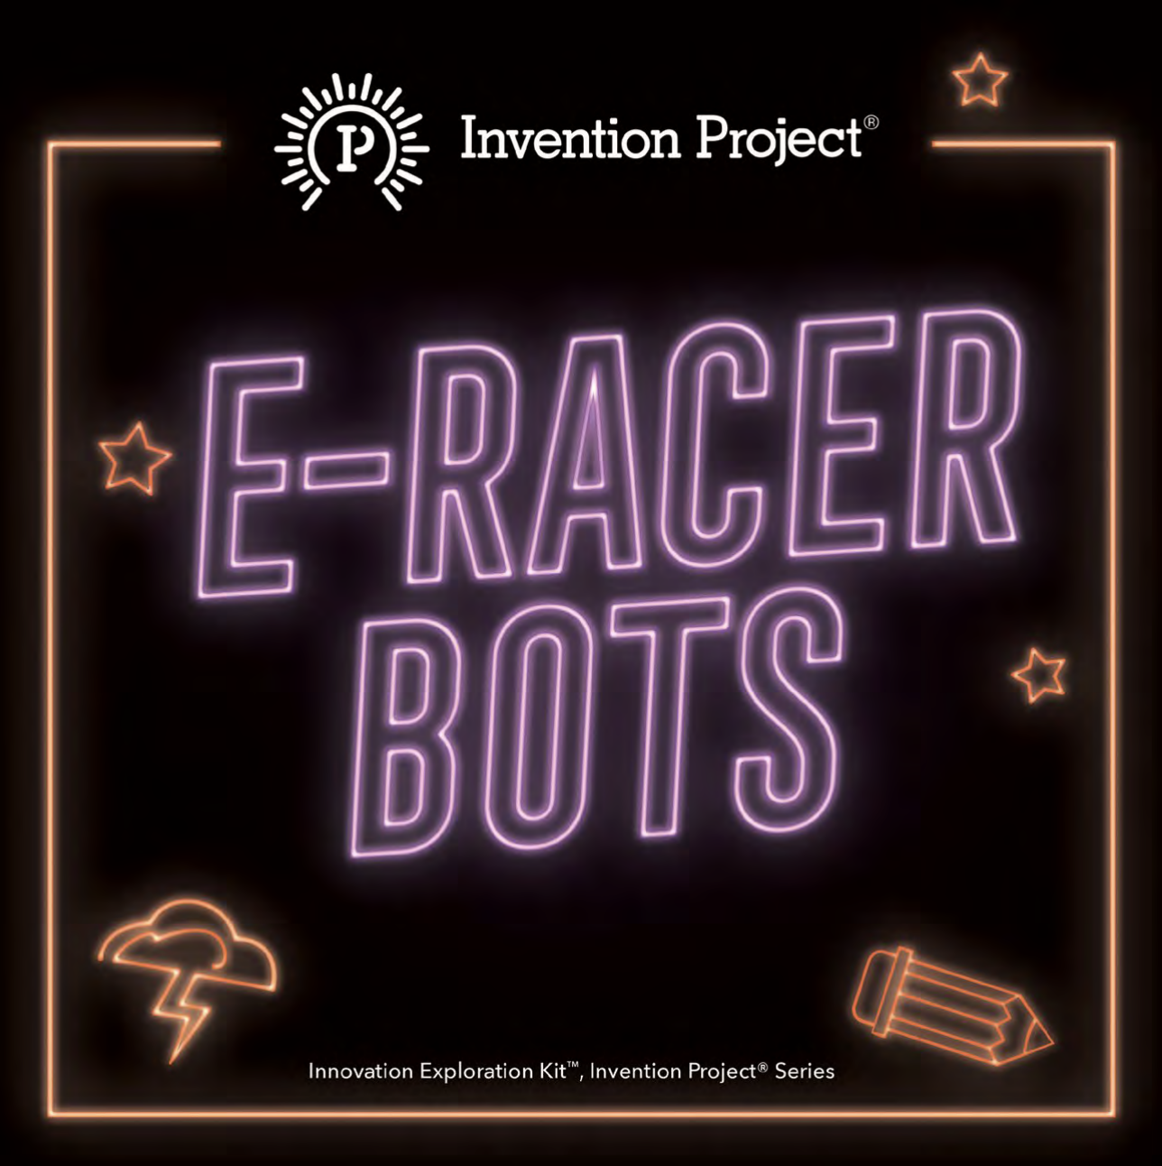
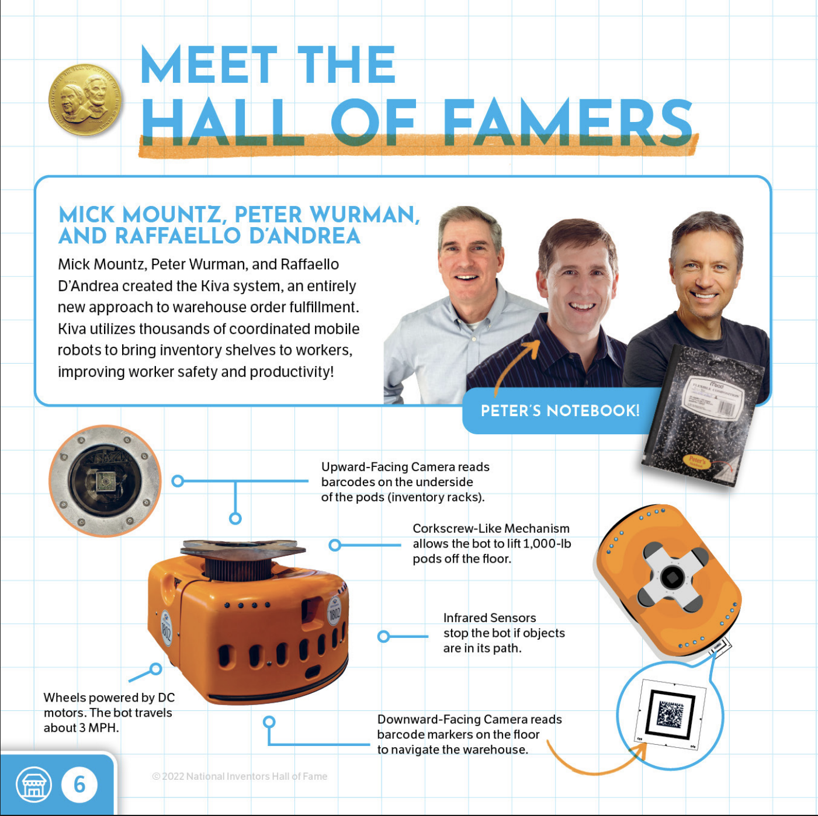
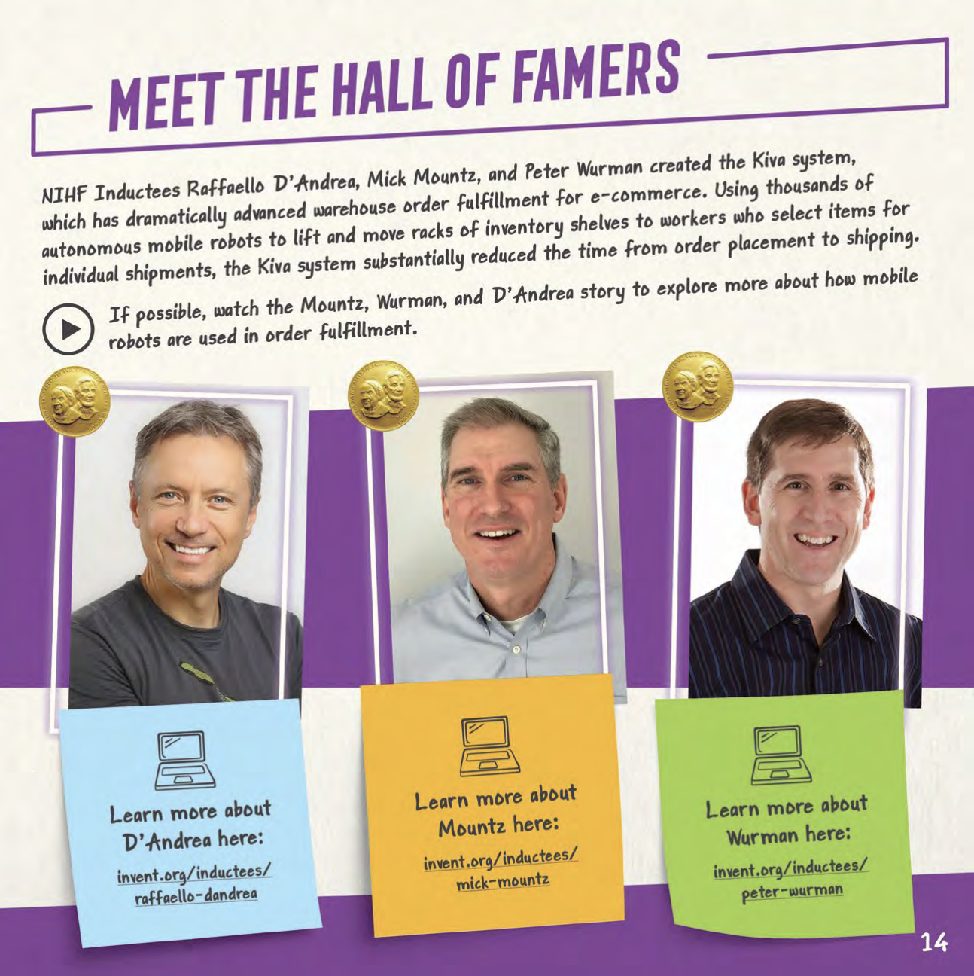
Showcasing Inductees
NIHF Inductees are featured in curricula, videos, logs, and other program assets.
The Inventor Log pages featured here are just one example of how Inductees with connections to AI are showcased in two different modules.
NIHF Inductees Raffaello D’Andrea, Mick Mountz, and Peter Wurman dramatically advanced warehouse order fulfillment for e-commerce by creating the Kiva system.
Kiva robots use AI‑driven coordination to autonomously navigate warehouses, reading floor markers and communicating with one another to move inventory with speed and precision.
Wurman has also worked to apply AI to video games.

Slide 7
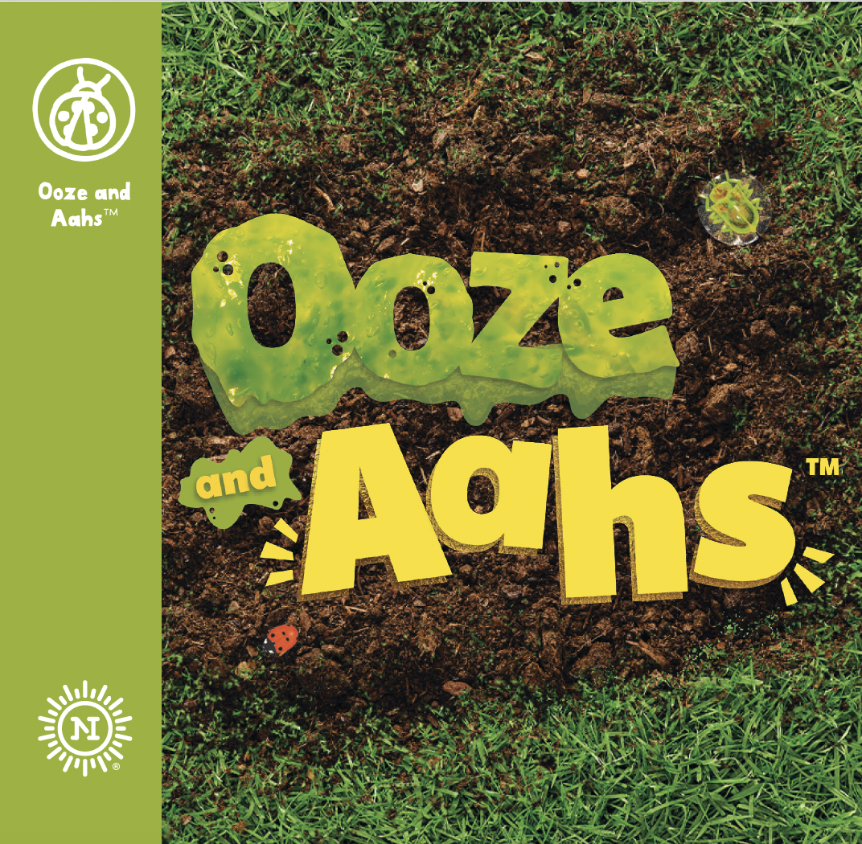
Curriculum: Ooze and Aahs™
In Ooze and Aahs™, children explore ooey gooey chemistry concepts as they investigate some of nature’s tiniest organisms in the Backyard Laboratory!
In the curriculum, Hall of Famer Pam Marrone is highlighted discussing the use of Artificial Intelligence to preserve ecosystems.
Her biologically based pest‑control innovations helped open the door to the growing use of Artificial Intelligence to accelerate the discovery and development of the natural, biology‑based products she works with.
Excerpt from curriculum:
"According to Marrone, artificial intelligence (AI) tools have transformed the industry. When it comes to invasive species research, traditional methods, such as field studies and laboratory tests, can be slow and costly compared to AI analyses. By increasing the speed and precision of data processing, AI tools allow Marrone and her team to uncover solutions that once took years to find. How do you think AI could change the way you create or solve problems in the future?"

Slide 8
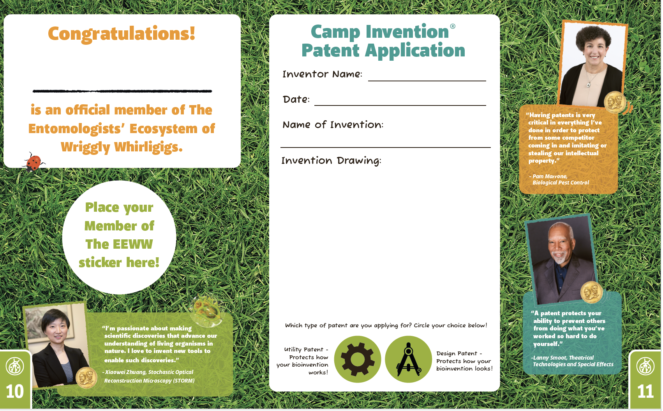
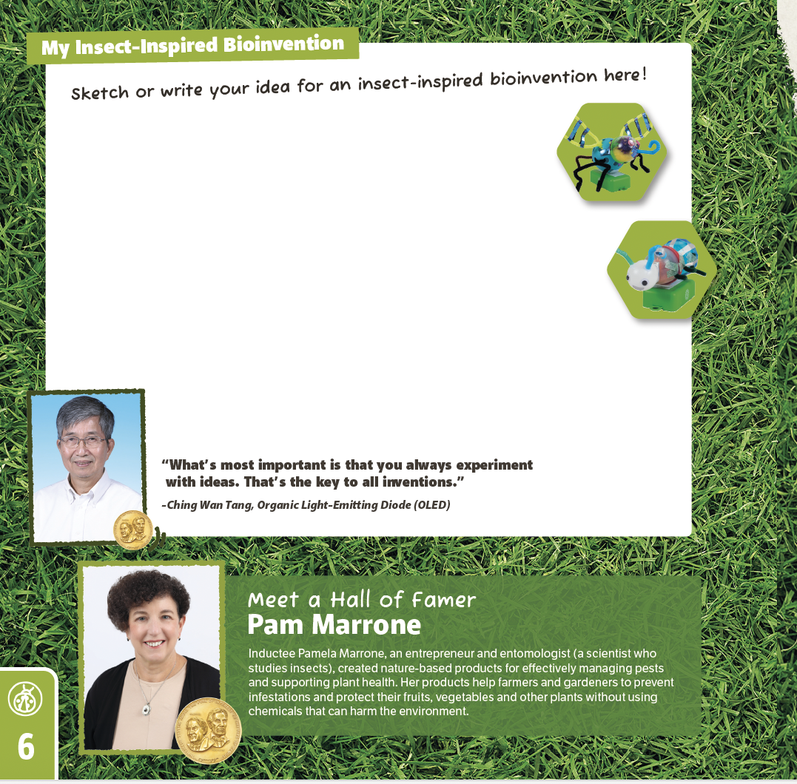
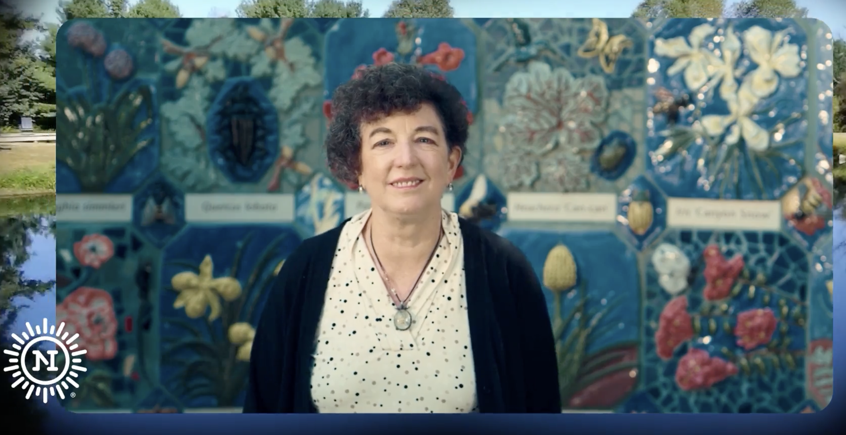
NIHF Inductee Pam Marrone
Along with excerpts from the Ooze and Ahhs™ curriculum, Pam Marrone is also featured in the Inventor Log and in videos.
Full Video

Slide 9
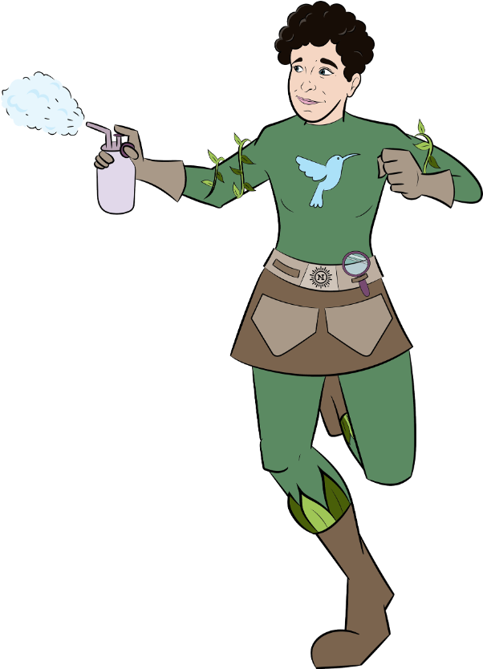

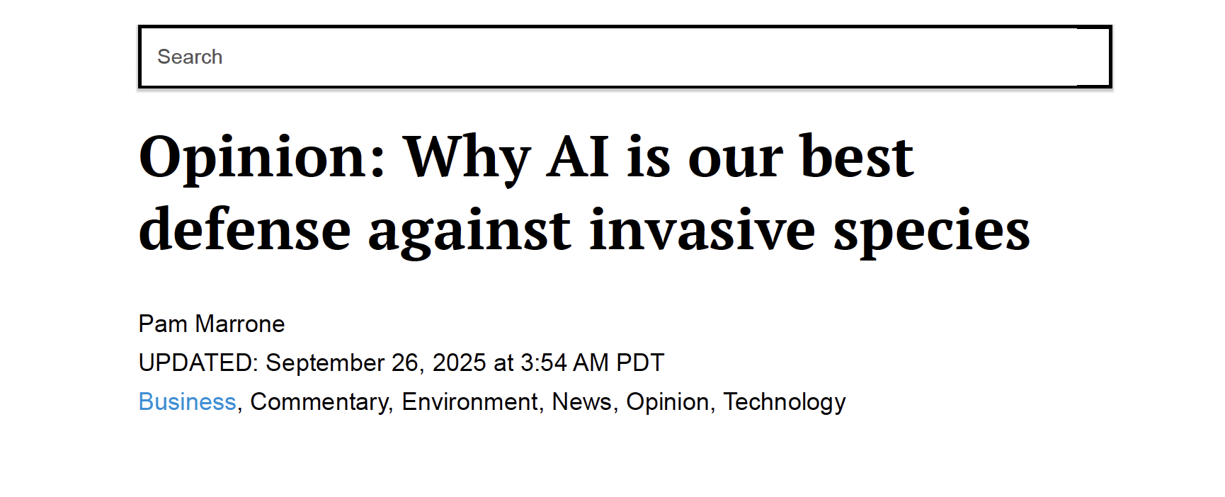
Informed by Experts
Educators can feel confident that the curriculum is directly shaped by innovation experts using AI for real-world applications.
Pam Marrone recently wrote an opinion piece sharing her thoughts on why AI is our best defense against the resource-intensive challenges invasive species.
Full Article

Slide 10
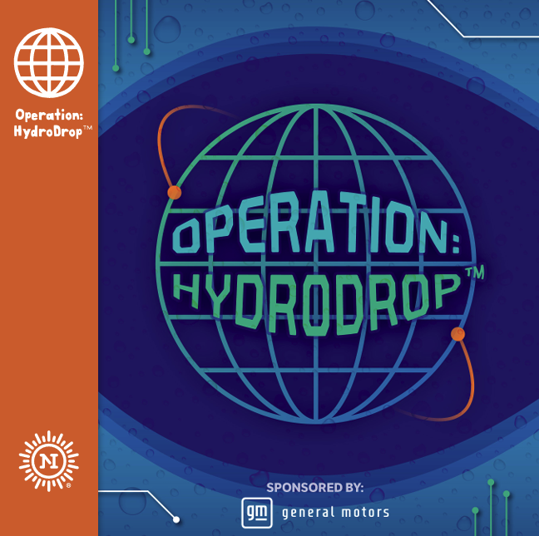
Curriculum: Operation: HydroDrop™
Children head out on an epic global operation to explore and solve water challenges around this big blue planet!
This curriculum highlights the use of Artificial Intelligence for underwater data collection.
Excerpt from curriculum:
"Artificial Intelligence (AI) is being used to help with water data collection and analysis. It plays a key role in the operation of many water treatment plants...AI is key to helping us conserve and manage water resources now and in the future."

Slide 11
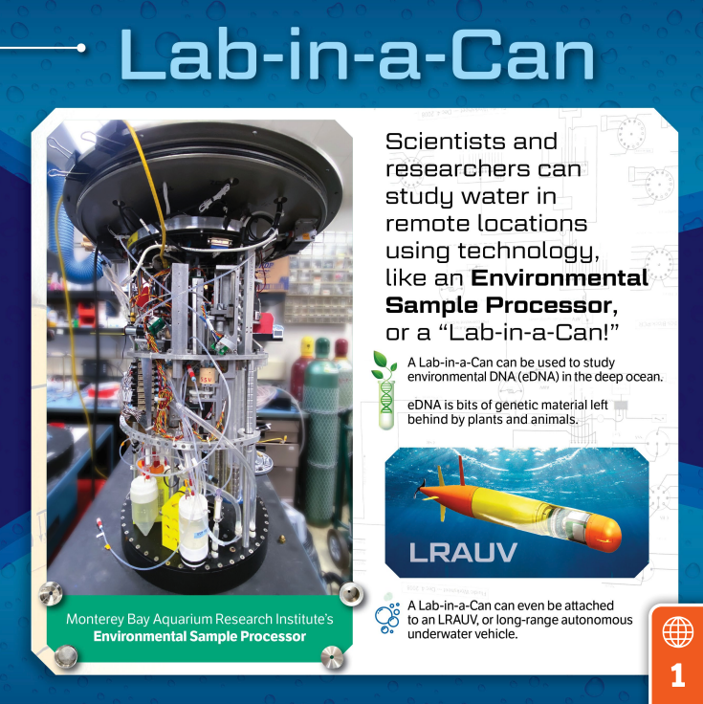
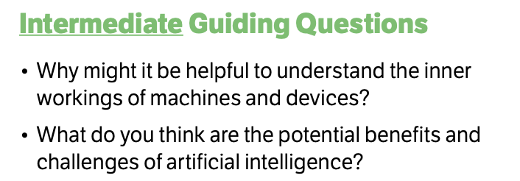
AI in Curricula
The Operation: HydroDrop™ curriculum takes a deep dive into collecting and analyzing eDNA (environmental DNA). The process of collecting and analyzing eDNA samples is increasingly using AI.
Excerpts from curriculum:
Primary Discussion: "It can be hard to go deep underground or in the water and study what is there. Robots can help us go to these places and learn more. When we discover more about the planet, we can often help better protect it."
Intermediate Discussion: "It can be challenging to go to places deep underground or in the water to collect and analyze data about those environments. Artificial intelligence allows us to conduct research in remote locations without navigating the challenges of returning samples to a laboratory. As we collect more environmental data, we can make more informed decisions to help protect the planet."

Slide 12

Curriculum: In Control™
Children take control of their innovation journey as they head out on the ultimate road trip!
From assembling a custom Control Panel with a Transmitter and Receiver to creating a prototype of their own Artificial Intelligence (AI)-inspired bobblehead assistant, they invent their way around every bump and twist in the road.
This curriculum heavily features AI, as participants are taught to use it as a resource during their road trip.
Excerpt from curriculum:
"Artificial Intelligence can be used as a helpful resource. It completes tasks that humans can complete, but sometimes in a more comprehensive, or thorough, way."

Slide 13
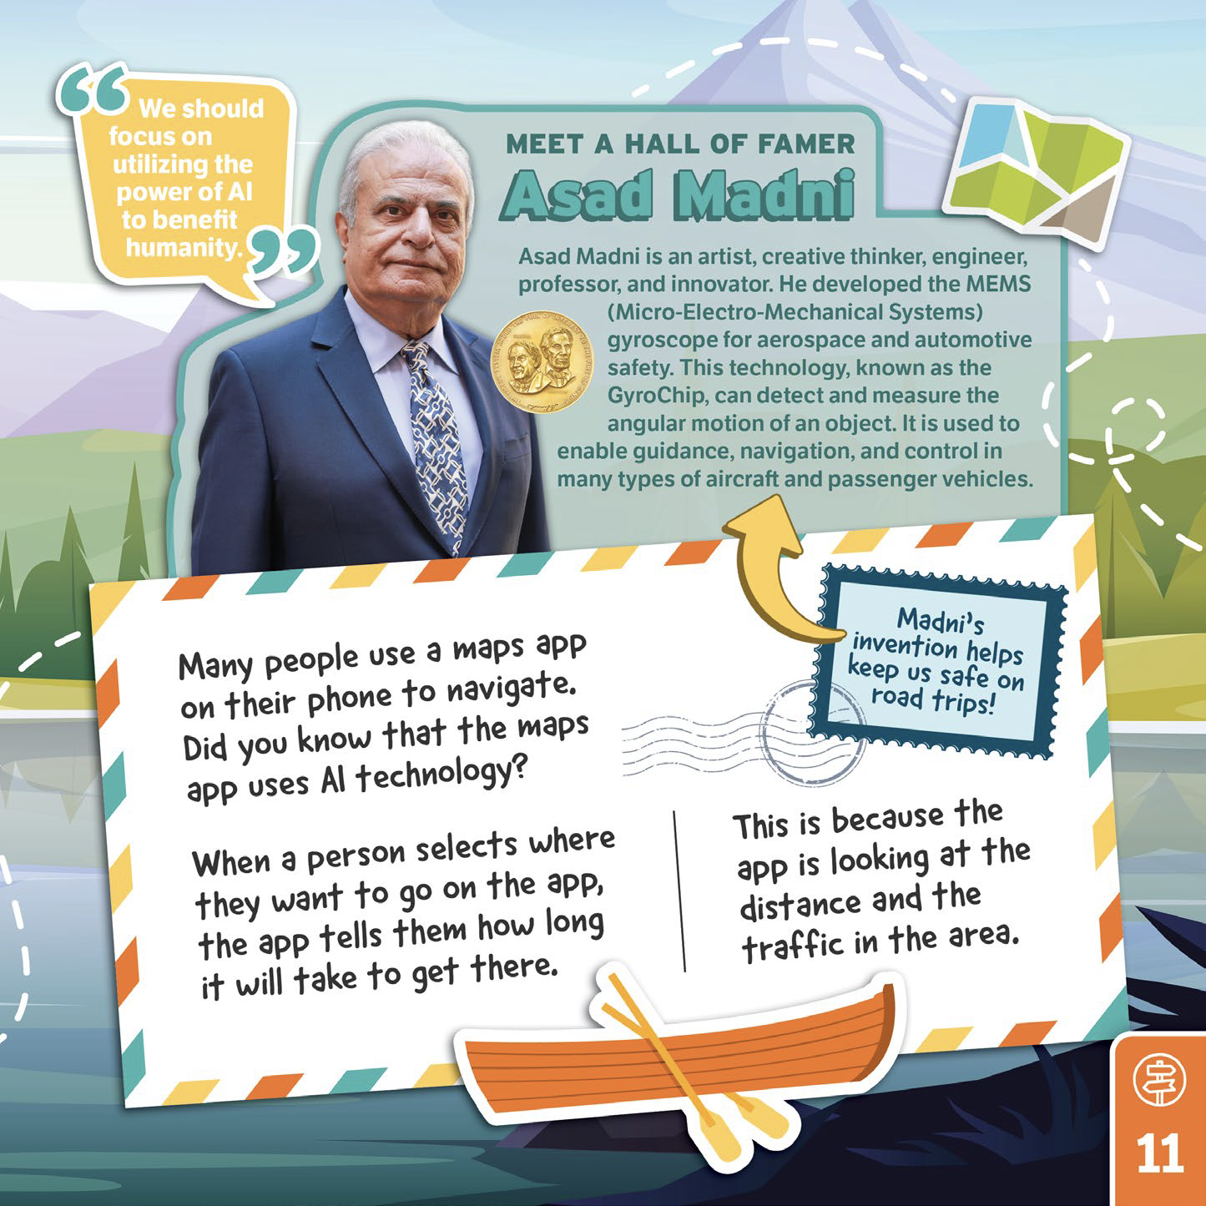
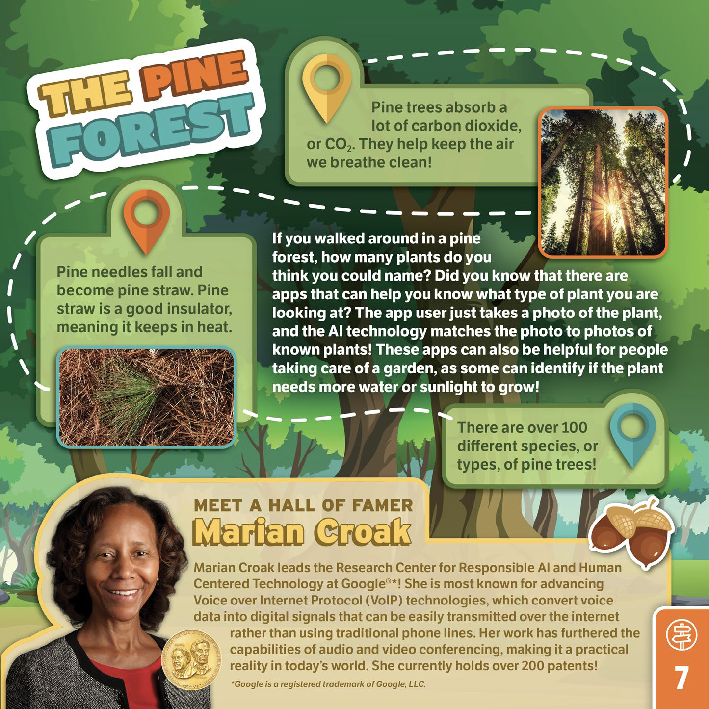
AI in the Inventor Log
Participants read about different ways that Artificial Intelligence can be used in the In Control™ Inventor Log. From navigating with a GPS to identifying plants, it proves to be a helpful resource!

Slide 14

Helping Teachers and Administrators Embrace AI
In Control™ helps teachers understand that the concept of AI has been around for a long time.
In the video pictured, Inductee Asad Madni narrates an animatic explaining to participants that the idea of machines completing human-type tasks is present in Greek Mythology.
Madni goes on to encourage the future generation to "focus on utilizing the power of AI to benefit humanity," and speaks to the breakthroughs in science that he has seen from Artificial Intelligence.
Full Video

Slide 15
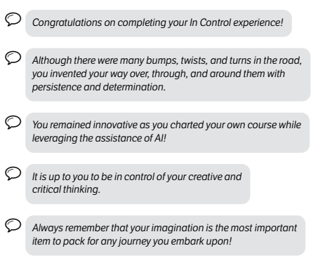
Teaching AI as a Resource
By framing AI as a helpful resource in In Control™, it opens the door for teachers and students to explore AI's benefits, while emphasizing that creativity still starts with them.
Participants are introduced to various ways to use AI on a road trip, such as: a GPS, apps that can identify plant and animal images, tire-changing machines, and vehicle safety features.
Excerpt from curriculum

Slide 16
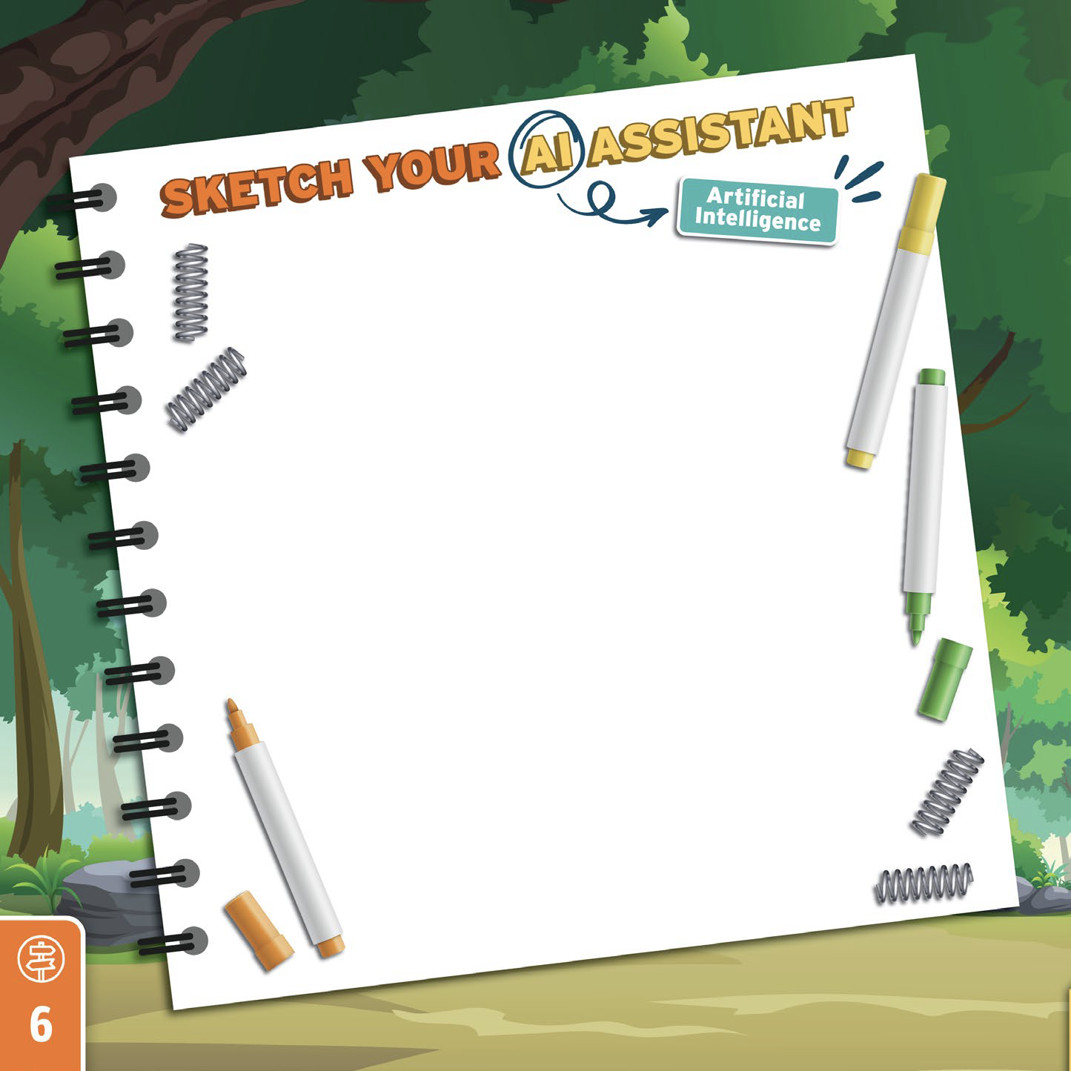
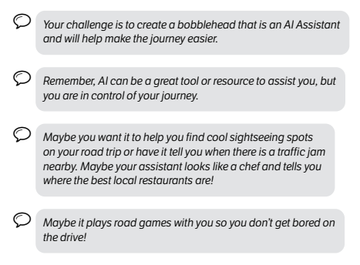

AI Assistant Challenge
Participants are challenged during In Control™ to sketch and design an AI Assistant bobblehead for their vehicle that will help make their journey more efficient.
Excerpt from curriculum

Slide 17
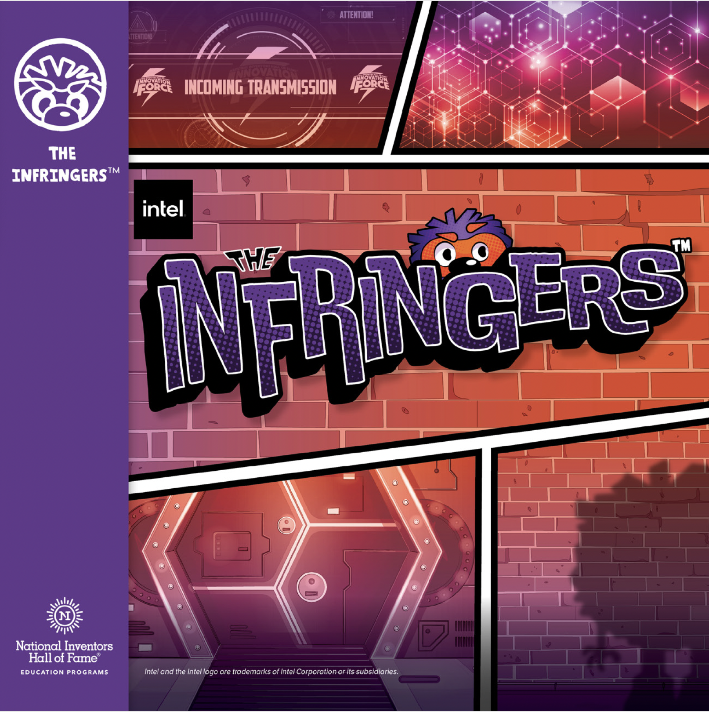
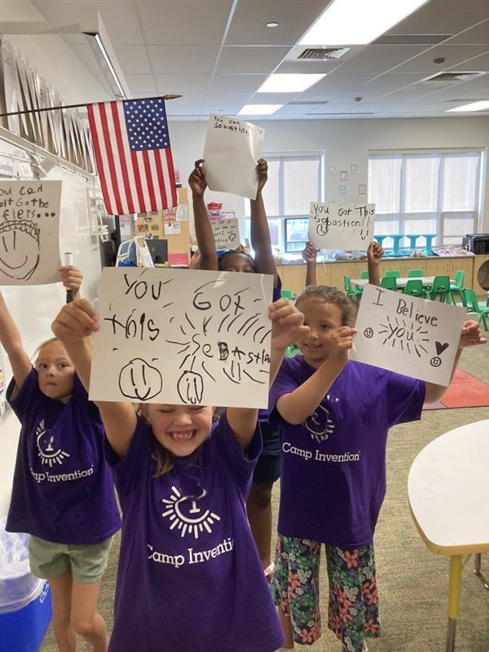
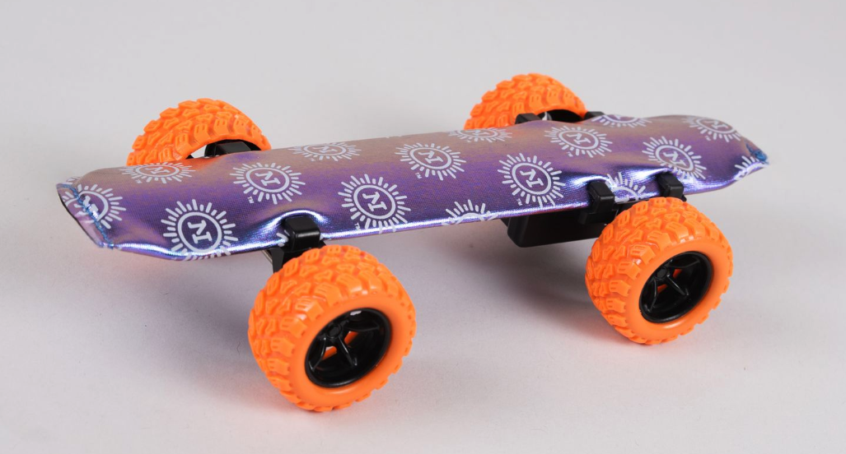
Curriculum: The Infringers™
In The Infringers™, children use the superpowers of the I Can Invent® Mindset to team up with the Innovation Force® — the National Inventors Hall of Fame Inductees — to identify and solve challenges in their community and around the world!
To safeguard their designs, participants construct wearable devices and develop a way to secure their ideas — outwitting the hackers from gaining access to their data.
This curriculum touches on AI as participants discover the science behind iris recognition systems.
Excerpt from curriculum:
"Another invention that is used to keep information safe is the iris recognition system invented by Innovation Force members Leonard Flom and Aran Safir. They based their idea on the fact that no two irises are alike."

Slide 18

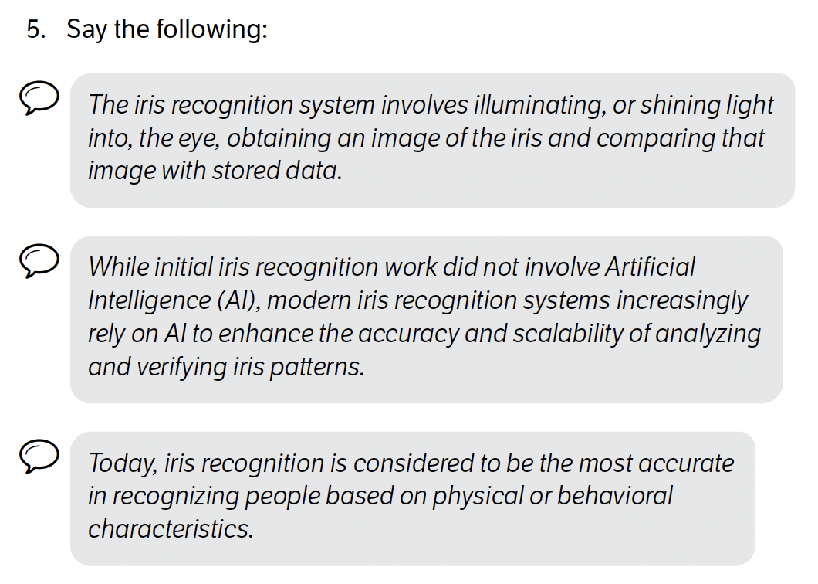

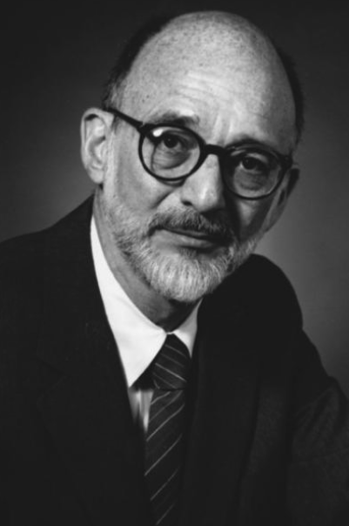
Iris Recognition & AI
The below excerpt from The Infringers™ curriculum provides an example of how we showcase advancements in technology and where AI is being utilized to create more efficient and secure processes.
Hall of Fame inventors of the iris recognition system: Leonard Flom and Aran Safir

Slide 19
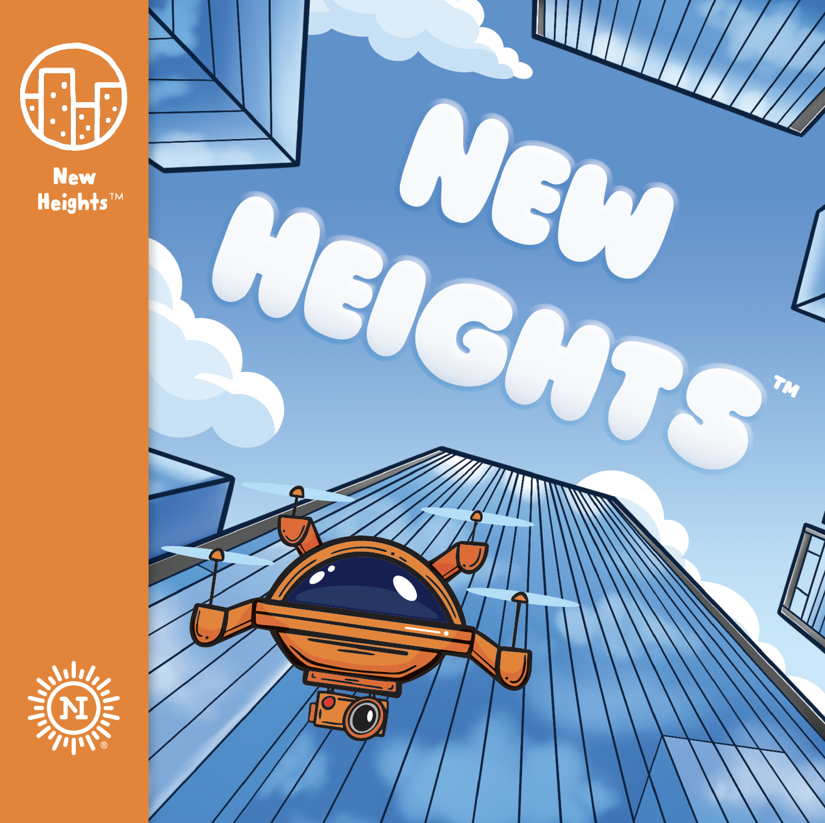

Curriculum: New Heights™
Children reach for New Heights™ as they discover what it takes to design and engineer buildings that touch the sky!
Participants incorporate Artificial Intelligence in their designs as they dream up smart features to help with efficiency.
Excerpt from curriculum:
"Have you ever seen a light that turns on without flipping a switch? Those lights are connected to a motion sensor. When you walk by the sensor, the light will turn on because of its programming. If there is no movement for a while, then the light’s programming will turn it off. It seems like the light is 'thinking,' but really it is controlled by smart technology."

Slide 20
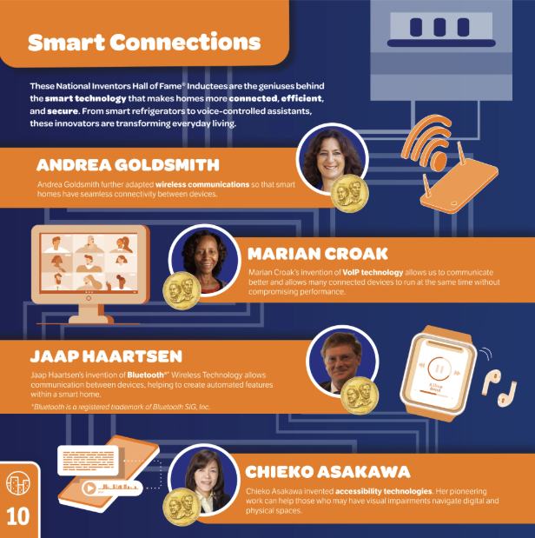

Smart Features
Smart inventions and inductees are highlighted in the New Heights™ Inventor Log and in videos to provide inspiration as participants sketch and design their own smart features.
Smart Structures Tour Video

Slide 21
For Teachers Who Want a Deeper Dive
NIHF Education team members collaborated with the Division Director for Information and Intelligent Systems at the National Science Foundation to help frame out Artificial Intelligence for teachers who are hoping to take a deeper dive into the topic. The following phrases are located in the back of select modules as an extended resource:
Artificial Intelligence, or AI, is technology programmed by humans to complete tasks that people can do.
A powerful way to build AI systems uses machine learning, a set of techniques for creating decision-making programs from data collected from the world.
The three sub-areas of machine learning are supervised learning, reinforcement learning, and unsupervised learning.
Supervised learning makes use of data labeled by human experts.
Reinforcement learning allows machines to do trial and error learning to create their own solutions to tasks defined by experts.
Unsupervised learning looks at unlabeled sets of data to create clusters or discover patterns without human guidance.
Deep learning is a method for carrying out machine learning that solves problems by enormous collections of very simple calculations that are inspired by networks of neurons that make up human and animal brains.
Machine-learning algorithms can produce decision-making systems, known as classifiers, as well as systems that can mimic the data it is trained on, resulting in a “generative AI.”
Generative AI systems are in wide use today and can produce natural sounding sentences and realistic pictures. While AI can provide a great resource to perform tasks, humans are the ones creatively thinking behind the scenes, as well as the ones producing the examples that are required to train them.

