Slide 1



Slide 2

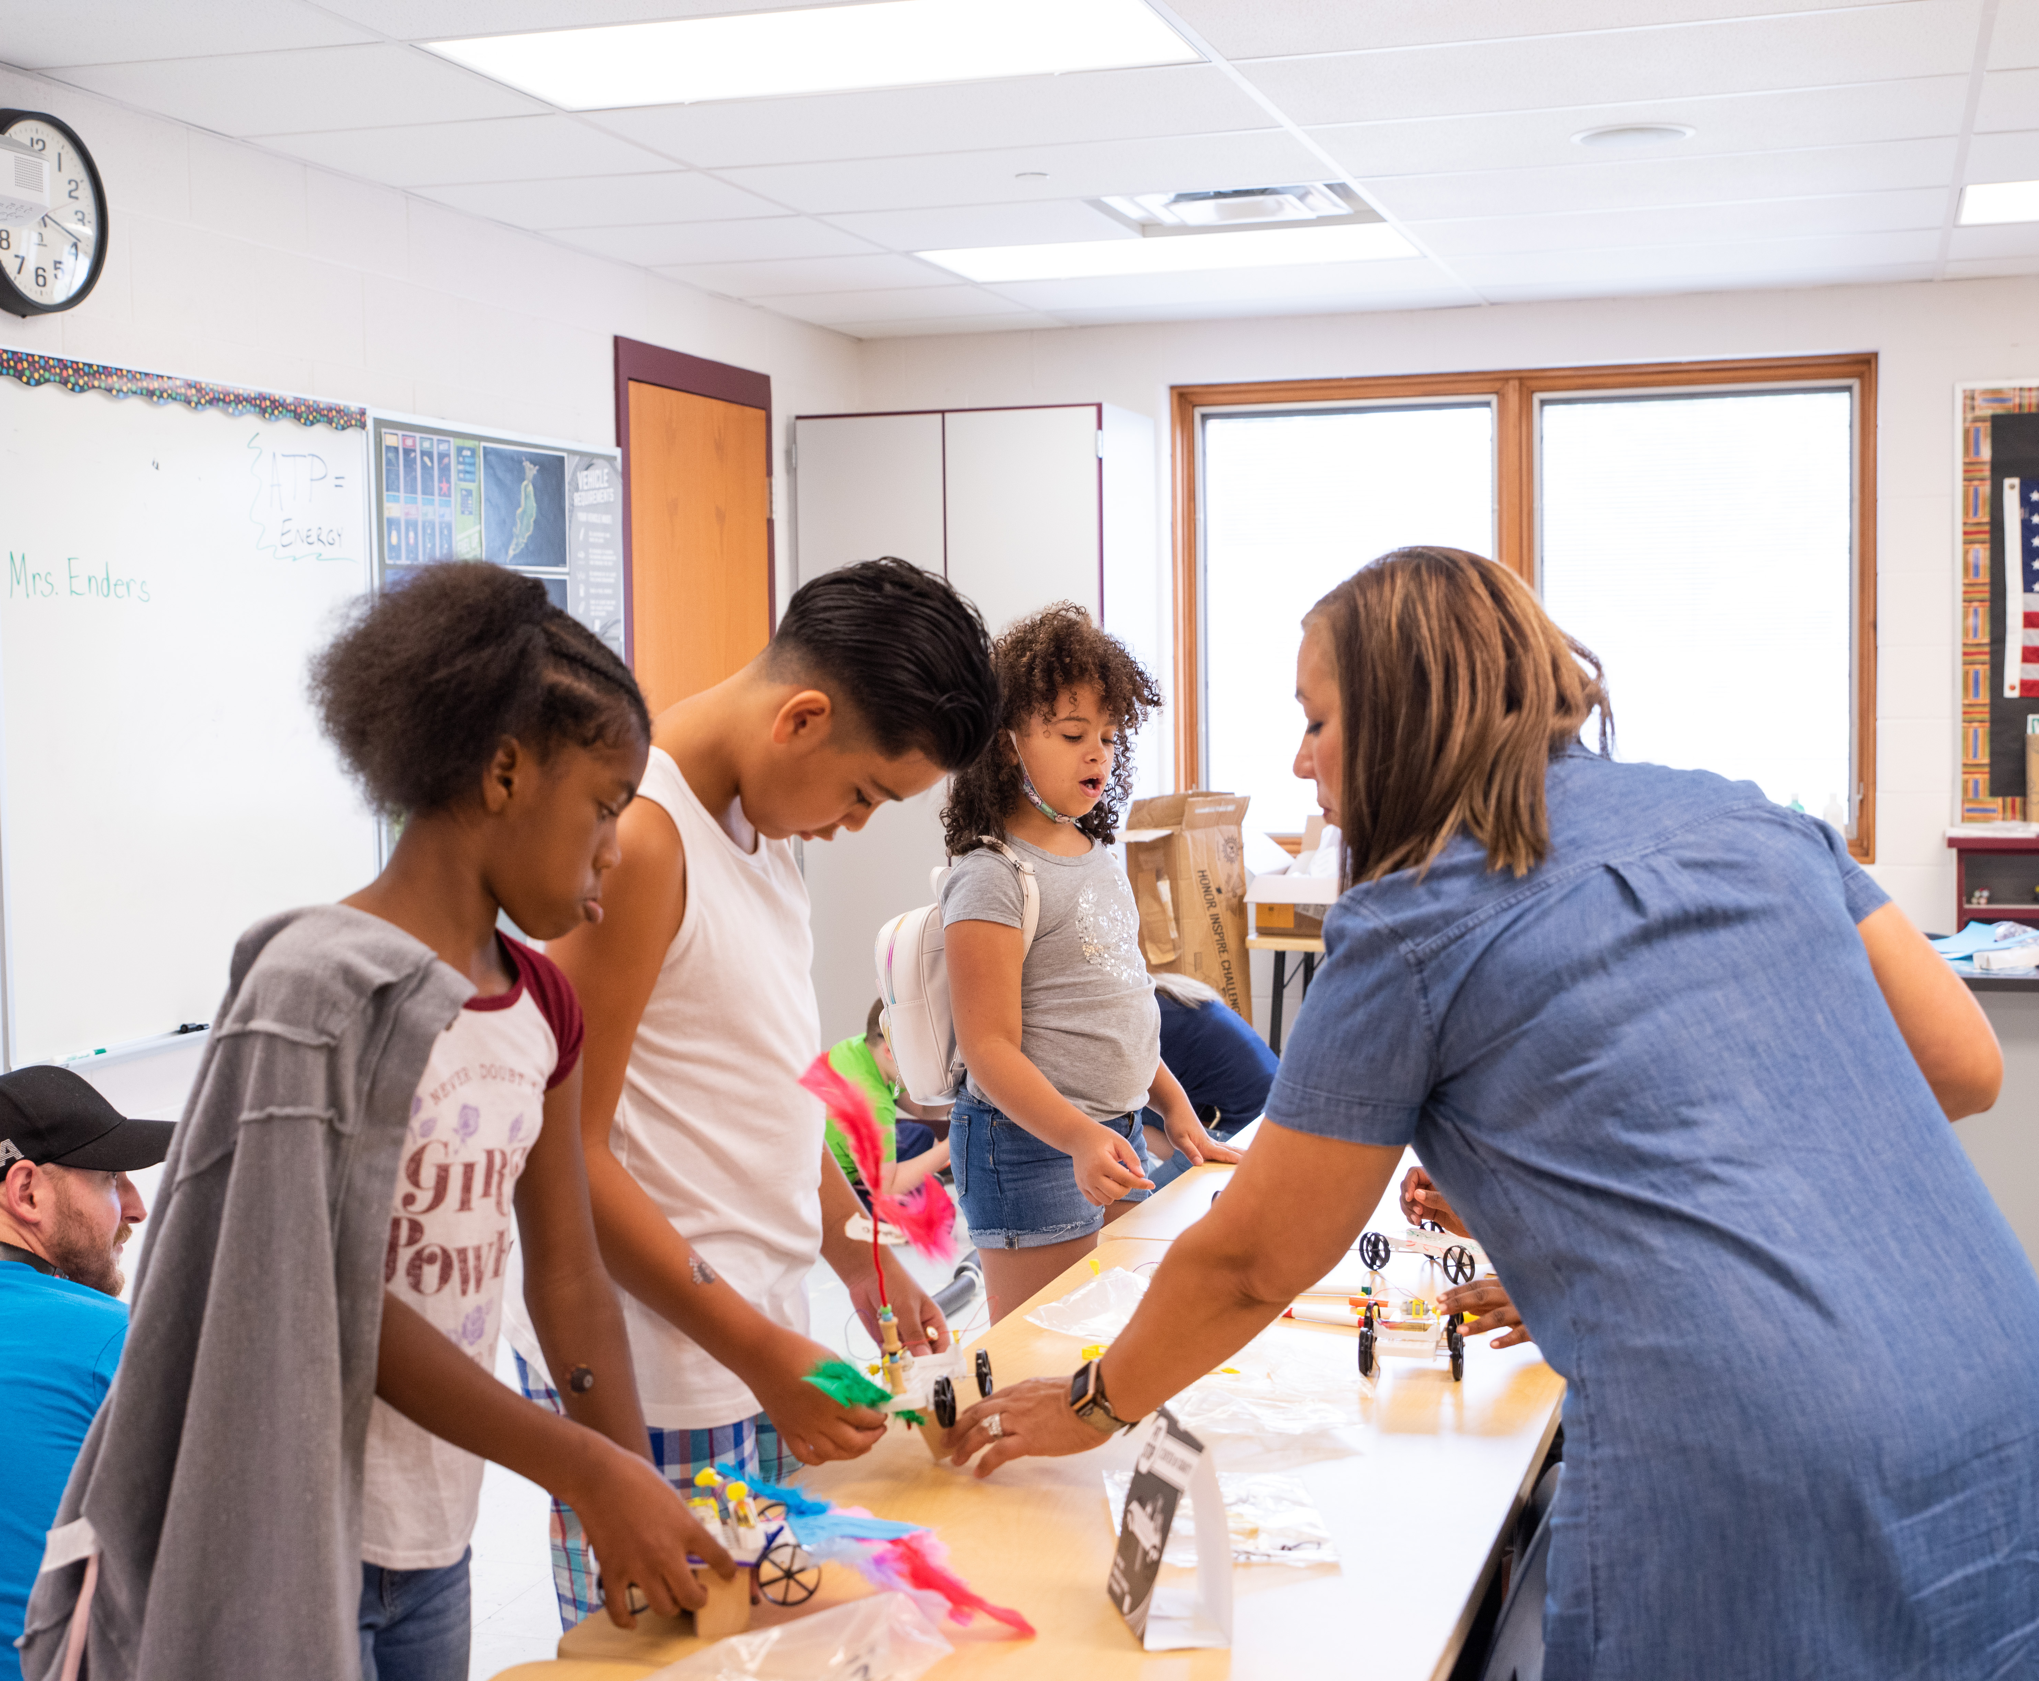

Invention Project® provides a turnkey system for bringing invention education to students year-round.
This is invention education
in action.

Slide 3
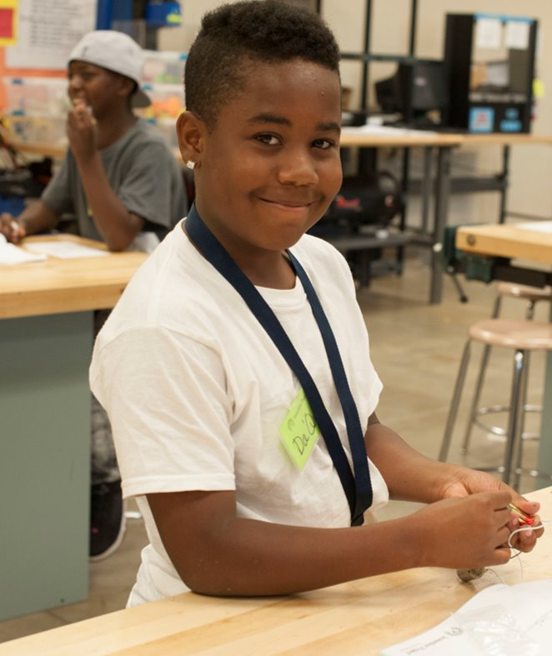




PreK-8 Differentiation
Flexible Curriculum
Stress-Free Implementation
Authentic Life Skills

Slide 4
PreK-8 Differentiation
Grade-aligned modules with developmentally
appropriate instruction
Ability to adapt to individual student needs and learning styles
Supportive student resources including required materials, interactive booklets and
an online learning platform

Slide 5
Flexible Curriculum
32 unique experiences that adapt to your
district’s exact in-school, afterschool or
summer learning needs
Instructor or self-led implementation
Includes pre- and post-tests to track
student progress
Aligned to national and state standards

Slide 6
Stress-Free Implementation
Step-by-step curriculum guide and online resources reduce prep time
Individually packaged materials allow for hassle-free implementation and setup
Dedicated National Inventors Hall of Fame® support to answer questions and provide solutions

Slide 7
Authentic Life Skills
Engaging, hands-on activities promote teamwork and collaboration
Invention education experiences that
build competency in decision-making
and self-management
Opportunities to practice empathy and relationship skills

Slide 8
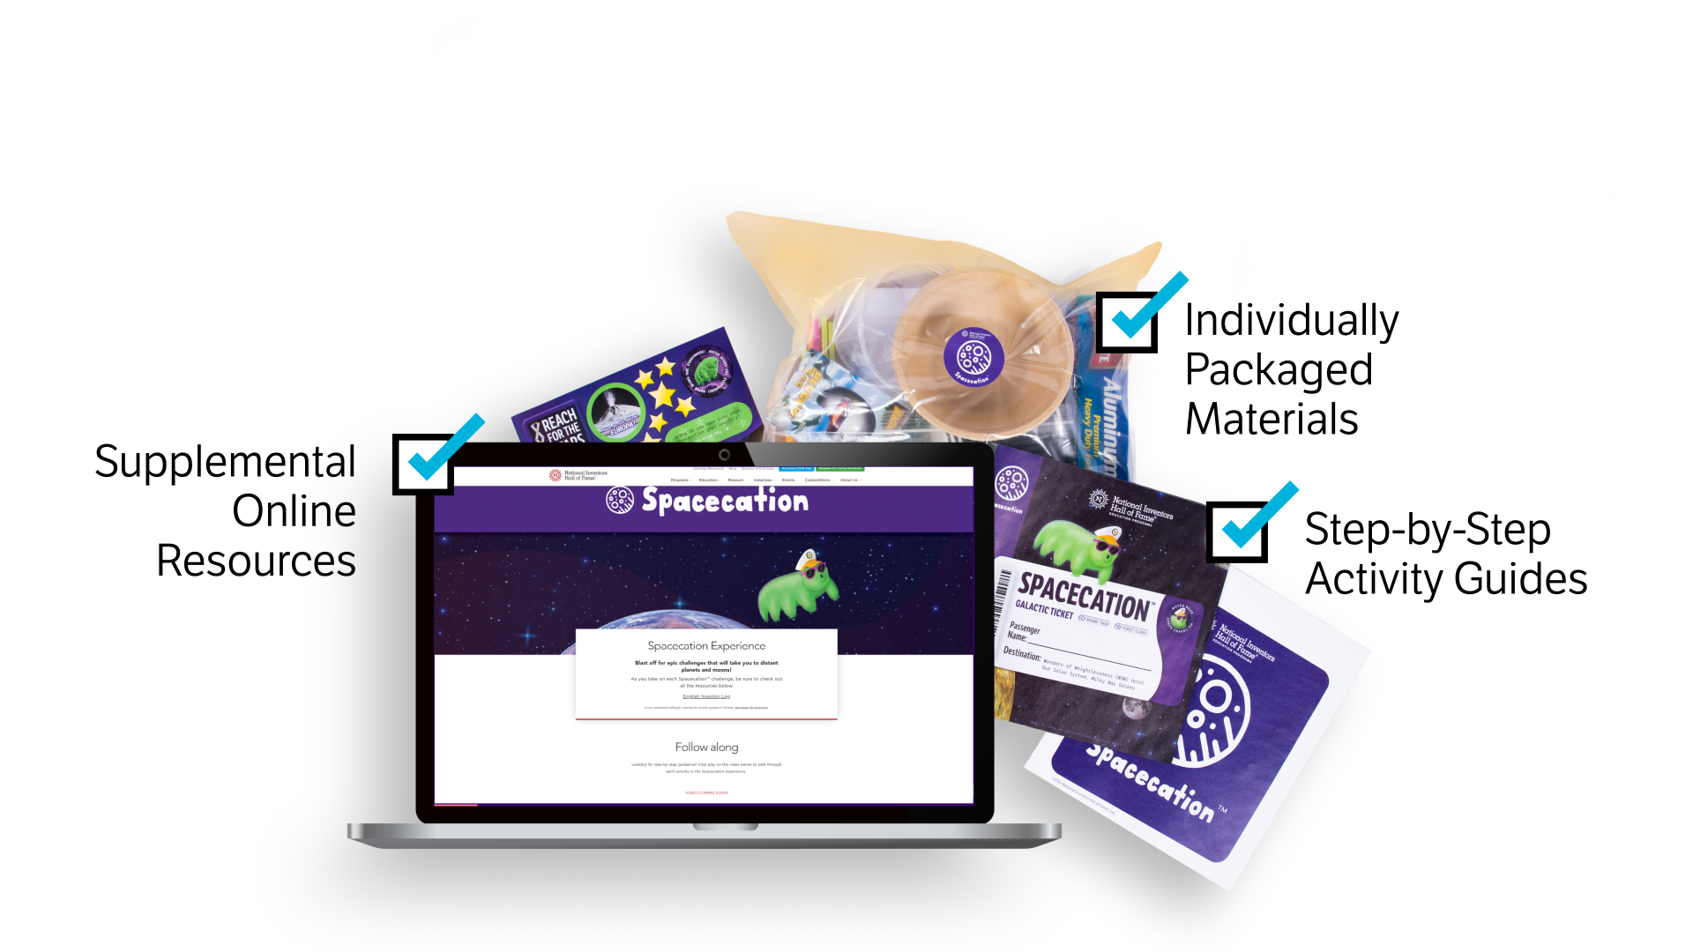
Student resources

Slide 9
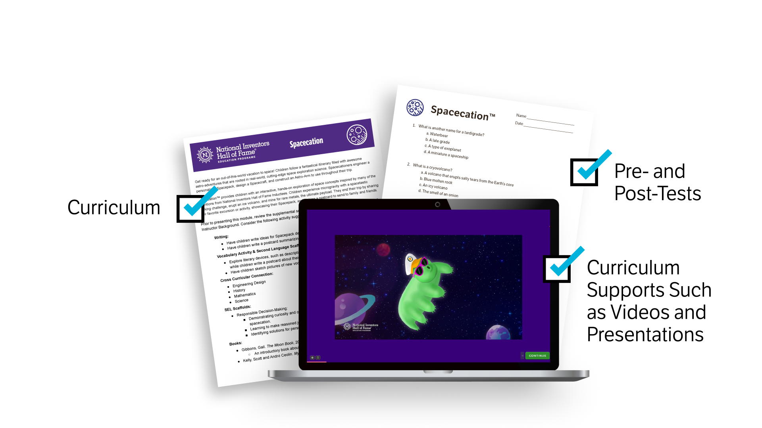
Teacher resources

Slide 10
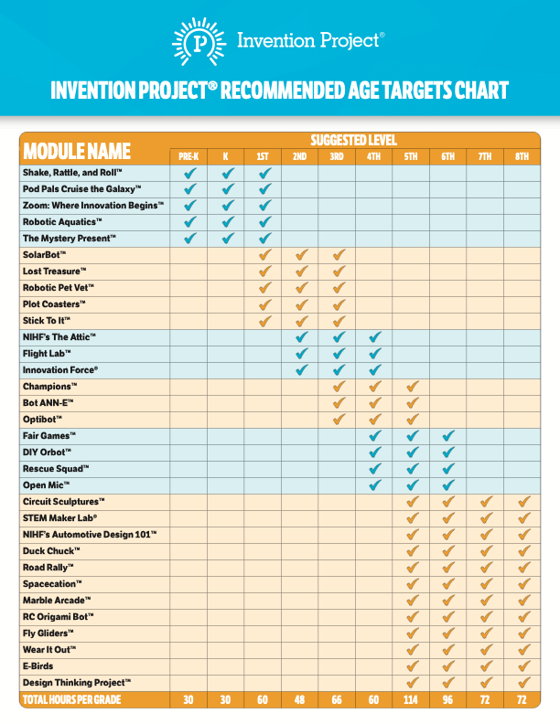
32 unique, six-hour
modules provide multiple, hands-on experience options for students in PreK-8

Slide 11
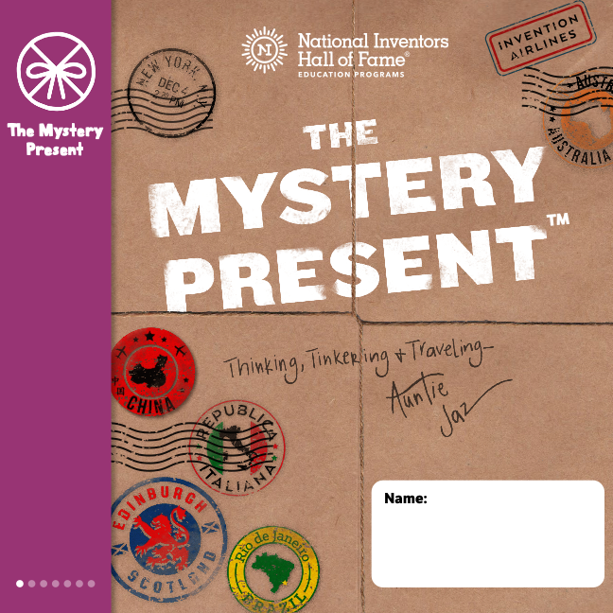

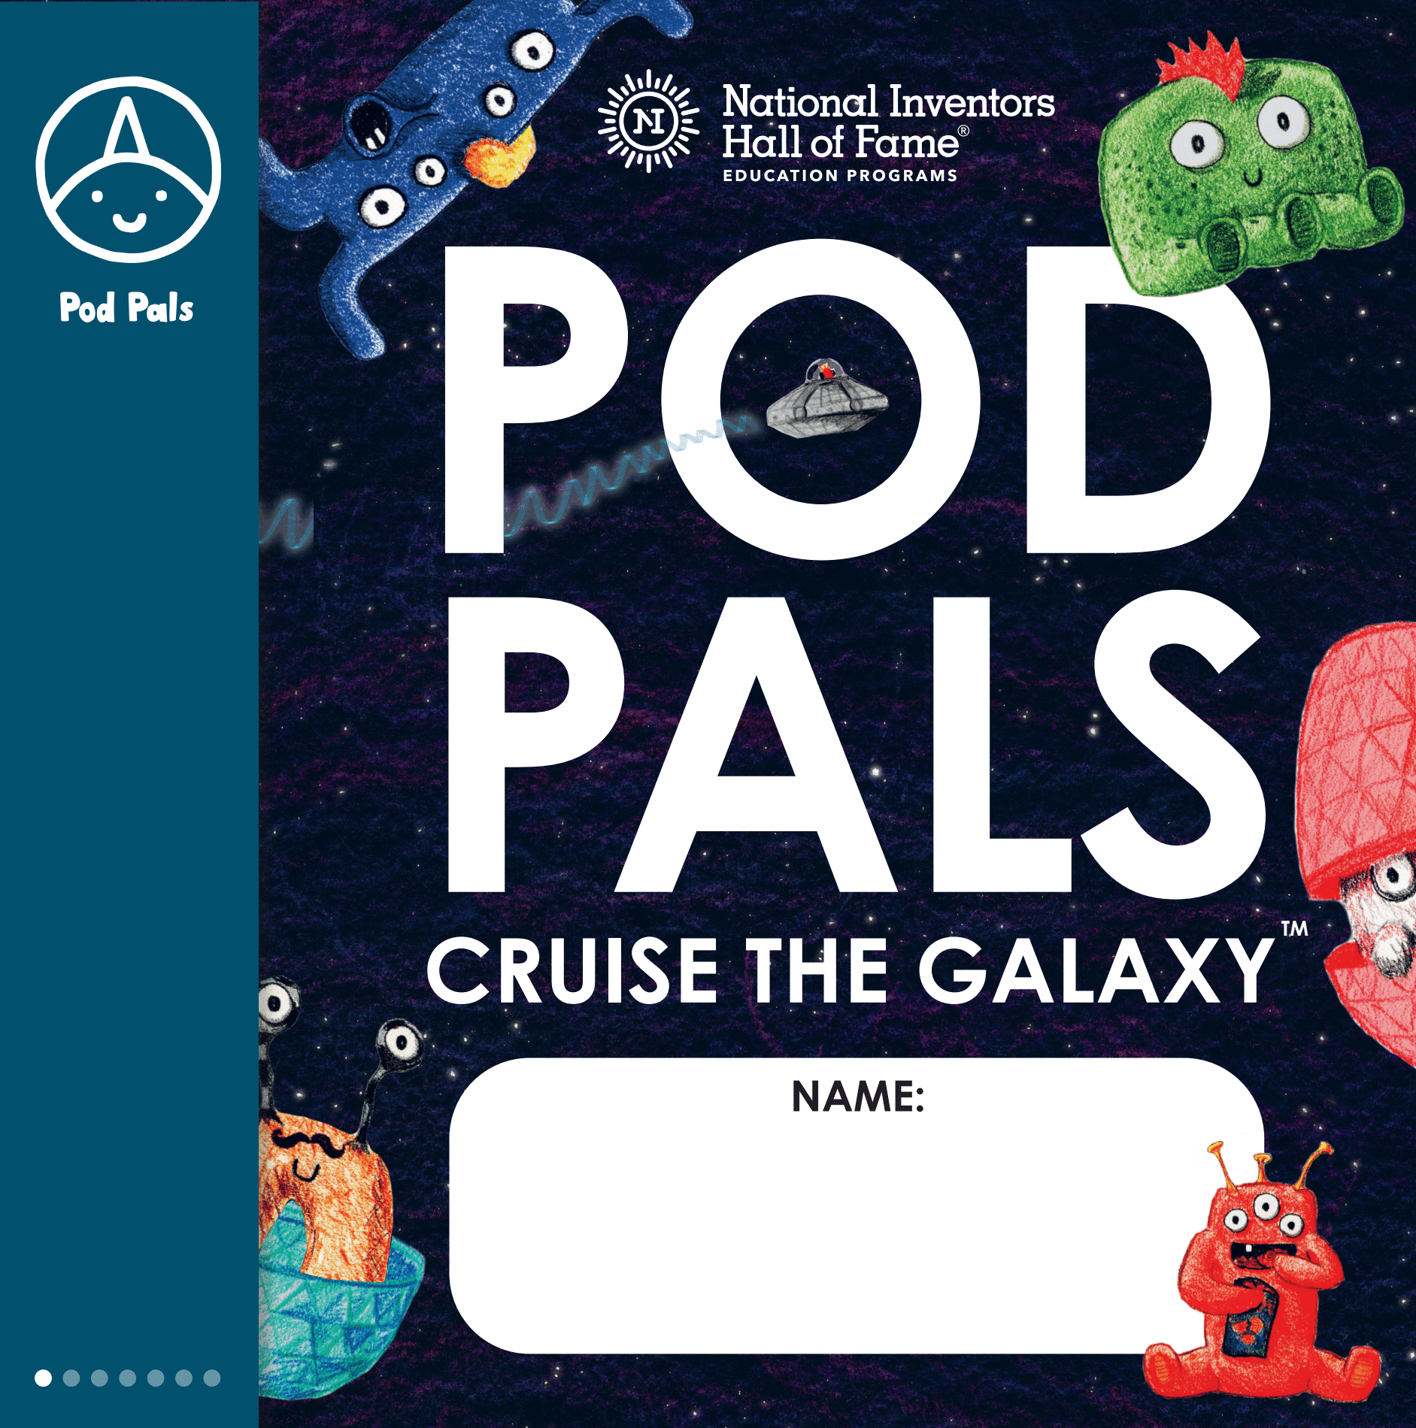
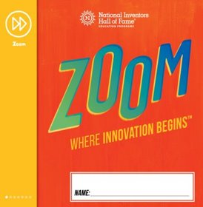
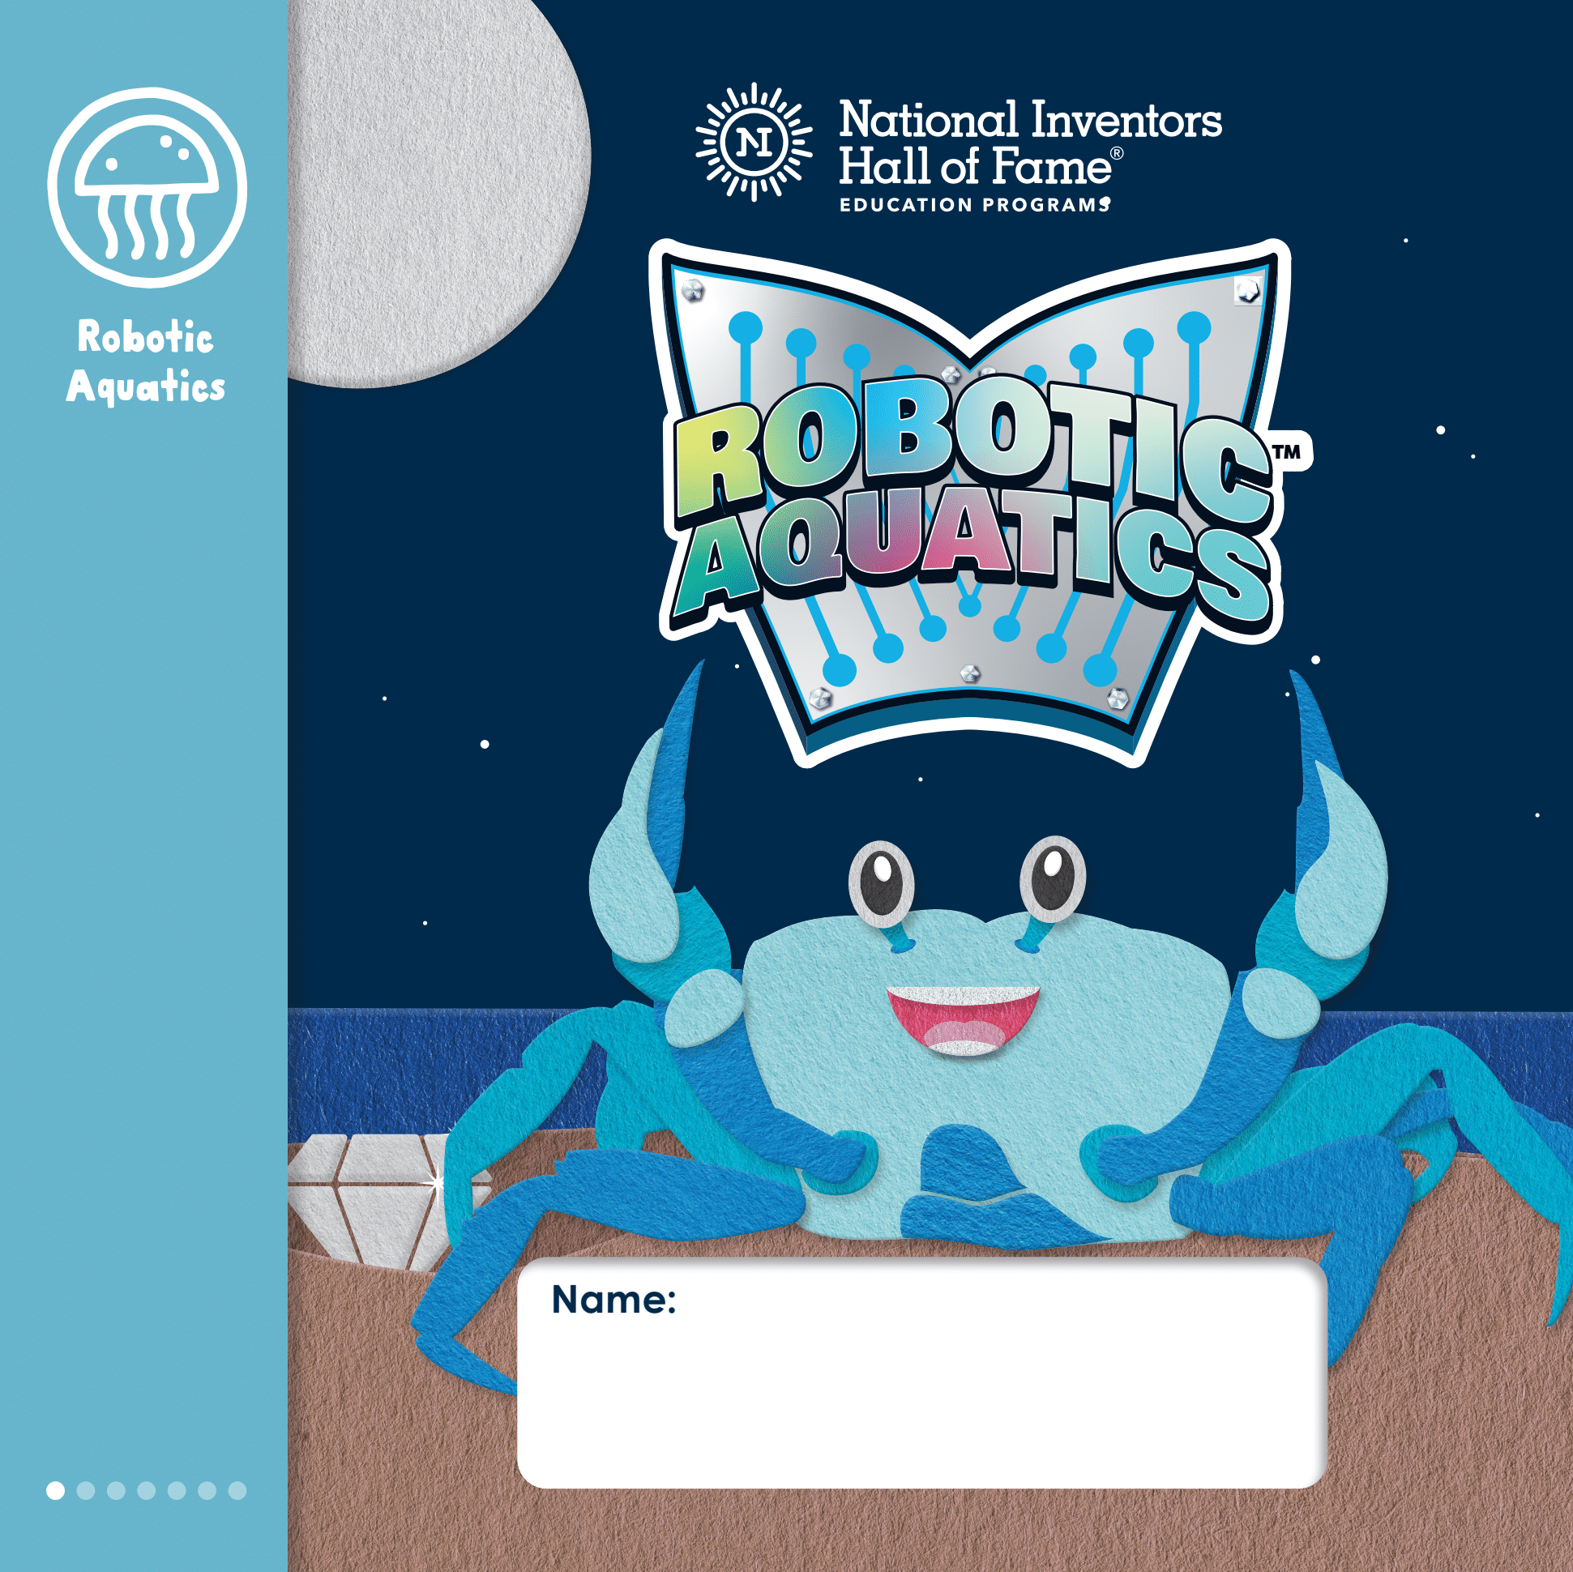
Grade Level: PreK-1st
In The Mystery Present™, children discover global geography through immersive storytelling, exploring circuitry, art and design thinking.
Shake, Rattle and Roll™ invites children to investigate sound waves, explore communication and build sound-based inventions.
As they help alien friends known as the Pod Pals™, children explore science concepts from gravity to nutrition to the color spectrum.
In Zoom™, children explore exciting career paths through challenges from developing ocean exploration inventions to creating slime.
Diving into ocean research, children create a habitat for their own aquatic friend and create a bio-inspired invention in Robotic Aquatics™.

Slide 12
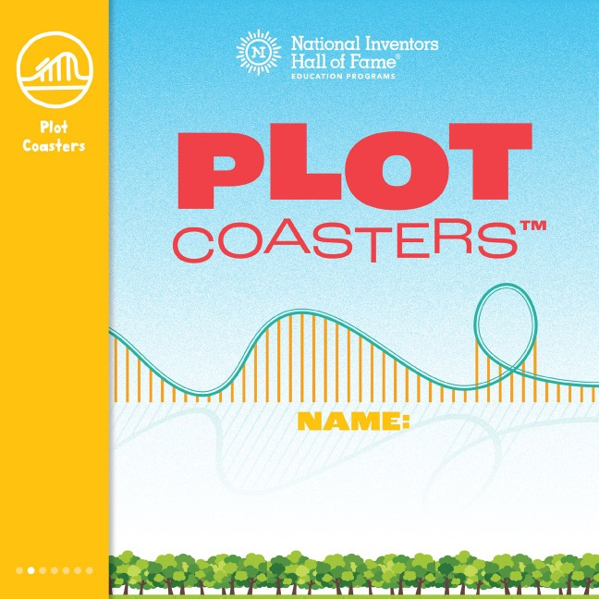
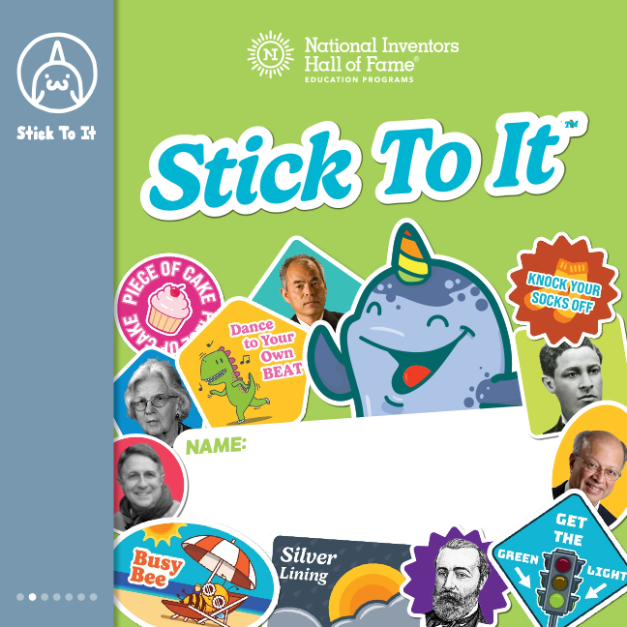
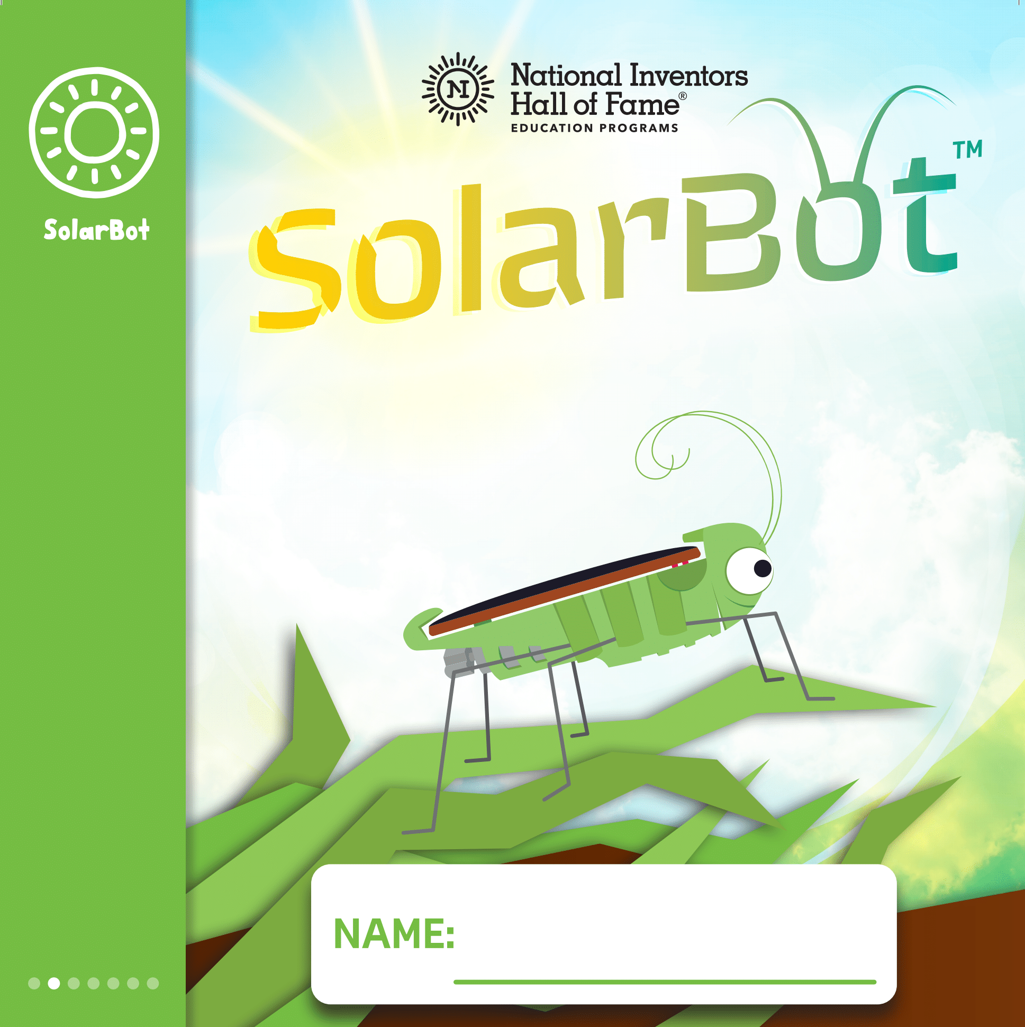

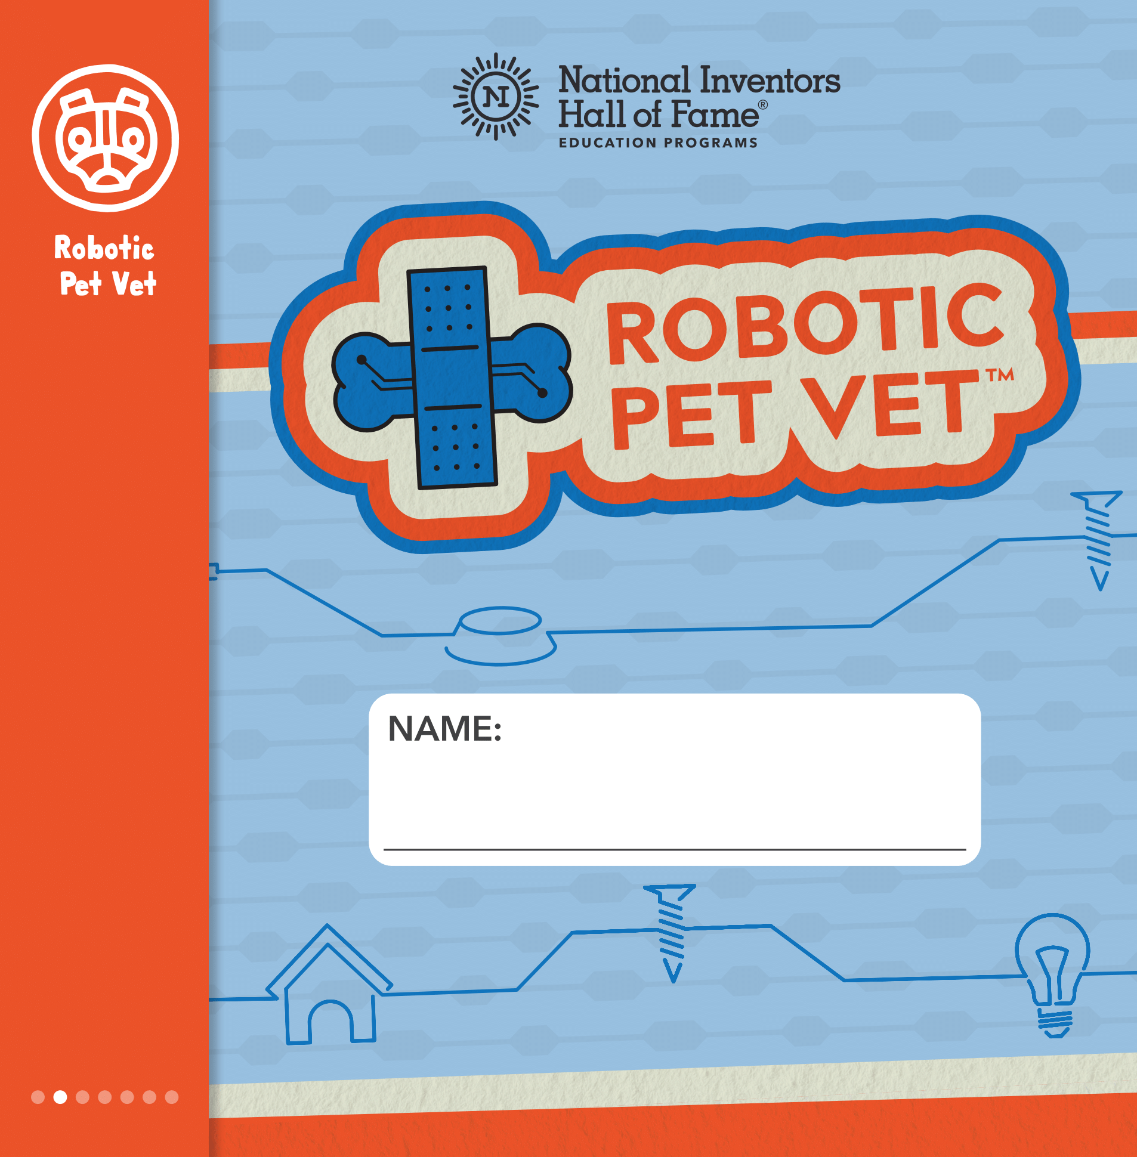
Grade Level: 1st-3rd
Students fasten their seatbelts for creativity as they design epic roller coasters and write a best-selling story while riding through physics and design engineering in Plot Coasters™.
Stick To It™ inspires children to dream big through hands-on challenges with the chance to think like a design engineer, mechanical engineer and physicist.
In SolarBot™, students explore circuitry, engineering and nature when they build a solar-powered cricket and customize its habitat.
To find Lost Treasure™, children create an adventure story, investigate volcanoes and build an invention to reach fruit in trees.
Exploring biology, physiology and circuitry, students take apart and diagnose a robotic dog in Robotic Pet Vet™.

Slide 13
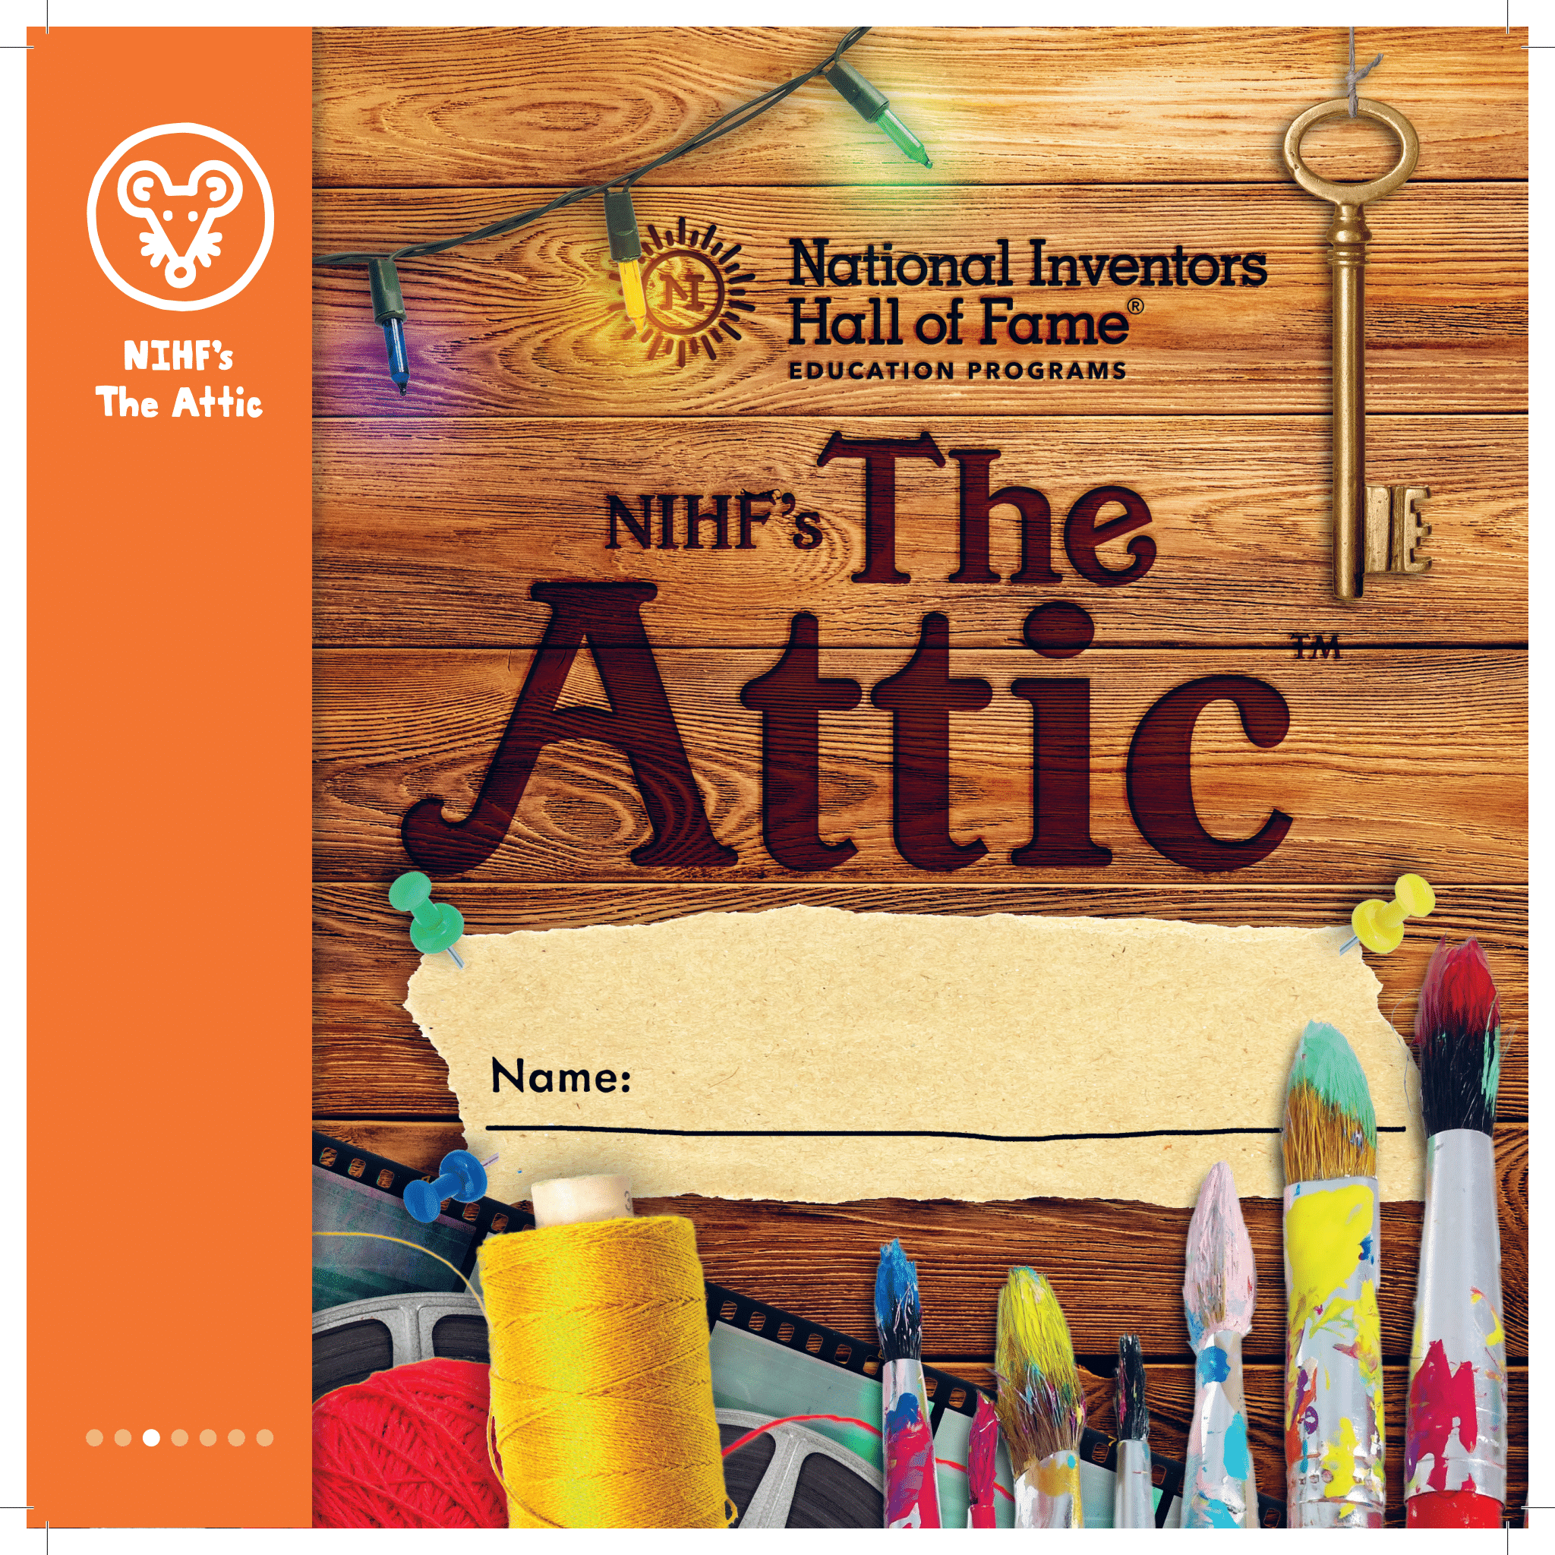
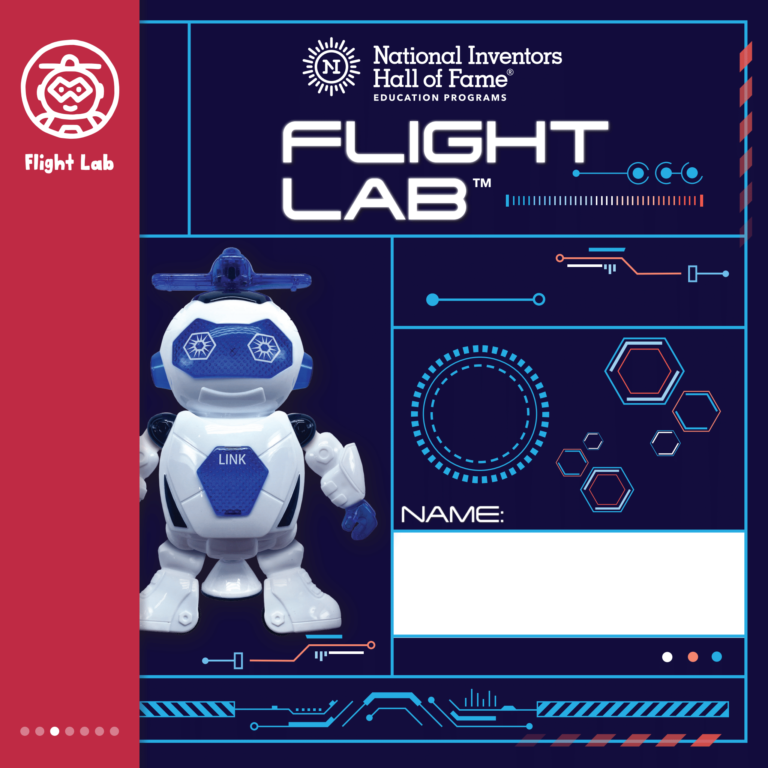
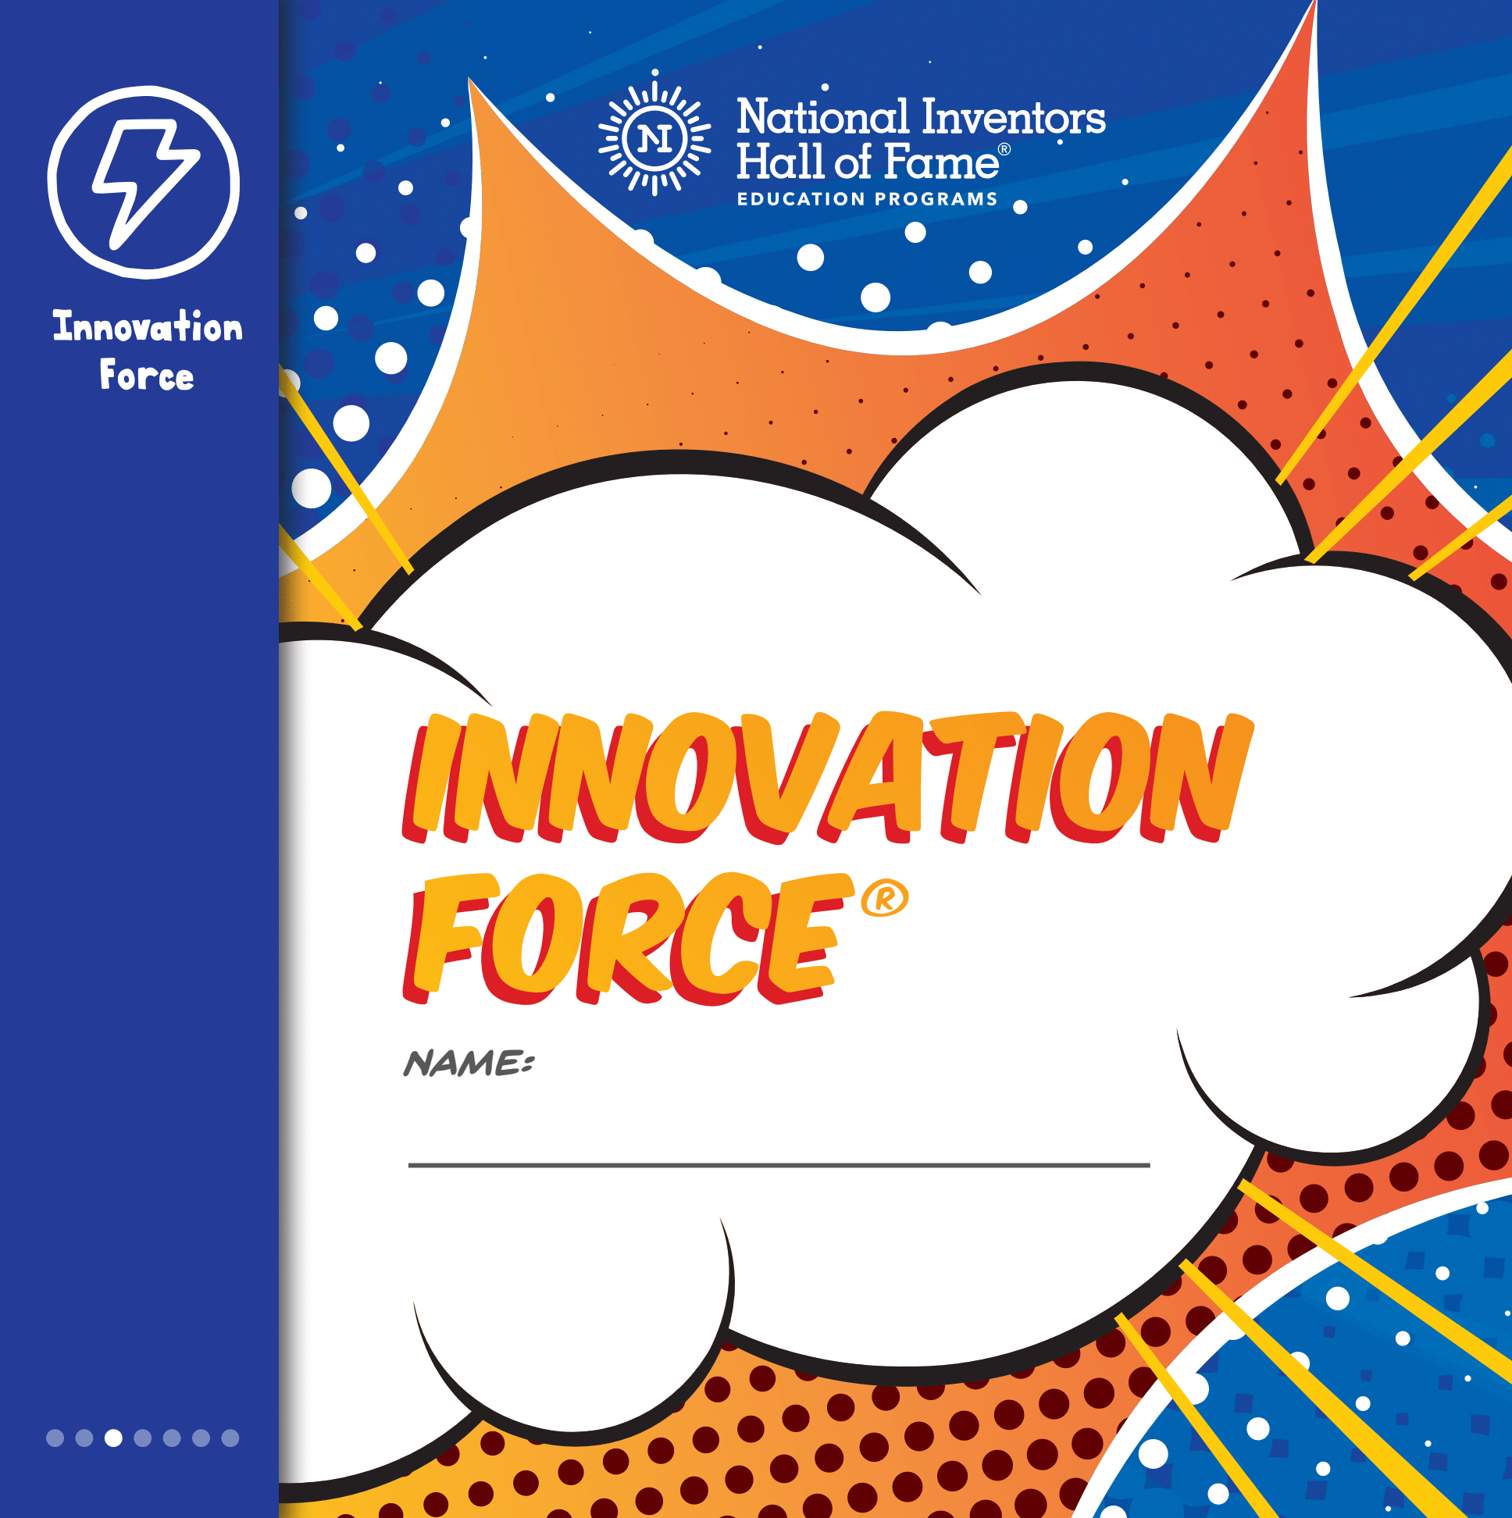
Grade Level: 2nd-4th
Children experiment with animation, chemistry and materials science, build their own Arty Bot and create spin art in The Attic™.
Students soar in Flight Lab™ as they explore the principles of flight with robots, gliders and handcopters.
Children join the Innovation Force®, a team of world-changing inventors, to design, build and market their own invention.

Slide 14

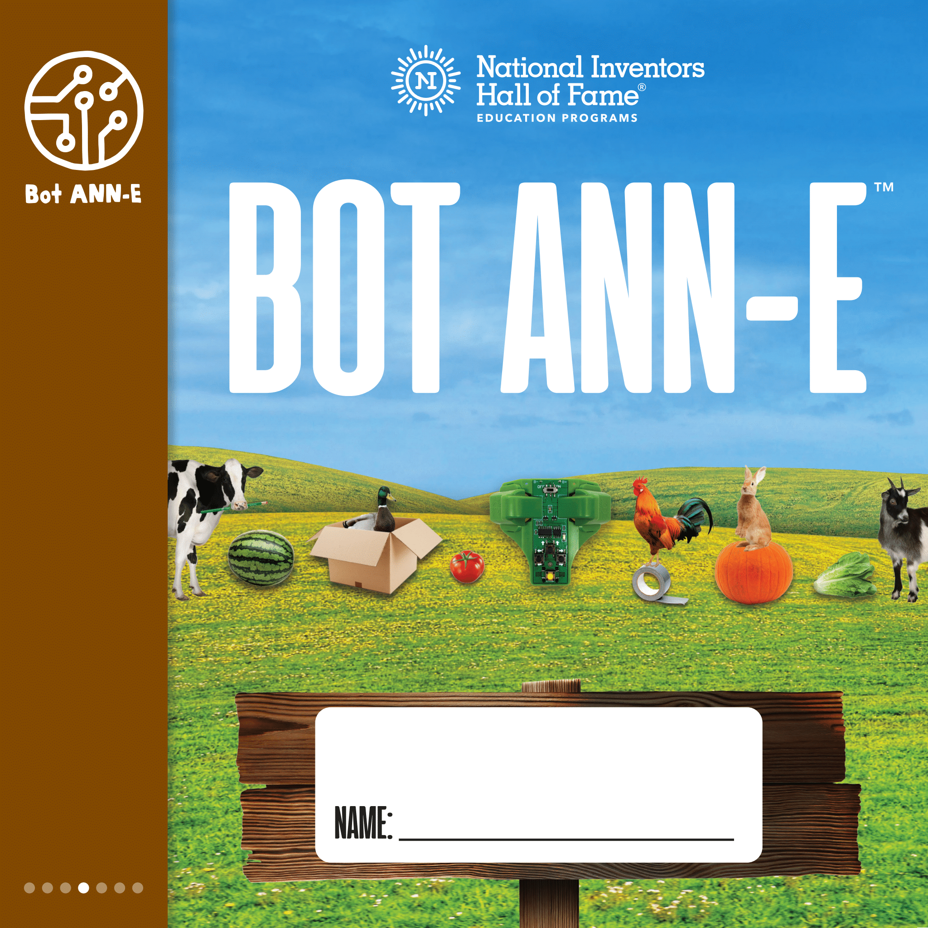
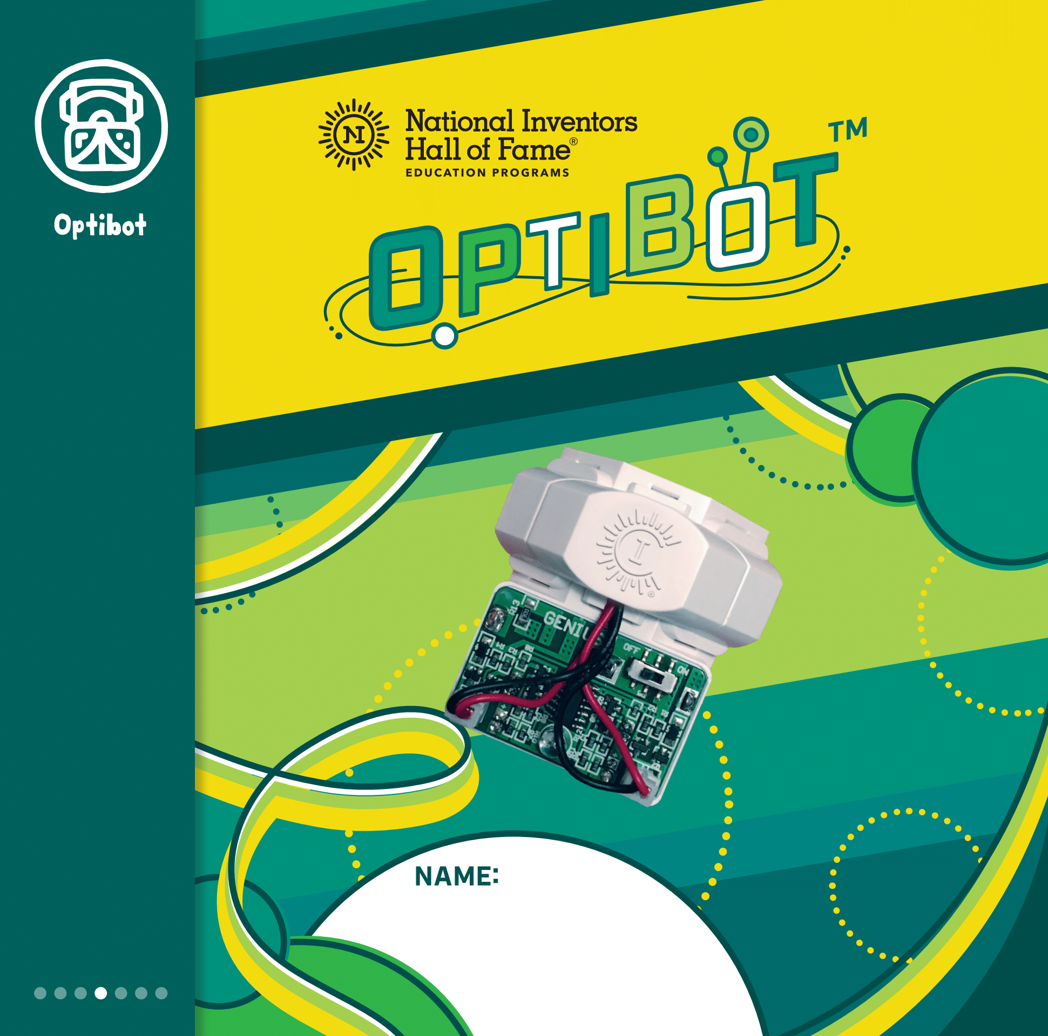
Grade Level: 3rd-5th
In Champions, children use creative problem solving to design and build the ultimate sports complex.
Children explore automated technology, learn fundamental coding and program a robot to tend to a farm in Bot ANN-E™.
With their self-driving Optibot™, children explore technology in transportation and design a futuristic vehicle.

Slide 15

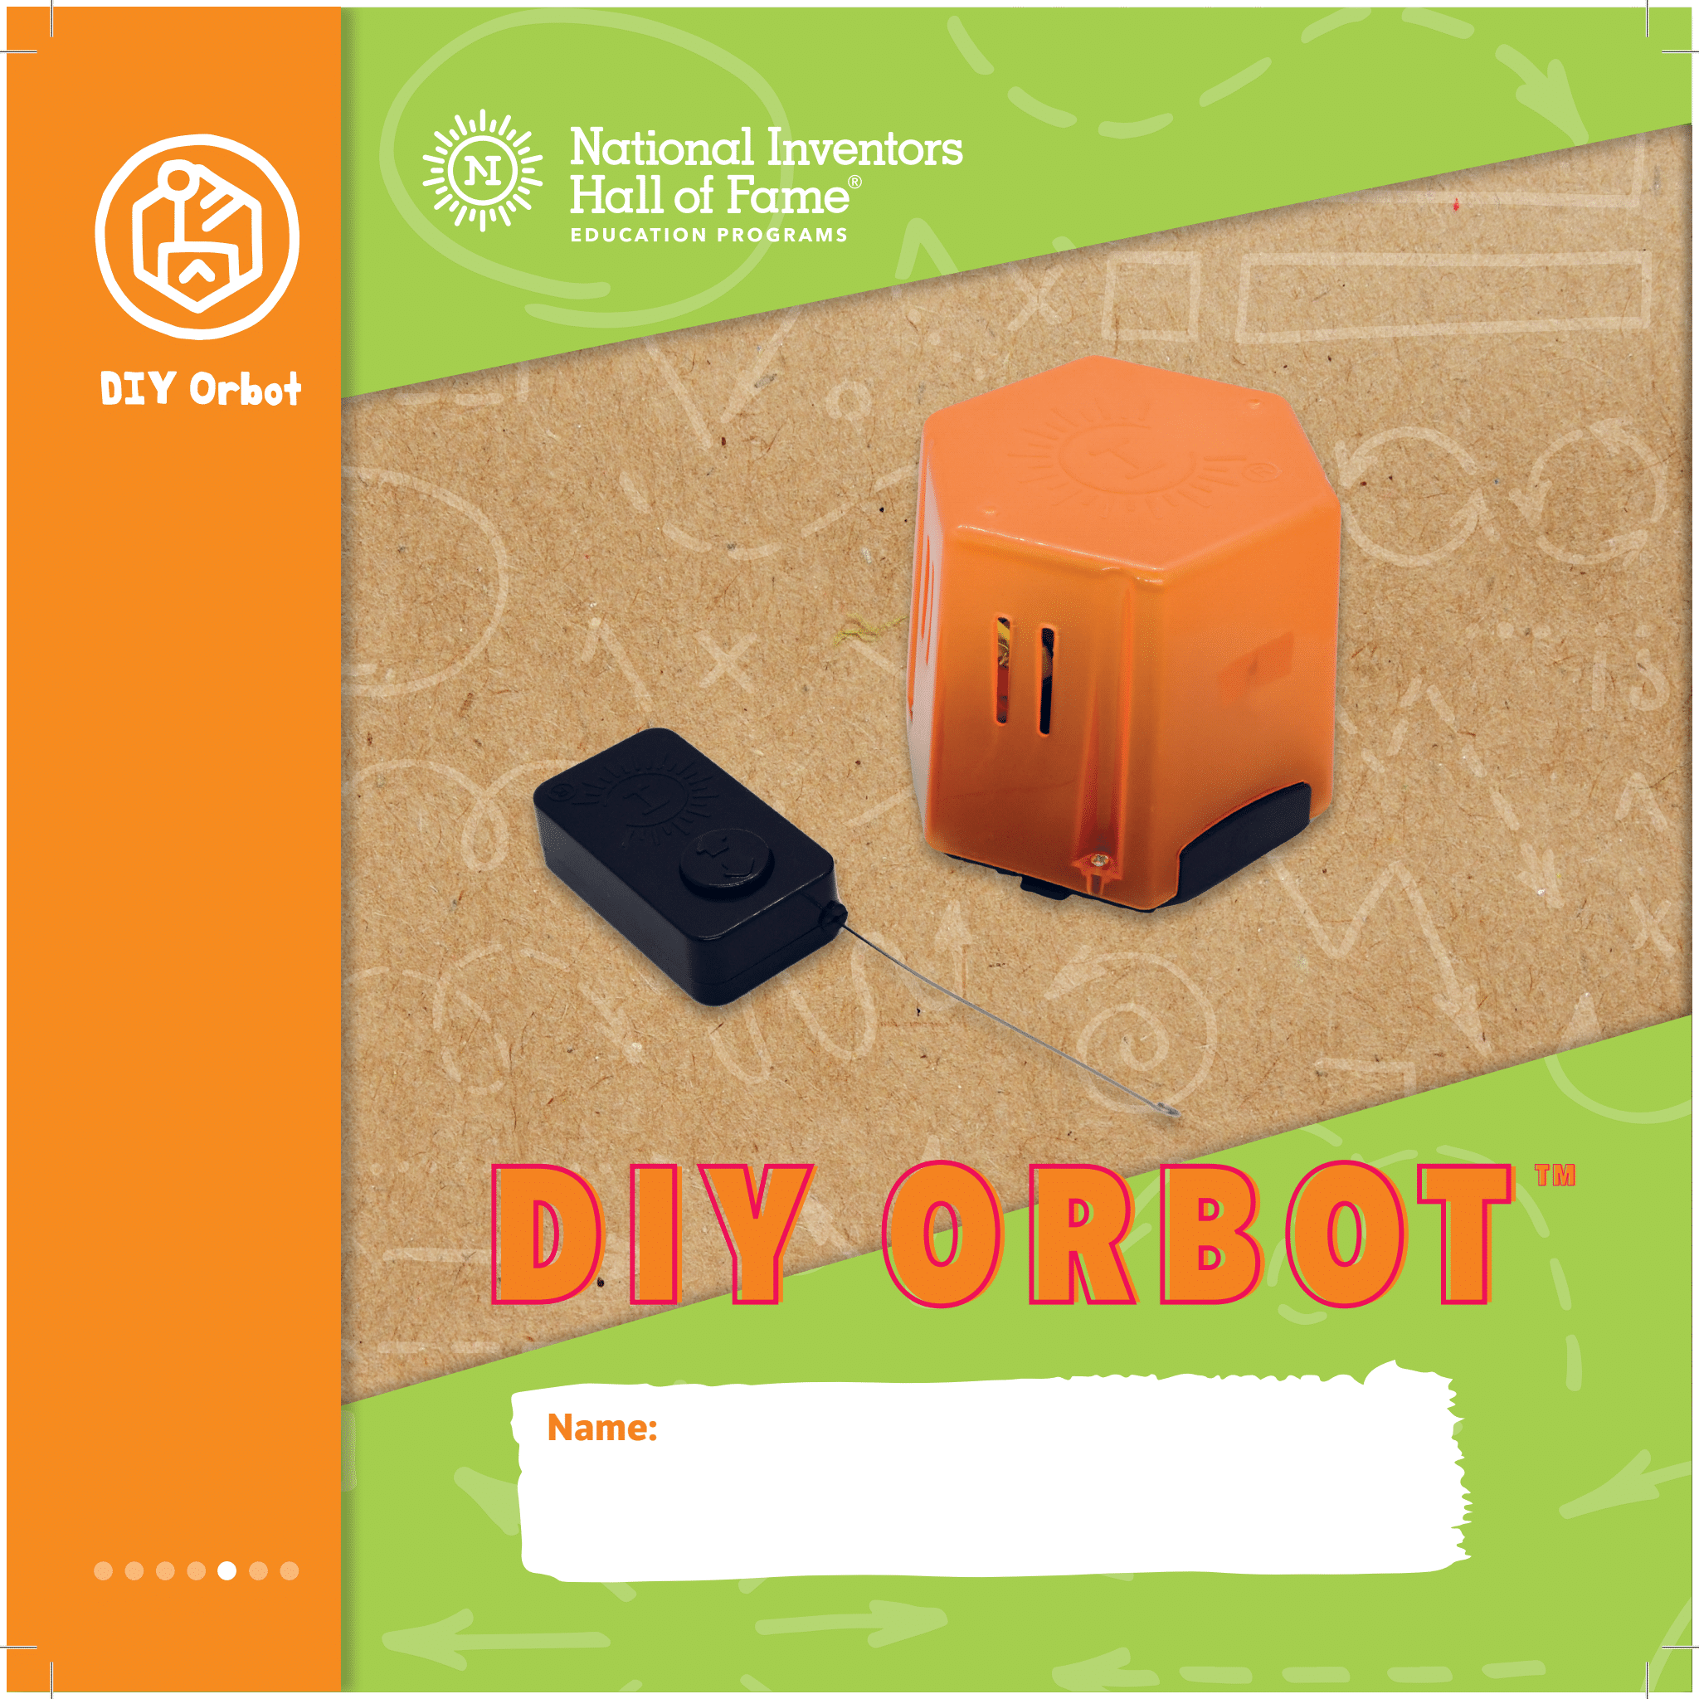
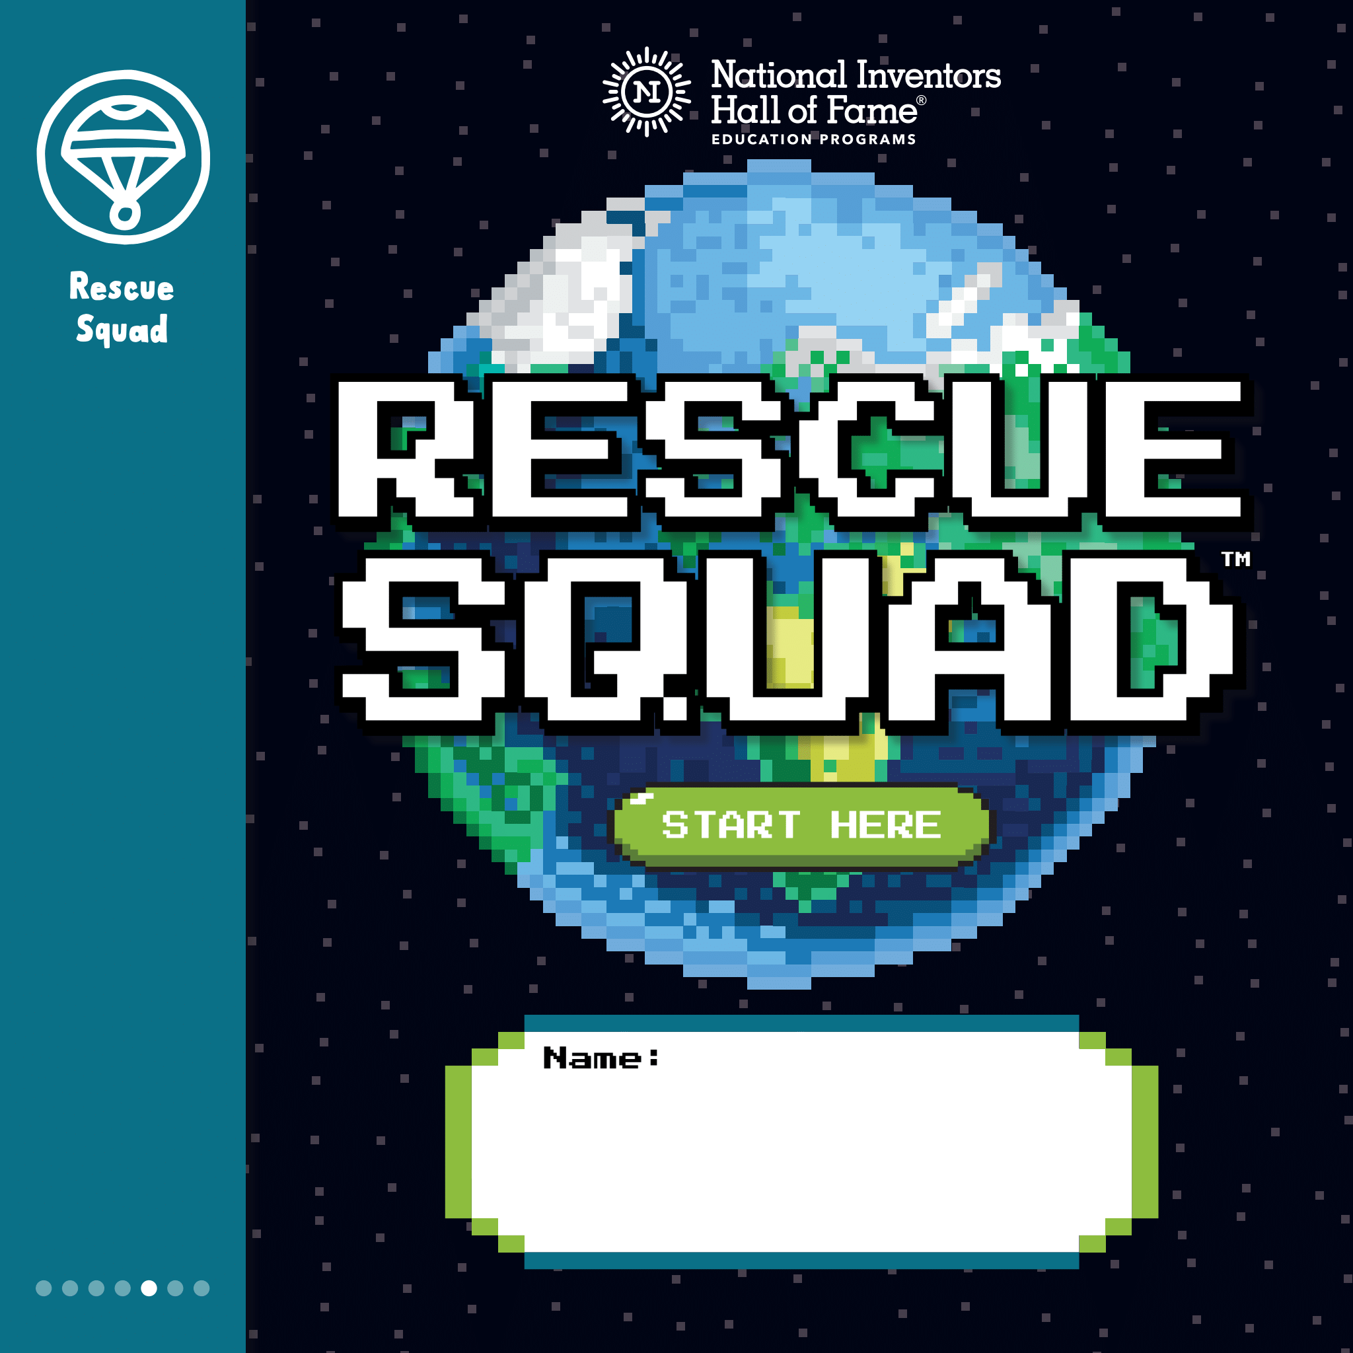
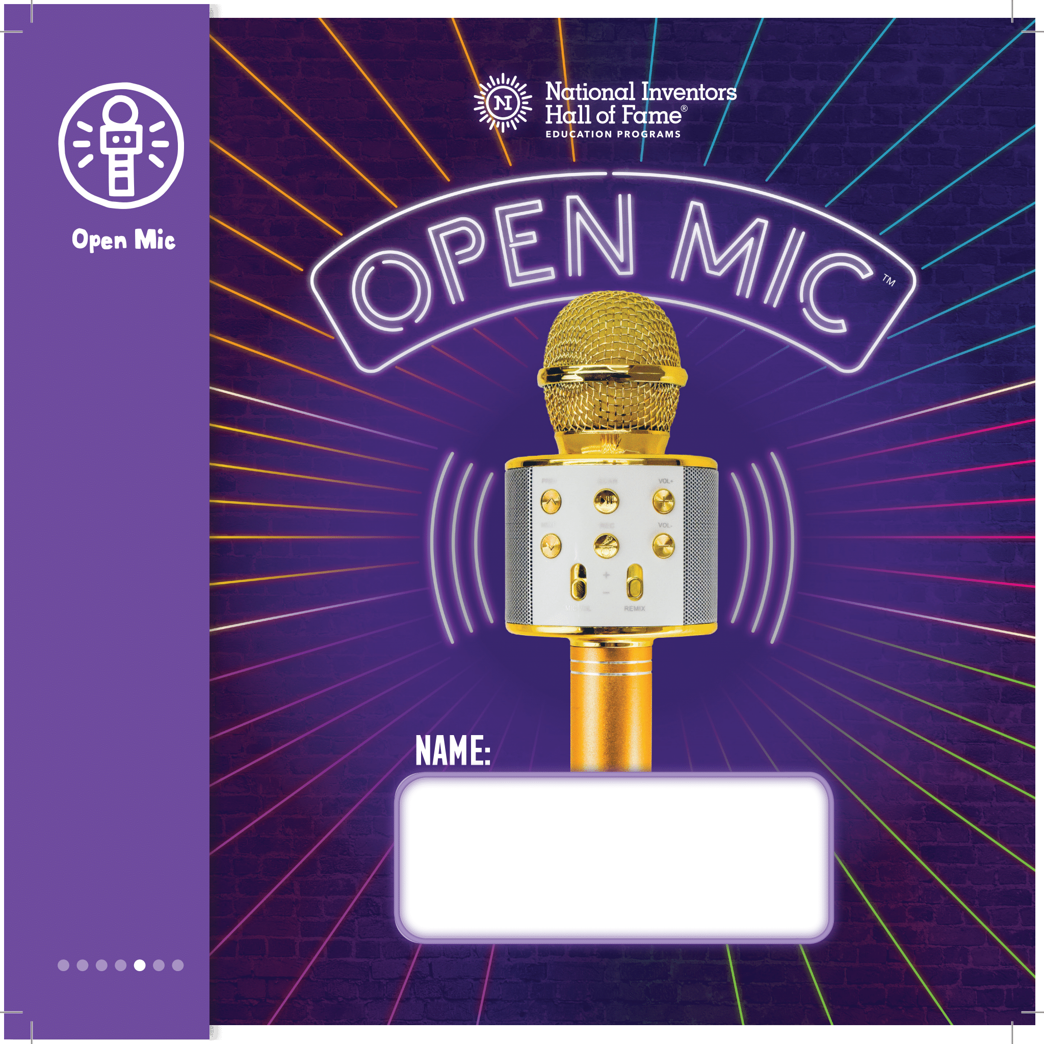
Grade Level: 4th-6th
Combining math concepts and physics, Fair Games™ provides a hands-on exploration of topics ranging from measurement, probability, and algebraic thinking to simple machines and design engineering.
Students build confidence and STEM skills when they create their own DIY Orbot™ and use it to complete fun challenges.
Rescue Squad™ inspires students to invent solutions to protect ecosystems, help wildlife and explore energy conservation.
In Open Mic™, children reverse engineer a wireless microphone, then develop and pitch their own inventions.

Slide 16


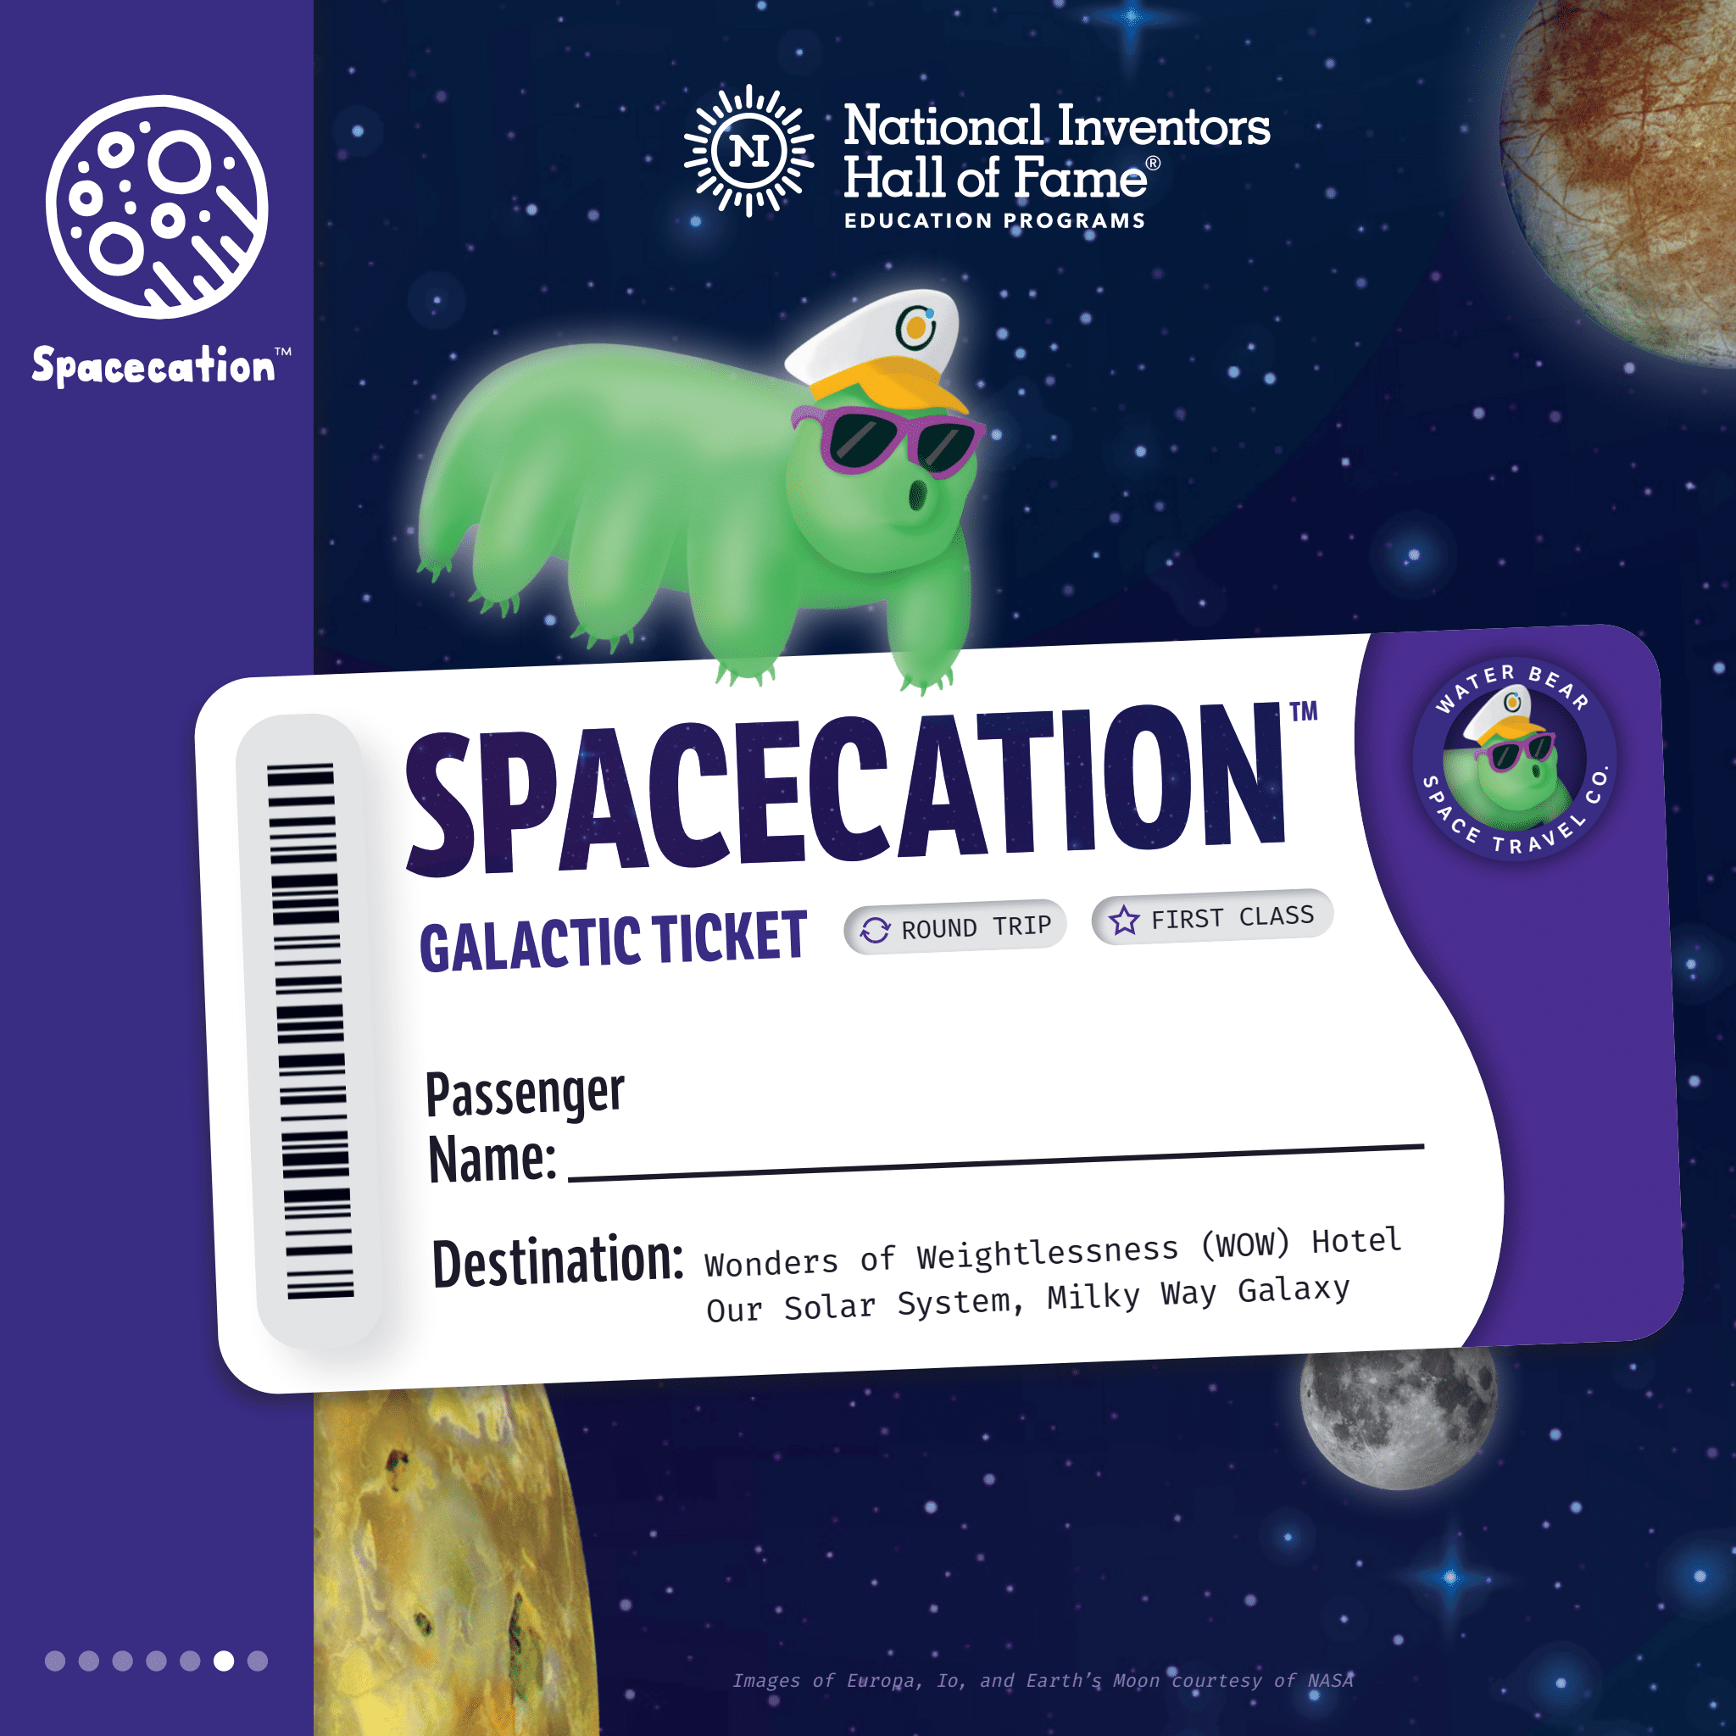
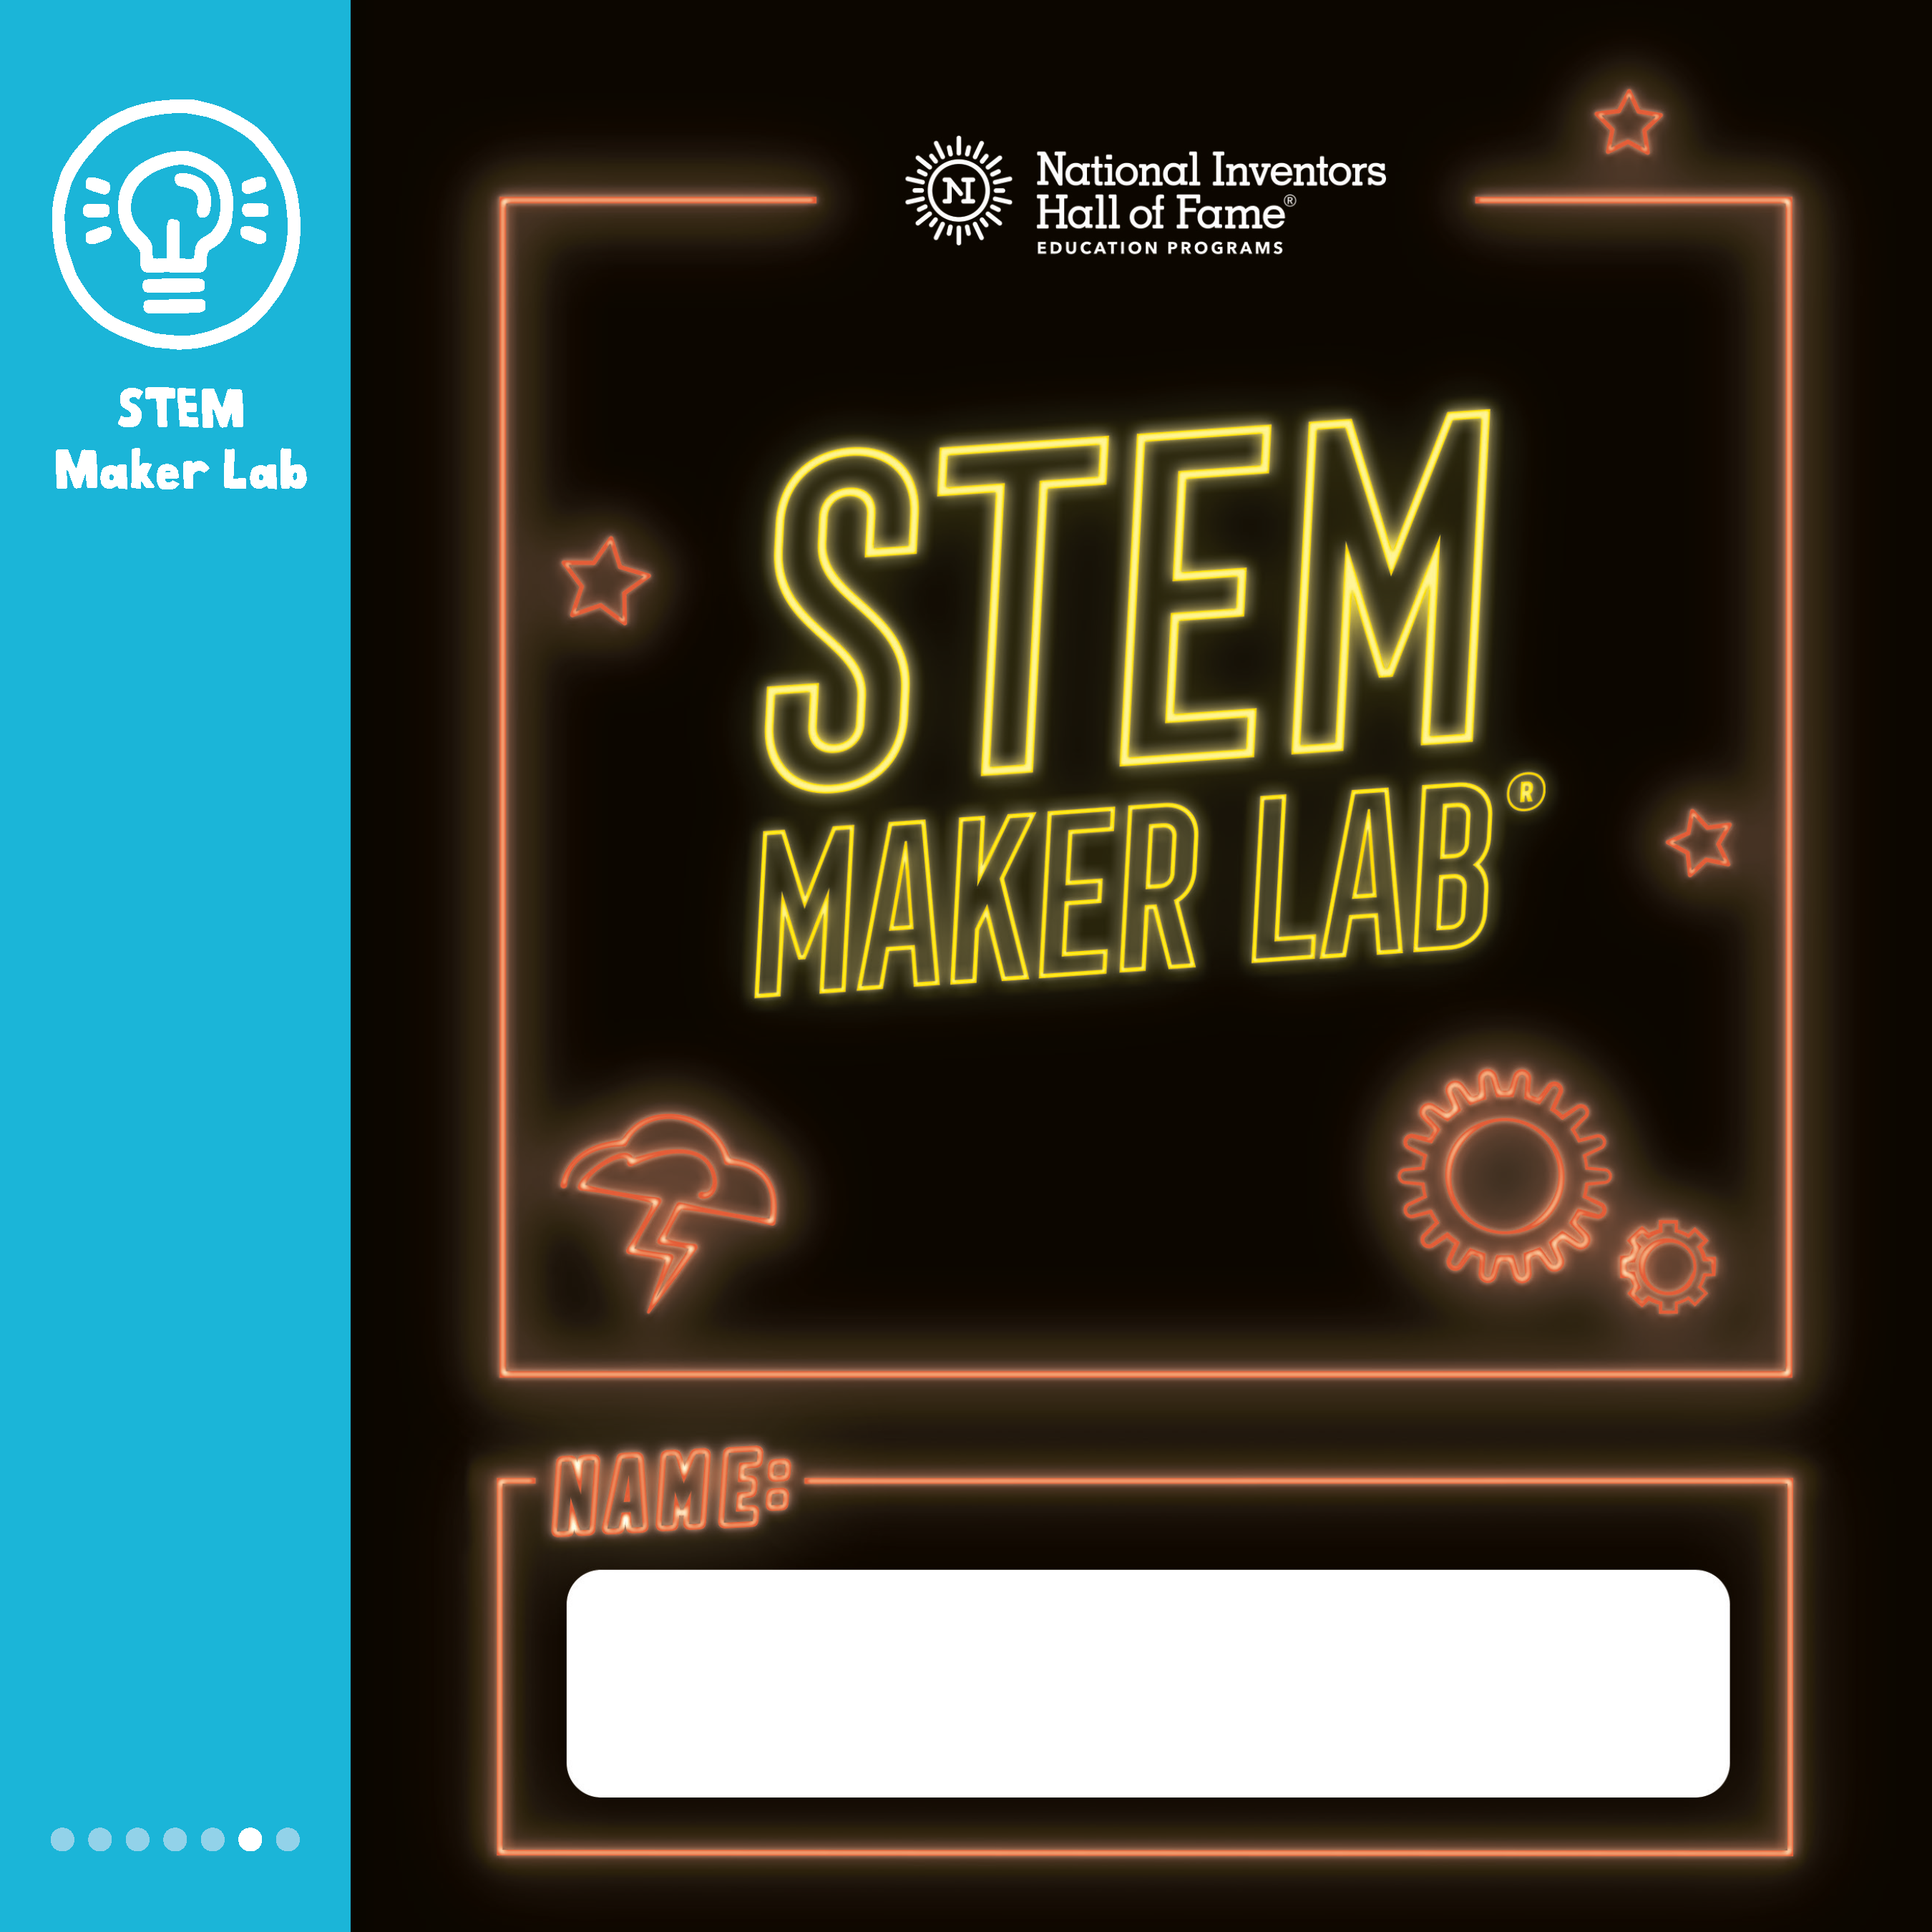
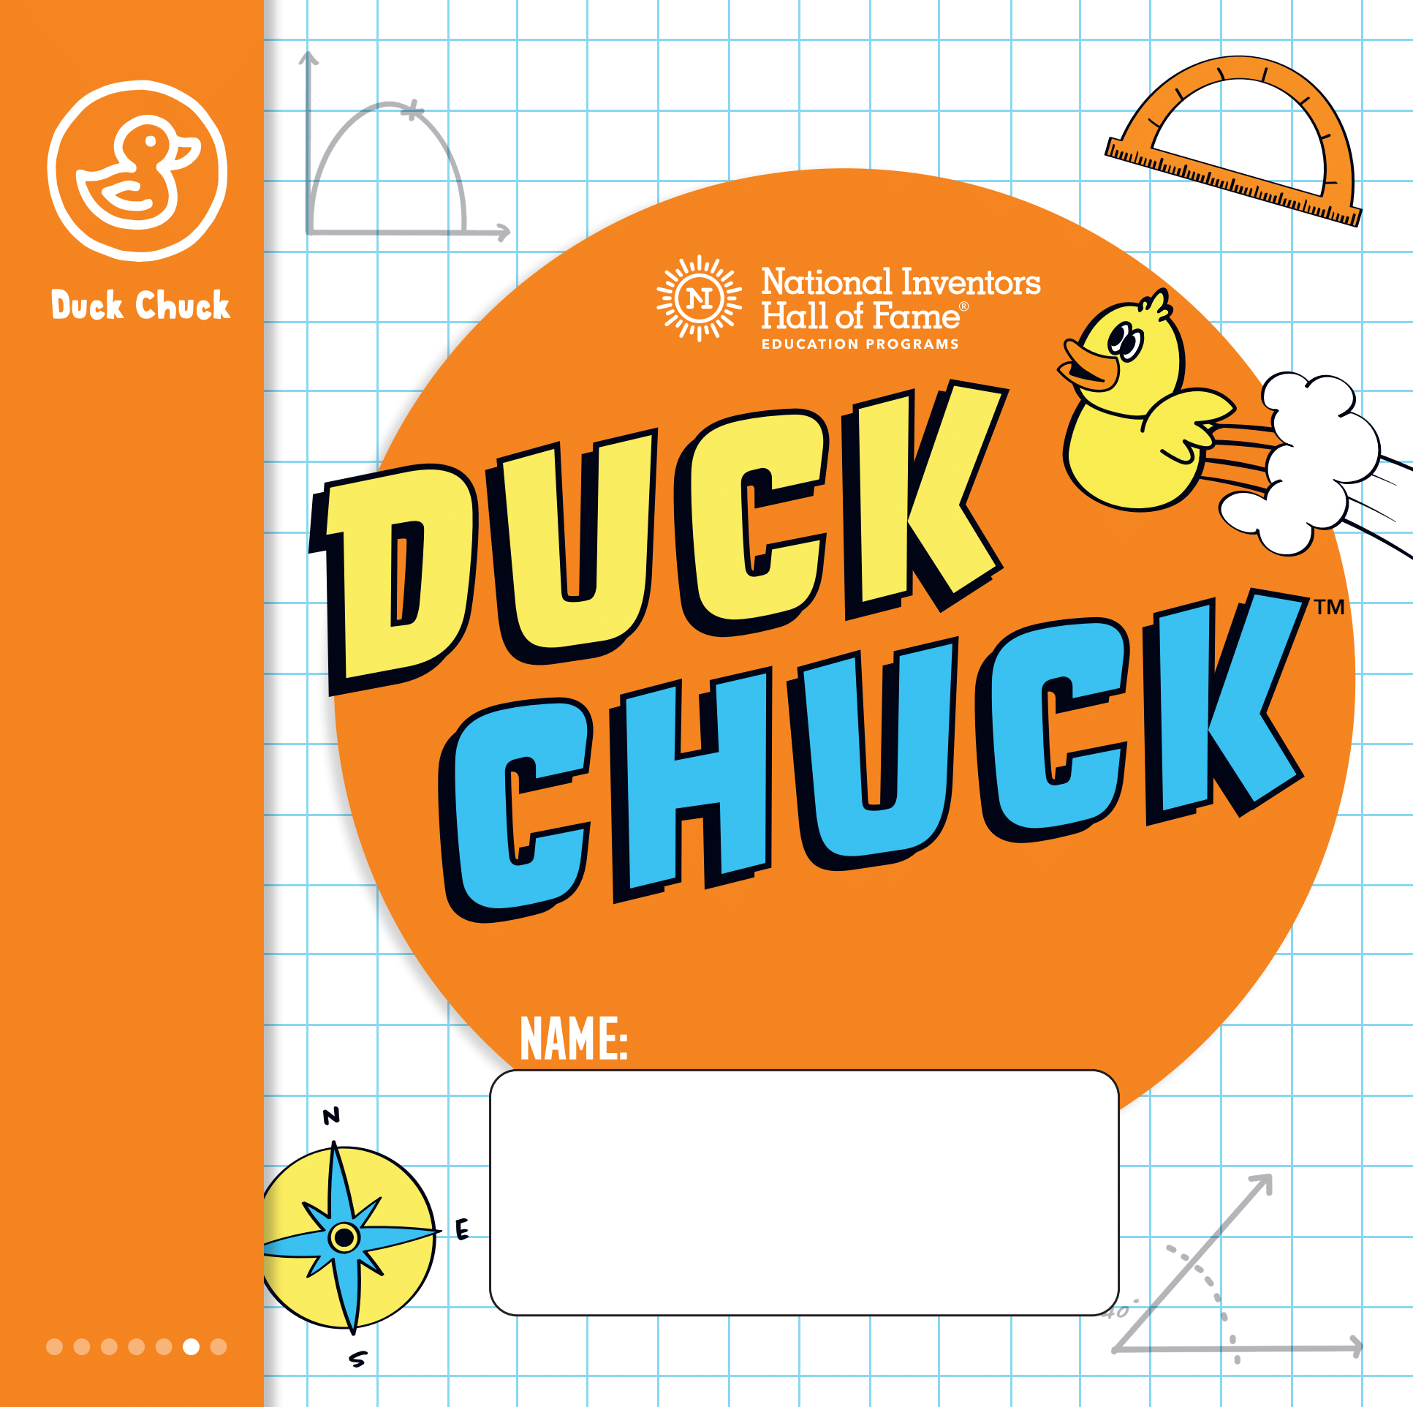
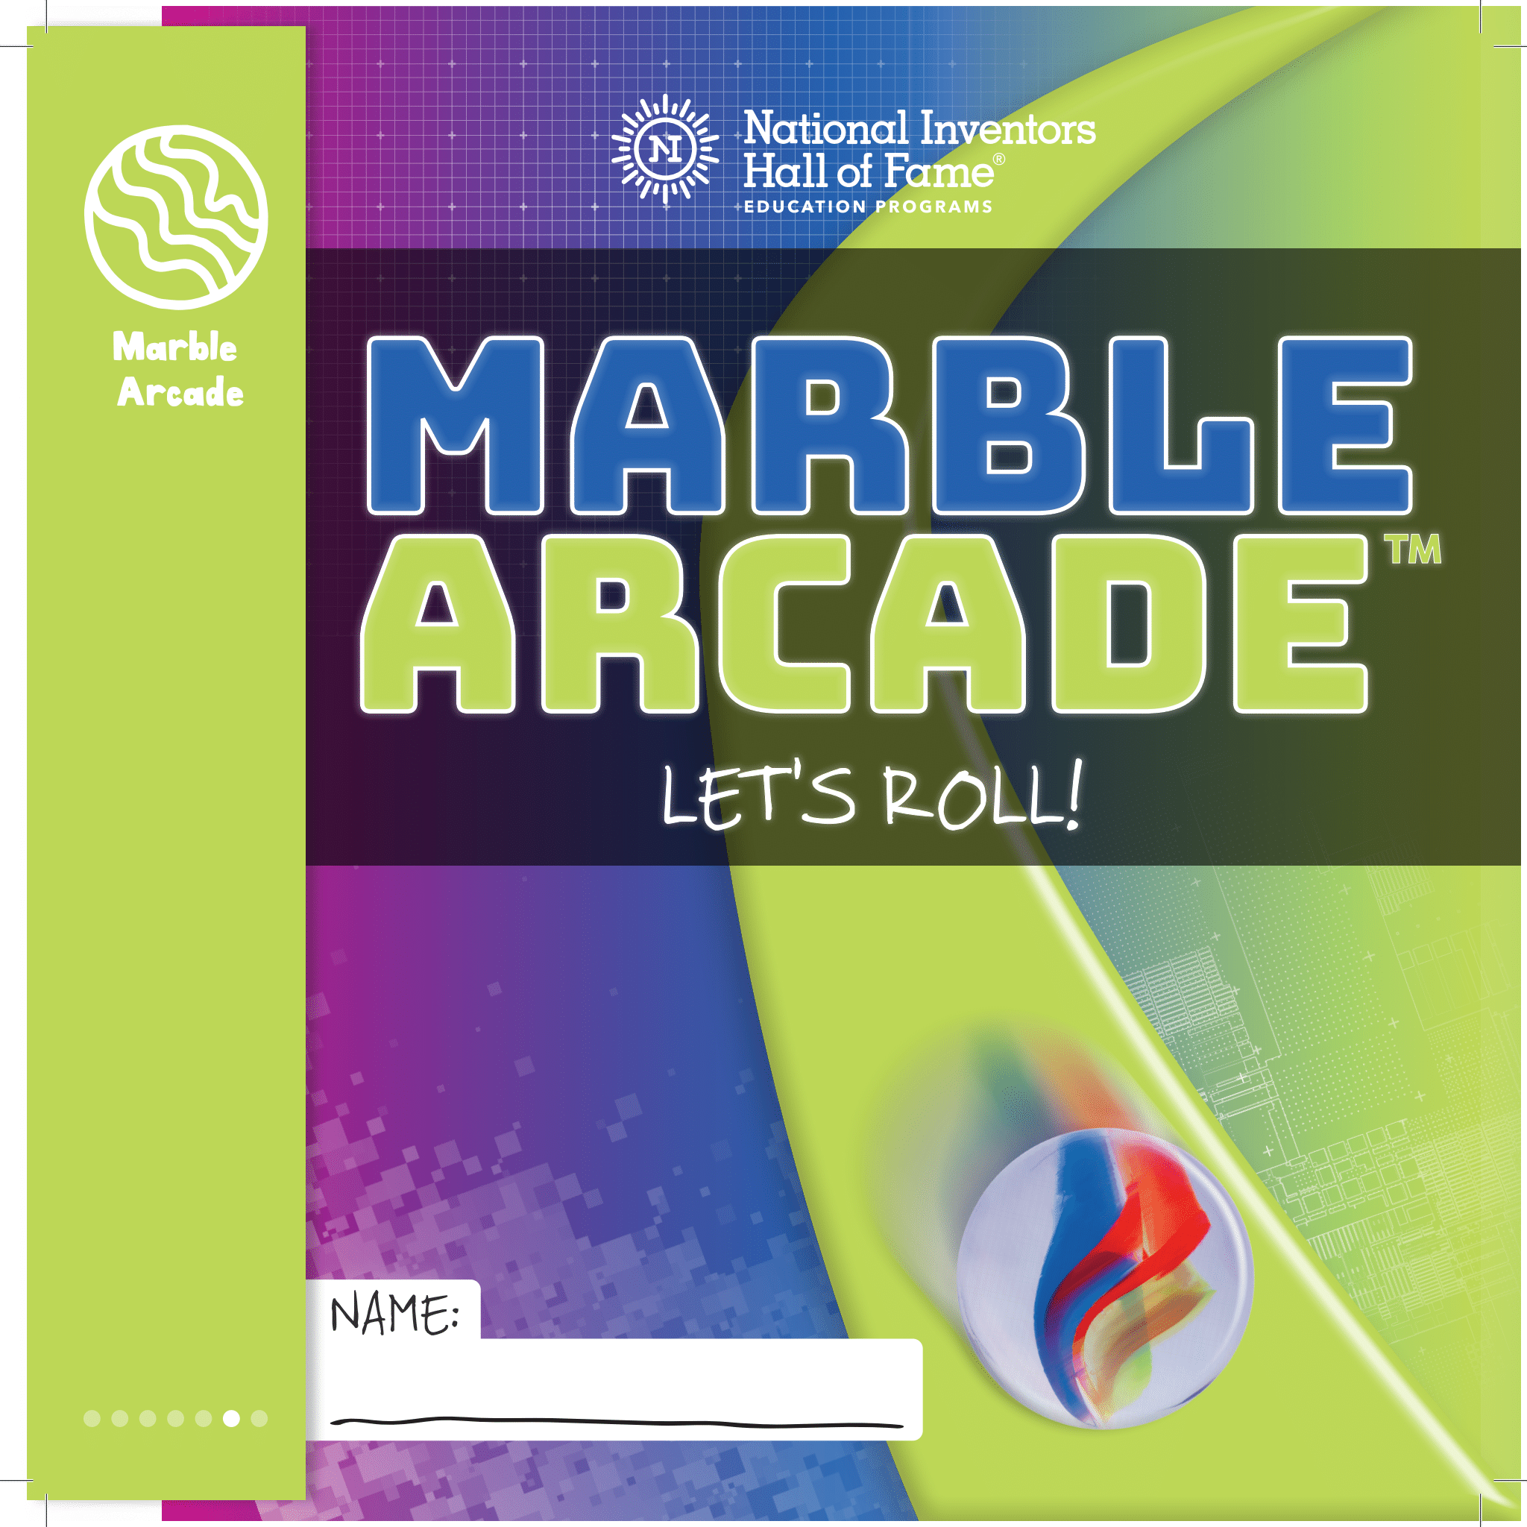
Grade Level: 5th-8th Level 1 Experience
Students become immersed in automotive design as they create a futuristic vehicle in NIHF's Automotive Design 101™.
Applying nature-based discoveries, children create dynamic vehicles and take on challenges in an exciting Road Rally™.
Inspired by real space exploration, children build innovative devices to help them problem solve on distant planets and moons in Spacecation™.
Participants explore what it takes to be a maker, inventor and entrepreneur as they use biomimicry to solve invention challenges in STEM Maker Lab™.
Duck Chuck™ challenges students to design, build and test a device that can launch rubber ducks.
Children zigzag through physics, engineering and gaming as they design, build and test a mega Marble Arcade™.

Slide 17
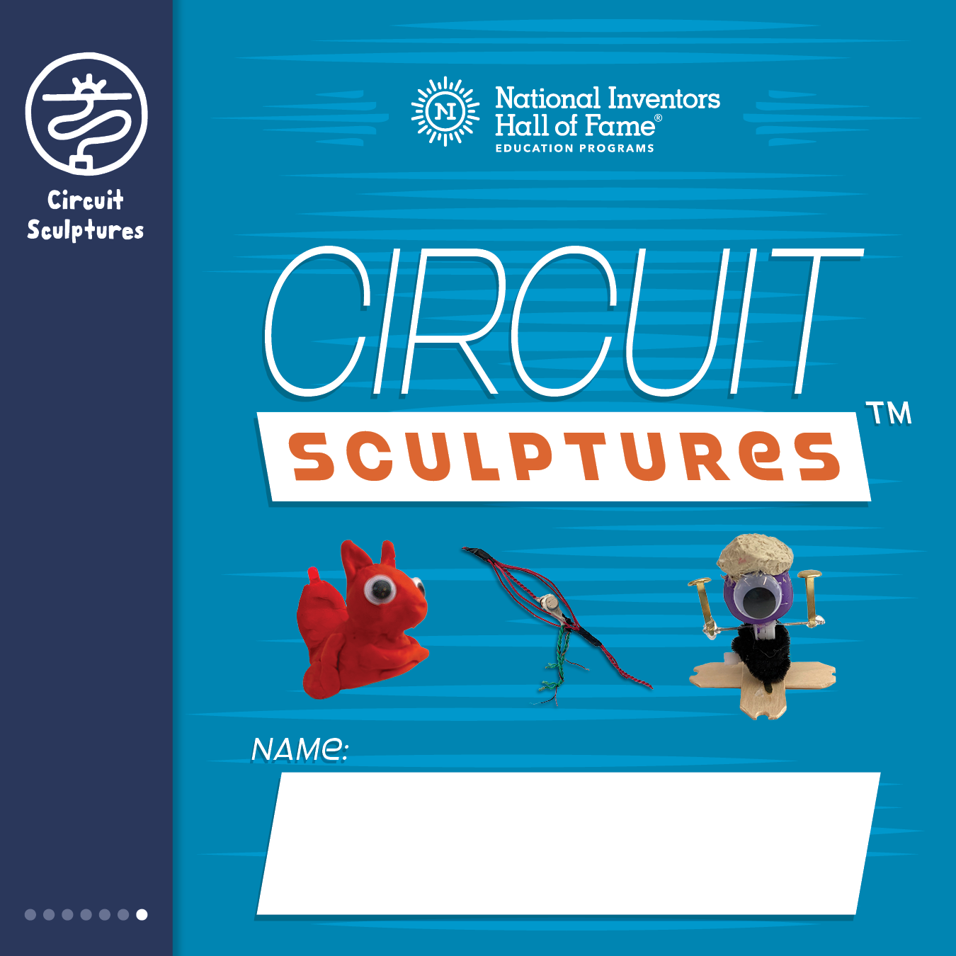
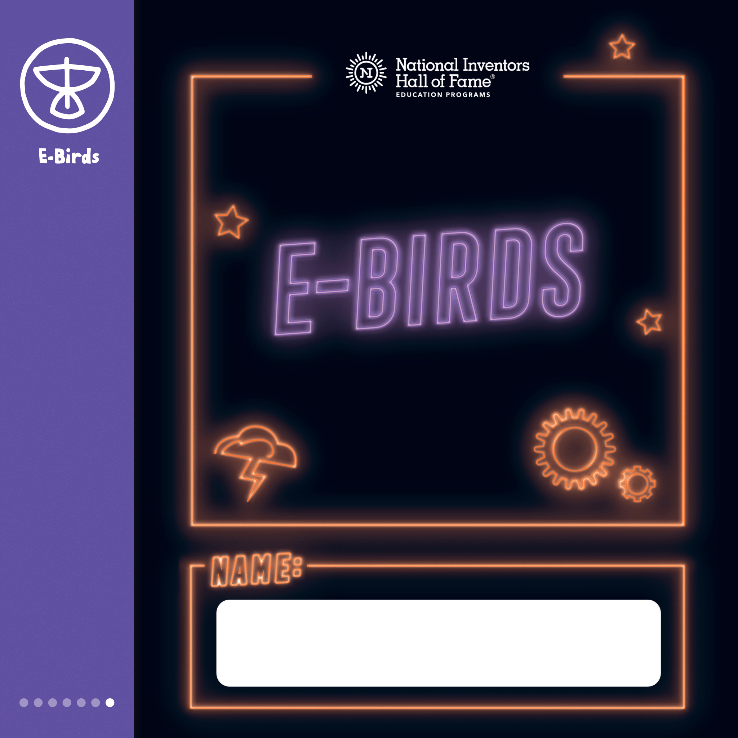
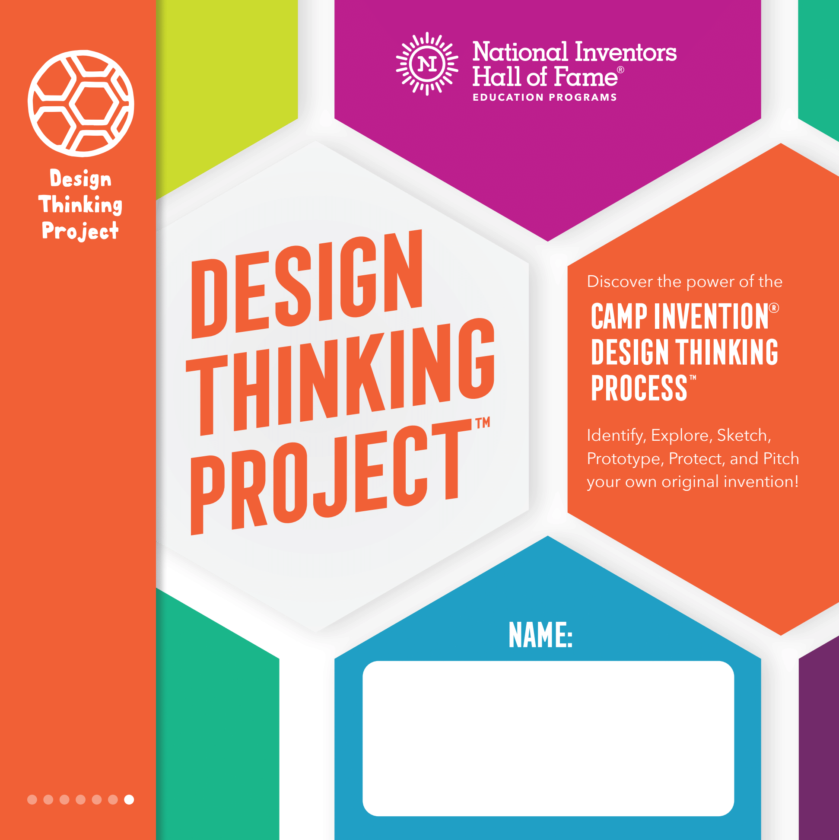

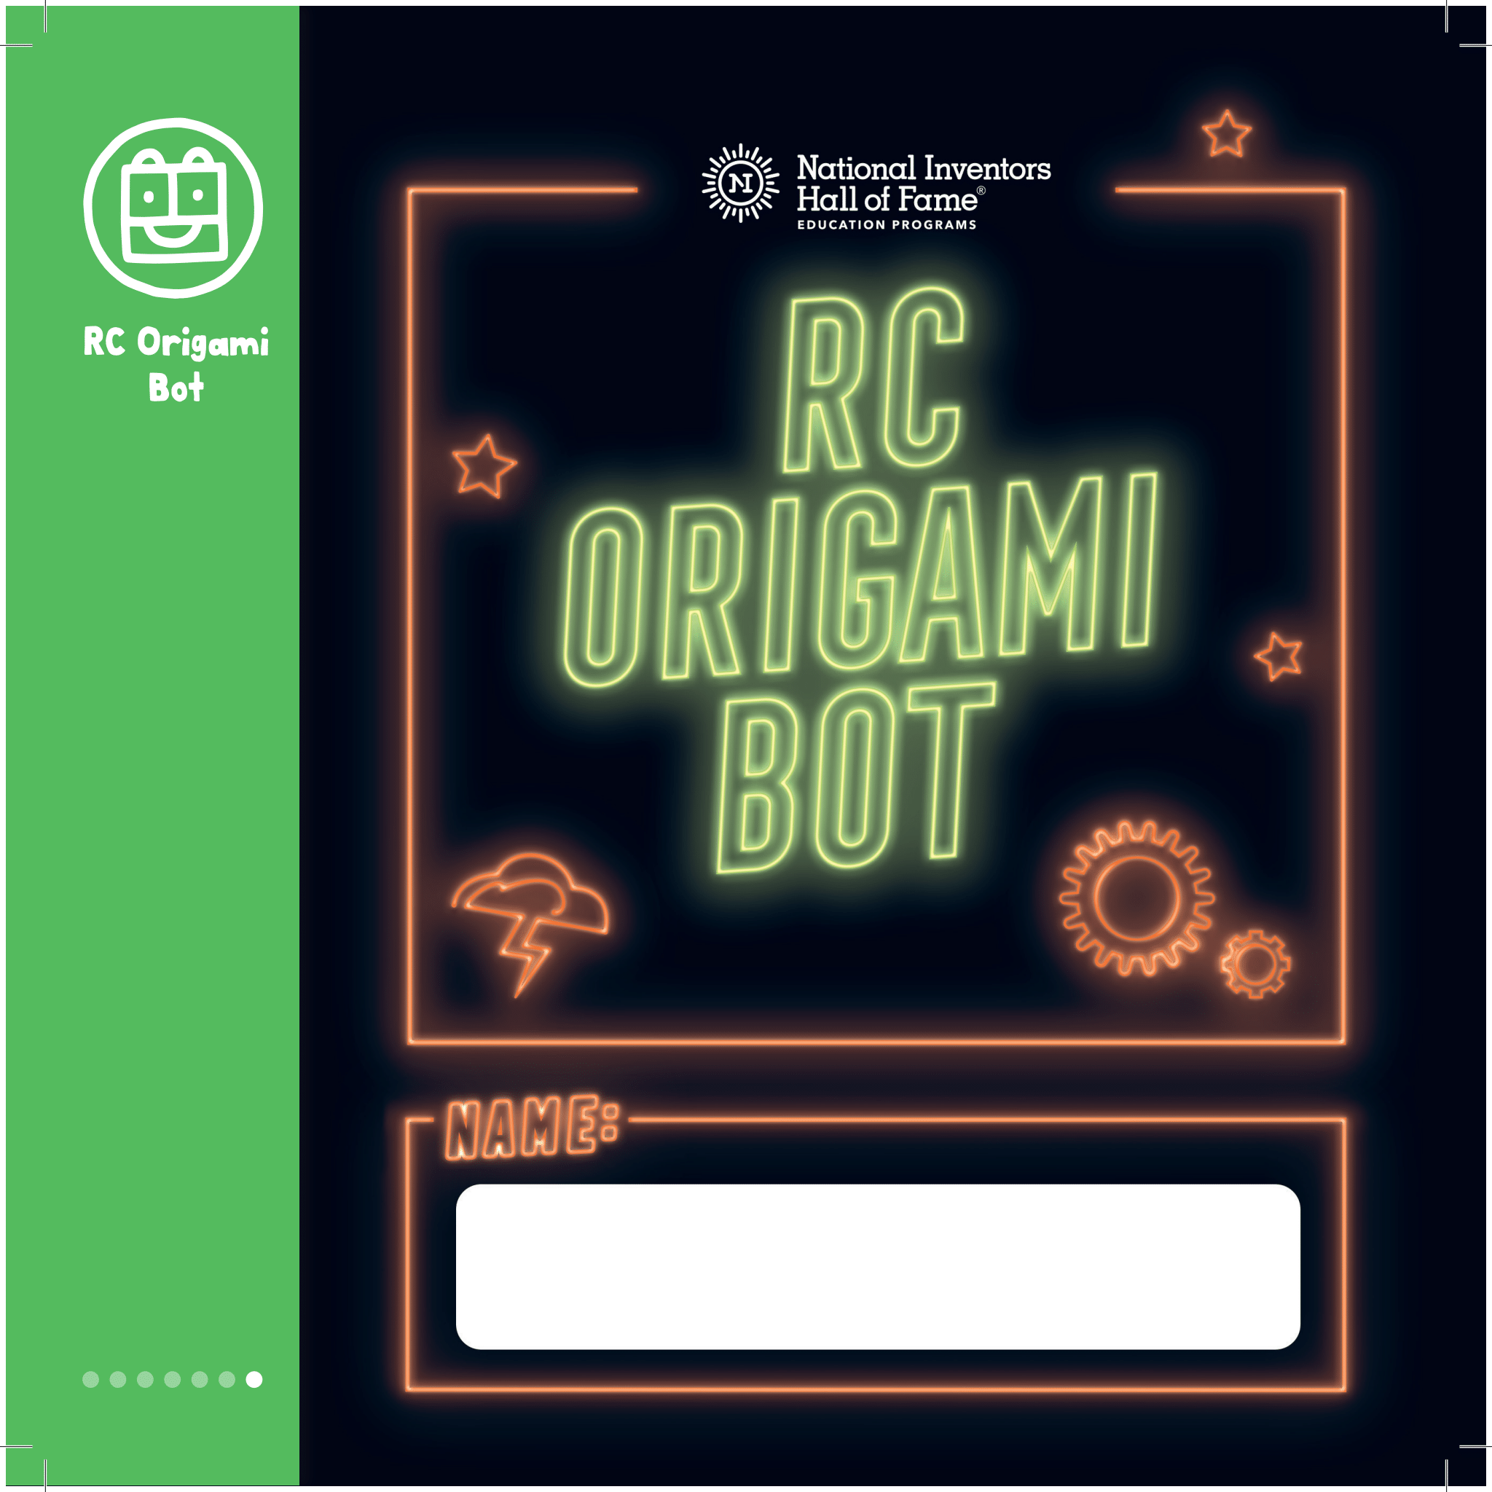
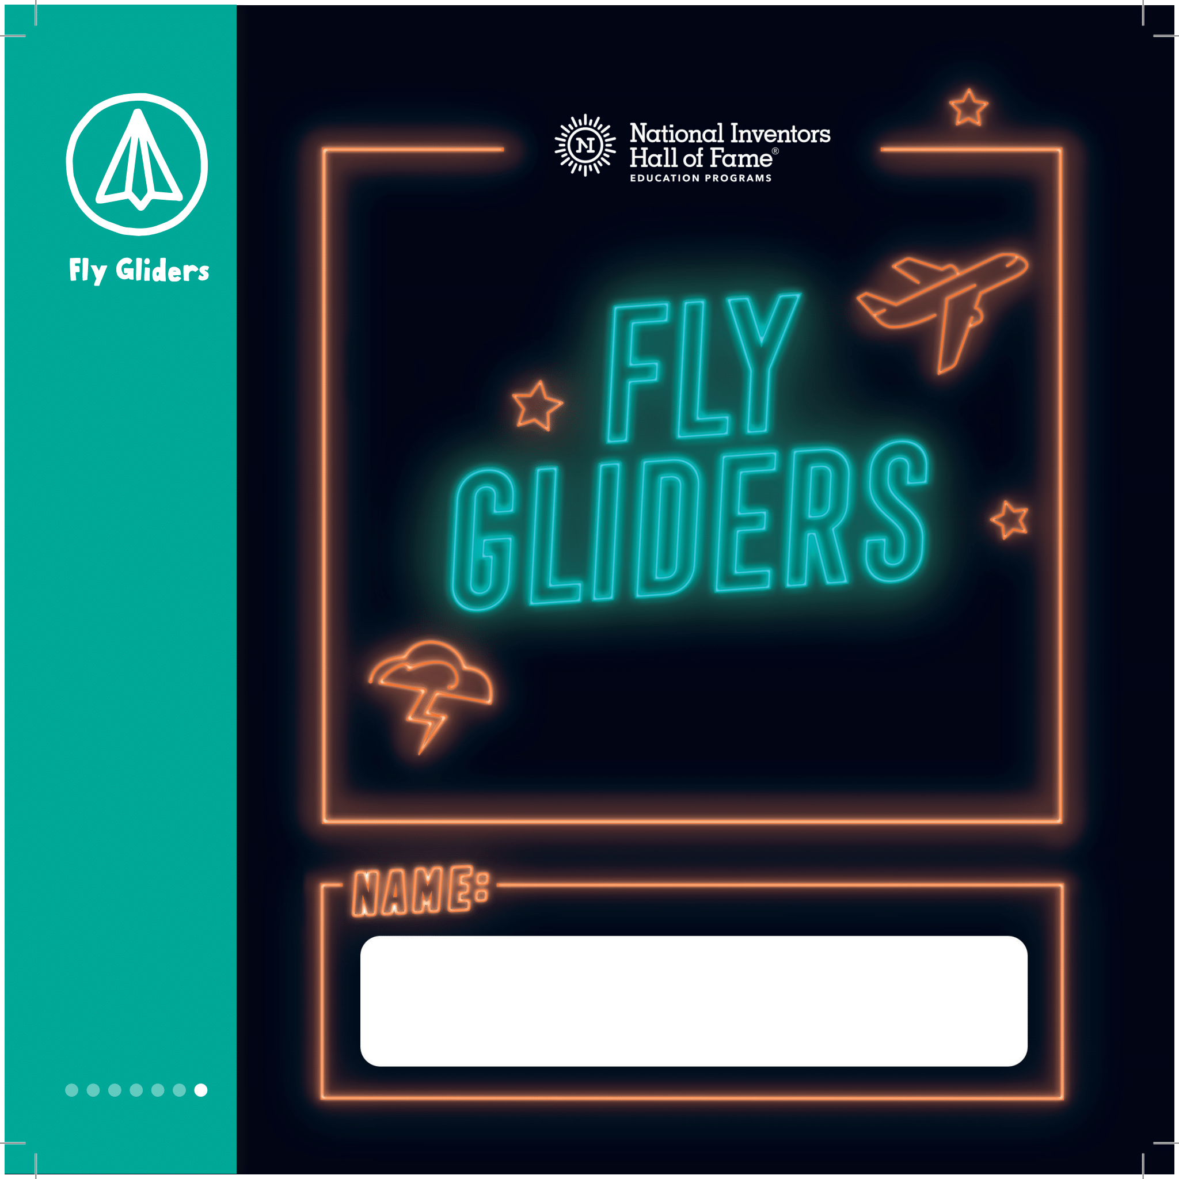
Grade Level: 5th-8th Level 2 Experience
Explore the dynamic connection of science and art by designing one-of-a-kind Circuit Sculptures ™.
E-Birds™ gives children the chance to build a flying electronic bird and design robots to research birds in the wild.
To solve real-world problems in Design Thinking Project™, children collaborate, brainstorm and bring ideas to life.
In Wear It Out™, students use creative ideas and maker materials to invent clothing and accessories that are fashionable and functional.
In RC Origami Bot™, students construct and operate their own remote-controlled robots to navigate an obstacle course.
With inspiration from great inventors, children experiment with the science of flight using paper airplanes and a heliball in Fly Gliders™.

Slide 18
Questions?

Slide 19


