Slide 1



Slide 2
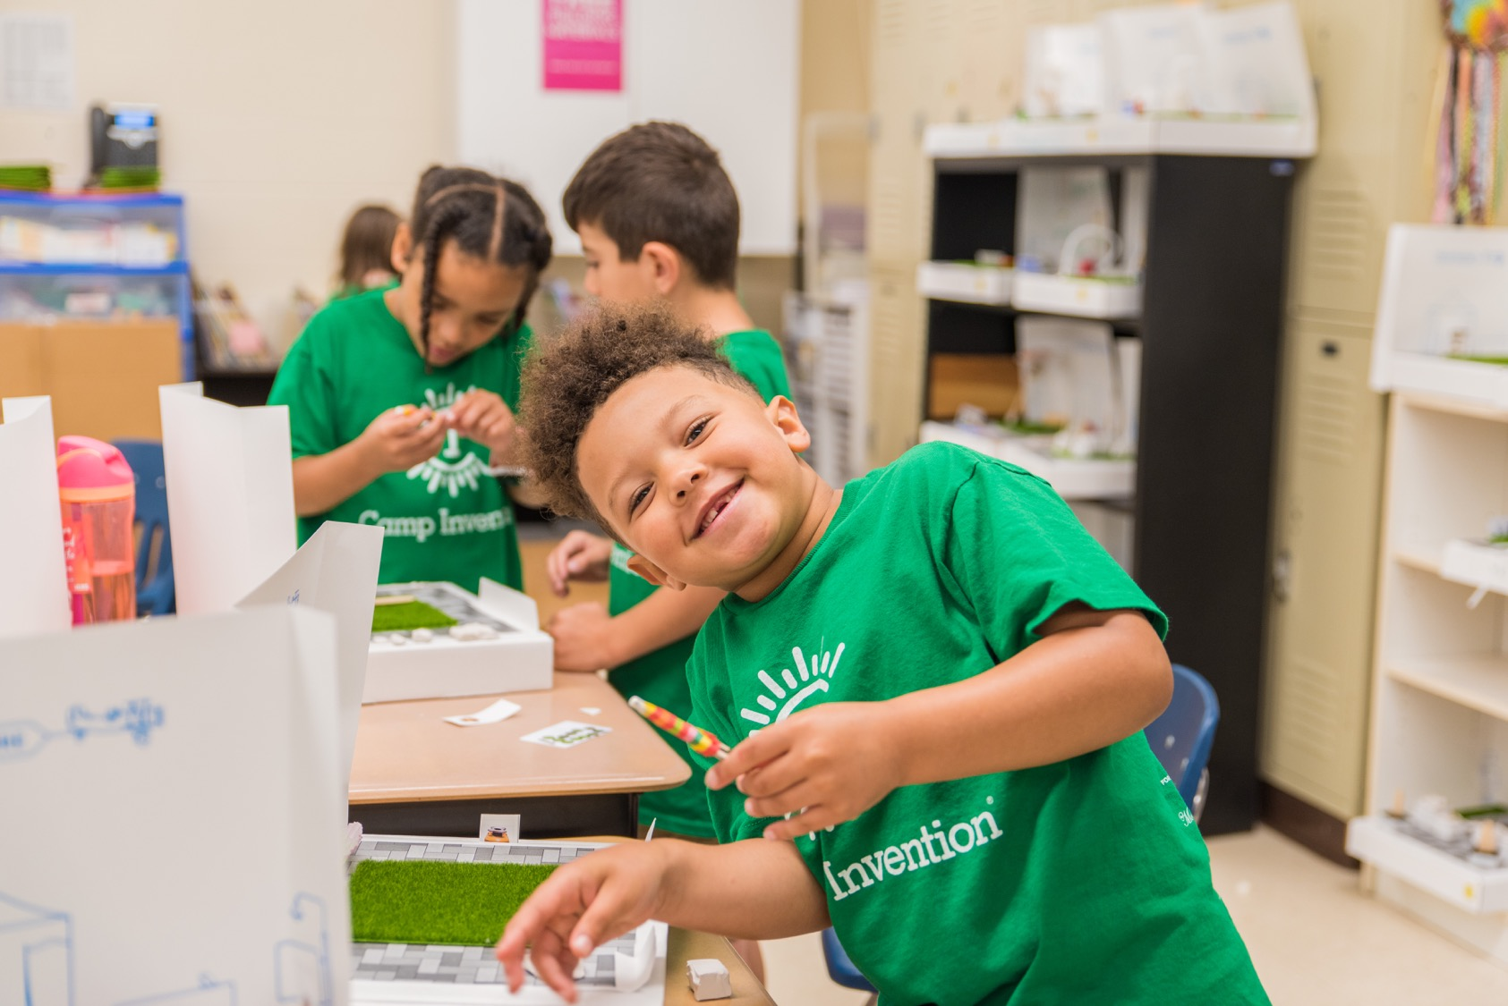

Camp Invention® is an acclaimed
hands-on STEM program that provides
a turnkey system for bringing invention education to students.

Slide 3
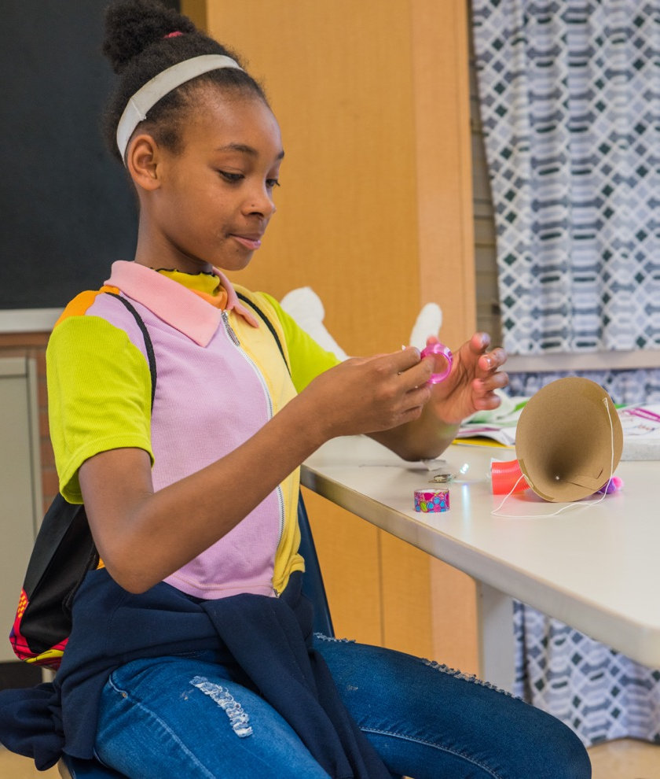
HANDS-ON STEM PROGRAMMING
An engaging, nationally recognized K-6 program
Authentic invention education to children for more than 30 years
Brand-new curriculum is developed and tested each year
Hands-on experiences that encourage divergent thinking
Backed by independent research
Designed to spark imaginations through open-ended engagement in creative problem solving
Student learns about electric circuitry during hands-on experiences.

Slide 4
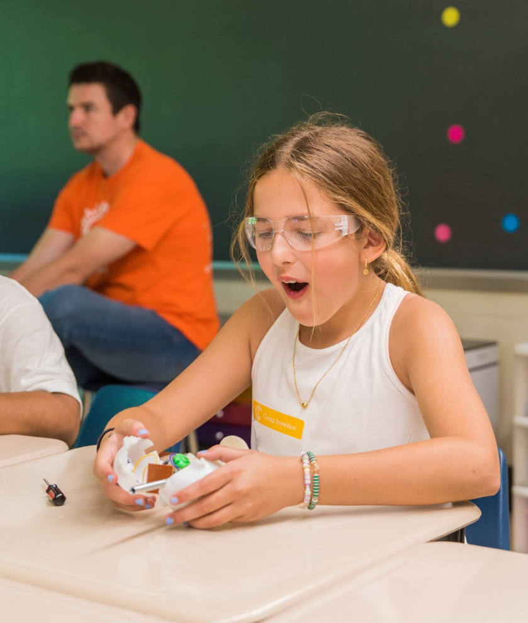
Innovative Experiences
Foster critical thinking, collaboration and creativity through authentic STEAM experiences
Practice empathy, and build confidence and persistence through real-world challenges
Engage children through high-energy activities and active participation in learning experiences
Cultivate educator's innovative mindset through job-embedded professional development
Student actively participates in a take-apart learning experience.

Slide 5
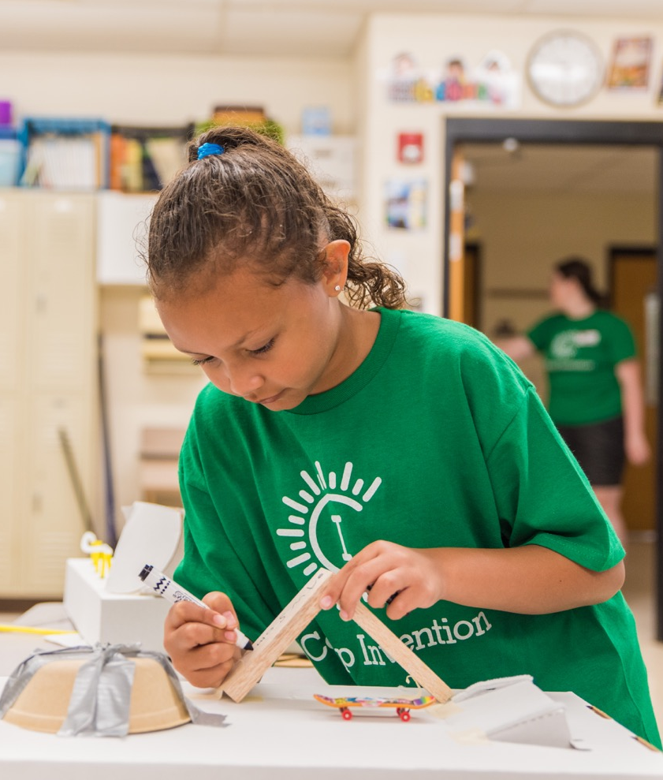
Turnkey Implementation
All-inclusive program curriculum and materials
All materials shipped in classroom sets from our warehouse to your program location
Personalized support and resources ensure a positive experience
Step-by-step curriculum guide and online resources reduce prep time
NIHF-provided materials support innovation and creativity.

Slide 6
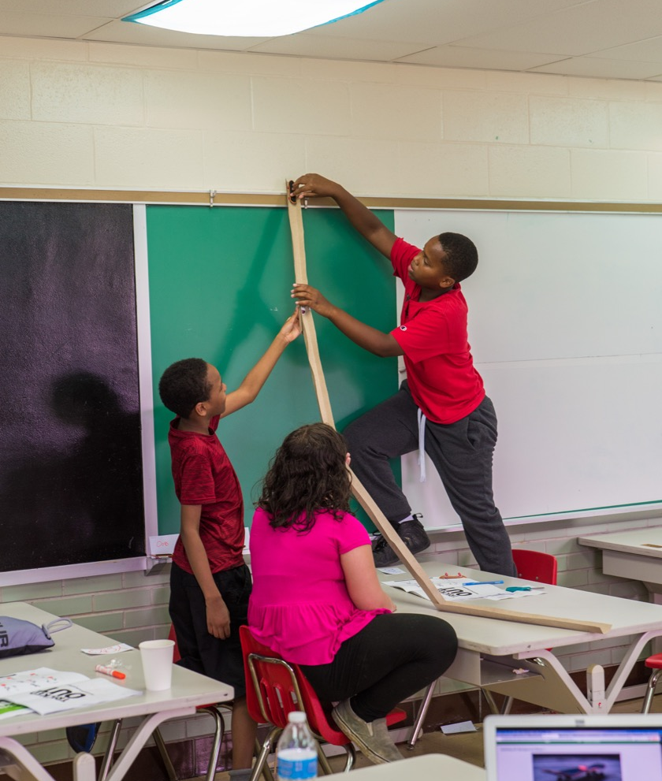
Flexible & Immersive Curriculum
Four all-new, themed modules with hands-on activities every year
Curriculum differentiated for primary and intermediate levels
Aligned to state, Common Core and Next Generation Science Standards as well as CASEL Social and Emotional Learning (SEL) Competencies
Physics? Fun? Both, as students learn about gravity and force in Catching Air.

Slide 7





Physics and design engineering
Genetics and intellectual property
Four confidence-boosting modules spark imagination and innovation through hands-on challenges and open-ended exploration.
Event planning and experimentation
with lights and sounds
Financial choices and creative skills involved in launching a business

Slide 8


Slide 9

Module Overview: CATCHING AIR
CATCHING AIR takes students on a ride through physics, engineering, invention and the art of design as they build their own mini skate park — complete with ramps, bowls, rails and jumps! They personalize their boards and gain momentum by practicing tricks in creativity and invention, including how to get back up from a fall.
PHENOMENA EXAMPLE: Students explore gravity and force through practicing skateboard tricks
SEL CONCEPTS: Healthy risk taking, resilience, self-awareness, teaming and collaboration
MATH CONCEPTS: Geometry, measuring
LITERACY CONCEPTS: Reading and writing in Inventor Log, presentation of knowledge, ideas and reading comprehension, 21st-century vocabulary
WHAT THEY TAKE HOME: Two mini skateboards, customized and personalized skate park, skateboarding slug figure, finger boarding shoe

Slide 10
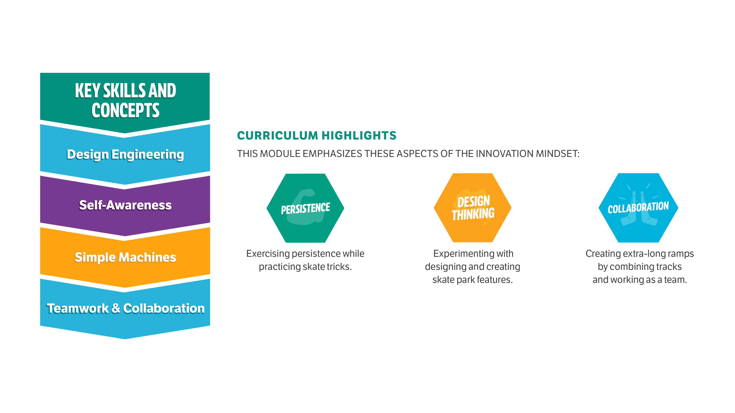
Module Overview: CATCHING AIR

Slide 11

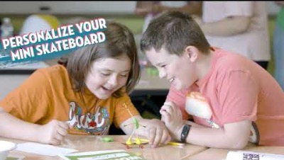

Slide 12


Slide 13


Module Overview: INVENTION CELEBRATION
In INVENTION CELEBRATION, students take on the role of event planners as they prepare for a grand celebration! They exercise their creativity and flexibility muscles by designing the lights, sounds and mood for the party. Children engineer light-up party hats, build a musical instrument and explore the science of color to make bubble art banners.
PHENOMENA EXAMPLE: Students naturally experiment with sound vibrations as they work with their instruments and make natural physics connections as they play party games
SEL CONCEPTS: Color psychology and mood, event planning, personalization and empathy
MATH CONCEPTS: Counting and cardinality
LITERACY CONCEPTS: Reading and writing in Inventor Log, comprehension and collaboration, presentation of knowledge and ideas, 21st-century vocabulary
WHAT THEY TAKE HOME: Party Assistant prototype, party invitation, personalized party hat, DIY musical instrument, bubble art banner, photo prop

Slide 14
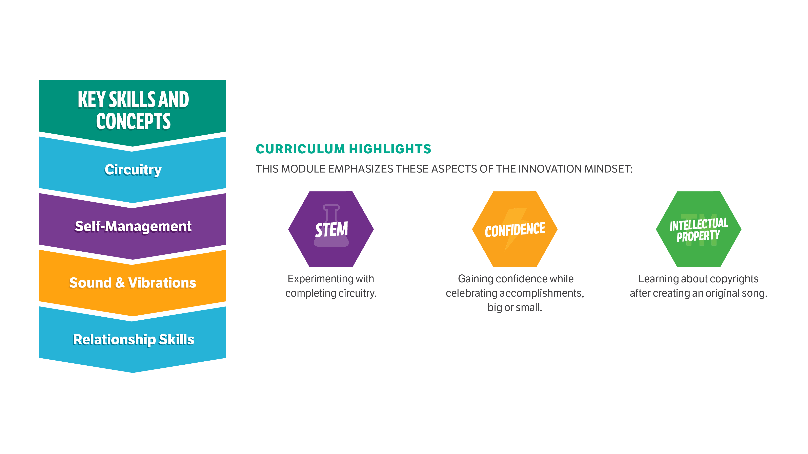
Module Overview: INVENTION CELEBRATION

Slide 15
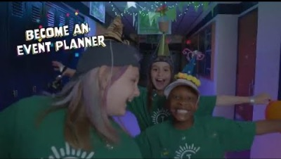

Slide 16


Slide 17
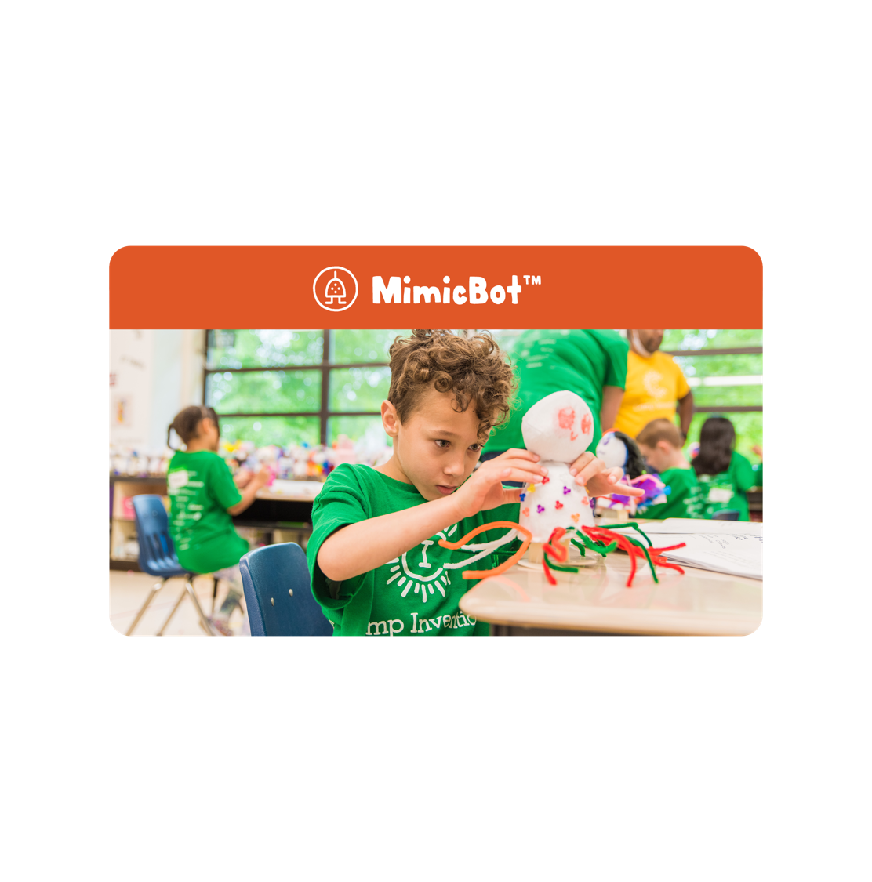
Module Overview: MIMICBOT
In MIMICBOT, students transform their very own robot into a one-of-a-kind stuffie, and use their creativity, inspiration from nature and the power of intellectual property to protect their creation from an idea-stealing Copy Cat. Along the way they explore the science of genetics and biomimicry!
PHENOMENA EXAMPLE: Students experiment with an animatronic mimicking bot and take a deeper look at nature’s use of mimicry
SEL CONCEPTS: Social awareness, empathy
LITERACY CONCEPTS: Diagramming and writing about invention, reading and writing in Inventor Log, comprehension and collaboration, STEM vocabulary
WHAT THEY TAKE HOME: Personalized animatronic MimicBot and any accessories, nature-inspired Copy Cat trap (if not team-built)

Slide 18
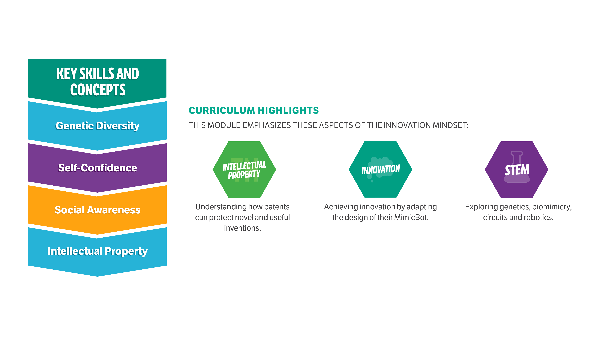
Module Overview: MIMICBOT

Slide 19


Slide 20


Slide 21

Module Overview: POP-UP VENTURE
Participants design their own POP-UP VENTURE and discover how to attract customers, make strong financial decisions and develop marketing strategies. Throughout the week, they get creative and incorporate green energy into their pop-up design and invent a unique way to distribute their products.
PHENOMENA EXAMPLE: Students observe how to close the loop in a circuit to make an LED light up
SEL CONCEPTS: Self-awareness, social awareness and responsible decision-making
MATH CONCEPTS: Counting and cardinality, measurement and data
LITERACY CONCEPTS: Reading and writing in Inventor Log, presentation of knowledge and ideas, 21st-century vocabulary
WHAT THEY TAKE HOME: Customized pop-up shop, pop-up bank card

Slide 22
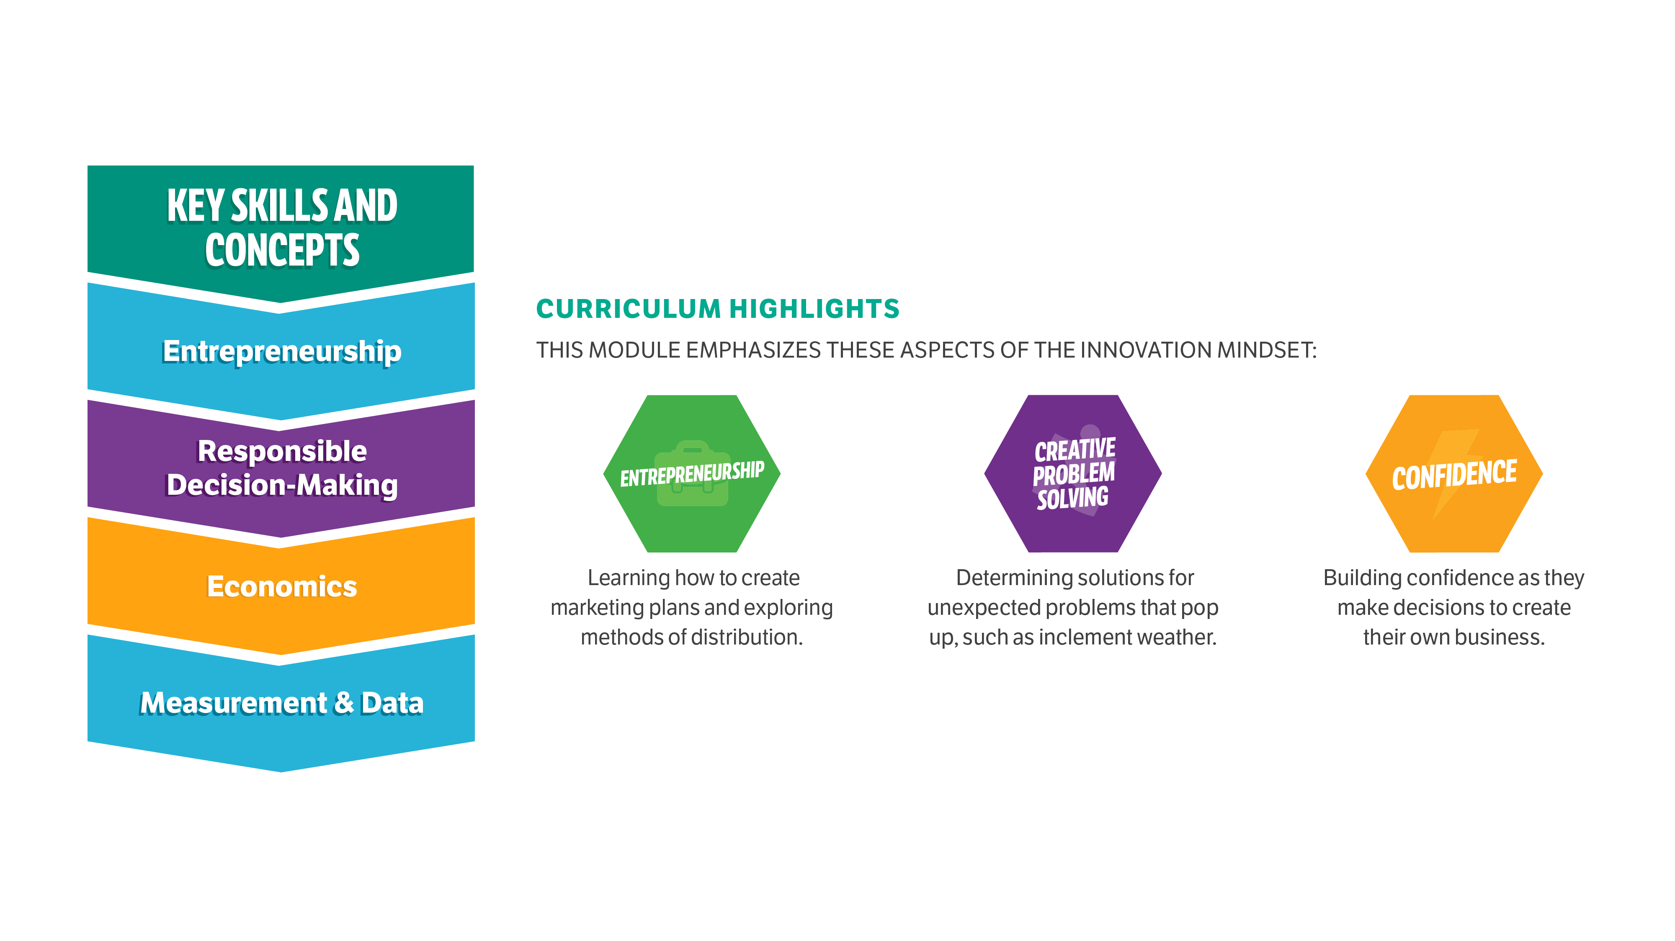
Module Overview: POP-UP VENTURE

Slide 23
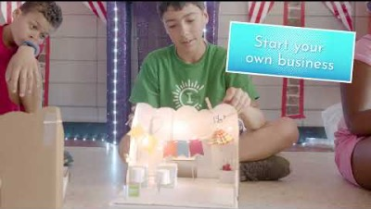

Slide 24
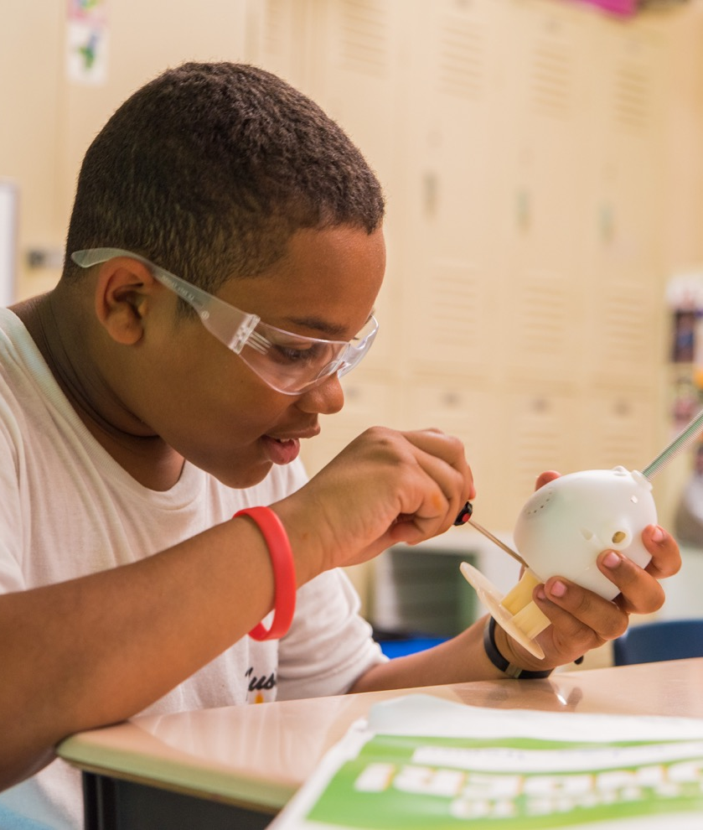
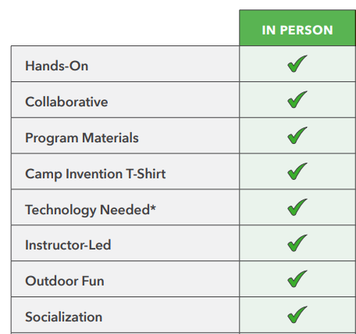
Meeting Your Districts' Unique Needs
A customizable program to fit a variety of summer schedules
All materials delivered in classroom sets
A classroom set covers a singular space with
up to 25 participants
A customizable curriculum,
supplements and
pacing guides

Slide 25
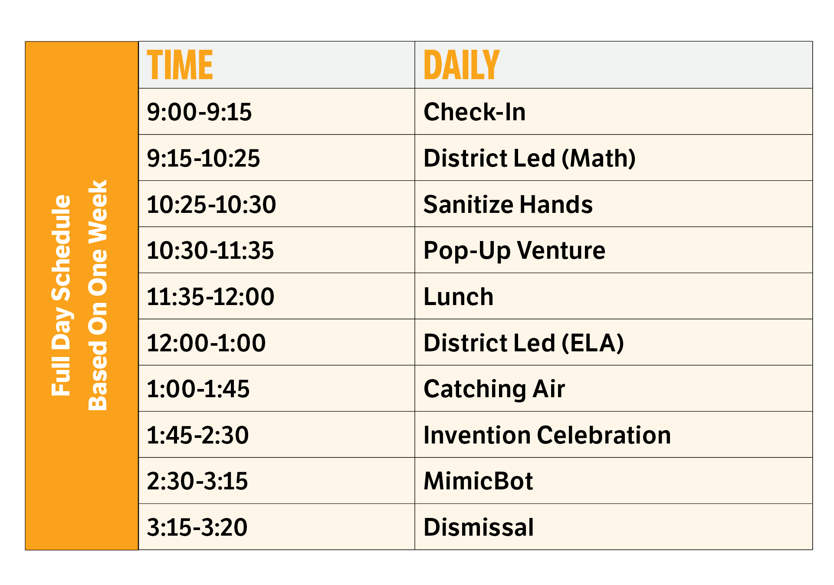
Customizable Implementation: Full Day
NIHF offers flexible programming that can stand alone or be embedded in district/school summer programming. Your dedicated NIHF representative will work with you to build a customized schedule that fits your specific needs.

Slide 26
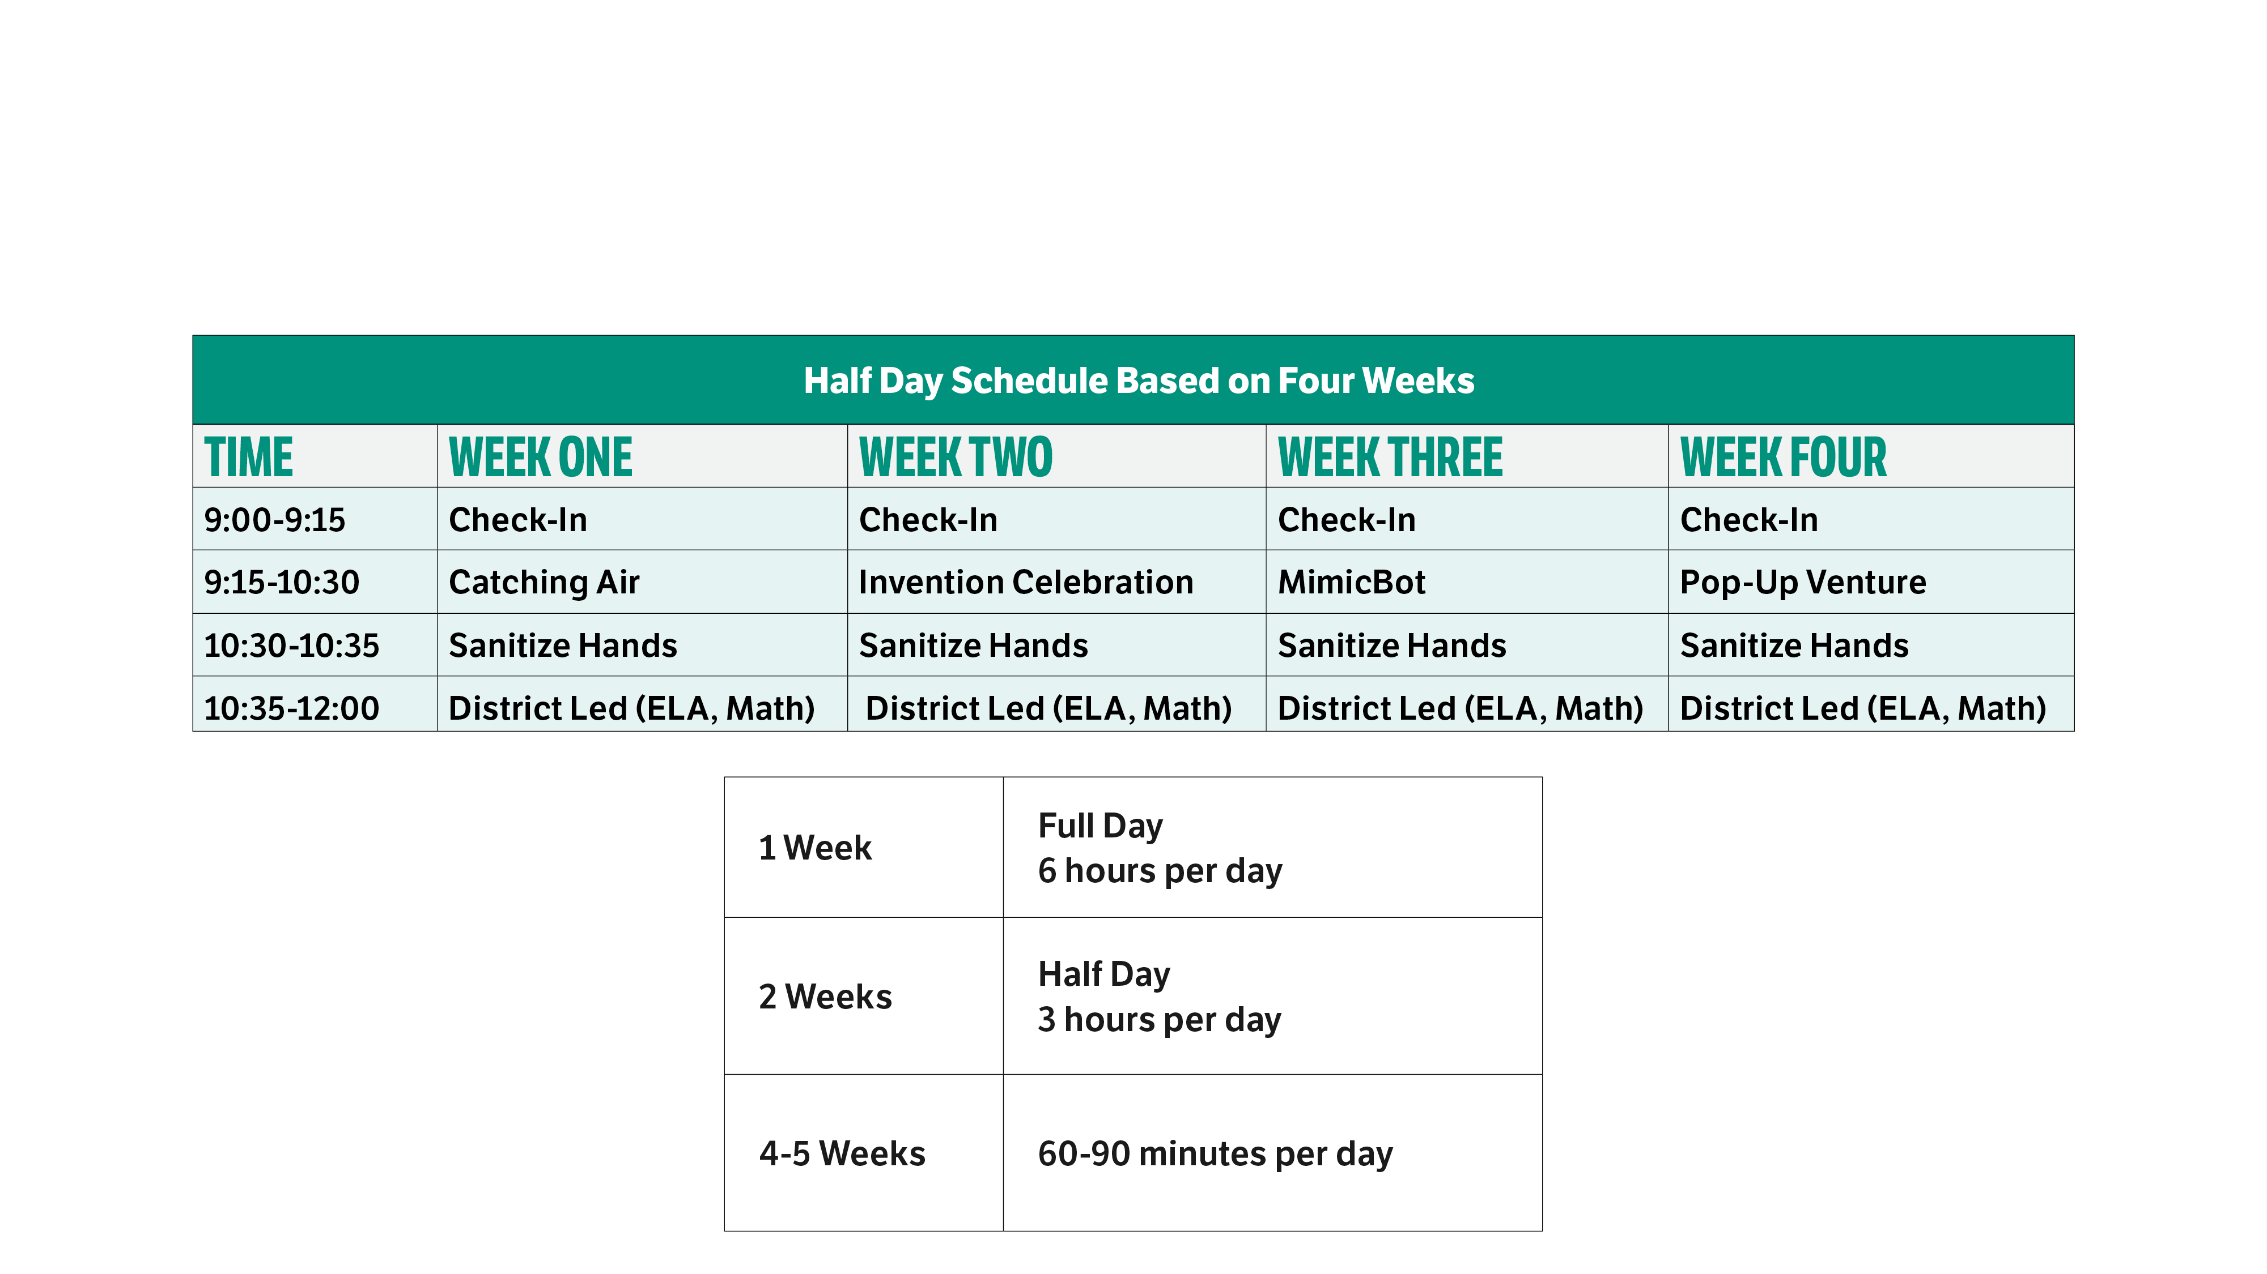
Customizable Implementation: Half Day

Slide 27
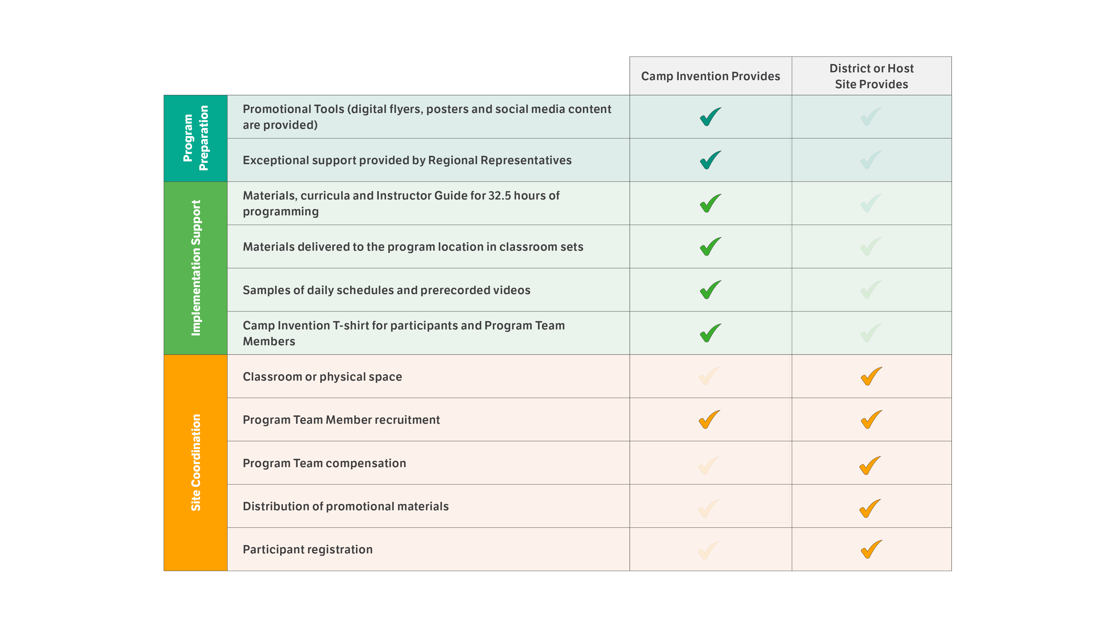
WHAT’S INCLUDED

Slide 28
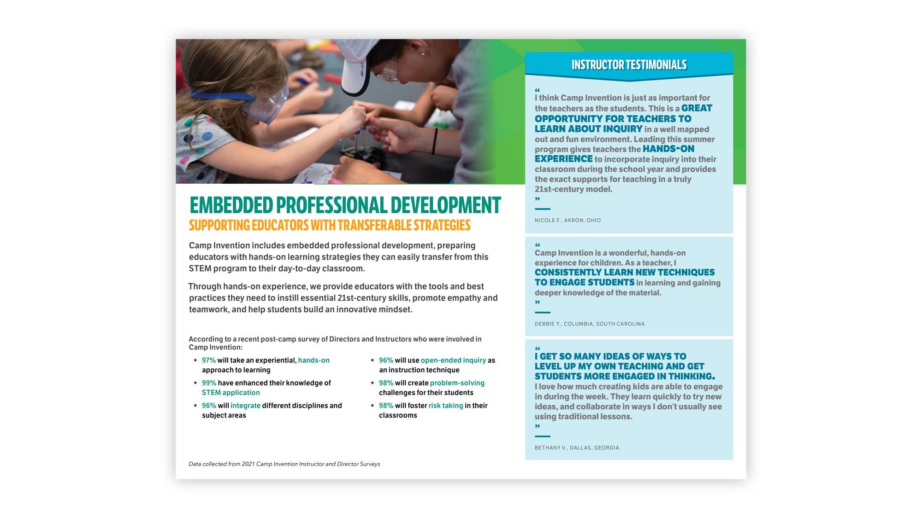

Slide 29

What are your specific program goals?
How many hours/days/weeks of programming do you need?
When do you plan to run the program?
How many classrooms are you planning to support?
How many students/teachers are you planning to support?

Slide 30


