Slide 1
Notes:
We love to start off with that video because it’s a great way to share the core tenants that drive everything we do and more importantly, how it all connects back to our future innovators.
But before we go further down that path, we’d like to take a step back and talk about this unique moment in time and the impact it’s having on the field of education.

Slide 2
Notes:
We love to start off with that video because it’s a great way to share the core tenants that drive everything we do and more importantly, how it all connects back to our future innovators.
But before we go further down that path, we’d like to take a step back and talk about this unique moment in time and the impact it’s having on the field of education.

Slide 3
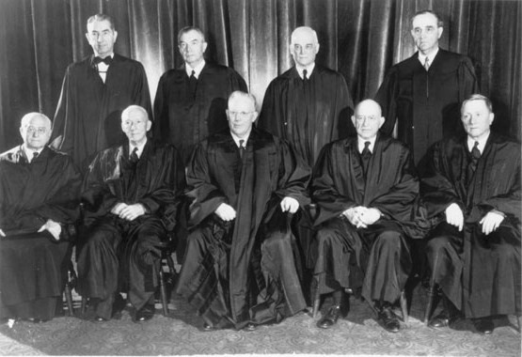
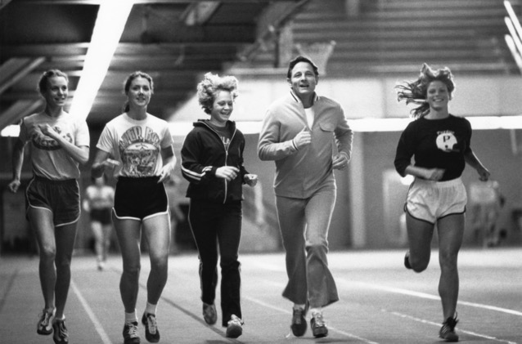
Pivotal moments create educational progress.
From student-focused learning strategies to the rise of STEM, education is transformed by shifts in society.
1954:
The Supreme Court’s ruling on Brown VS. Board of Education desegregated schools.
1965:
Lyndon B. Johnson’s Elementary and Secondary Education Act provided an unprecedented amount of federal funding and support to schools nationwide.
1972:
Title 9 ensured that no individual can be excluded from a school program based on gender.
Notes:
From student-focused learning strategies to the rise of STEM, education is transformed by shifts in society.
On May 17, 1954, the Supreme Court’s ruling on Brown VS. Board of Education desegregated American schools.
April 9, 1965 marked the passing of Lyndon B. Johnson’s Elementary and Secondary Education Act which provided billions of dollars federal funding to support children in need. In the two years following the passage of ESEA, the U.S. Office of Education budget for school districts nationwide jumped from $1.5 billion to $4 billion. Today, the Title 1 budget is close to $16 billion each year.
After Title 9 was signed into law on June 23rd 1972, no individual could be excluded from a school program based on their gender.

Slide 4
This is one of those moments.
Notes:
Though it’s hard sometimes to realize the significance of a moment while you’re living through it, it’s clear that these are unprecedented times that have the potential to change education for generations.
Due to the spread of COVID 19, and the social distancing required to halt its spread across the country, traditional teaching strategies must be reimagined.

Slide 5
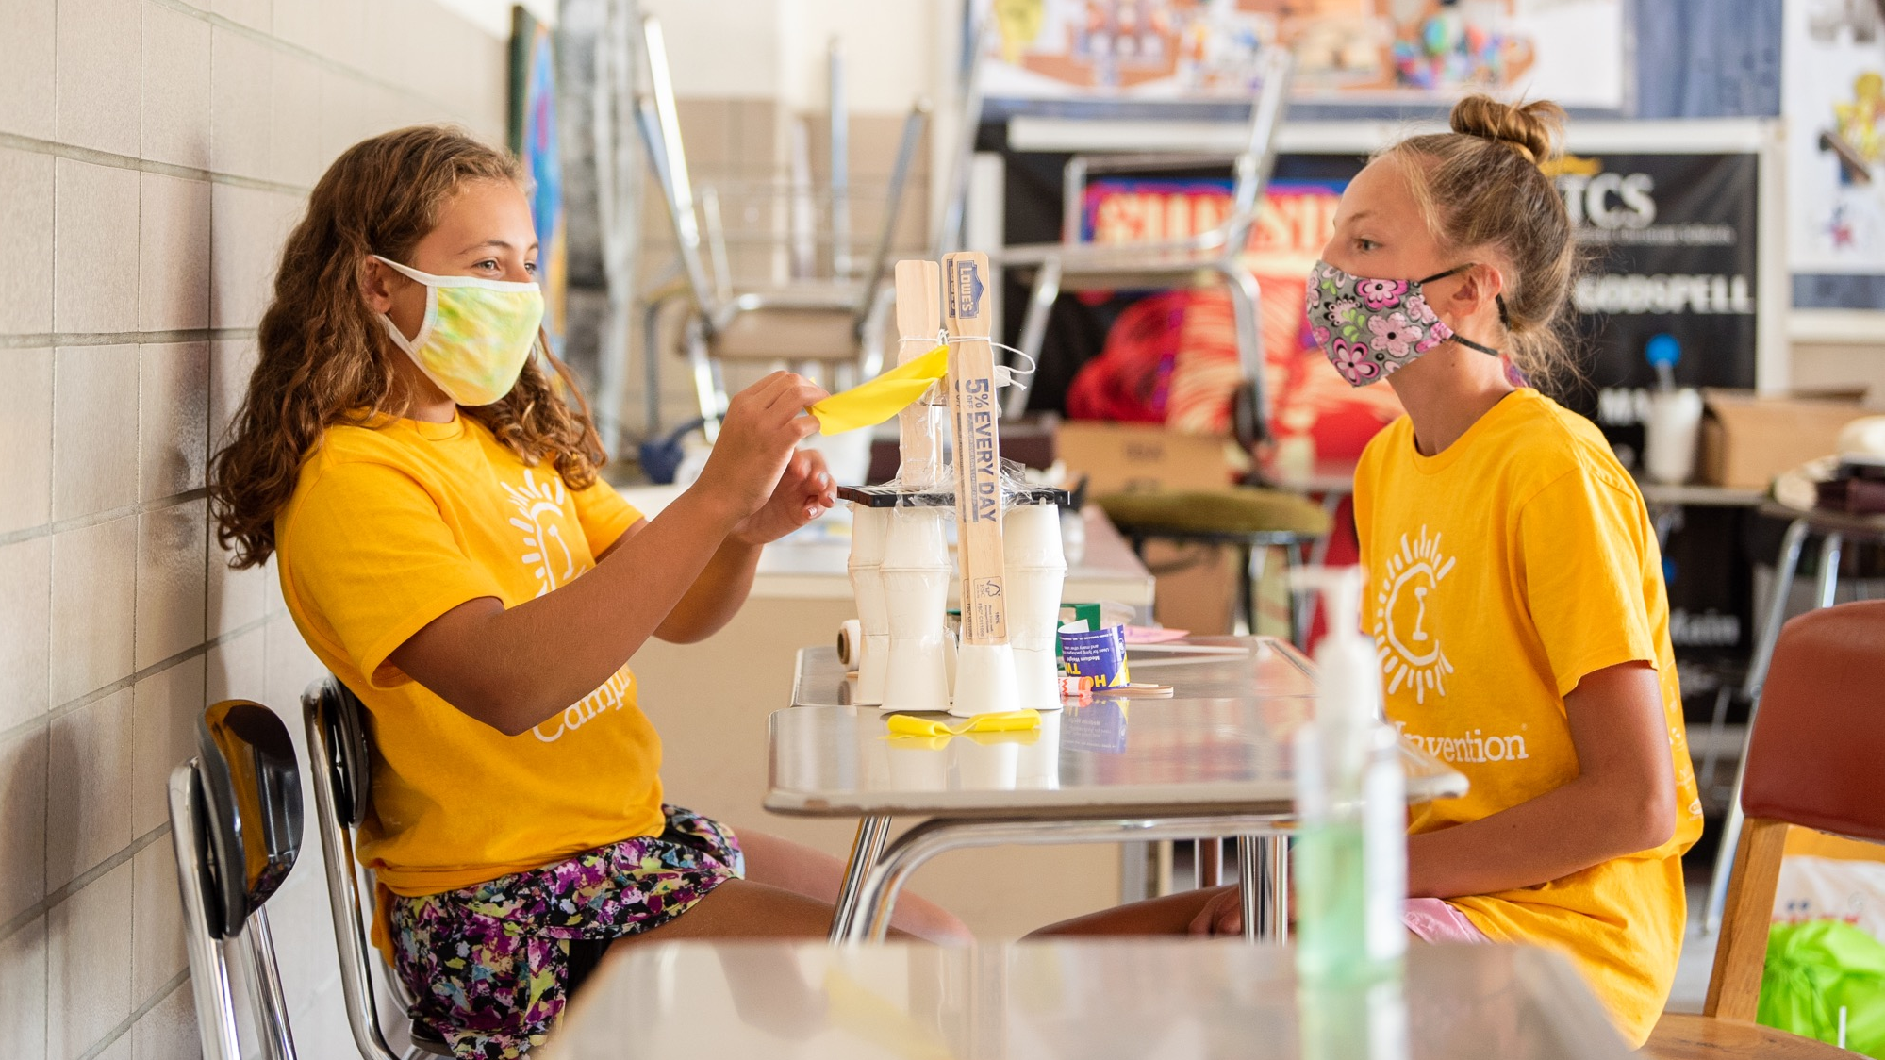
Preparation through Adaptability
Notes:
This moment has reminded us that challenges in the real world rarely have simple solutions.
We need to help students develop the perseverance and mindset of an innovator.

Slide 6
THE SOLUTION:
In this uncertain environment, the ability to adapt and solve complex challenges through creativity and innovation is more important than ever before.
Notes:
In this uncertain environment, teaching the ability to adapt and solve complex challenges through creativity and innovation is more important than ever before.
Simply put, we must embrace education that champions adaptation.

Slide 7
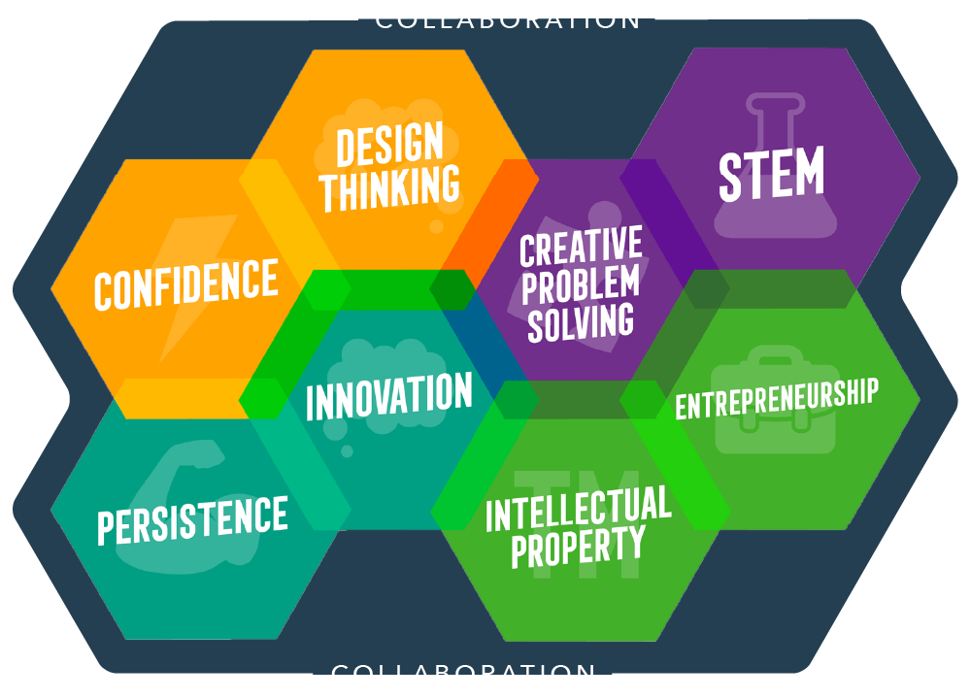
The National Inventors Hall of Fame’s unique approach to Invention Education: THE INNOVATION MINDSET
Distilled from the lessons and stories of National Inventors Hall of Fame® Inductees, these 9 essential skills and traits will empower children throughout their lives.
Notes:
By consulting with our National Inventors Hall of Fame® Inductees, we’ve been able to identify 8 essential skills and traits that can transform today’s students into the innovators of tomorrow.
Let’s unpack the different parts of the Innovation Mindset!

Slide 8
Notes:
The drive to innovate is what moves society forward. By engaging in hands-on challenges involving real-world issues, children are encouraged to dream up new inventions and improve upon existing ones.

Slide 9
Notes:
The persistence to recover from failure and overcome obstacles is essential for every aspect of life. Our programs foster perseverance through a “create, test and retest” approach to learning.

Slide 10
Notes:
Children build confidence as they turn their ideas into reality and begin to see themselves as capable creators. This will benefit them not only in the process of invention but in every area of life.

Slide 11
Notes:
Design thinking helps children identify and solve problems. By focusing on the people who will use the things they create, children can apply empathy to design solutions that meet their users’ needs.

Slide 12
Notes:
Through creative problem solving, children learn to use critical and creative thinking to develop innovative solutions, preparing them to take on both everyday problems and complex challenges.

Slide 13
Notes:
By engaging in STEM (science, technology, engineering and math), children will be better equipped to apply their ingenuity, pursue in-demand careers and make their mark on our rapidly evolving world.

Slide 14
Notes:
By exploring entrepreneurship and building basic business skills, children become curious, creative risk-takers and self-assured leaders who follow their dreams and can inspire others to do the same.

Slide 15
Notes:
As they discover the power and purpose of intellectual property (IP), children recognize the value of their own ideas. With an understanding of IP, children are prepared to protect their rights as creators.

Slide 16
While the Innovation Mindset is particularly effective in this critical moment, for more than 30 years our education team has developed curricula with these principles as their core.
Notes:
While the Innovation Mindset is undeniably effective in this critical moment, it also represents who we are as a non-profit.
For more than 30 years our education has developed innovative curricula that uses these principles as their foundation.

Slide 17
Camp Invention has the right balance of challenge and engagement to support student learning, creativity and confidence. - Julia, Camp Invention Director
My twin girls learned so much at camp. It literally changed how they play with their toys at home and even their perception of the world has changed. - Alex, Parent of Camper
I really liked taking the LINK robot apart because I got to see all of the parts inside. It makes me feel more confident in building and feel like I could fix my bike or build something bigger. - Reed, Camp Invention Participant
Notes:
Research from Opportunity Insights tells us that the earlier a child is introduced to innovation, the more likely they will innovative into adulthood.
Educators appreciate how NIHF programs strike the right balance of challenge and engagement to support learning, creativity and confidence.
Parents say our programs are empowering and have transformed the way their children see the world.
Students tell us that our programs have made them feel more confident as creators.

Slide 18
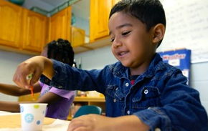
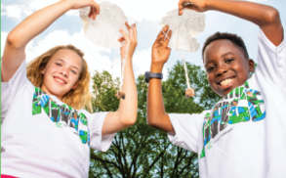
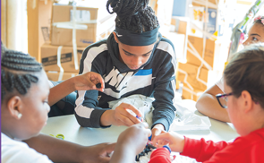
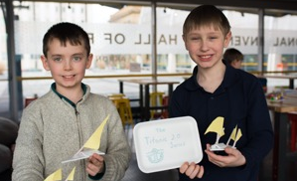
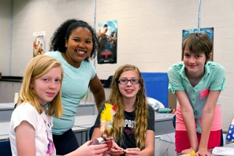
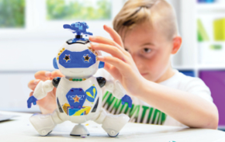
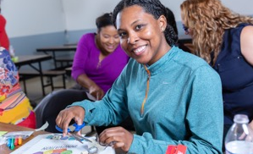
Now Is the Time to Bring the Innovation Mindset to Your District
Early STEM learning through play for in-person preschool classrooms
Nationally acclaimed K-6 STEM summer camp providing in-person and at-home learning opportunities
Engaging, in-person and at-home afterschool STEM programs for grades 1-6
Innovative, in-person makerspace experiences for grades 1-6
Immersive, cross-cutting K-6 curriculum for in-school, at-home and blended learning
Empowering, in-person STEM programming for grades 6-9
Hands-on STEM activity kits for independent learning in grades K-9
Customizable professional development workshops for educators
Notes:
From in-school and afterschool, to at-home and blended settings, all of our programs are designed to help children cultivate the Innovation Mindset.
Let’s talk about what some of your biggest challenges are right now.

Slide 19
Now Is the Time to Discover our Invention Education Programs
Early STEM learning through play for in-person preschool classrooms
Nationally acclaimed K-6 STEM summer camp providing in-person and at-home learning opportunities
Engaging, in-person and at-home afterschool STEM programs for grades 1-6
Innovative, in-person makerspace experiences for grades 1-6
Immersive, cross-cutting K-6 curriculum for in-school, at-home and blended learning
Empowering, in-person STEM programming for grades 6-9
Hands-on STEM activity kits for independent learning in grades K-9
Customizable professional development workshops for educators
Notes:
Your students have experienced the power of the Innovation Mindset through Camp Invention.
Our other programs can bring this same level of inspiration and excitement in at-home, in-school, afterschool and blended settings.
Let’s talk about what some of your biggest challenges are right now.

