Slide 1
BUILDING AN
INNOVATION ECOSYSTEM

Slide 2
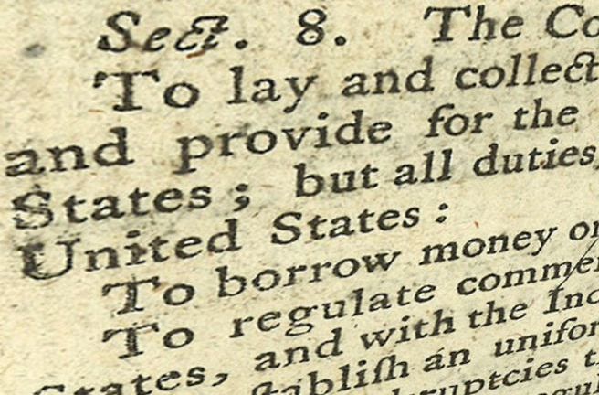
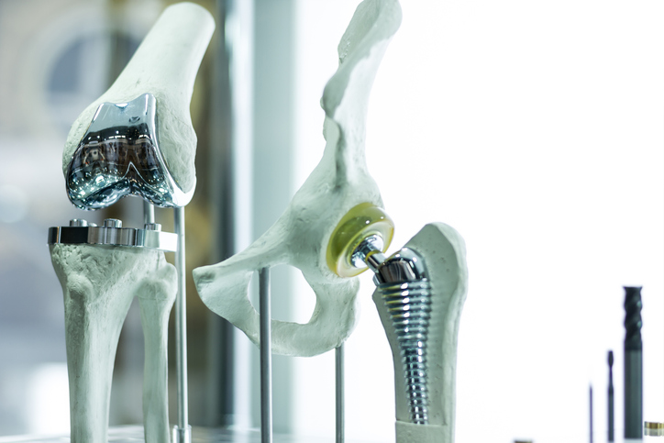
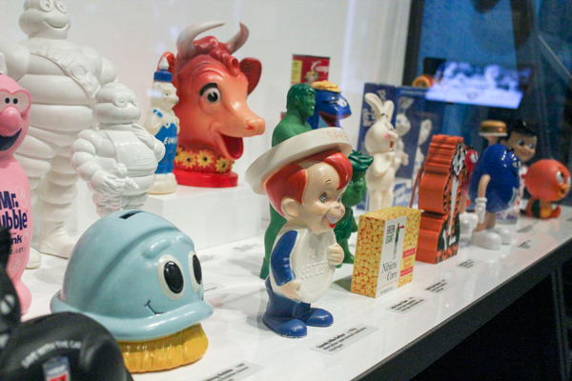
230 Year Old Patent System
45 Million IP-intensive Industry Jobs
9 of the Top 10 World Brands are U.S. Brands
STEM Career Growth +12% by 2022
We are an Intellectual Property Economy
Notes:
Innovation is widely viewed as the engine of economic growth and rightfully so.
We are an IP economy. With an IP system that is 230 years old, we are by far the longest-tenured intellectual property economy.
According to the U.S. Commerce Department, IP-intensive industries – which includes information and communications technology, pharma, oil, agriculture, construction, mining, machinery manufacturing, entertainment and more – account for more than 45 million direct and indirect U.S. jobs (nearly a third of the workforce), 50 percent of U.S. exports, and almost 40 percent of U.S. GDP.
90% of the top world brands are U.S. brands = Google, NBC, Coca Cola, Johnson’s, Nike, McKinsey, PricewaterhouseCoopers, L’Oreal and Walt Disney (Lego is the one that is not)
The number of STEM career openings is expected to grow by 12% or 1MM jobs by the year 2022
Developing skills that support an innovative career path and building a better understanding of Intellectual Property is key to success
SOURCES:
- The Equality of Opportunity Project
- https://tr.usembassy.gov/intellectual-property-key-innovation-economy/
https://www.uspto.gov/sites/default/files/documents/IPandtheUSEconomySept2016.pdf
http://www.businessinsider.com/the-worlds-10-most-powerful-brands-2016-2/#1-walt-disney-10
- Linsen, A. W. and Dr. Lamen, R. (2015). Enhancing K-12 Curriculum with STEM Integration. Advanced Education, Inc. 2017, December 15. Retrieved from: http://www.advanc-ed.org/source/enhancing-k-12-curriculum-stem-integration

Slide 3
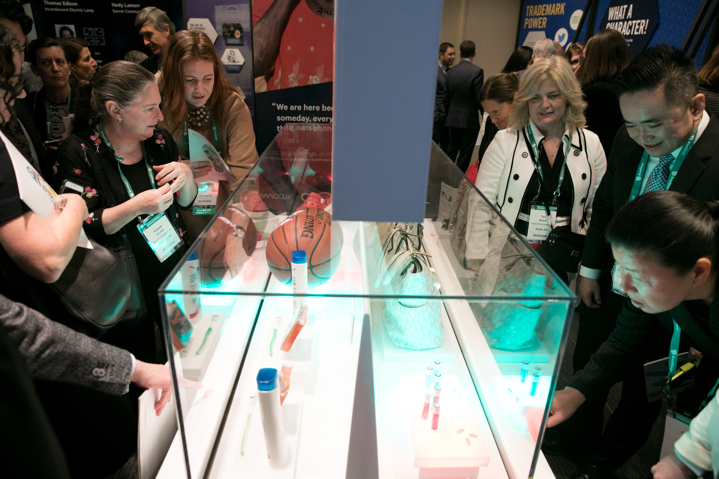
The Impact of Counterfeiting and Piracy
- $959B
~4.8M Jobs Lost
Notes:
But we are falling short on IP literacy and losing billions of dollars and millions of jobs to counterfeiting and piracy
Total domestic production and consumption of counterfeit pirated goods will be $959 billion by 2022
Frontier economics project global net job losses of 4.2 to 5.4 million due to the effects of counterfeiting and piracy by 2022
SOURCES:
Most of the stats on this page came from a report commissioned by BASCAP and INTA. Frontier Economics actually did the research and developed the report.
https://www.voanews.com/a/global-trend-in-counterfeiting-and-piracy/3783360.html
https://iccwbo.org/publication/economic-impacts-counterfeiting-piracy-report-prepared-bascap-inta/
https://cms.iccwbo.org/content/uploads/sites/3/2017/02/ICC-BASCAP-Frontier-report-2016-Executive-Summary.pdf

Slide 4
Annual Income
Innovation & Invention Equates to Success
Notes:
Innovation isn’t just key to the US economy – it is a pathway to success. A team of researchers led by the Stanford economist Raj Chetter, researched the lives of more than one million inventors in the U.S., tracking these individuals from birth onward, to identify the key factors that determine who becomes an inventor. One of the primary findings of the study is that patented inventors are very successful – the average patent holder earns over 4x the average American. $49,000:$256,000. Star inventors whose discoveries make a major impact or have highly sited patents earn more than $1M.
Innovation and, specifically, invention are key to personal and business financial success. More important are the lessons learned from going through the invention process, and embracing that way of critical thinking and creative problem solving
Source:
https://www.ssa.gov/OACT/COLA/AWI.html

Slide 5
Disparity in Innovation Rates
10X
3X
4X
Socioeconomic Class
Race
Gender
Notes:
The study also uncovered some issues - disparity in innovation rates by class, gender and race
Class - Children from high-income families are 10 TIMES more likely to become inventors than children from low-income families
Race - Caucasian children are 3 TIMES more likely to become inventors than African-American children
Gender - Only 18% of females are inventors and it will take 118 years to close that gap
Source: The Equality of Opportunity Project

Slide 6
Along with the issues came one key solution
EXPOSURE
Notes:
The good news, and a major revelation we have experienced through our work, is that the study found a way to reverse the trend – EXPOSURE.
Source: The Equality of Opportunity Project

Slide 7
EXPOSURE to Invention at a Young Age
Notes:
EXPOSURE to invention at an early age can stimulate interest in becoming an inventor and innovator
Study found that children who grow up in AREAS OF MORE INNOVATION OR WHO ARE EXPOSED TO / GROW UP WITH INVENTORS are more like to become inventors themselves.
And this is what we provide – Exposure through curriculum that introduces the invention process and encourages exploration and innovative thinking…

Slide 8
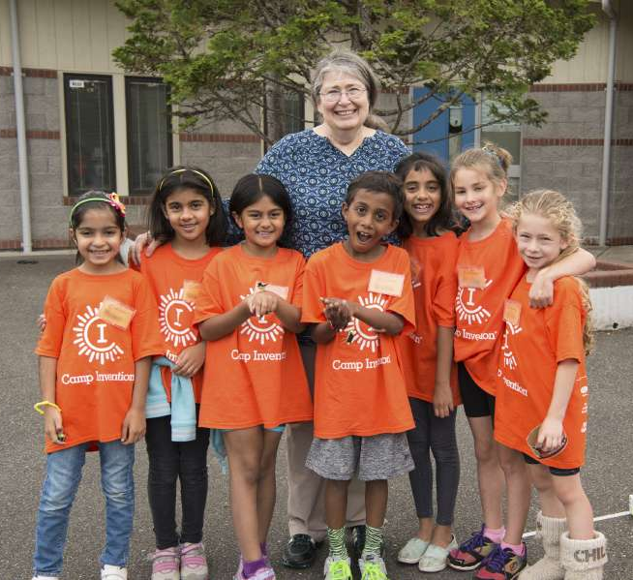
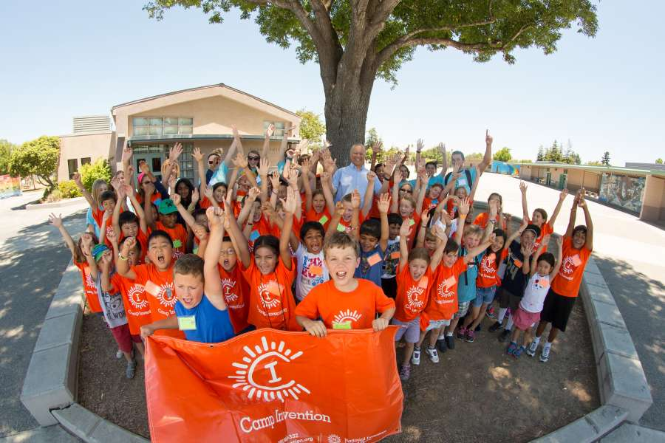
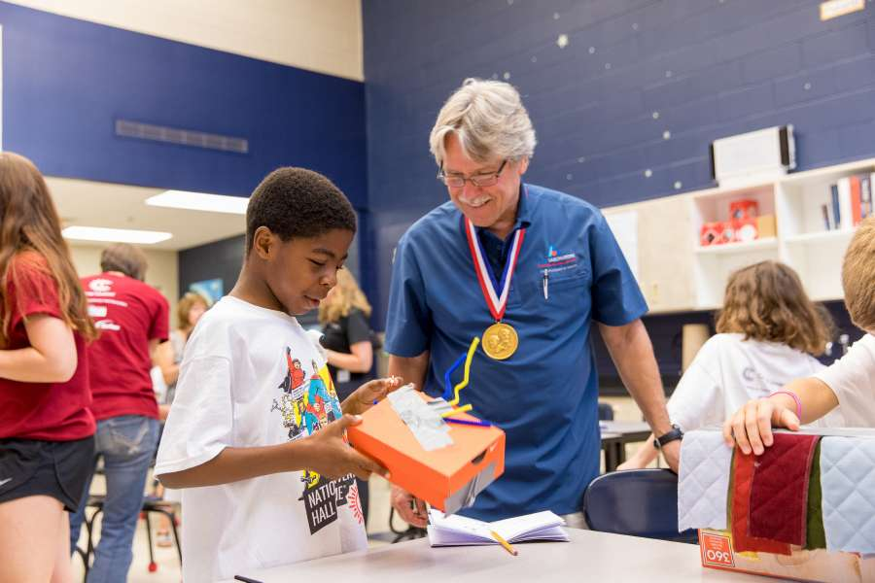
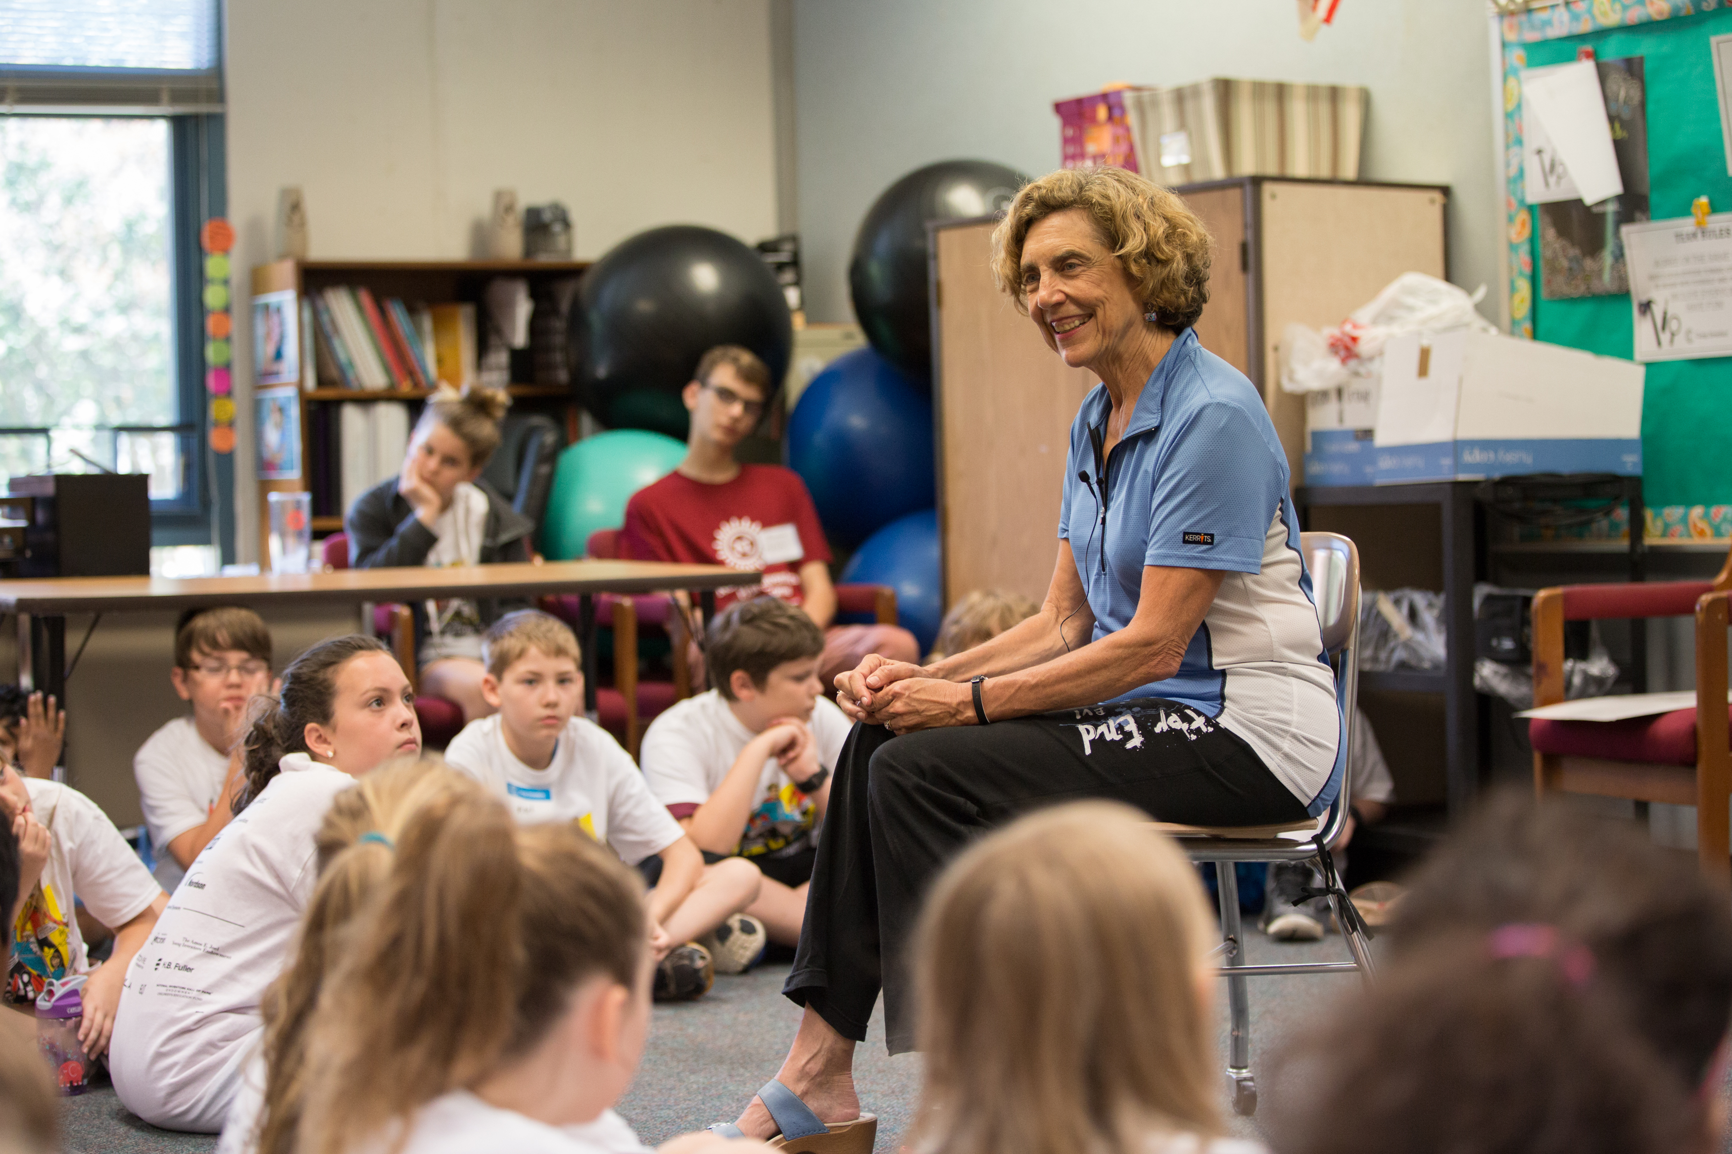
EXPOSURE to Innovators
Notes:
…Through on-site visits by the National Inventors Hall of Fame inductees…
A Camper share his idea with Iver Anderson
Radia Perlman poses with a group of campers
Frances Ligler answers questions about innovation
Jim West poses in front of Camp Invention class

Slide 9
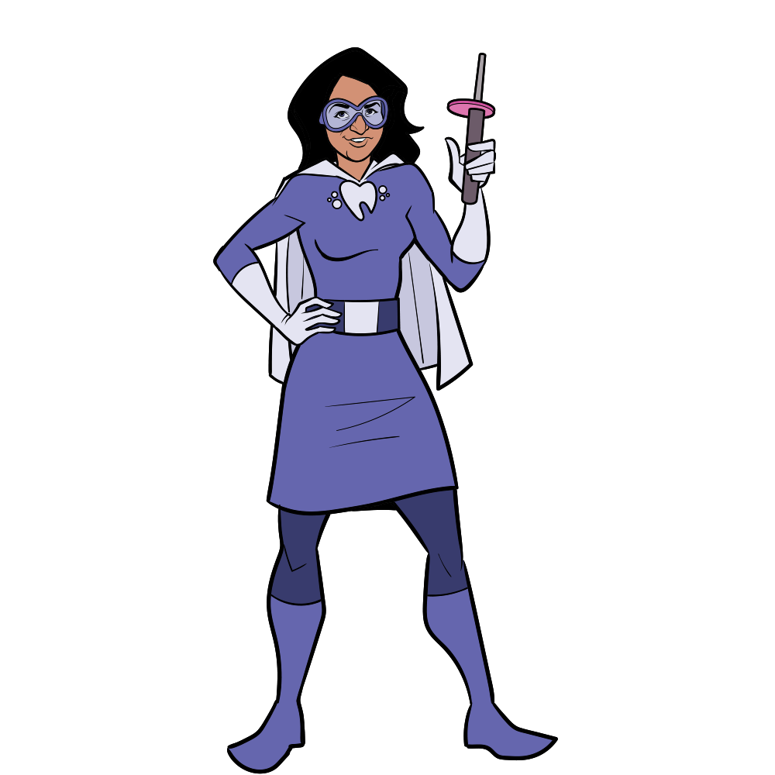
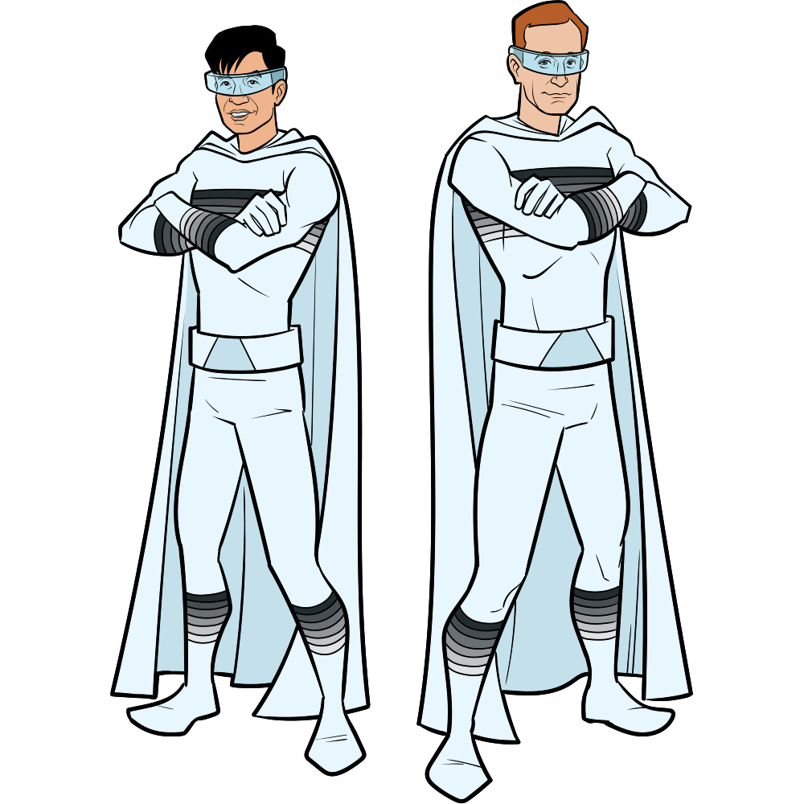
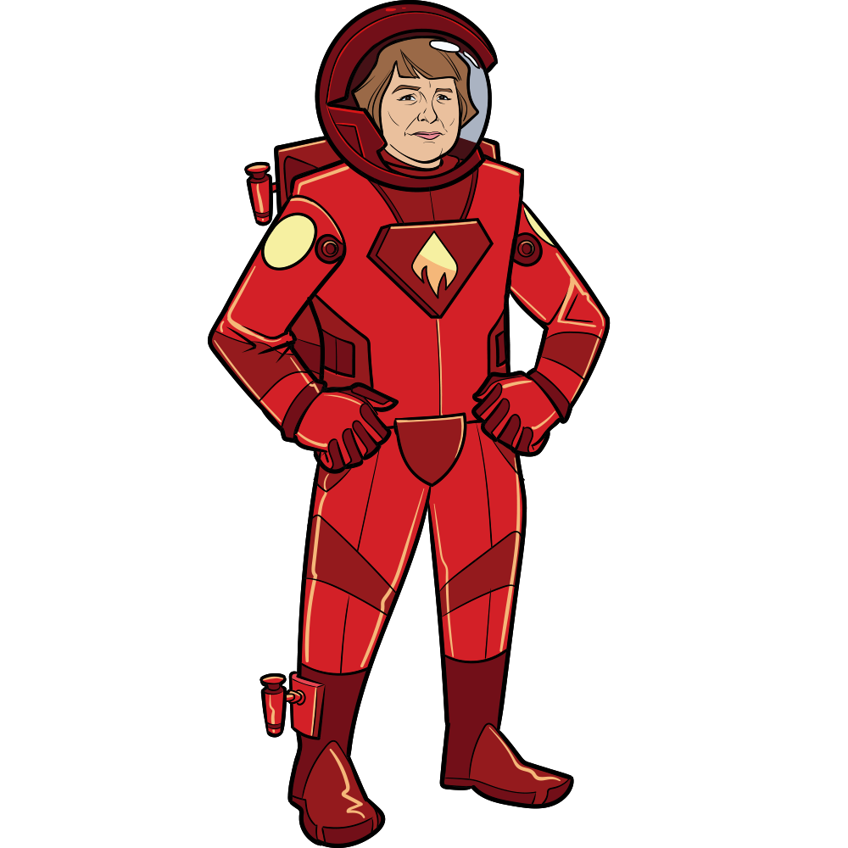
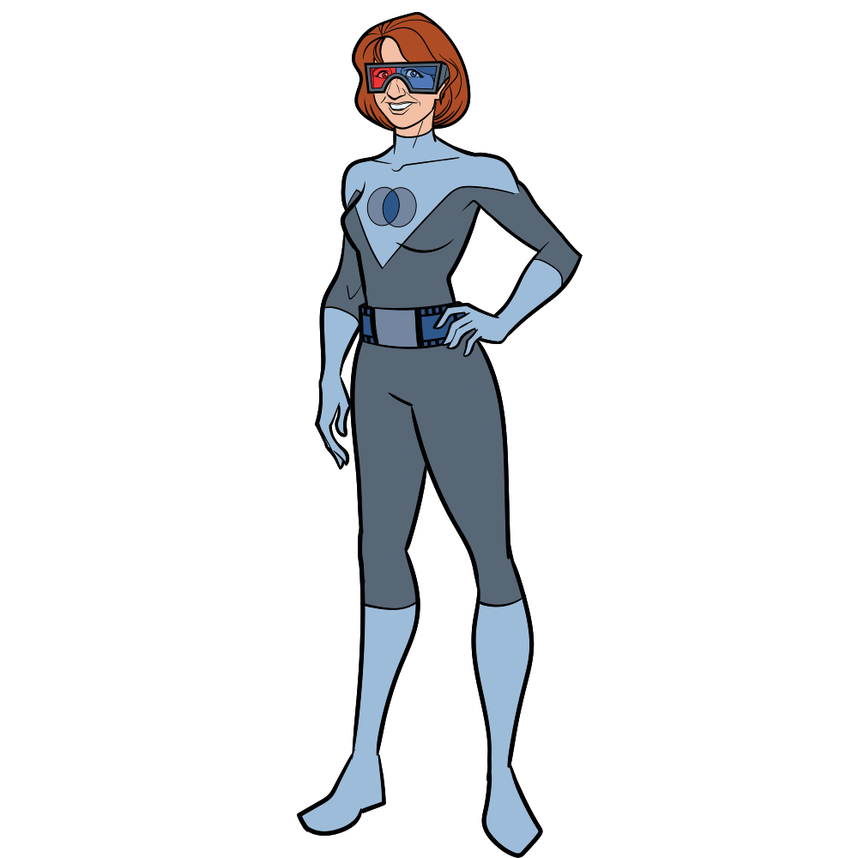
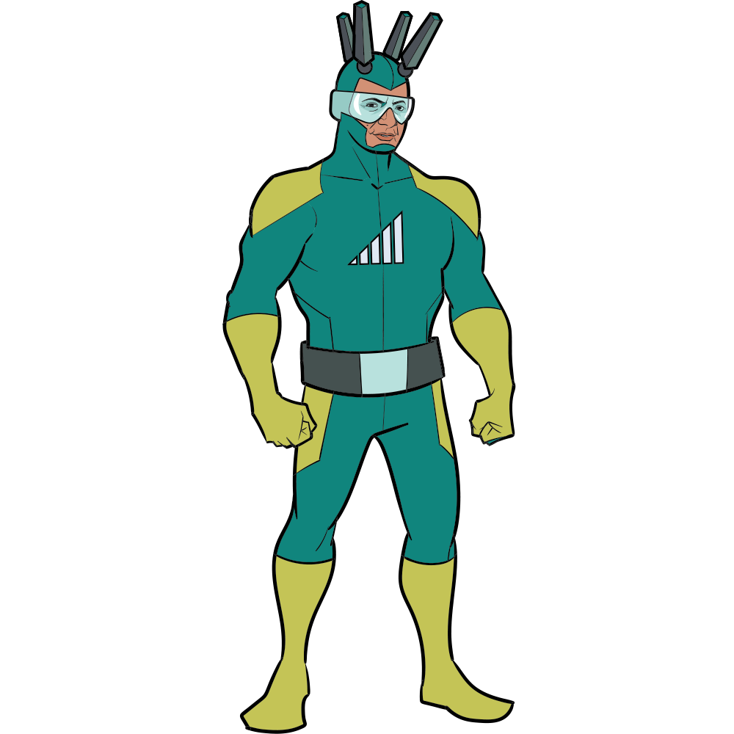
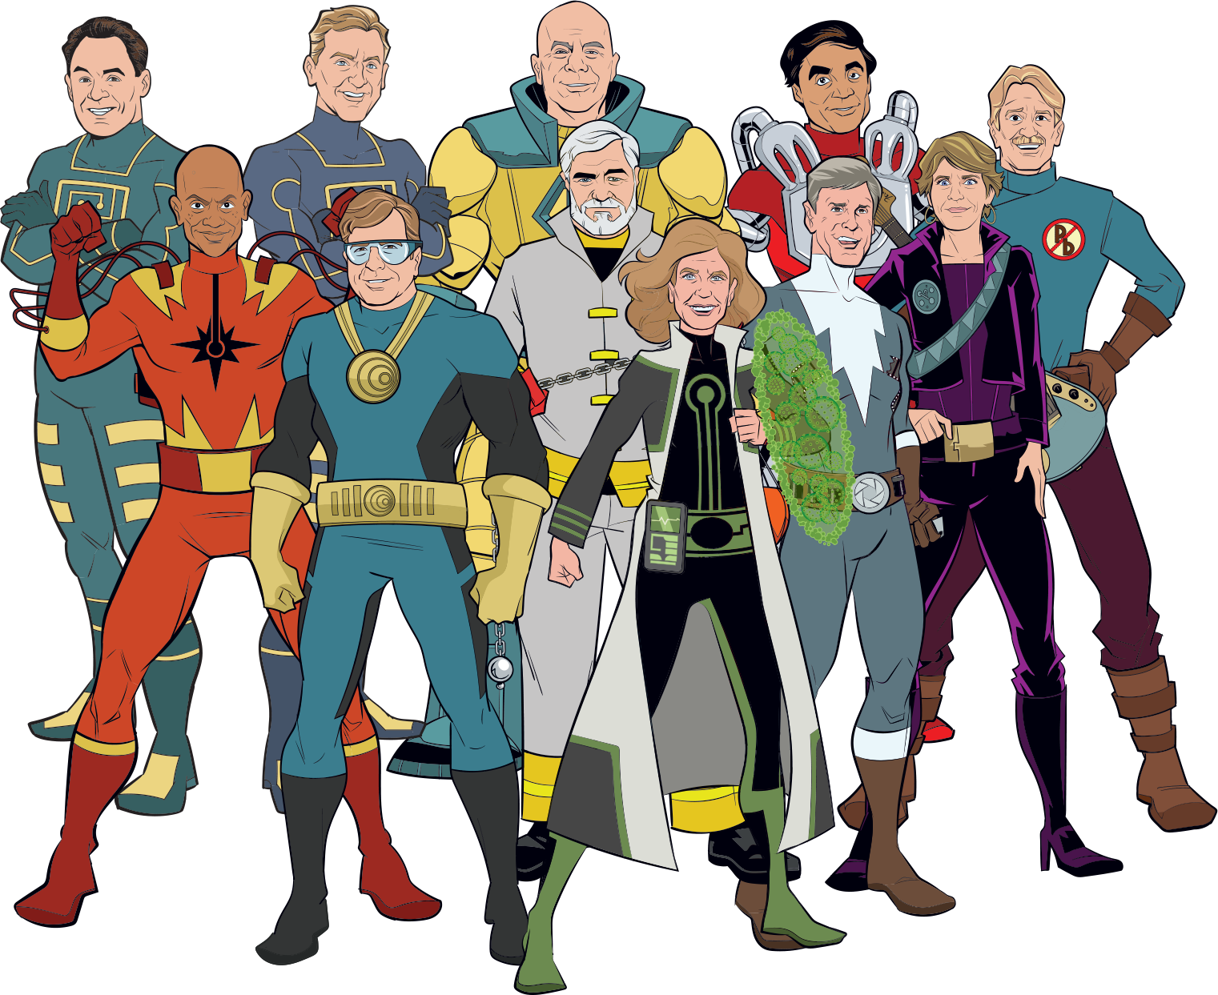
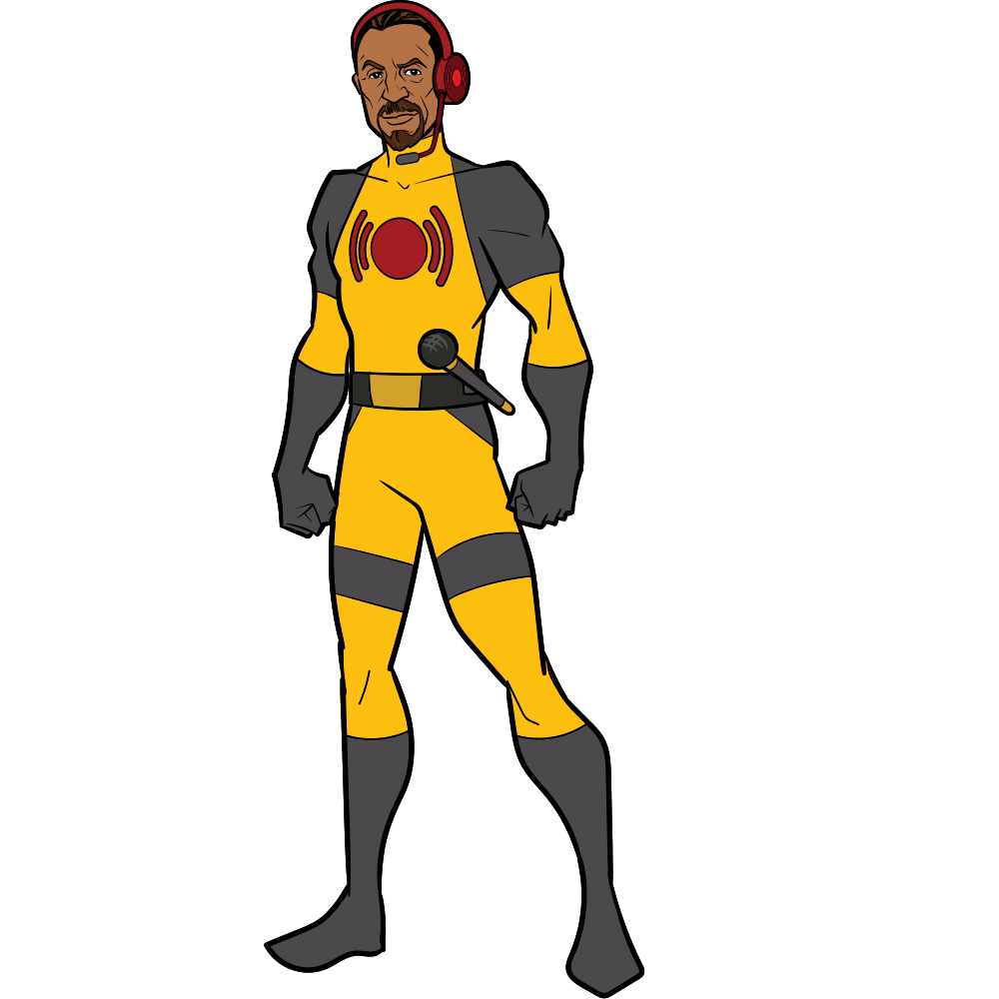
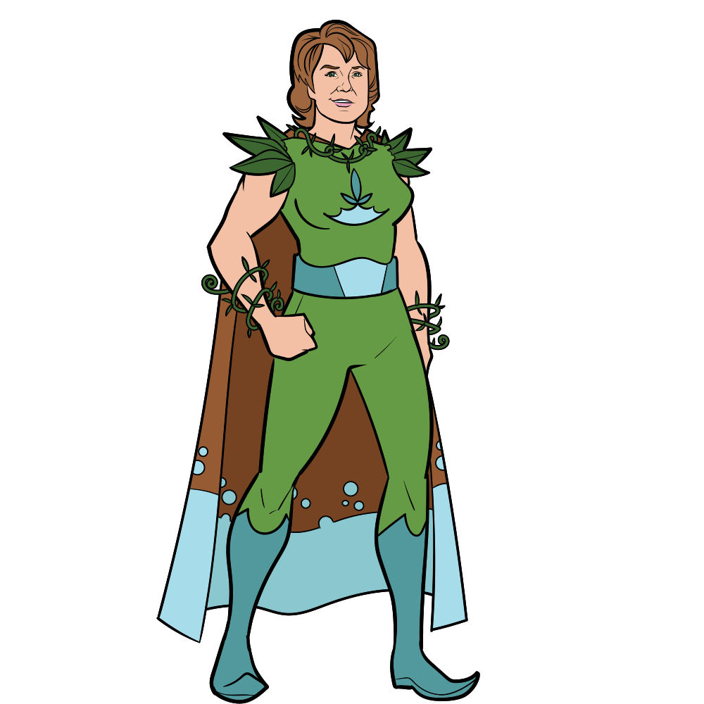
EXPOSURE that is Relatable
Notes:
…And through our Innovation Force, or Inventor Superheroes, that portray innovation and inventors in a way that all children can relate to, since we know EXPOSURE TO role model inventors is a proven, credible way to reverse the disparity.
The NIHF program curriculum features over 100 inductees.

Slide 10
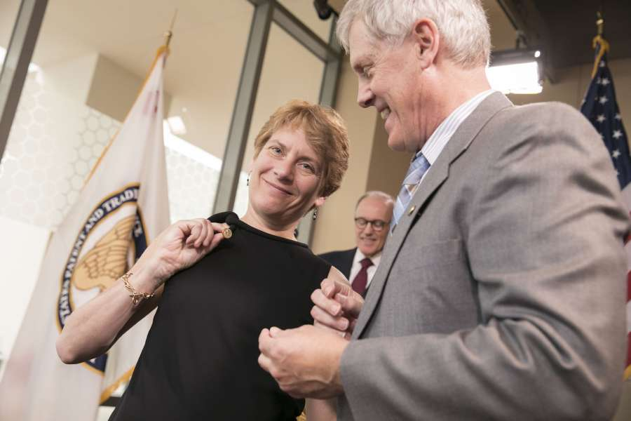
EXPOSURE that Helps Children Realize Inventors are Cool
Notes:
It is also a way to help children realize that Inventing is COOL! AND should be something that we strive for!

Slide 11
INNOVATION ECOSYSTEM
TEAM BUILDING
CREATIVITY
CPS
STEM
ENTREPRENEURSHIP
Notes:
So, understanding this landscape, how is the National Inventors Hall of Fame uniquely positioned to address the nation’s IP Code Red?
The solution lies in building a comprehensive Innovation Ecosystem—a system that is Integrated with STEM, Creativity and Innovation, Creative Problem Solving, Team Building, and Entrepreneurship.

Slide 12
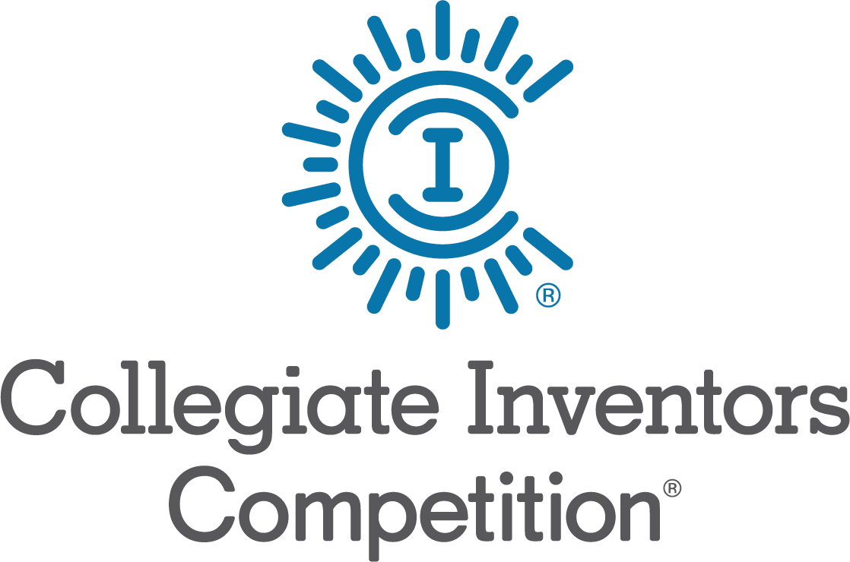
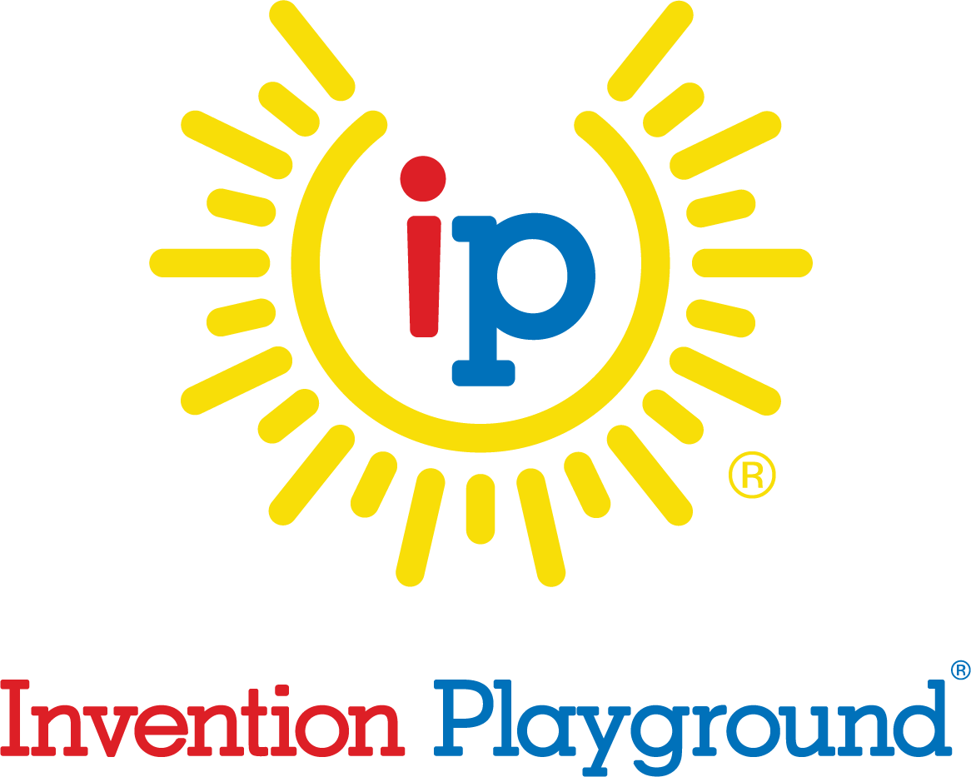
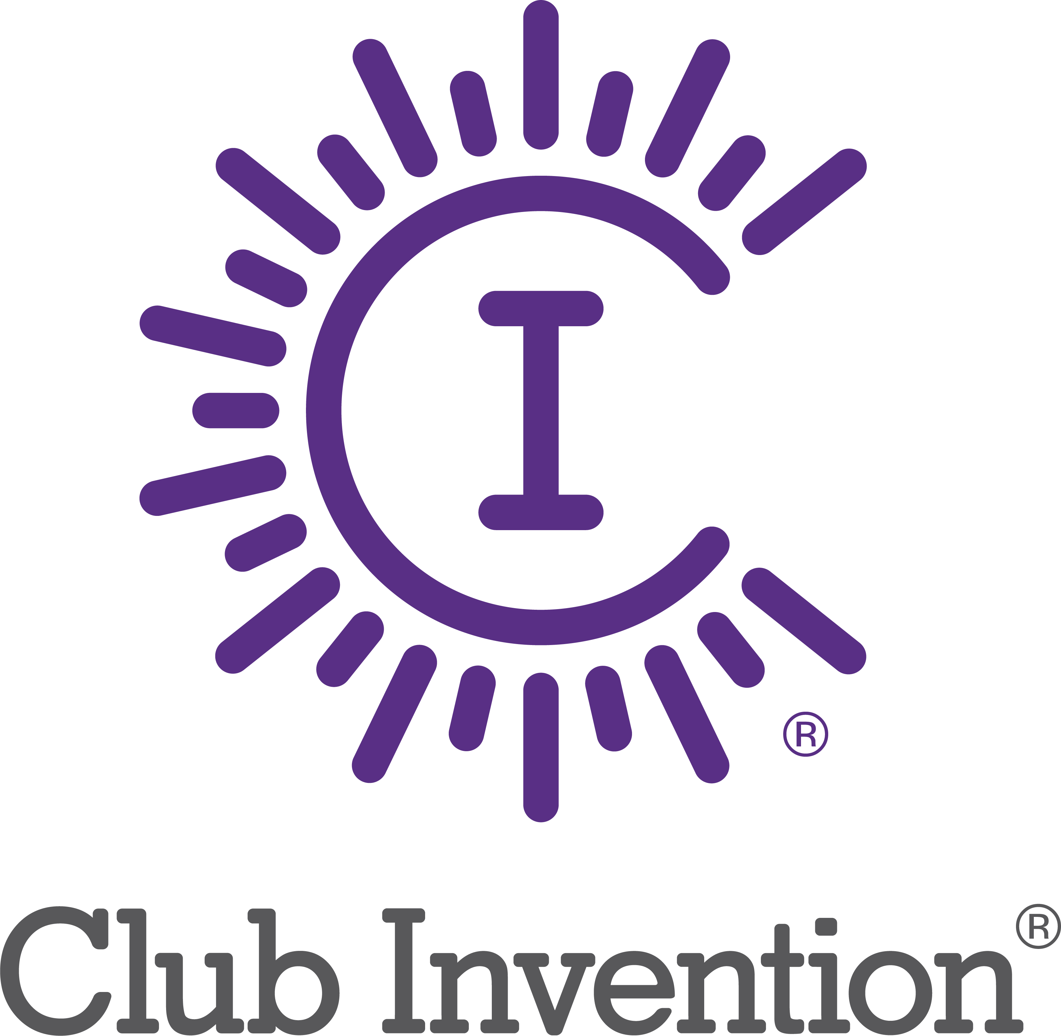
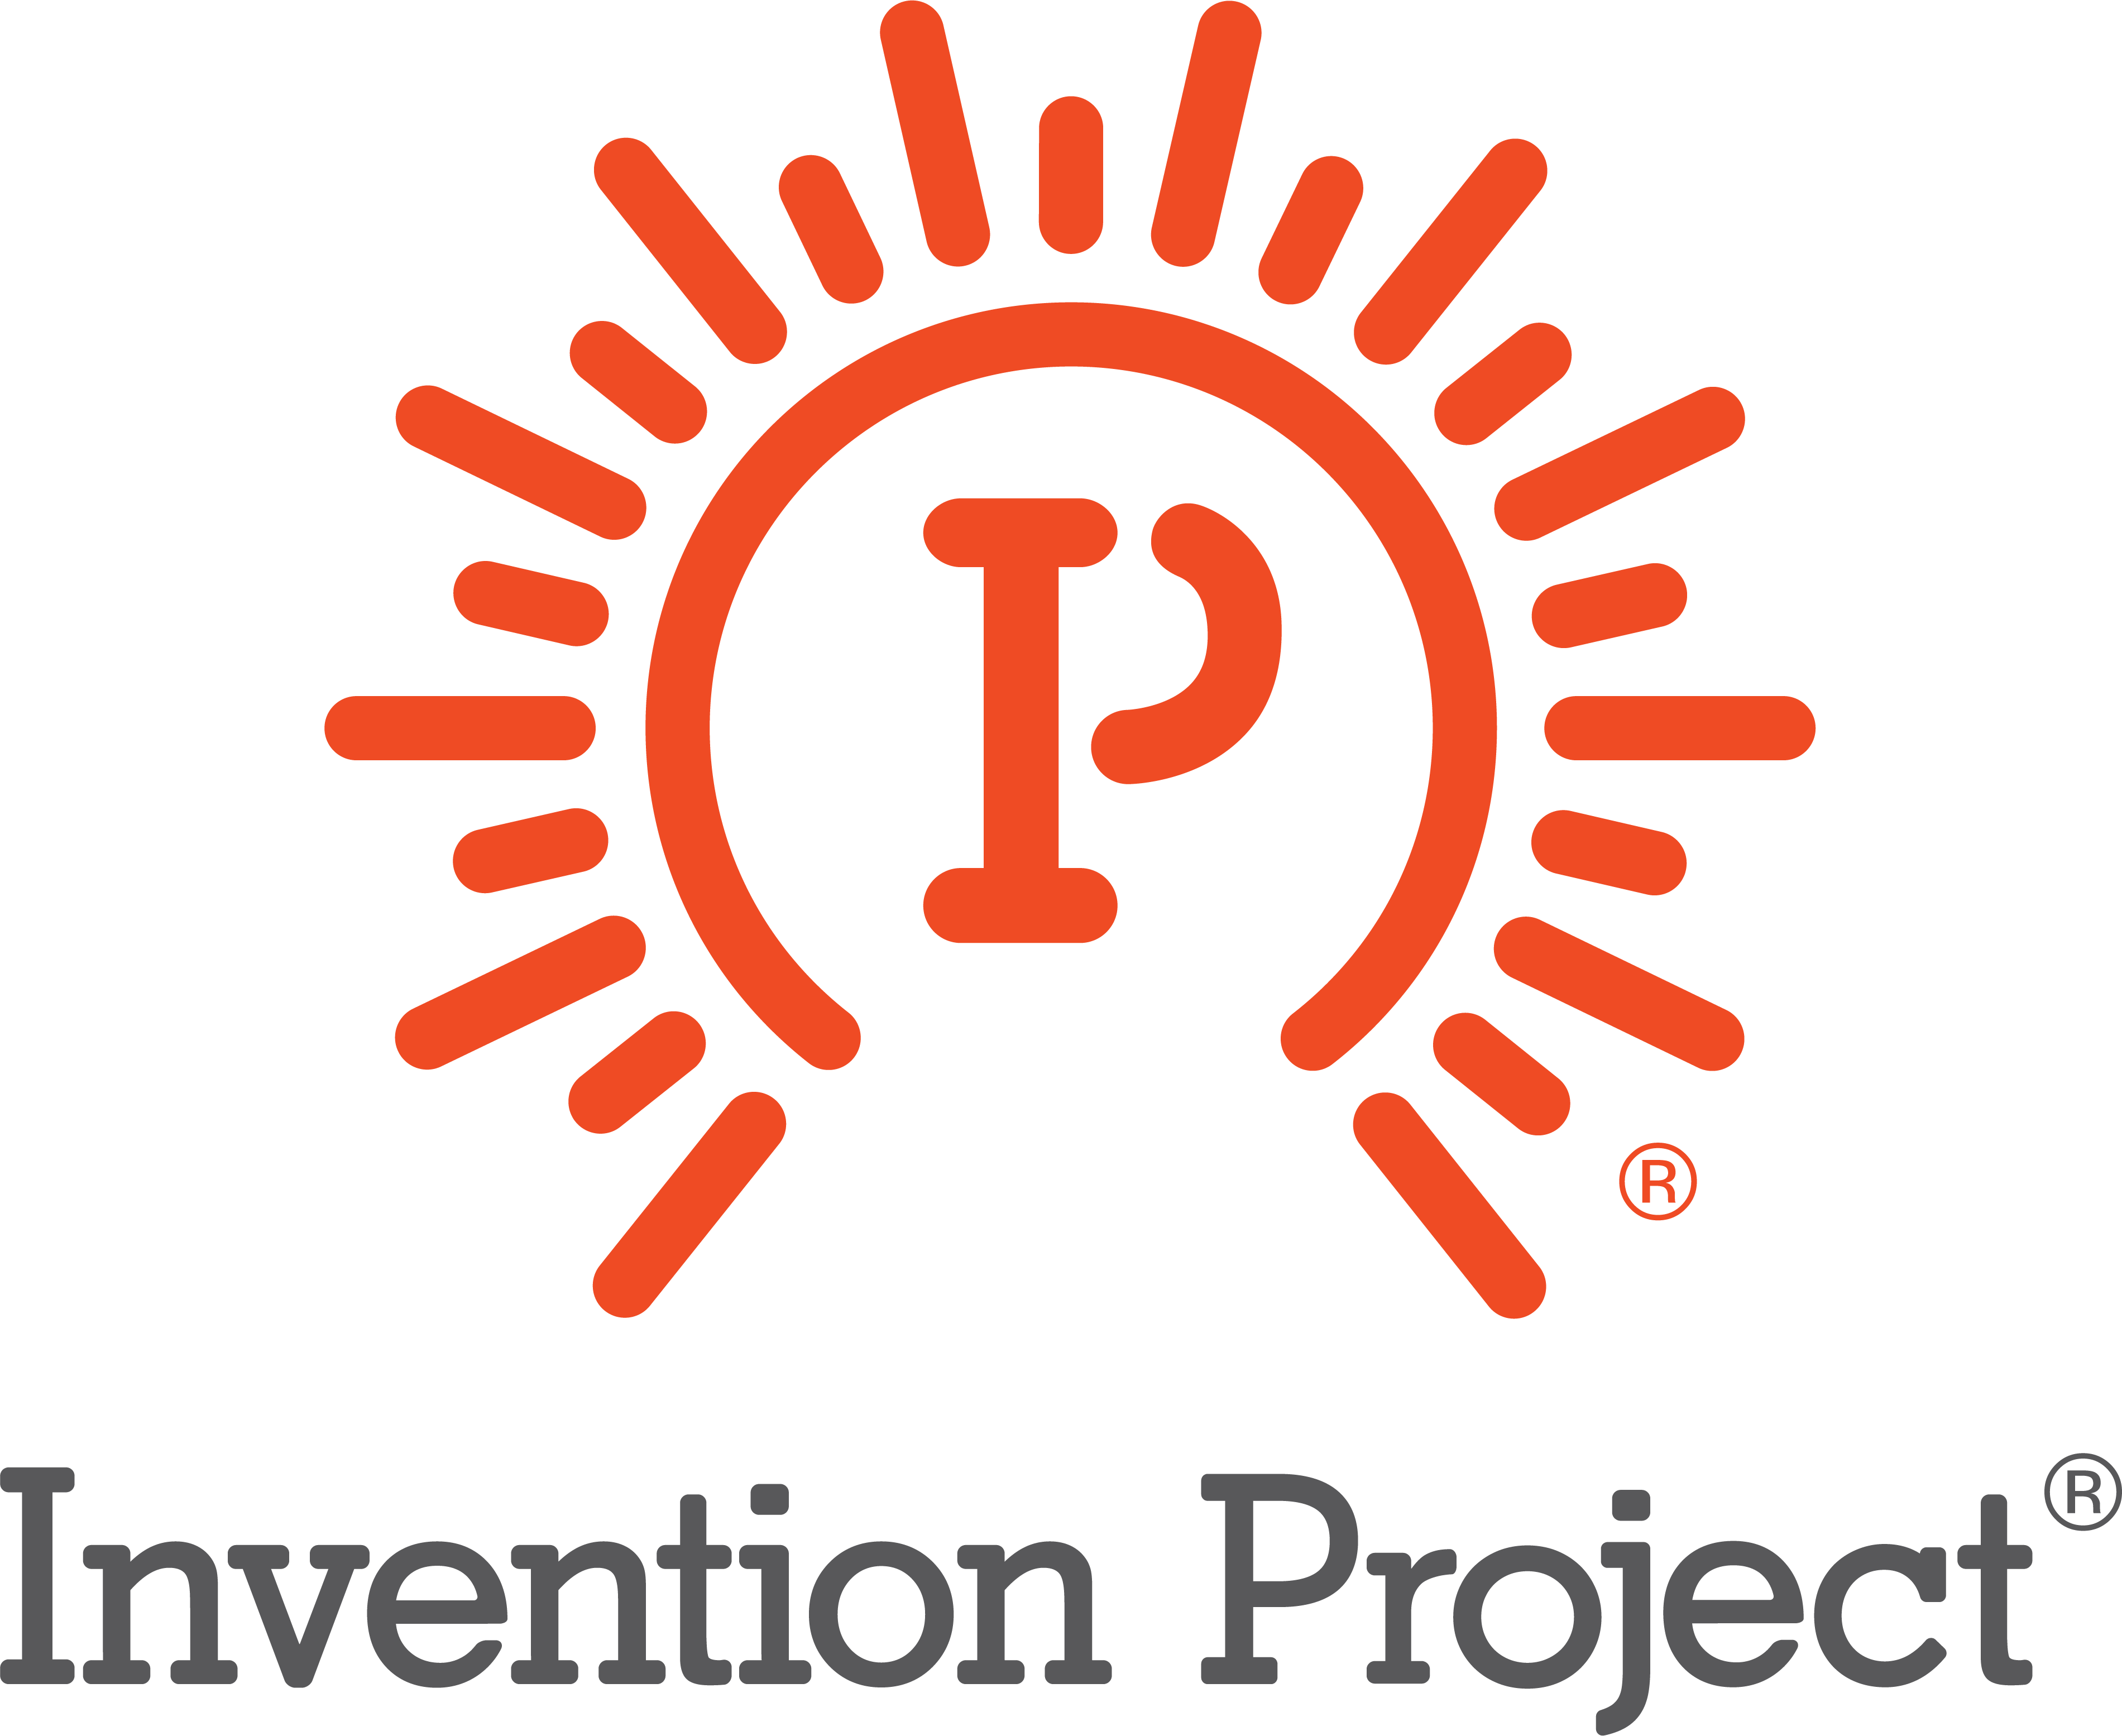
INNOVATION ECOSYSTEM
TEAM BUILDING
CREATIVITY
CPS
STEM
PD
Professional Development
ENTREPRENEURSHIP
Notes:
OUR INNOVATION ECOSYSTEM PROGRAMS:
Invention Playground: help children understand that their ideas have value
Club Invention: Empower children to generate, select, and strengthen ideas that are novel, nonobvious, and effective solutions to challenges.
Camp Invention: Empower children to generate, select, and strengthen ideas that are novel, nonobvious, and effective solutions to challenges.
Invention Project: Help youth explore the value of bringing original and effective solutions to market.
Professional Development: Empowering teachers to enhance the Intellectual Property Literacy of youth through the lenses of Creativity and Innovation, STEM, and Entrepreneurship
Collegiate Inventors Competition: Help collegiate students harness the power of Intellectual Property and its concepts (e.g., Triangulation) to maximize market value.
IP Power: Help collegiate students, innovators, and entrepreneurs harness the power of Intellectual Property and its concepts (e.g., Triangulation) to maximize market value.

Slide 13
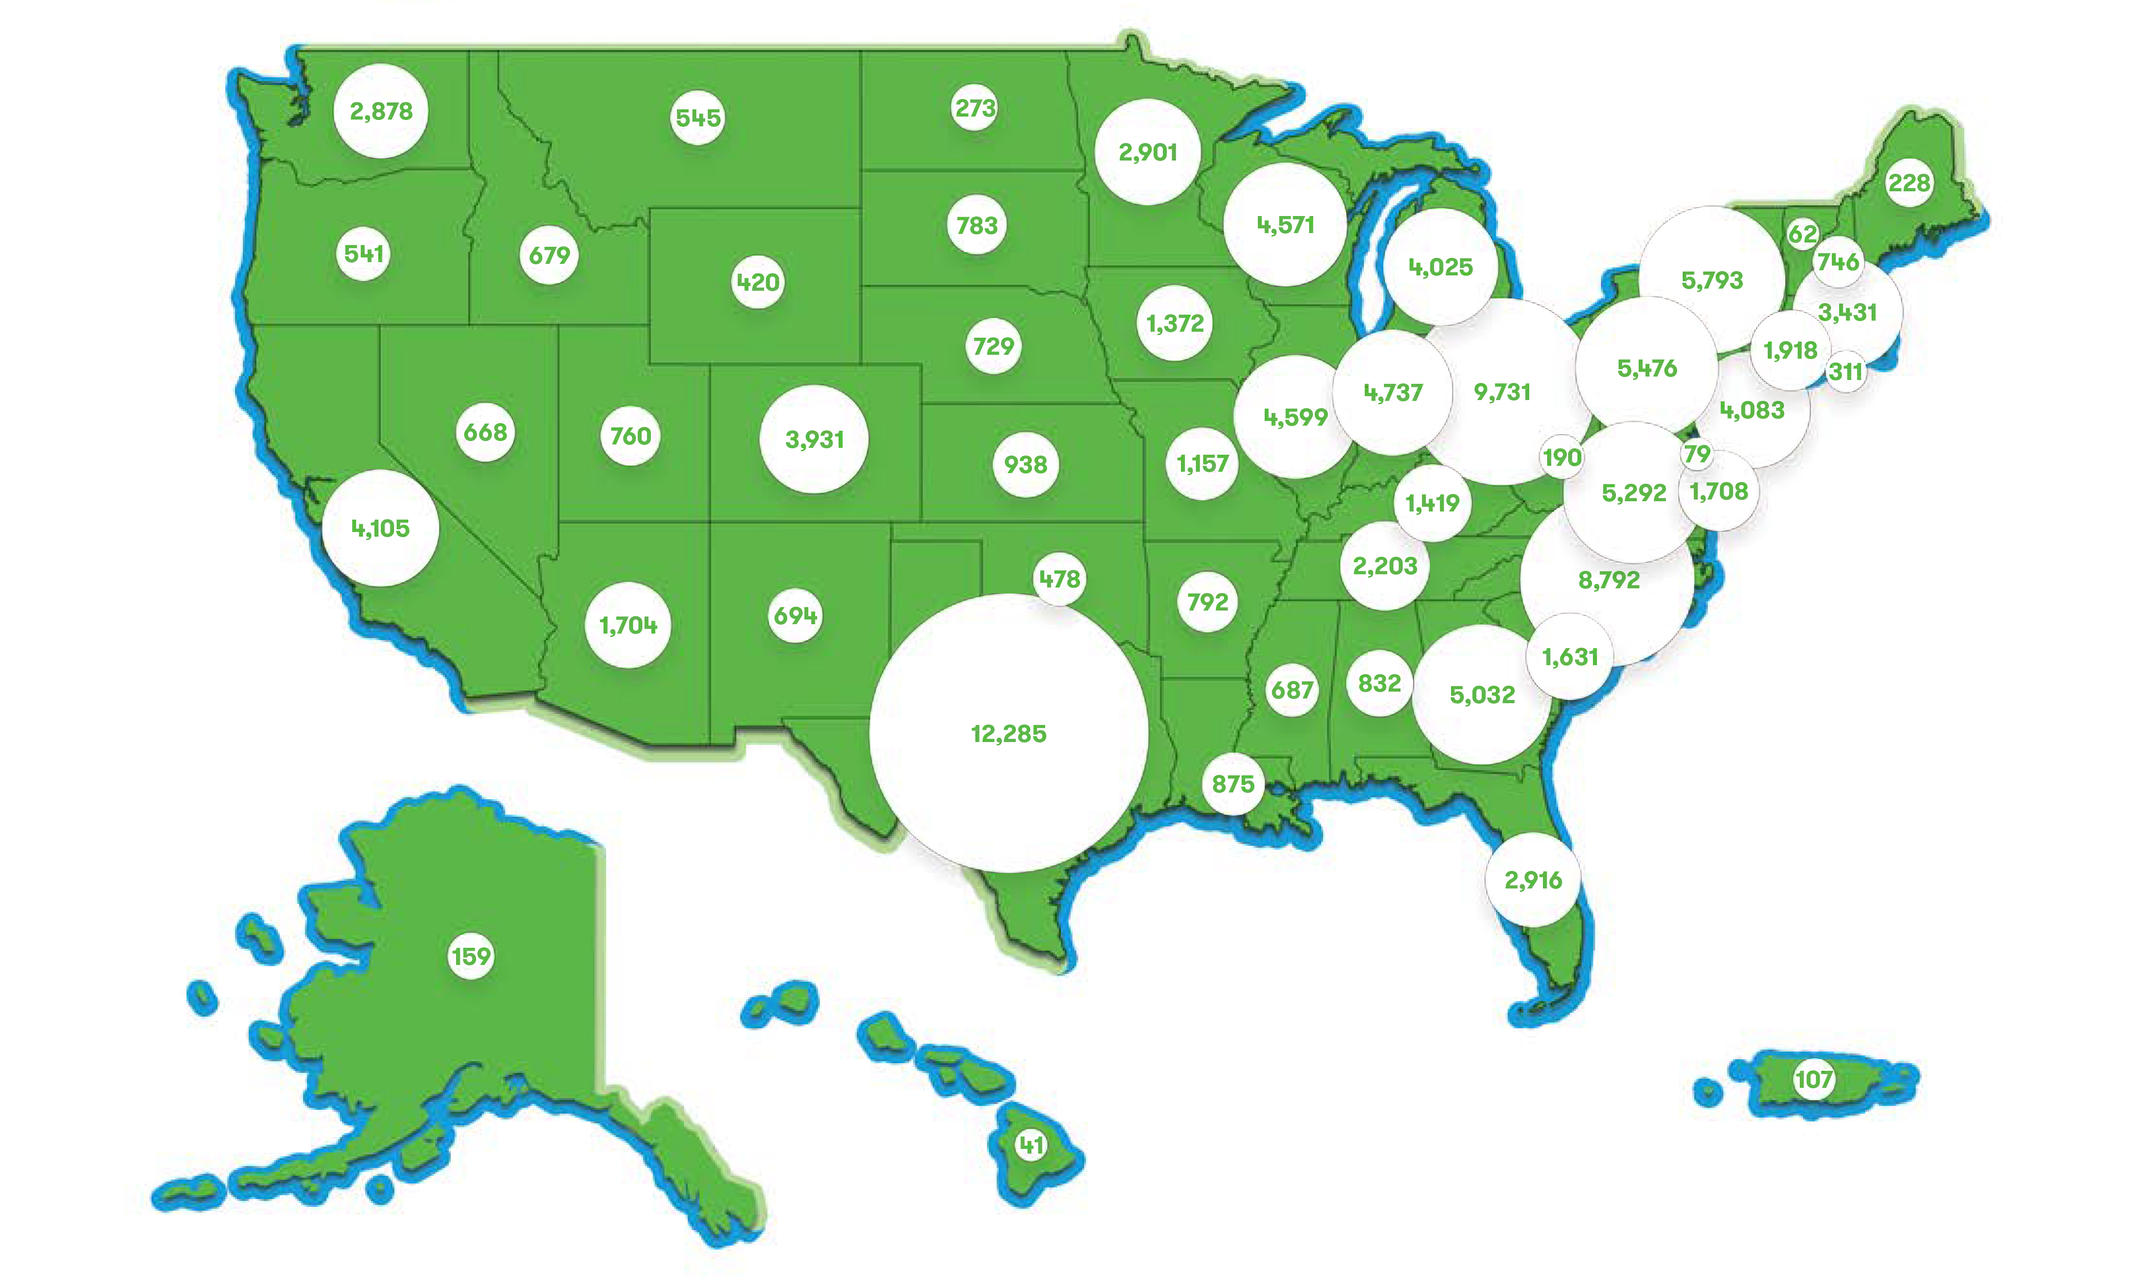
Join our Innovation Ecosystem TODAY
Notes:
THE PROGRAMS IN OUR INNOVATION ECOSYSTEM HAVE BEEN DOING THIS FOR 27 YEARS FOR THE BEST SCHOOL DISTRICTS IN THE COUNTRY
In fact, NO OTHER ORGANIZATION can provide these benefits to students Pre-K – 12 like the National Inventors Hall of Fame does
Join in our efforts to close the gap and expose more children to innovation so we can continue to create more inventors, innovators, and future game changers

Slide 14
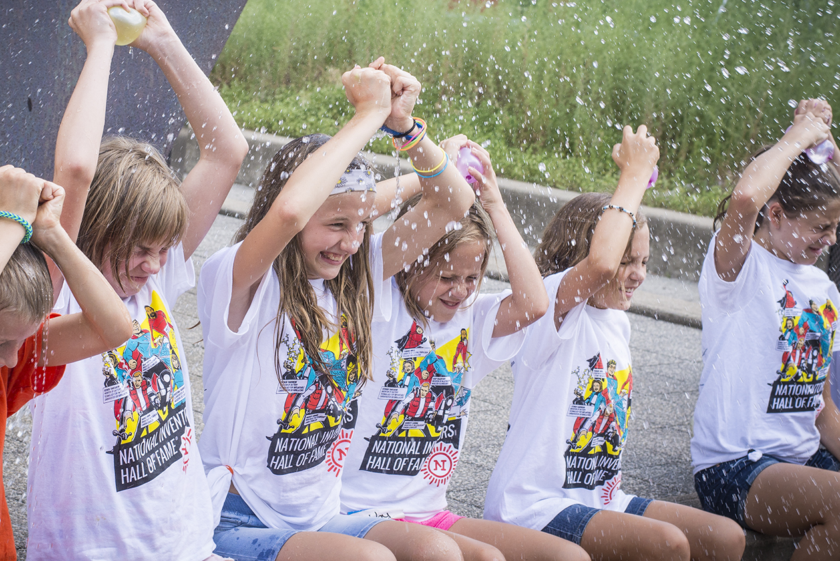
+13
In 2017 our Camps were 60% male / 40% female.
Let’s make 2018 the year we close the gap.
Notes:
Children from low-income families, minorities and women are less likely to have such exposure through their families or neighborhoods, which helps to explain why they have significantly lower rates of innovation. Stanford study estimates that if girls were exposed to female inventors as boys are to male inventors, the gender gap in innovation would fall by half.
Help us close the gaps by bringing the NIHF Innovation ecosystem to your district.
Math:
1,345 C Camps in 2017
37,211 Female campers
55,027 Male campers
Camper average 68.8
Female camper average: 27.6
Male camper average: 40.9

Slide 15
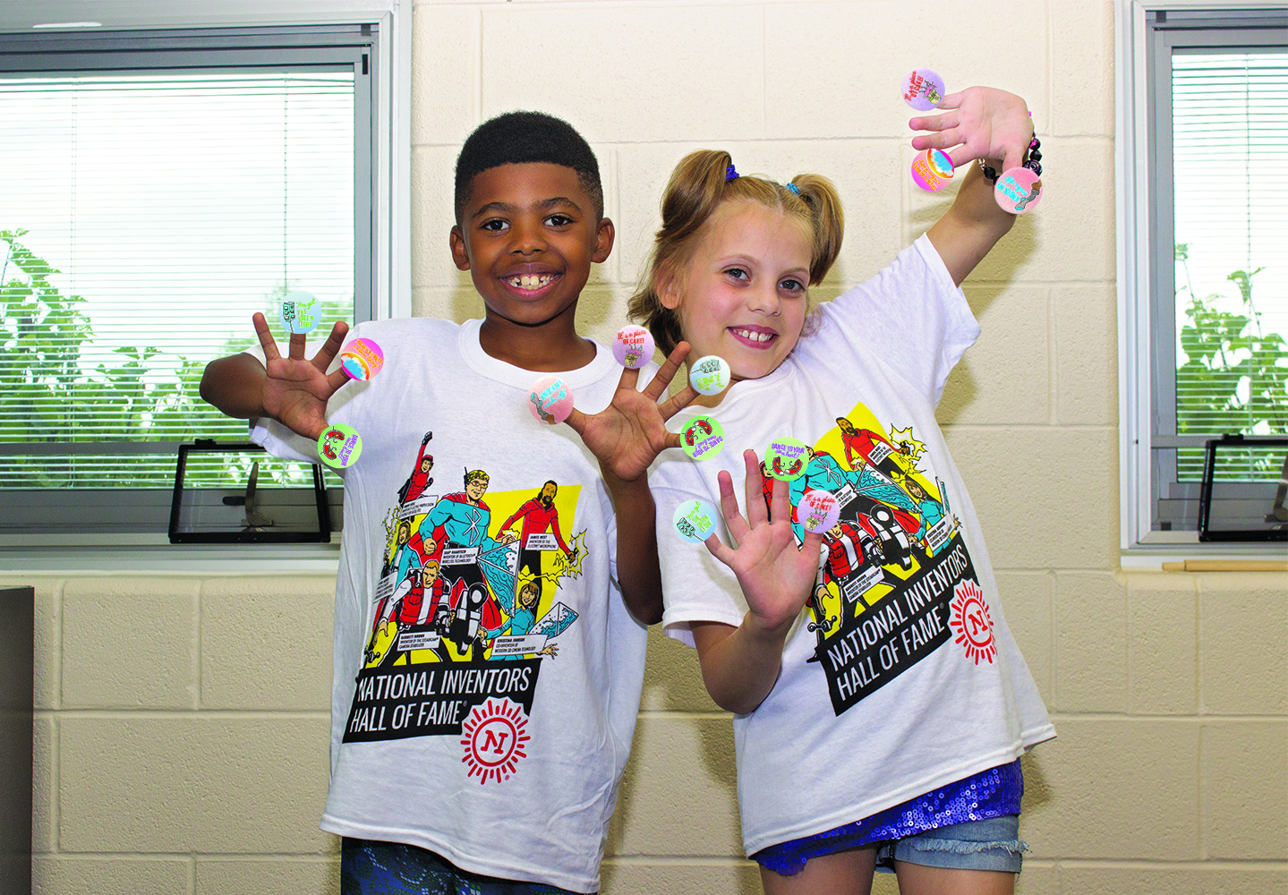
In 2017 over 40,000 program participants were underserved children.
Let’s get to 50,000 in 2018!
Notes:
Children from low-income families, minorities and women are less likely to have such exposure through their families or neighborhoods, which helps to explain why they have significantly lower rates of innovation.
In 2017 almost one third or over 40,000 of our campers were underserved children.
Help us GET TO 50,000 this year by bringing the NIHF Innovation ecosystem to your district.

